Slide 1

Unit 13
ECONOMIC FLUCTUATIONS AND UNEMPLOYMENT

Slide 2
Figure 13.2. UK GDP per capita (1875-2014).

Slide 3
Figure 13.3. UK GDP growth and unemployment rate (1875-2014).
Business cycle peak
Business cycle trough
Start of Great
Depression:1929
End of WWII:
1945
Start of global financial crisis:
2008
End of
WWI: 1918

Slide 4
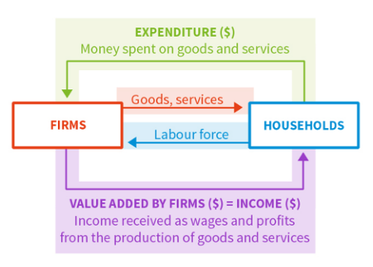
Figure 13.6. The circular flow model: Three ways to measure GDP.

Slide 5
Figure 13.7. Decomposition of GDP in 2013 for the US, the Eurozone, and China.
 | US | Eurozone (19 countries) | China
Consumption (C) | 68.4% | 55.9% | 37.3%
Government spending (G) | 15.1% | 21.1% | 14.1%
Investment (I) | 19.1% | 19.5% | 47.3%
Change in inventories | 0.4% | 0.0% | 2.0%
Exports (X) | 13.6% | 43.9% | 26.2%
Imports (M) | 16.6% | 40.5% | 23.8%

Slide 6
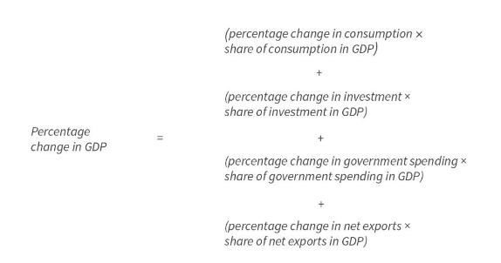
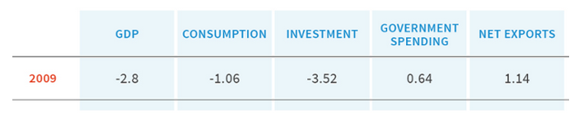
Figure 13.8. Contributions to percentage change in real GDP in the US in 2009.

Slide 7
Figure 13.10. Consumption smoothing through our lifetime.
= Path of income
= Path of consumption
Income, consumption
Accumulating savings and repaying debt
Running down savings
Borrowing
Time
Start work
Promotion
Retirement

Slide 8
Figure 13.11. Consumption when credit constraints bind: An anticipated rise in income.
= Path of income
= Path of consumption
Income, consumption
Consumption-smoothing households
Repaying debt
Borrowing
News about rise in future income received
Actual income
rises
Time
Income, consumption
Credit-constrained households
News about rise in future income received
Actual income
rises
Time

Slide 9
Figure 13.12. Credit-constrained and unconstrained households: An unanticipated temporary fall in income.
IC1
IC2
Household’s endowment following the temporary income shock; its pattern of consumption if it cannot borrow
A
Household’s initial endowment and pattern of consumption
y
Income, Consumption later, $
Aʹ
Aʹʹ
Household’s pattern of consumption following the temporary income shock if it can borrow.
cʹ
Slope = -(1 +r)
0
0
yʹ
cʹ
y
Income, Consumption now, $

Slide 10
Figure 13.13. Consumption when households are weak-willed: An anticipated fall in income.
= Path of income
= Path of consumption
Income, consumption
Consumption-smoothing households
Saving
Running down savings or borrowing
News about fall in future income received
Actual income
falls
Time
Income, consumption
Households with ‘weakness of will’
News about fall in future income received
Actual income
falls
Time

Slide 11
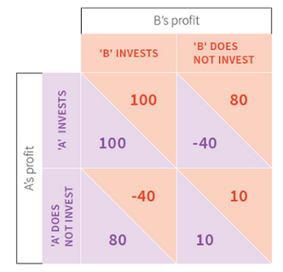
Figure 13.15. Investment decisions as a coordination game.

Slide 12
Figure 13.18a. UK GDP growth (1875-2014).
Start of global financial crisis:
2008
Start of Great
Depression: 1929
End of WWI: 1918
End of WWII: 1945
1970s

Slide 13
Figure 13.18b. UK unemployment rate (1875-2014).
Start of global financial crisis:
2008
Start of Great
Depression: 1929
End of WWI: 1918
End of WWII: 1945
1970s

Slide 14
Figure 13.18c. UK inflation rate (1875-2014).
Start of global financial crisis:
2008
Start of Great
Depression: 1929
End of WWI: 1918
End of WWII: 1945
1970s

Slide 15
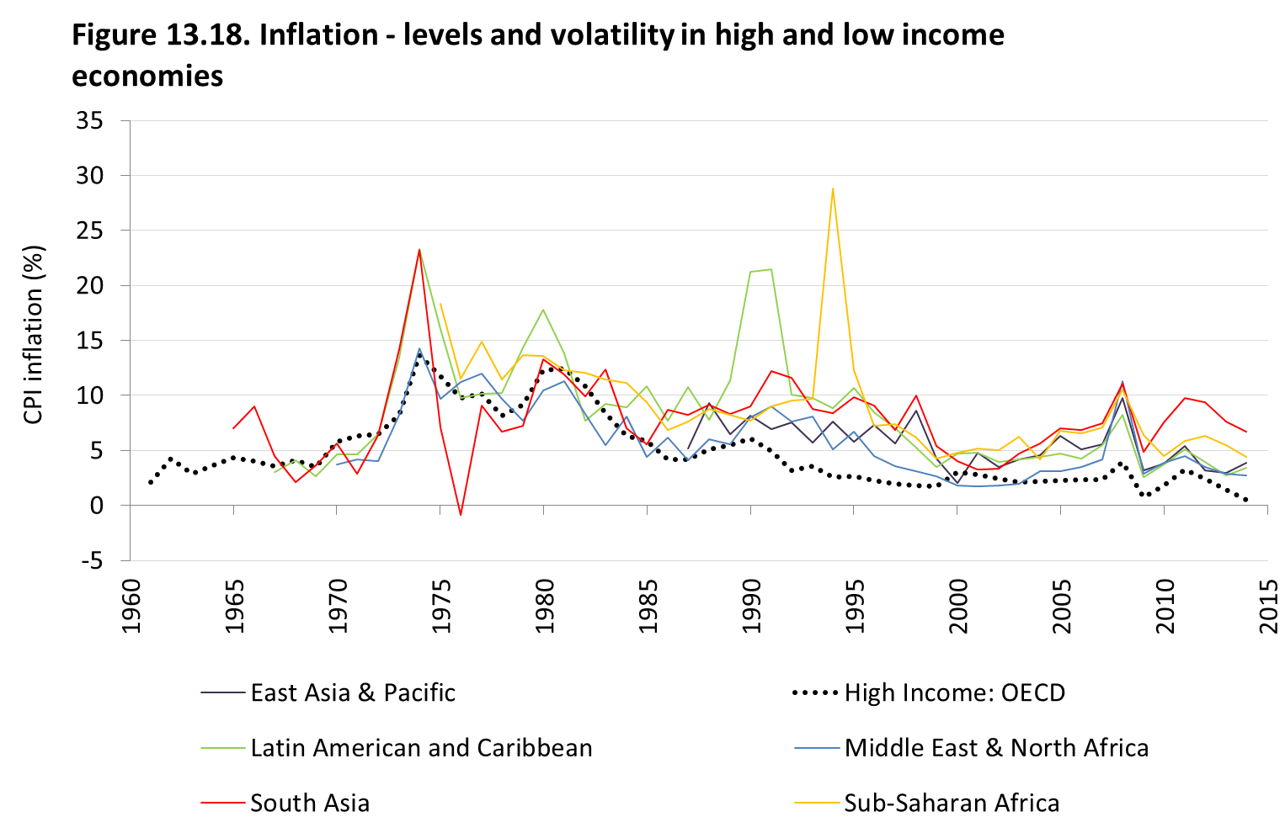
Figure 13.19. Inflation levels and volatility in high- and low-income economies.

