Slide 1

Unit 16
TECHNOLOGICAL PROGRESS, UNEMPLOYMENT, AND LIVING STANDARDS IN THE LONG RUN

Slide 2
Figure 16.1. Unemployment rates in selected OECD countries (1960-2014).
Start of global financial crisis: 2008
End of ‘golden age’ of capitalism: 1973
First
oil
shock: 1973-74
Second
oil
shock: 1979-80
Third oil shock: 2002-2008
Divergent 1970s and 1980s
Convergent 1990s and 2000s

Slide 3
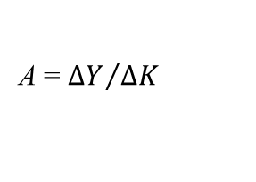
Figure 16.2. The economy’s production function and technological progress.
Marginal product of capital at
A = ${∆Y}/{∆K}$
A
Δ(Y/worker)
Δ(K/worker)
Production function (after technological progress)
22.5
C
A
Production function
15
B
Output per worker, $US thousands
Average product of capital, Y/K
0
0
20
30
Capital equipment per worker, $US thousands

Slide 4
Figure 16.3. Long-run growth trajectories of selected economies.
US (1800-1990)
US,
1953
UK (1760-1990)
Taiwan (1901-1990)
Japan (1870-1990)
UK,
1973
UK,
1910
UK,
1760
US, 1910
India (1860-1990)
US, 1800

Slide 5
Figure MCQ2.
Production function (after technological progress)
22.5
B
Production function
15
A
Output per worker, $US thousands
0
0
20
30
Capital equipment per worker, $US thousands

Slide 6
Figure 16.4. Job destruction, job creation, and net employment across countries.

Slide 7
Figure 16.7a. Firm entry, exit, and the equilibrium markup.
Markup, μ
B
High markup, attracts entry of firms
A
Equilibrium markup, μ*
C
Low markup, promotes exit of firms
Profit-maximizing mark-up
Number of firms, n
190
250
Firms entering
210
Firms leaving
Equilibrium number of firms

Slide 8
Figure 16.7b. An improvement in conditions for doing business: Firm entry, exit, and the equilibrium markup.
Markup, μ
A
Initial equilibrium markup
C
New equilibrium markup, μ*
Profit-maximizing mark-up
Number of firms, n
210
250
Firms entering
New equilibrium number of firms

Slide 9
Figure 16.8. Changes in the long-run markup shift the price-setting curve.
Real wage
Real wage
λ
Output per worker, λ
Price-setting curve (low μ*)
Price-setting curve (medium μ*)
Price-setting curve (high μ*)
0
1
0
low μ*
high μ*
Employment
Mark-up, μ*
medium μ*

Slide 10
Figure 16.9a. The long-run unemployment rate and new technology.
Output per worker
(new technology)
Output per worker
(old technology)
Wage-setting curve
Real wage (new)
B
Price-setting curve
(new technology)
Real wage
A
Price-setting curve
(old technology)
Real wage (old)
Employment, N
6% unemployment rate
(Initial long-run unemployment rate)
4% unemployment rate
(New long-run unemployment rate)

Slide 11
Figure 16.9b. The long-run unemployment rate and new technology.
Output per worker
(new technology)
New technology shifts up output per worker and the price-setting curve
Output per worker
(old technology)
Wage-setting curve
A→D: Introduction of new technology leads to a rise in unemployment
B
Price-setting curve
(new technology)
Real wage (new)
Real wage
D
A
Price-setting curve
(old technology)
D→E: High profits encourage new firms to enter
Real wage (old)
E
E→B: Lower unemployment leads to rising real wages
B: The new long-run rate of unemployment is 4%
Employment, N
6% unemployment rate
(Long-run unemployment rate)
4% unemployment rate
(New long-run unemployment rate)

Slide 12
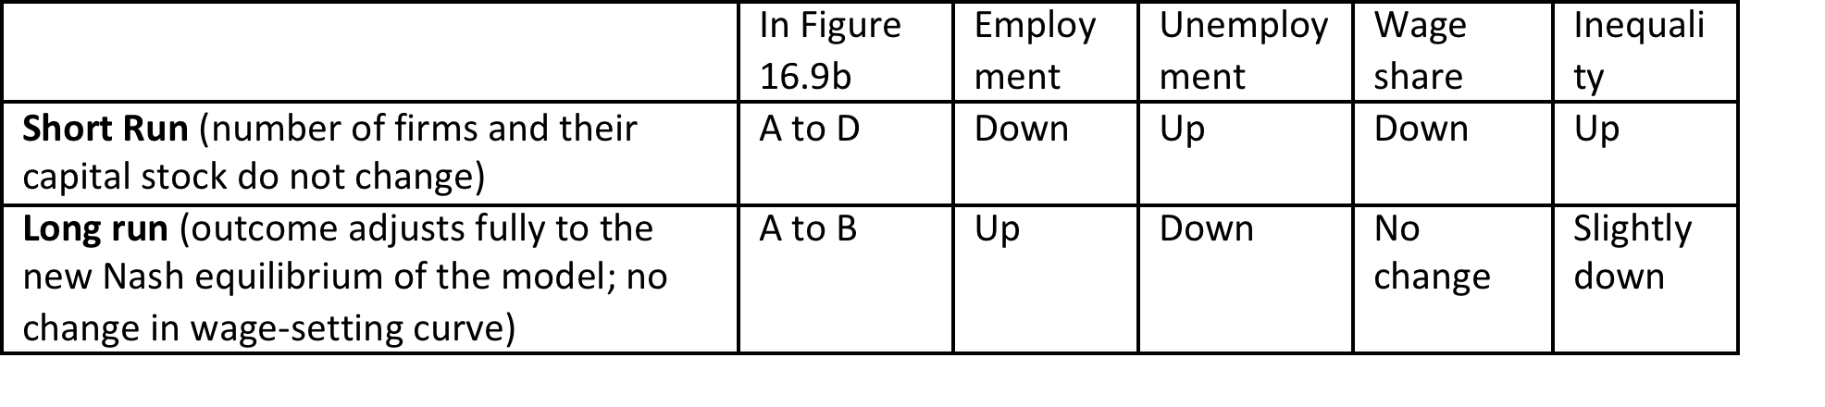
Figure 16.10. Effects of technological improvements on the labour market model: Short vs. long run.

Slide 13
Figure 16.11. Effects of a new technology on inequality in the short and long run.
100
Cumulative share of income (%)
0
0
A
B
D
Unemployed
Workers
Employers
Cumulative share of the population from lowest to highest income (%)

Slide 14
Figure 16.12. Long-run unemployment and real wage growth across the OECD (1970-2011).
High performers
Low performers

Slide 15
Figure 16.13. Unemployment rates of stars and laggards (1960-2014).
Start of global financial crisis: 2008
End of ‘golden age’ of capitalism: 1973
First
oil
shock: 1973-74
Second
oil
shock: 1979-80
Third oil shock: 2002-2008
Divergent 1970s and 1980s
Convergent 1990s and 2000s
Spain
Italy
Japan
Norway

Slide 16
Figure 16.17. Different ways of pushing down the wage curve: The Netherlands and the UK.
Start of global financial crisis: 2008
End of ‘golden age’ of capitalism: 1973
First
Oil
shock: 1973-74
Second
oil
shock: 1979-80
Third oil shock: 2002-2008
Divergent 1970s and 1980s
Convergent 1990s and 2000s
United Kingdom
Netherlands

Slide 17
Figure 16.18. The rise and fall of the share of employment in industry (1870-2013).
UK
Taiwan
China
US
Germany
Japan
South Korea
Japan
South Korea

Slide 18
Figure 16.19. Increased productivity in goods production raises the fraction of workers in services.
They consume equal quantities of goods and services both before and after
Quantity of services
1
B
2/3
1/2
Feasible frontier after effect of doubling labour productivity in goods production
After: 2/3 of labour force produces this
A
Feasible frontier before
1/2
2/3
1
2
Quantity of goods
After: 1/3 of labour force produces this
© The CORE Project 2015

Slide 19
Figure 16.20. Determinants of the unemployment rate and the growth rate of real wages in the long run.
Productivity growth
U1, U2, U3
Technological change
U1, U2, U3
Price-setting curve
U9, U15, U16
Job creation and destruction; firm entry and exit
U16
Unemployment rate; growth rate of real wages
Beveridge curve
U16
Wage setting by firms & work effort by workers
U6, U9
Conflict over work and wages
U6
Wage-setting curve
U6, U9, U15, U16

Slide 20
Figure 16.21. The institutions, policies, and shocks that can influence unemployment and real wages.
Productivity growth
U1, U2, U3, U16
Technological change
U1, U2, U3
Price-setting curve
U9, U15, U16
Competition policy
R&D, Patents
Job creation and destruction; firm entry and exit
U16
Tax policy
Competition policy
Environment for doing business
Oil shocks
Education
Active labour market policy
Employment protection legislation (EPL)
Unemployment rate; growth rate of real wages
Beveridge curve
U16
Conflict over work and wages
U6
Wage setting by firms and work effort by workers
U6, U9
Wage-setting curve
U6, U9, U15, U16
Unemployment benefits
Employment protection legislation (EPL)
Unions
Industrial relations legislation

