Slide 1
Figure 14.1. Fluctuations in output and the size of government in the US (1870-2015).
President Roosevelt’s New Deal: 1933-36
US War on Poverty begins: 1964
Start of global financial crisis: 2008
Start of
Great
Depression: 1929
US deploys ground troops in Vietnam:
1965
End of WWI: 1918
End of WWII: 1945
1970s

Slide 2
Figure 14.2. The aggregate consumption function.
Aggregate consumption
spending, C
Consumption = c₀ + c₁Y
0.6
Slope of the consumption function = 0.6
= marginal propensity to consume = c₁
1
Autonomous consumption, c₀
Current income (output), Y

Slide 3
Figure 14.3. Fear and household consumption in the US during the global financial crisis (2008 Q1 – 2009 Q4).
Real disposable income
Real consumption of non-durable goods
Consumer sentiment index
Real consumption of durable goods

Slide 4
Figure 14.4. Goods market equilibrium: The multiplier diagram.
Aggregate demand, AD
On 45 degree line:
output = aggregate demand
Aggregate demand =
c₀ + c₁Y + I
C = c₀ + c₁Y
A
Autonomous consumption
and investment
c₀ + I
Autonomous consumption, c₀
45°
Output (income), Y

Slide 5
Figure 14.5. The multiplier in action: An investment-led recession.
Aggregate demand, AD
Y = AD on 45 degree line
A
AD = c₀ + c₁Y + I
1.5
AD = c₀ + c₁Y + I ′
1.5
C
B
E
D
3.75
Decrease in investment of €1.5bn; investment falls from I to I′
Z
c₀ + I
1.5
c₀ + I′
After multiplier process, output has fallen by €3.75bn; multiplier is 3.75/1.5 = 2.5
45°
Output (income), Y

Slide 6
Figure MCQ2
Aggregate demand, AD
Increase in investment of €2bn; investment rises from I to I′
Y = AD on 45 degree line
Z
AD = c₀ + c₁Y + I′
4bn
D
E
AD = c₀ + c₁Y + I
B
2bn
C
2bn
A
c₀ + I′
2bn
c₀ + I
45°
Output (income), Y

Slide 7
Figure 14.6. Aggregate demand in the Great Depression: Multiplier and positive feedback processes.
Aggregate demand in constant 1972 $, AD
On 45 degree line:
output = aggregate demand
AD (pre crisis)
A
AD (crisis)
B
AD (trough)
Initial fall in aggregate demand due to fall in investment late-1929/early-1930
C
Subsequent fall in aggregate demand due to shift downwards in the consumption function and investment function
45°
206bn
1933 Q1
(trough)
324bn
1929 Q3
(peak)
Output in constant 1972 $, Y

Slide 8
Figure 14.7. Household wealth: Key concepts.
Debt
Value of house
Target broad
wealth
Home equity =
value of house – debt
Home equity
Net
worth
Financial wealth
Expected future earnings from employment
Total broad wealth including expected future earnings from employment

Slide 9
Figure 14.8. The Great Depression: Households cut consumption to restore their target broad wealth.
A
Debt
B
Target broad
wealth
Home equity
Debt
Increase in savings to restore target wealth
Financial wealth
Expected future earnings from employment
Home equity
Financial wealth
Expected future earnings from employment
Total broad
wealth
Early 1929
Late 1929-31

Slide 10
Figure 14.9. Investment, expected rate of profit, and the interest rate in an economy with two firms.
Firm A
Firm B
Interest rate,
Profit rate
Expected profit rate
(project 1)
5%
5%
4%
(project 2)
4%
Expected profit rate
(project 1)
3%
3%
(project 2)
2%
2%
(project 3)
1%
(project 3)
1%
I_{A}
I_{B}
Aggregate economy: both firms
Interest rate,
Profit rate
5%
4%
Fall in interest rate
3%
2%
1%
I_{A} + I_{B}
Increase in investment

Slide 11
Figure 14.10a. The aggregate economy, where the expected rate of profit rises for a given set of projects (supply effect).
Aggregate economy: both firms
Expected rate of profit rises for a given set of projects (supply effect)
Interest rate,
Profit rate
5%
4%
3%
2%
1%
I_{A} + I_{B}
Increase in investment

Slide 12
Figure 14.10b. The aggregate economy, where the desired capacity rises for each project (demand effect).
At an interest rate of 2%,
Initial investment
Investment (increase in demand)
Aggregate economy: both firms
Interest rate,
Profit rate
5%
5%
4%
4%
3%
3%
2%
2%
1%
1%
I_{A} + I_{B}
I_{A} + I_{B}

Slide 13
Figure 14.10c. Aggregate investment function: Effects of the interest rate and profit expectations.
Interest rate,
Profit rate
%
C
D
4%
E
3%
Investment (I), higher profit expectations
Investment (I), holding profit expectations constant
Investment

Slide 14
Figure 14.11a.
Aggregate demand, AD
Y = AD on 45
degree line
AD
AD(lower consumption, c₀′,
and higher government
spending, G′)
A
C
AD(lower level of
consumption, c₀′)
c₀ + I(r) + G + X
B
c₀′ + I(r) + G′+ X
c₀′ + I(r) + G + X
45°
Output (income), Y
Note: AD = c₀ + c₁(1 - t)Y + I(r) + G + X - mY

Slide 15
Figure 14.11b. Government austerity can worsen a recession.
Aggregate demand, AD
Y = AD on 45
degree line
AD
A
AD(lower level of
consumption, c₀′)
AD(lower consumption, c₀′,
and lower government
spending, G′)
c₀ + I(r) + G + X
B
C
c₀′ + I(r) + G + X
c₀′ + I(r) + G′+ X
45°
Output (income), Y
Note: AD = c₀ + c₁(1 - t)Y + I(r) + G + X - mY

Slide 16
Figure 14.12. The role of the private sector and the government in the business cycle.
 | Dampening mechanisms offset shocks (stabilising) | Amplifying mechanisms reinforce shocks (may be destabilising)
Private sector decisions | Consumption smoothing | Credit constraints limit consumption smoothing
 |  | Rising value of collateral (house prices) can increase wealth above the target level and raise consumption
 |  | Rising capacity utilization in a boom encourages investment spending, adding to the boom
Government and central bank decisions | Automatic stabilizers (e.g. unemployment benefit) | Policy mistakes such as limiting the scope of automatic stabilizers in a recession or running deficits during low demand periods while not running surpluses during booms.
 | Stabilization policy (fiscal or monetary)

Slide 17
Figure 14.13. UK government debt as a percentage of GDP (1700-2014).
Start of global financial crisis: 2008
End of WWII: 1945
Start of Great
Depression:
1929
End of WWI: 1918

Slide 18
Figure 14.15. The supply side of the aggregate economy: The labour market.
Labour
supply
Wage-setting
curve
Labour productivity
Price-setting curve
Real wage
A
9.5
10
Workers (millions)
8.5
Employed
Unemployed (U rate = 5%)

Slide 19
Figure 14.16. The supply side and the demand side of the aggregate economy.
Labour
supply
Real wage
Labour productivity
A
Supply side
(medium & long run)
Price-setting curve
Wage-setting
curve
Workers, N
Aggregate demand, AD
B
AD (high)
A
AD (normal)
C
AD (low)
Demand side
(short run)
normal
recession
boom
45°
Output, Y

Slide 20
Figure 14.17. Business cycle fluctuations around equilibrium unemployment.
Labour
supply
Real wage
Labour productivity
C
A
B
Supply side
(medium & long run)
Price-setting curve
Wage-setting
curve
Workers, N
Aggregate demand, AD
B
AD (high)
A
AD (normal)
C
AD (low)
Demand side
(short run)
Shifts in aggregate demand cause cyclical fluctuations in unemployment
normal
recession
boom
45°
Output, Y

Slide 21
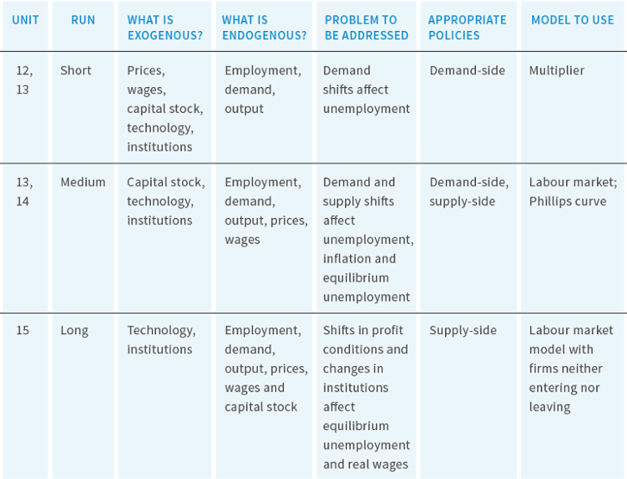
Figure 14.18. Models to study the aggregate economy.

