Slide 1

Unit 15
INFLATION, UNEMPLOYMENT, AND MONETARY POLICY

Slide 2
Figure 15.2. Three causes of inflation.
Wage-setting curve
Profit curve shifts down
Real wage
Price-setting curve
1. Owners’ power rises relative to consumers (e.g. lower competition) – medium to long run
0
Employment, N
Wage curve shifts up
Wage-setting curve
Price-setting curve
2. Employees’ power rises relative to owners (e.g. stronger unions) –
medium to long run
0
Wage-setting curve
Unemployment falls
3. Employees’ power rises relative to owners in a business cycle upswing –
short to medium run
Price-setting curve
0

Slide 3
Figure MCQ3 Equilibrium in the labour market.
Labour
supply
Wage-setting
curve
Labour productivity
Real wage
A
Price-setting curve
0
9
10
Workers (millions)
5
Employed
Unemployed

Slide 4
Figure 15.4a. Inflation and conflict over the pie: Stable price level at labour market equilibrium.
Labour
supply
Wage-setting
curve
Labour productivity
Real profit per worker
Real wage
Price-setting curve
A
Output per worker
Real wage per worker
0
Employment, N
Unemployed at labour market equilibrium

Slide 5
Figure 15.4b. Inflation and conflict over the pie at low and high unemployment.
Wage-setting
curve
Labour productivity
Real profit per worker
Price-setting curve
Real wage
(high unemployment)
C
A
B (low unemployment)
Real wage per worker
Employment, N
Employment at labour market equilibrium

Slide 6
Figure 15.4c. Bargaining gaps, inflation, and the Phillips curve.
Real wage
Wage-setting curve
1% = Bargaining gap (%), positive
Price-setting curve
Bargaining gap,
negative(-0.5%)
Employment, N
Inflation
Rate, π
Phillips curve
1%
Inflation (%) = bargaining gap (%)
0
Employment, N
-0.5%
Deflation
Employment at labour market equilibrium, no bargaining gap

Slide 7
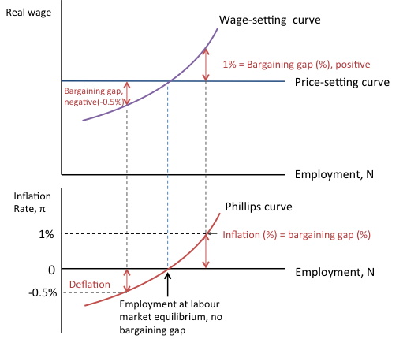
Figure 15.4d. The short-and medium-run models: Aggregate demand, employment, and inflation.
Supply side
(medium run)
Aggregate demand, AD
AD(high)
B
AD(medium)
A
AD(low)
Demand side
(short run)
C
45°
Recession
(U=9%)
Normal
(U=6%)
Boom
(U=3%)
Output, Y

Slide 8
Figure 15.5. The Phillips curve and the policymaker’s preferences.
Policymaker’s
indifference
curves
Inflation (%) , π
Inflation (%)
Labour
supply
Phillips
curve
Labour
supply
Worse outcomes
Policymaker’s
indifference
curves
5%
C
F
F
2%
2%
0
0
Employment, N
(U=6%)
(U=3%)
Best outcome
a. The policymakers’ preferences
b. The policymakers’ preferences and the Phillips curve tradeoff

Slide 9
Figure 15.6. Phillips curves in the United States (1960-2014).
1980
1981
PC (late 1970s)
1975
PC (early 1970s)
1982
PC (1960s)
1983
PC (late 1990s-2010s)

Slide 10
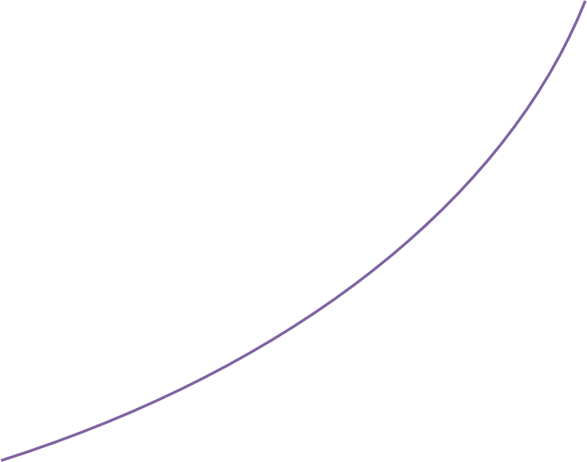
Figure 15.7. Bargaining gaps, expected inflation, and the Phillips curve.
Real wage
Wage-setting curve
2% = Bargaining gap
Price-setting curve
Employment, N
Inflation
rate, π
Phillips curve
5%
B
Inflation (%) =
bargaining gap (2%)
+
expected inflation (3%)
A
3%
Inflation (%) =
expected inflation = 3%
0
U=3%
Employment, N
Employment at labour market equilibrium, no bargaining gap (U=6%)

Slide 11
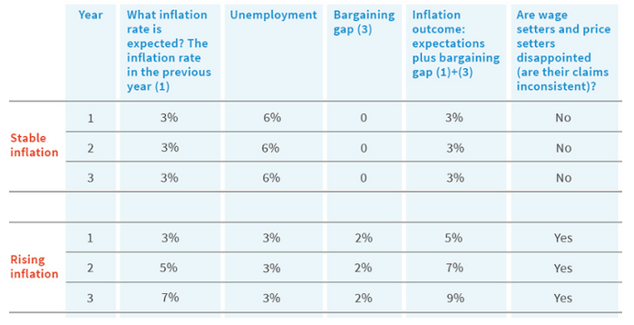
Figure 15.8. Unstable Phillips curves: Expected inflation and the bargaining gap.

Slide 12
Figure 15.9. Inflation expectations and Phillips curves.
Real wage
Wage-setting curve
2% = Bargaining gap
Price-setting curve
Employment, N
Inflation
rate, π
Phillips curves
7%
C
Inflation (%) =
bargaining gap (2%)
+
expected inflation (5%)
5%
B
Inflation (%) =
bargaining gap (2%)
+
expected inflation (3%)
3%
A
0
U=3%
Employment, N
Employment at labour market equilibrium, no bargaining gap (U=6%)

Slide 13
Figure 15.10. Inflation, expected inflation, and the bargaining gap.
Inflation, π (%)
11%
9%
Inflation
Expected inflation = last year’s
inflation
7%
5%
3%
2%
Bargaining gap
1
2
3
4
5
6
years

Slide 14
Figure 15.11. An oil shock and the price-setting curve.
Wage-setting
curve
A
Price-setting curve (pre oil shock)
Real wage
Increase in oil price
2% = Bargaining gap
B
Price-setting curve (post oil shock)
Employment, N
Post oil shock labour market equilibrium (inflation-stabilizing employment level)
Pre-oil shock labour market equilibrium

Slide 15
Figure 15.12. UK GDP growth and real oil prices (1950-2015).
First oil shock
Second oil shock
Third oil shock
GDP growth (%)
Log of real oil prices (right axis)

Slide 16
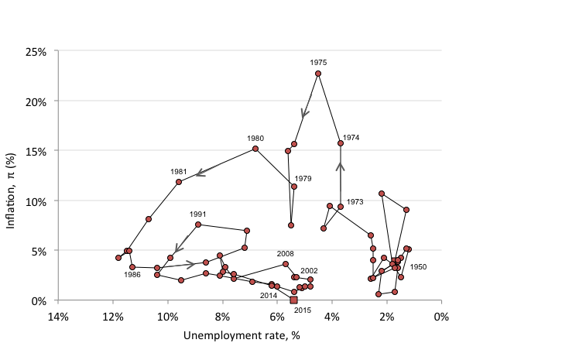
Figure 15.13. UK Inflation and unemployment rate (1950-2015).

Slide 17
Figure 15.14. Monetary policy transmission mechanisms.
Market interest
rates
Domestic aggregate demand
Asset
prices
Aggregate demand
Domestic inflationary pressure
Policy interest rate
Net
exports
Inflation
Expectations/Confidence
Import prices
Exchange rate

Slide 18
Figure 15.15. The use of monetary policy to stablise the economy in a recession.
Aggregate
demand, AD
Y = AD on 45
degree line
AD
AD(lower consumption, c₀′,
and higher investment due to lower interest rate, r′)
A
AD(lower level of
consumption, c₀′)
c₀ + I(r) + G + X
c₀′ + I(r′) + G + X
B
c₀′ + I(r) + G + X
45°
Output (income), Y
Note: AD = c₀ + c₁(1 – t)Y + I(r) + G + X - mY

Slide 19
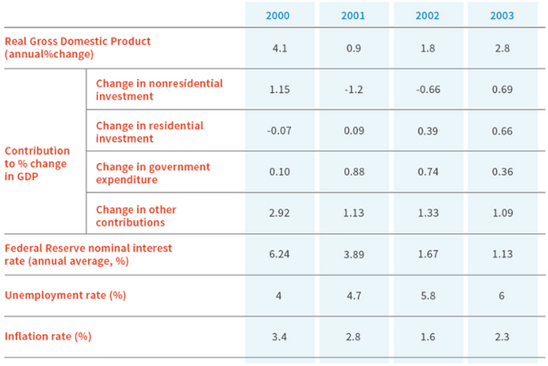
Figure 15.16. The policy mix: Fiscal and monetary policy in the US following the collapse of the tech bubble.

Slide 20
Figure 15.17. A policy intervention to restore employment and output after a fall in investment.
Inflation, π (%)
Phillips
curve
Labour
supply
C
4%
Inflation target
X
Best outcome
2%
D
0
Employment, N
45° line
; AD(Monetary and fiscal stimulus)
C
AD
Aggregate demand
AD(Investment slump)
D
Output (income)

Slide 21
Figure 15.18. Countries who had inflation-targeting central banks by 2012.
Country | Inflation targeting adoption date | Inflation rate at adoption date (%) | 2010 end-of-year inflation (%) | Target inflation rate (%)
New Zealand | 1990 | 3.30 | 4.03 | 1 - 3
Canada | 1991 | 6.90 | 2.23 | 2 +/- 1
United Kingdom | 1992 | 4.00 | 3.39 | 2
Australia | 1993 | 2.00 | 2.65 | 2 - 3
Sweden | 1993 | 1.80 | 2.10 | 2
Czech Republic | 1997 | 6.80 | 2.00 | 3 +/- 1
Israel | 1997 | 8.10 | 2.62 | 2 +/- 1
Poland | 1998 | 10.60 | 3.10 | 2.5 +/- 1
Brazil | 1999 | 3.30 | 5.91 | 4.5 +/- 1
Chile | 1999 | 3.20 | 2.97 | 3 +/- 1
Colombia | 1999 | 9.30 | 3.17 | 2 - 4
South Africa | 2000 | 2.60 | 3.50 | 3 - 6
Thailand | 2000 | 0.80 | 3.05 | 0.5 - 3
Hungary | 2001 | 10.80 | 4.20 | 3 +/- 1
Mexico | 2001 | 9.00 | 4.40 | 3 +/- 1
Iceland | 2001 | 4.10 | 2.37 | 2.5 +/- 1.5
Korea, Republic of | 2001 | 2.90 | 3.51 | 3 +/- 1
Norway | 2001 | 3.60 | 2.76 | 2.5 +/- 1
Peru | 2002 | –0.10 | 2.08 | 2 +/- 1
Philippines | 2002 | 4.50 | 3.00 | 4 +/- 1
Guatemala | 2005 | 9.20 | 5.39 | 5 +/- 1
Indonesia | 2005 | 7.40 | 6.96 | 5 +/- 1
Romania | 2005 | 9.30 | 8.00 | 3 +/- 1
Serbia | 2006 | 10.80 | 10.29 | 4 - 8
Turkey | 2006 | 7.70 | 6.40 | 5.5 +/- 2
Armenia | 2006 | 5.20 | 9.35 | 4.5 +/- 1.5
Ghana | 2007 | 10.50 | 8.58 | 8.5 +/- 2
Albania | 2009 | 3.70 | 3.40 | 3 +/- 1

Slide 22
Figure 15.20. The economy’s inflation-stabilizing unemployment rate.
Inflation, π (%)
Labour
supply
Phillips
curves
Central bank’s
indifference
curves
Inflation targeting central bank’s best outcome: target inflation and the inflation-stabilizing unemployment rate
Inflation target
X
2%
0
Employment, N
(U=6%)
Employment at labour market equilibrium,
Inflation-stabilizing unemployment rate

Slide 23
Figure 15.21. Price responses to rising employment and capacity utilisation.
Price
mark-up
curve
Price mark-up
Capacity utilisation
Less competition →

