Slide 1
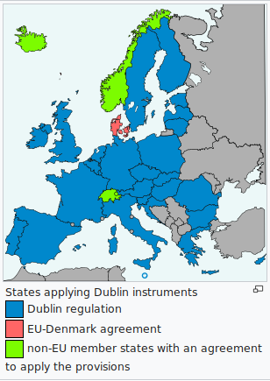
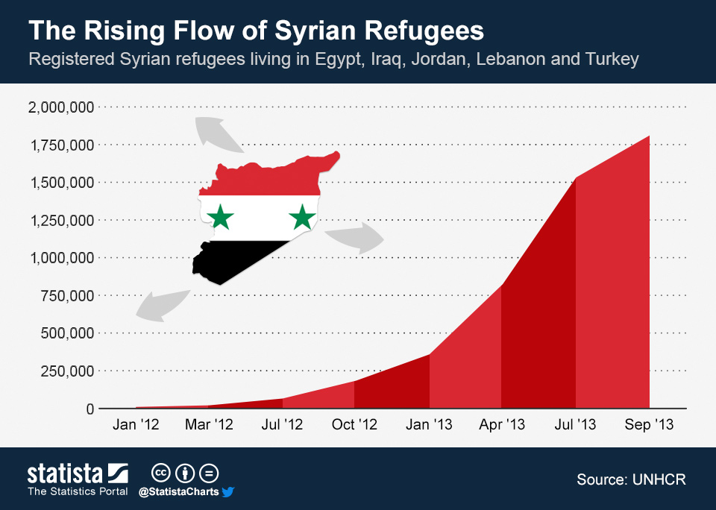
Dublin treaty

Slide 2
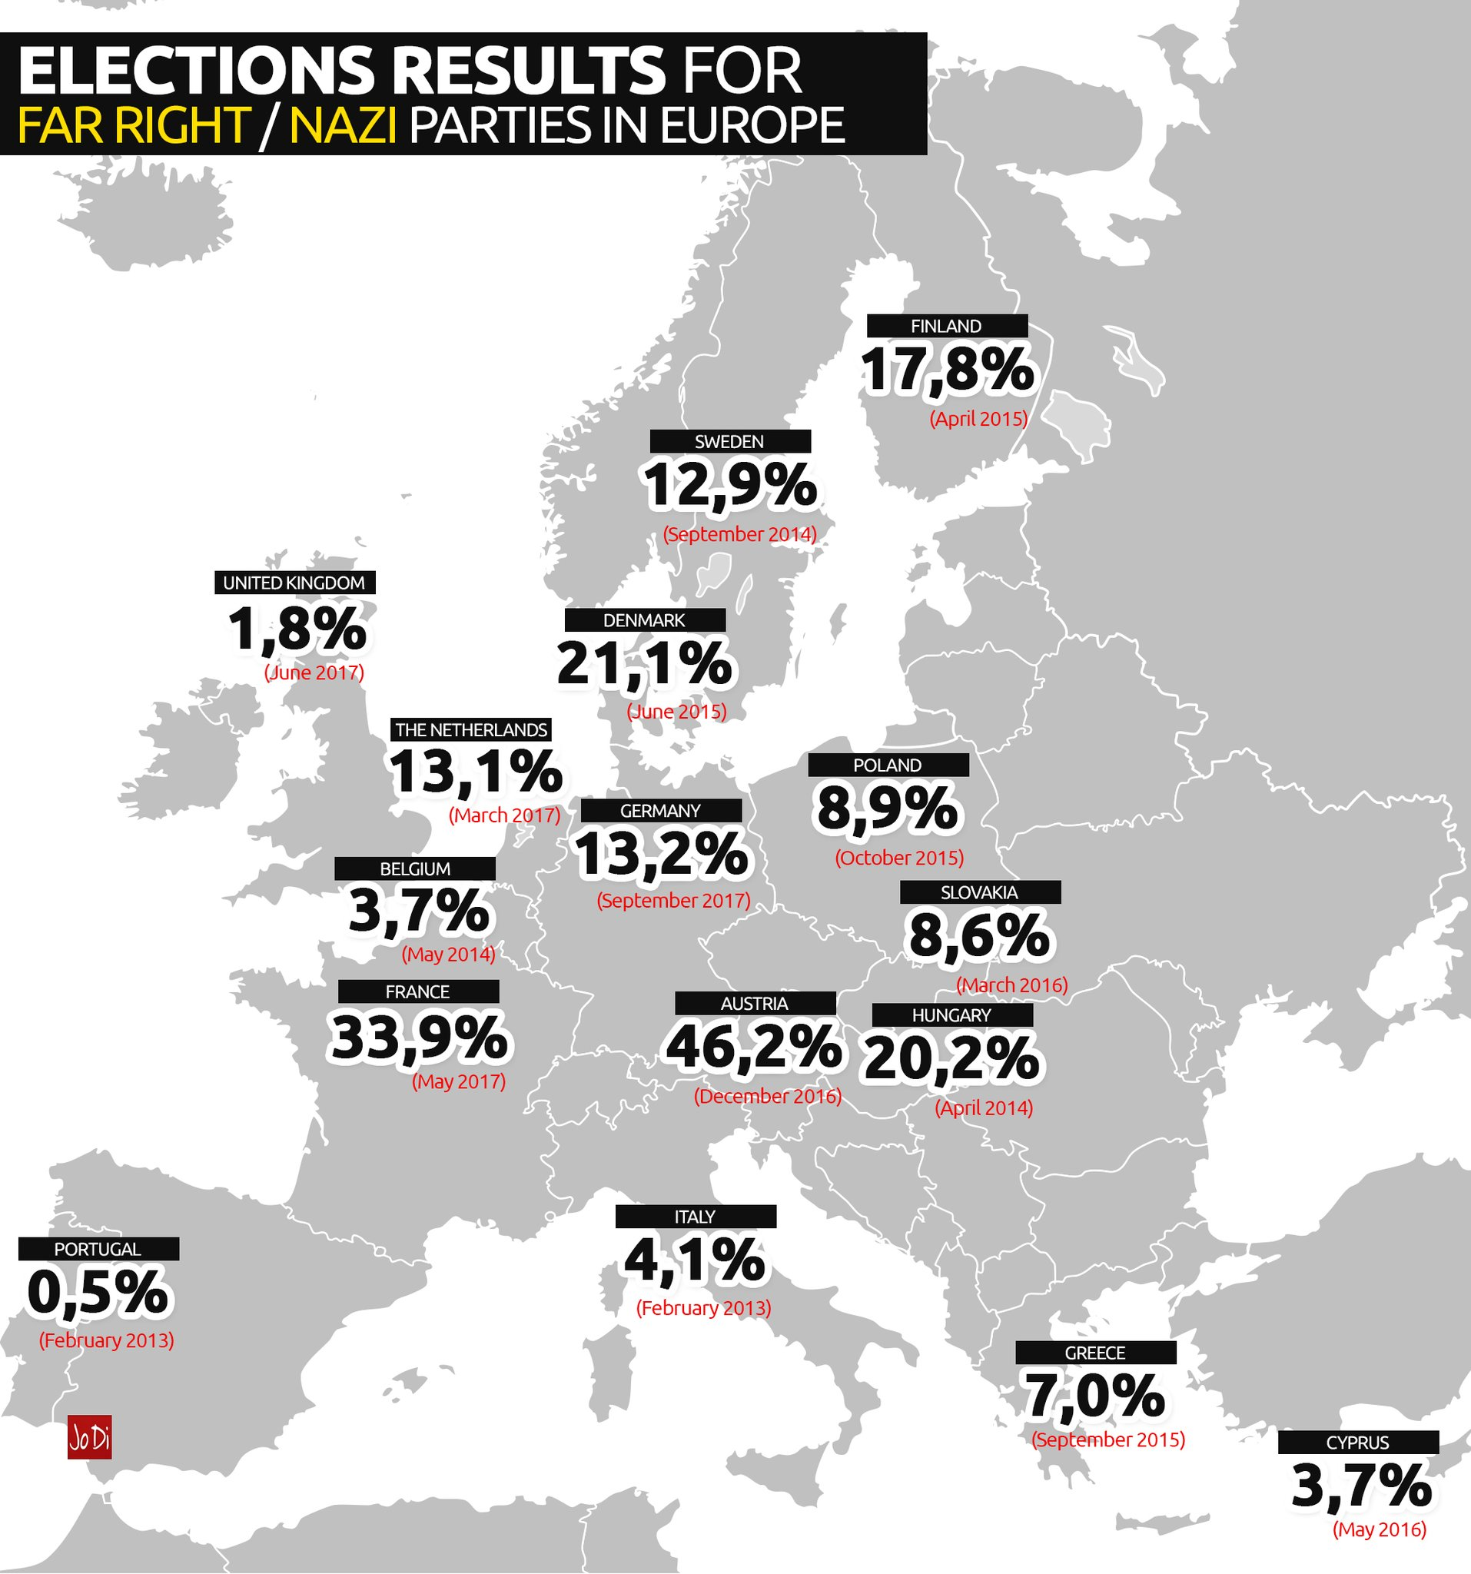
Immigration :
a controversial topic in our societies
- Societal aspects
- Integration of refugees

Slide 3
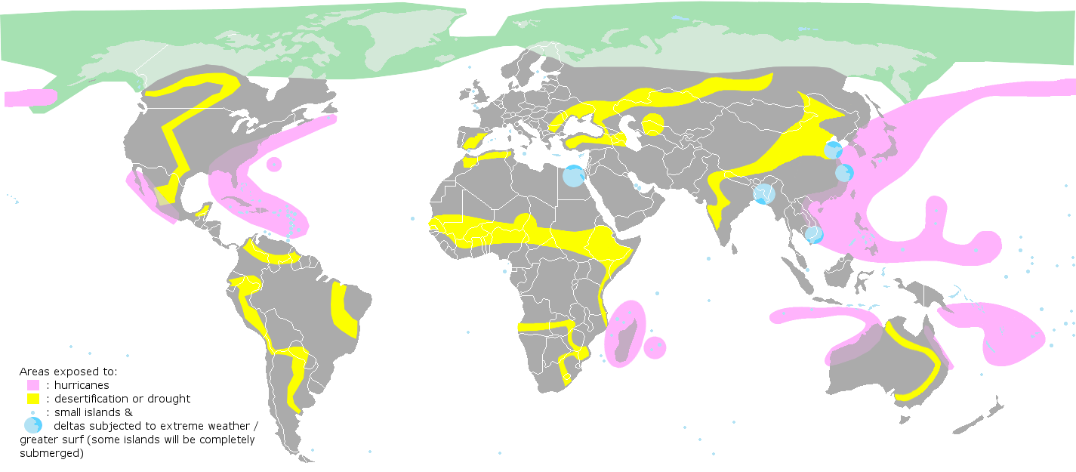
Environnemental risks

