Slide 1
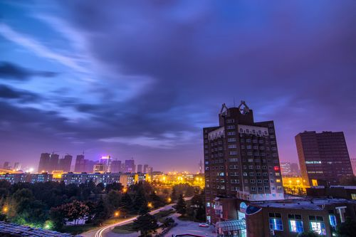
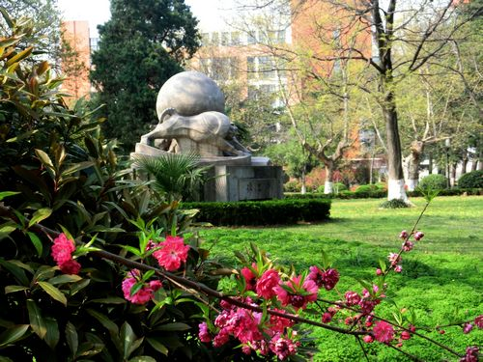
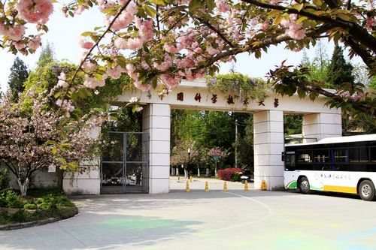
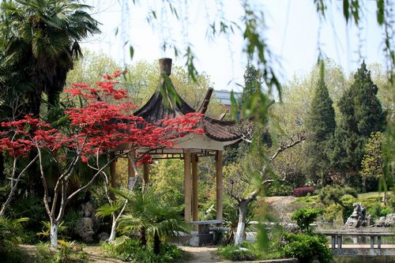
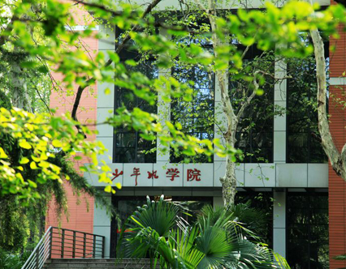
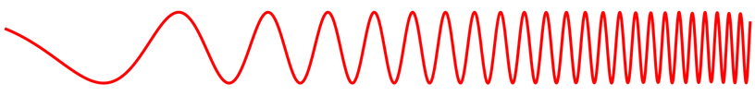

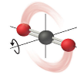



University of Science and Technology of China, Hefei, Anhui, China
中国科学技术大学,合肥，安徽，中国
The 3rd Asian Workshop on Molecular Spectroscopy
第三届亚洲分子光谱研讨会
March 6th-9th,2019
http://atta.ustc.edu.cn/AWMS2019/
3rd AWMS 2019
http://atta.ustc.edu.cn

Slide 2
Session A Chair: Bor-Chen Chang
8:45 – 9:15 (A1) | PL Luo High-resolution mid-infrared laser spectroscopy of small Criegee intermediates
9:15 – 9:33 (A2) | DF Zhao High resolution laser spectroscopy of astrophysically relevant small molecules
9:33 – 9:51 (A3) | LH Deng Measurement of OH Radicals Based on Concentration Modulation Absorption Spectroscopy
9:51 – 10:09 *(A4) | YH Tsao HCl Formation in the Reaction of Cl Atom with trans-2-Butene Probed with Step-scan Time-resolved Fourier-transform IR Emission Spectroscopy
10:09-11:08 | Photographing Coffee break and posters

Slide 3
Session B Chair: Thomas Schultz
11:08 – 11:26 (B1) | M Baba High-resolution spectroscopy of 9-methylanthracene
11:26 – 11:44 (B2) | G Feng Rotational and theoretical characterization of sulfur centered non-covalent interactions
11:44 – 12:02 *(B3) | Y Jin The preferred conformers of the tetrafluoro-1,3-dithietane- isopropylamine complex by rotational spectroscopy
12:02 – 12:20 (B4) | LS Ma Study on the Stark effect to conversion of nuclear spin isomers of CH₃OH
12:30 – 14:00 Lunch buffet ( 3rd floor of East Campus Activity Center)

Slide 4
Session C Chair: Kaito Takahashi
14:00 – 14:30 (C1) | A Nishiyama Highly Sensitive and Broadband Frequency Comb Spectroscopy Using a High Finesse Cavity
14:30 – 14:48 (C2) | RM Guo Comb-assisted Pound-Dreve-Hall-locked cavity ring-down spectrometer
14:48 – 15:06 (C3) | M Misono Frequency control of a single mode Ti:Sapphire laser with reference to an optical frequency comb
15:06 – 15:24 *(C4) | TP Hua Cavity-enhanced saturation spectroscopy of molecules by three methods
15:24 – 15:42 (C5) | ZQ Chen High-resolution Gigahertz and Terahertz Spectroscopy of the isotopically chiral molecule trans-2,3-dideutero-oxirane (c-CHD-CHDO)
15:42 – 16:30 | Coffee break and posters

Slide 5
Session D Chair: Ling Jiang
16:48 – 17:06 (D1) | Q Gou Rotational Pursuits on Internal Dynamics of Water in Molecular Complexes
17:06 – 17:24 *(D2) | N Stolarczyk Ab initio quantum scattering calculations of beyond-Voigt line-shape parameters for the H2-He system for the HITRAN database
17:24 – 17:42 *(D3) | Z Liu Mid-infrared quantum cascade laser spectroscopy of the Ar-NO complex: fine and hyperfine structure
17:42 – 18:00 (D4) | J.U Grabow Dual Excitation-Emission Propagation (DEEP) vs. Coaxial Orientation Beam-Resonator Arragenment (COBRA) FTMW Spectrometers: Rotational Studies of (chiral) Molecules/Complexes in Jets (& Flames)
18:00 Dinner buffet at USTC Reception Center Experts Building 2nd floor

Slide 6
Session E Chair: Malgorzata Biczysko
8:30 – 9:00 (E1) | CJ Moon IR induced isomerization of invisible isomers (I⁵) spectroscopy: watching the invisible conformers of ortho-substituted phenols
9:00 – 9:18 *(E2) | HR Tsai Infrared Spectra of BrC₆H₆ in Solid p-H₂
9:18 – 9:36 *(E3) | Z. Wu Spectroscopic Detection of Interstellar Sulfur Oxides
9:36 – 9:54 (E4) | BC Chang Spectroscopic Studies of Luminescent Crystals Containing Trivalent Lanthanides
9:54 – 10:12 *(E5) | Y Zhai Quantum Vibration Perturbation Theory: A Way of Systematically Improving the Accuracy in Simulating Infrared Probe Spectra
10:12 – 11:08 | Coffee break and posters

Slide 7
Session F Chair: Chuan-Xi Duan
11:08 – 11:26 (F1) | L Jiang Vacuum Ultraviolet Free Electron Laser-Based Infrared Spectroscopy of Neutral Water Clusters
11:26 – 11:44 *(F2) | Y Zheng Rotational spectroscopy of the n-propylamine-water complex
11:44 – 12:02 *(F3) | Q Yang Theoretical Investigations of the Optical Properties of Helicene-Iridium Complexes
12: 02 – 12:20 (F4) | M Biczysko Molecular systems under external stimuli
12:30 – 14:00 Lunch buffet ( 3rd floor of East Campus Activity Center)

Slide 8
Session G Chair: Masatoshi Misono
14:00 – 14:30 (G1) | CF Cheng Dissociation energy of molecular hydrogen at 10⁻⁹ accuracy
14:30 – 14:48 (G2) | A.S.-C Cheung Electronic transitions of ScO in the UV region
14:48 – 15:06 *(G3) | CW Chen A new 4Σ - a⁴Π_{i} Electronic Transition of ScC in the near infra-red
15:06 – 15:24 (G4) | D Witsch Infrared Spectroscopy of TiO in a supersonic jet expansion
15:24 – 15:42 (G5) | V Perevalov Line intensities of the radioactive isotopologues of the carbon monoxide molecule
15:42 – 16:30 | Coffee break

Slide 9
16:30 | Memorial Session Chair: Jens-Ulm Grabow

Slide 10
Section H Chair: Qian Gou
8:30 – 8:48 (H1) | ZD Sun Conversion dynamics of nuclear spin isomers of the CH3OH molecule in the gas phase
8:48 – 9:06 (H2) | M. Xie Spectral Characterization of Three-Electron Two-Center (3e-2c) Bonds of Gaseous CH₃SH Clusters
9:06 – 9:24 *(H3) | XL Li Sulfur hydrogen bonding: diethyl disulfide-H₂O dimer in gas phase studied by microwave spectroscopy
9: 24 – 9:42 *(H4) | JT Yang QVP Theory: Application to the Sum Frequency Generation
9:42 – 10:00 *(H5) | W Fan Amyloid Fibrillation of Hen Egg White Lysozyme Acceerated by Succinimide
10:00 – 10:30 | Coffee break

Slide 11
Section I Chair: D.-F. Zhao
10:30 – 10:48 (I1) | K Takahashi Is the OH Stretching Vibrational Transition Moment of Simple Molecules Aligned Along the OH Bond?
10:48 – 11:06 (I2) | C. Fittschen Near-IR spectroscopy of Radicals using cw-CRDS coupled to Laser photolysis
10:06 – 11:24 (I3) | CL Li A proposal for laser directly cooling AgH & AgD radicals
11:24 – 11:42 (I4) | YC Hsu The electronic excited state of C3Ar studied by hole burning spectroscopy and the ab initio calculation
11:42 – 12:10 Award and Closing
12:20 – 13:50 Lunch buffet ( 3rd floor of East Campus Activity Center)
14:00- Lab Tour/City Tour

Slide 12
University of Science and Technology of China, Hefei, Anhui, China
中国科学技术大学,合肥，安徽，中国
Thanks all!
The 3rd Asian Workshop on Molecular Spectroscopy
第三届亚洲分子光谱研讨会
Sponsor：
3rd AWMS 2019
http://atta.ustc.edu.cn

