Slide 1



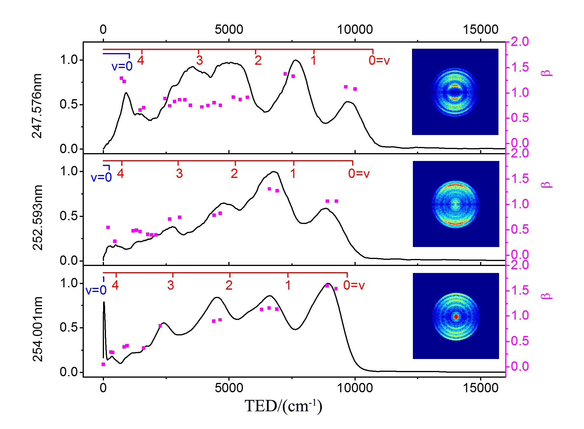
Photodissociation dynamics of N₂O⁺ via B²Π state
Zhengfang Zhou, Hao Liang, Shaowen Feng, Yang Chen, Dongfeng Zhao
CAS Center for Excellence in Quantum Information and Quantum Physics, Hefei National Laboratory for Physical Sciences at the Microscale, Department of Chemical Physics, University of Science and Technology of China, Hefei, Anhui 230026, PR China.
zzfph@mail.ustc.edu.cn
Abstract
Photodissociation dynamics of the N₂O⁺ cation has been experimentally investigated using the cryogenic cylindrical ion trap velocity map imaging spectrometer. We select three photolysis wavelengths (254.001 nm, 252.593 nm, 247.576 nm) where the ultraviolet photon energies locates in the low energy region of B²Π state as photolysis laser. Total kinetic energy release (TKER) spectra, as well as recoiling angle distribution of the photofragmented NO⁺(¹Σ⁺) have been measured using the DC-Slice velocity map imaging technique. It is found that the dissociation by absorbing one UV photon via the second excited state B²Π of N₂O⁺ can produce NO in both ²D and ²P states, i.e., NO⁺(¹Σ⁺) + N(²D) (channel 1 ) and NO⁺(¹Σ⁺) + N(²P) (channel 2). Specifically, the NO⁺(¹Σ⁺) + N(²P) channel are found to open at ~ 254.001 nm, which is in good agreement with the previously reported dissociation energy for this channel and the large positive of the anisotropy parameter indicating that it was direct dissociation of B²Π state.
Background
Results and Discussion
N₂O⁺ is the intermediate product of the most important ion-molecule reaction: O⁺(⁴S) + N₂(X¹Σ⁺) → NO⁺(X¹Σ⁺) + N(⁴S)
(Pre-)Dissociation via A and C states has been extensively studied.
B²П state has long been considered to proceed predissociation to NO⁺(¹Σ⁺) + N(²D).
B²П state surface adiabatically correlates with production of NO⁺(X¹Σ⁺) + N(²P).
N₂O⁺(X¹Σ⁺) → N₂O⁺(B²Π,V) → N₂O⁺(²Σ⁻/²Δ) → NO⁺(¹Σ⁺) + N(²D)
At high energy the bent mode (υ₂) of N₂O⁺ have been excited, the fragment of NO⁺ got more internal energy.
The shoulder peaks of the high vibration are likely due to the doublet surface of the B²П state in the bending configuration (Renner-Teller effect).
N₂O⁺(X¹Σ⁺) → N₂O⁺(B²Π) → NO⁺(¹Σ⁺) + N(²P)
Starts to be appear at 254.001nm.
B²П of N₂O⁺ was direct dissociation with a positive anisotropy parameter β .
For small linear molecule N₂O⁺(X¹Σ⁺) , the lifetime of the excited state N₂O⁺(B²Π) is: 30 f s
For the direct dissociation of B(²Π) state to product the NO⁺(¹Σ⁺) + N(²P), β < 2 was caused by molecular bending. The bending angle of B was between 30º - 50º(β = 2P₂(cosγ) * P₂(cosχ) (the γ is the angle between the light polarization vector and the molecular dipole moment vector, χ is the molecular bending angle.).
Setup & Experiment principle
Energy distribution
Momentum:
Conservation
Acknowledgements
Energy :
National Basic Research Program of China (MOST)
National Natural Science Foundation of China
Fundamental Research Funds for the Central Universities of China
Angular distribution (Single photon dissociation)

