Slide 1


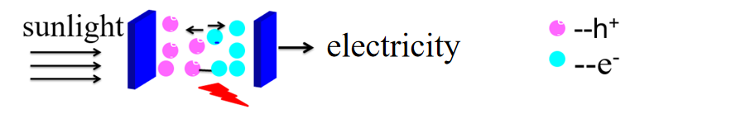

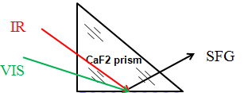
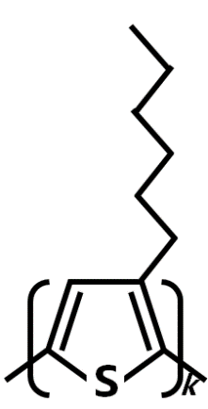
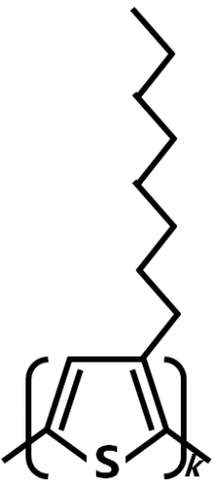
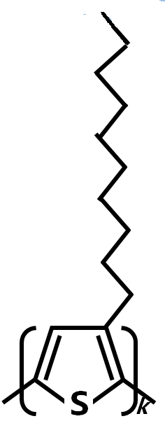
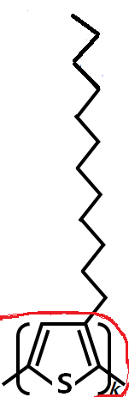
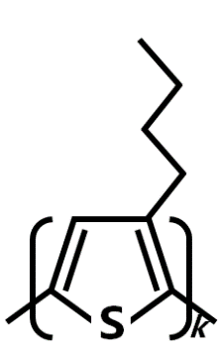
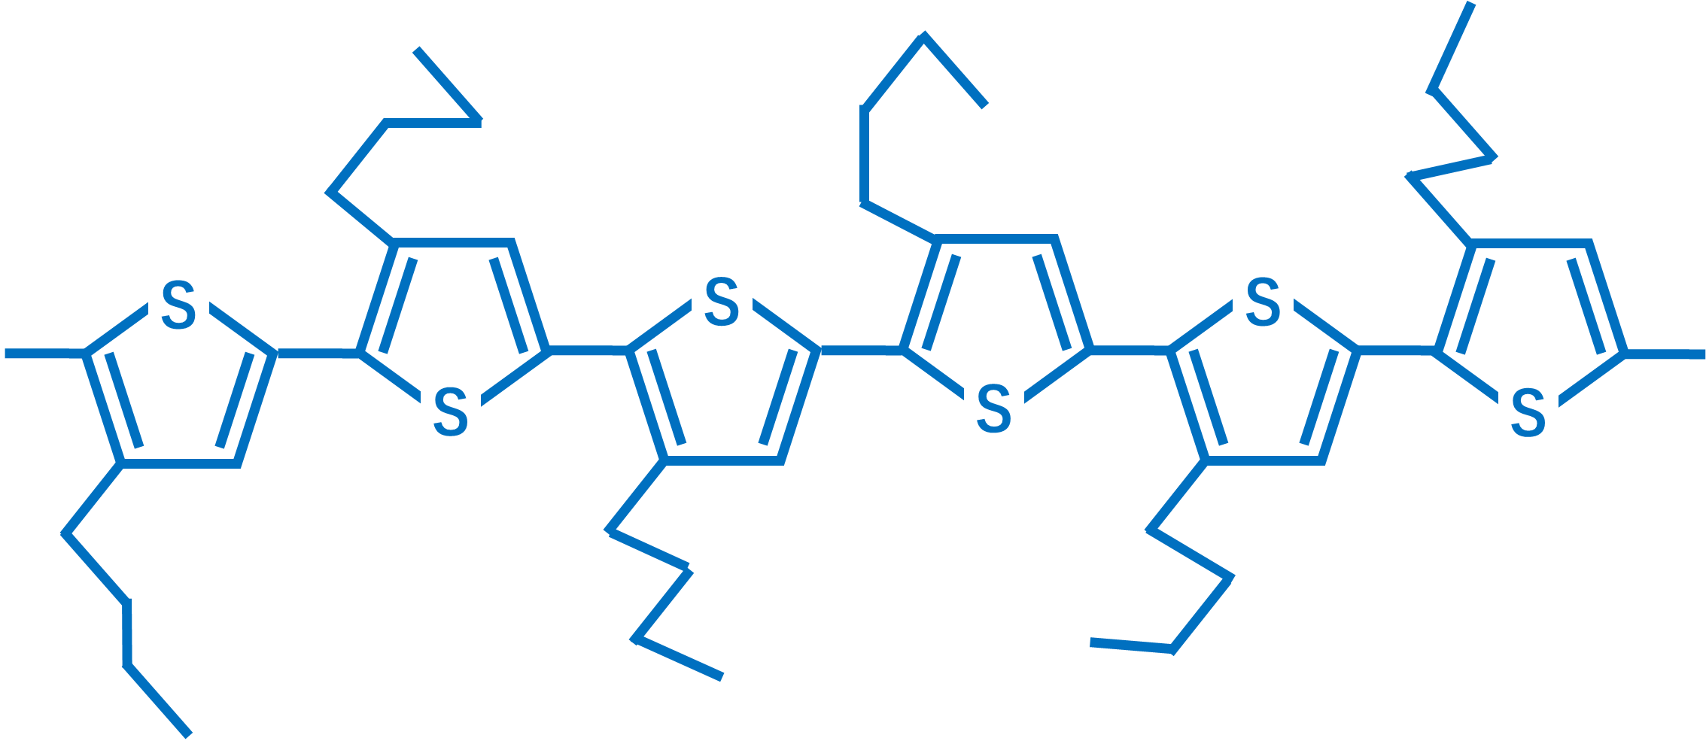
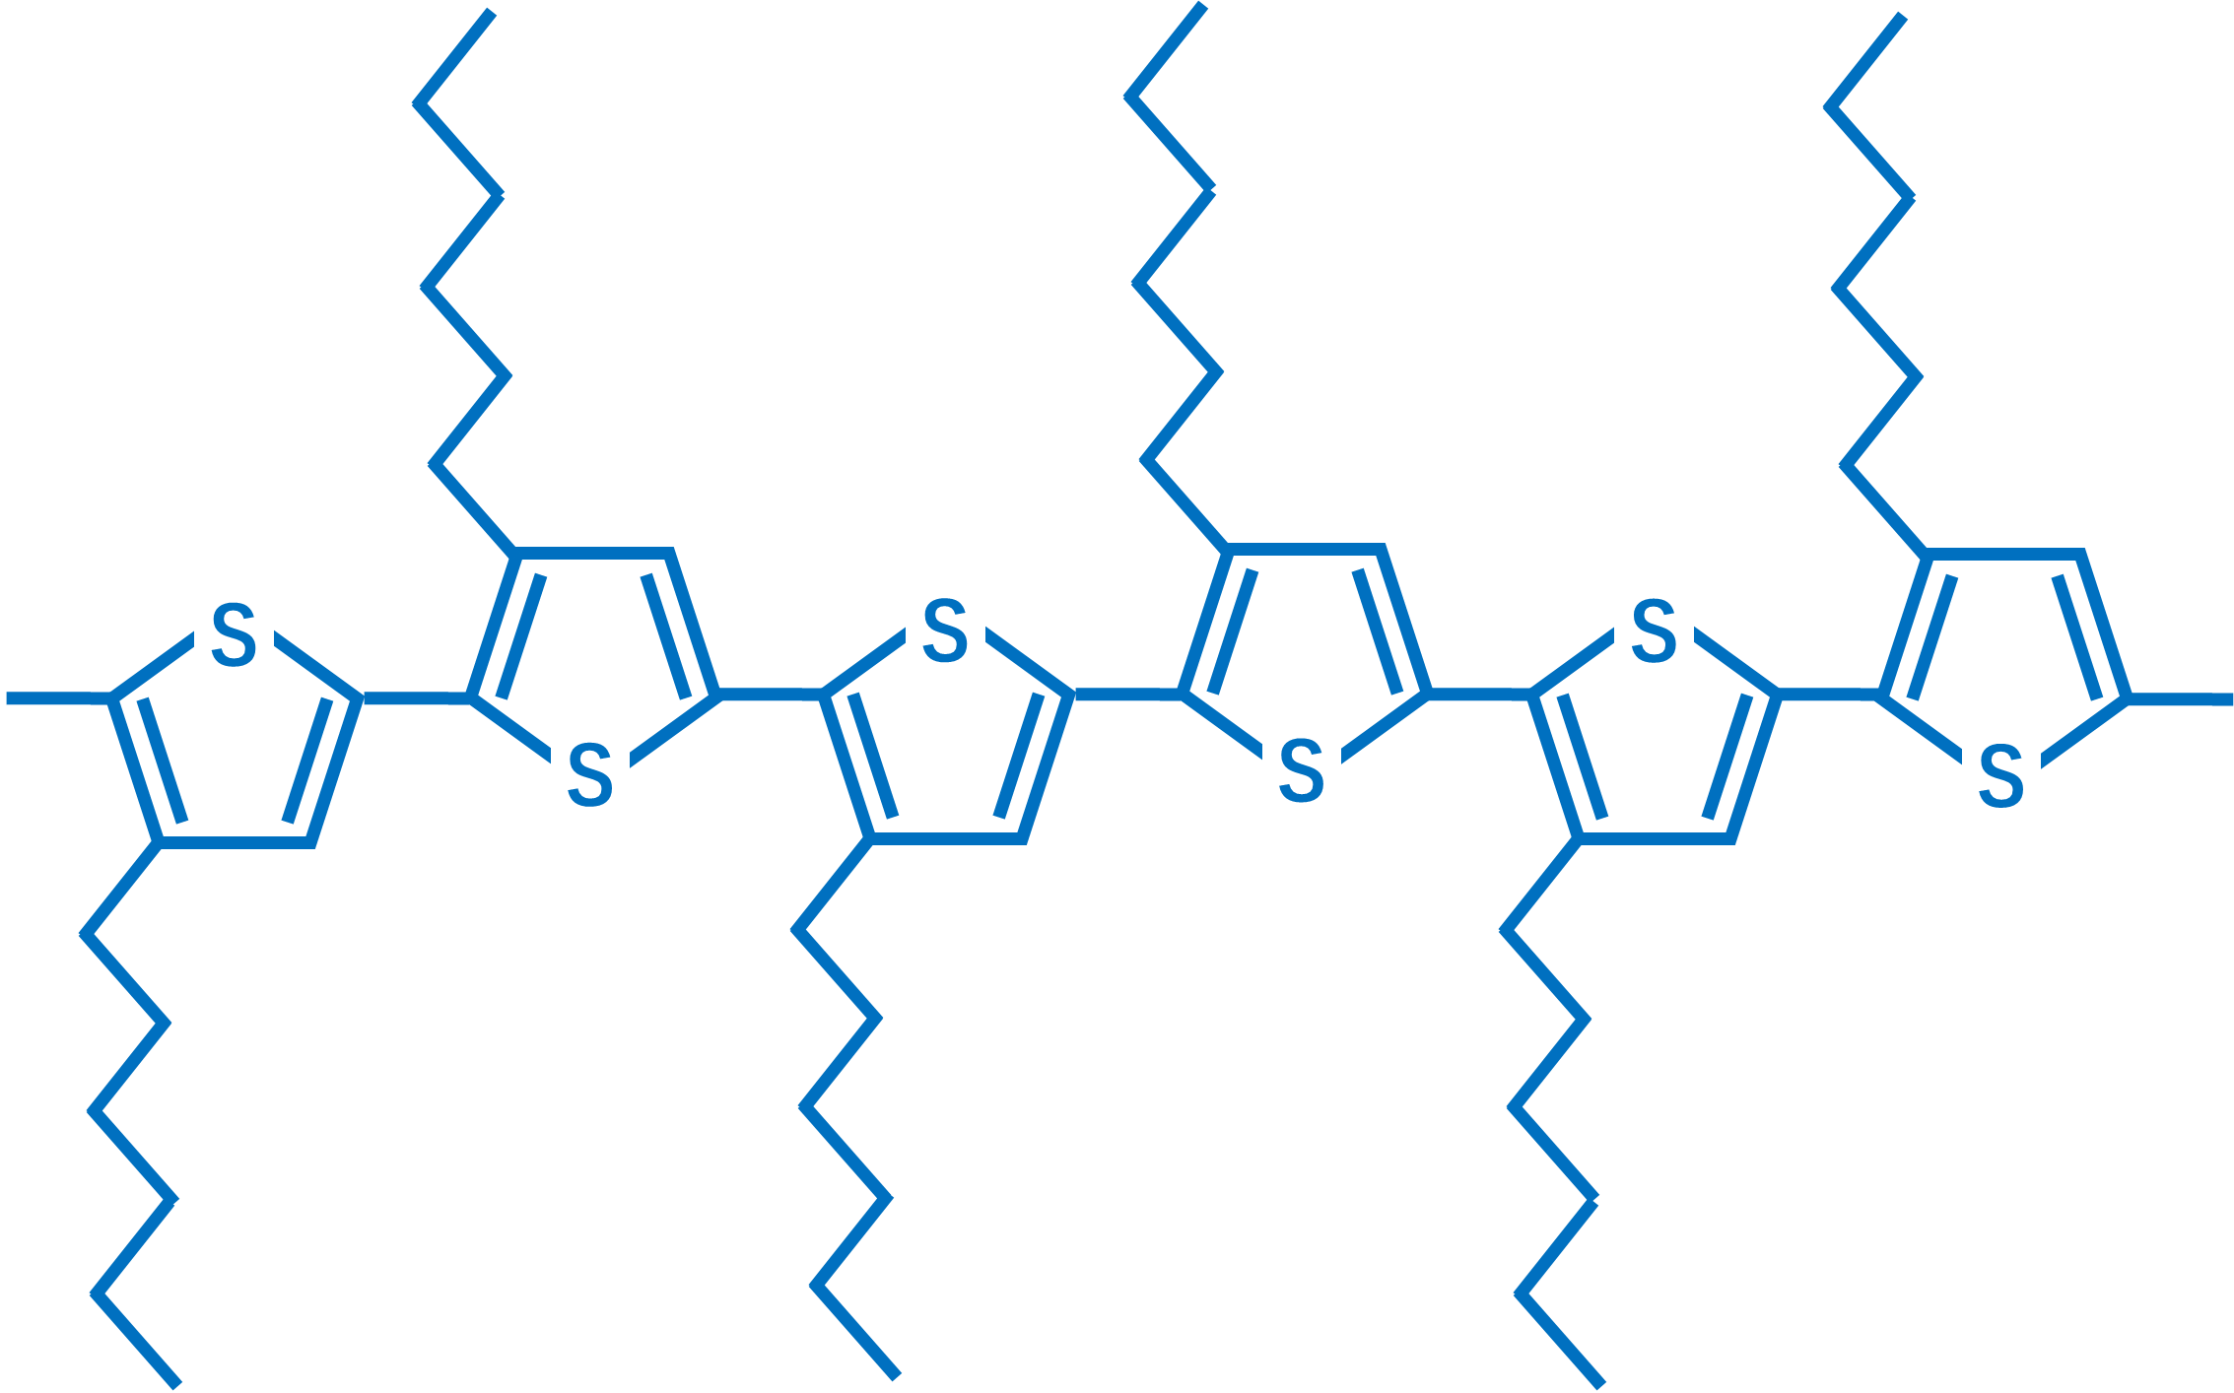
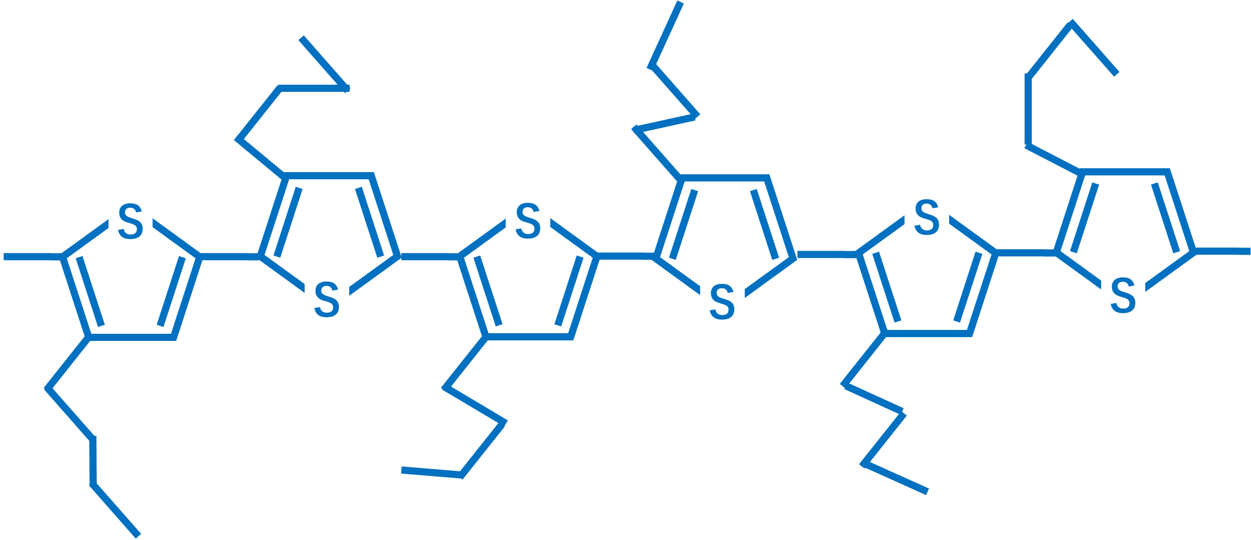
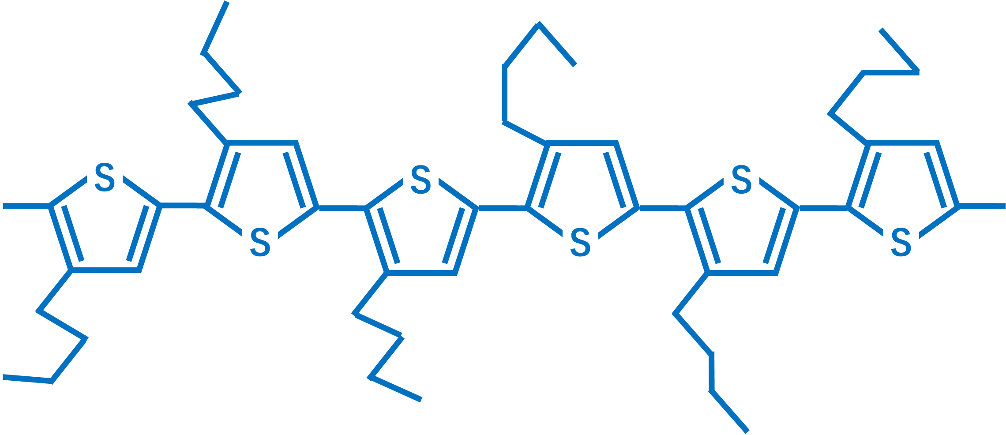
Influence of Alkyl Side-chain Structure on
Charge Transfer Rate
Chuanzhao Li , Yi Luo, Shuji Ye*
University of Science and Technology of China
Hefei National Laboratory for Physical Sciences at Microscale，230026，Hefei
E-mail: shujiye@ustc.edu.cn
Introduction
SFG spectrum of P3ATs
hole and electron separation and recombination occurs at the interfaces
Interface-sensitive
optical tenique
require
Effect of peripheral groups on the PCE
Effect of molecular symmetry on the PCE
Effect of functional groups density on the PCE
Mainly focus on pursuing the better performance
B) The value of CH₂,ss/CH₃,ss
Previous studies
Figure 2 A):The ssp SFG spectrum of P3ATs.
Figure 2 B): After fitting Figure 2 A), the value of CH₂,ss/CH₃,ss
Figure 2A) The ssp spectrum of P3ATs
PCE
hole transfer rate
The side-chain molecular order of P3ATs is different.
How to precisely describe interacial molecular
structure?
How to build the relationship between structure
and perfomance?
The connection between side-chain molecular order of P3ATs and the hole-extraction capability
Experiment Content
Figure 3. Red line is the value of CH₂,ss/CH₃,ss, black line is the ratio between PL intensity of heterjunction and that of pure perovskite.
SFG
ω_{IR}+ ω_{vis} = ω_{sfg}
SFG
-(CH₂)_{n}CH₃
The side-chain molecular order of P3ATs is consistent with
hole extraction capability.
Molecular
structure
The schematic representation of
chain arrangements in P3BTand P3HT
P3BT
P3HT
P3OT
P3DT
P3DDT
N= 4
6
8
10
12
Short
Side Chain length
Long
~2 nm
PVSK
P3ATs
~2 nm
h⁺
Hole trans-
fer rate
0.379nm
0.386nm
The steady state and time-resolved PL spectrum of perovskite/P3ATs heterojunctions
Figure 4. The schematic representation of chain arrangements in P3BT and P3HT according to previous results of GIXRD.
Π-stacking distance is not the main reason
Summary
1. Alkyl side-chains introduce two competing effects: the steric hindrance and the intermolecular dispersive attraction (Marcus theory).
2.
Invesion area
Hole transfer rate
ΔG ±
Normal area
Steric constraints
'Trans' or 'gauche'
Long range molecular order
Figure 1 A)Steady state PL spectrum B) Time-resolved PL spectrum
Figure 1 A) :The steady state PL spectrum of Perovskite/P3ATs heterojunctions.
Figure 1 B): The time-resolved PL spectrum of Perovskite/P3ATs heterojunctions.
Acknowledgements
ΔG ⁰
Hole-extraction capability of P3ATs from perovskite layer is different.
National Natural Science Foundation of China (Grants 21473177, 91127042)
Fundamental Research Funds for the Central Universities(WK2340000064)
Key Research Program of the Chinese Academy of Sciences

