Slide 1

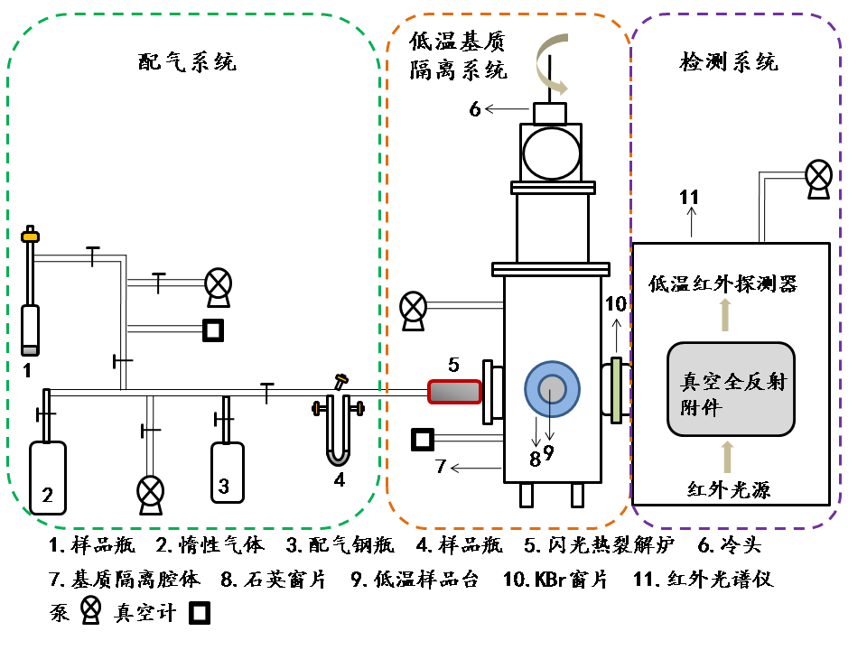
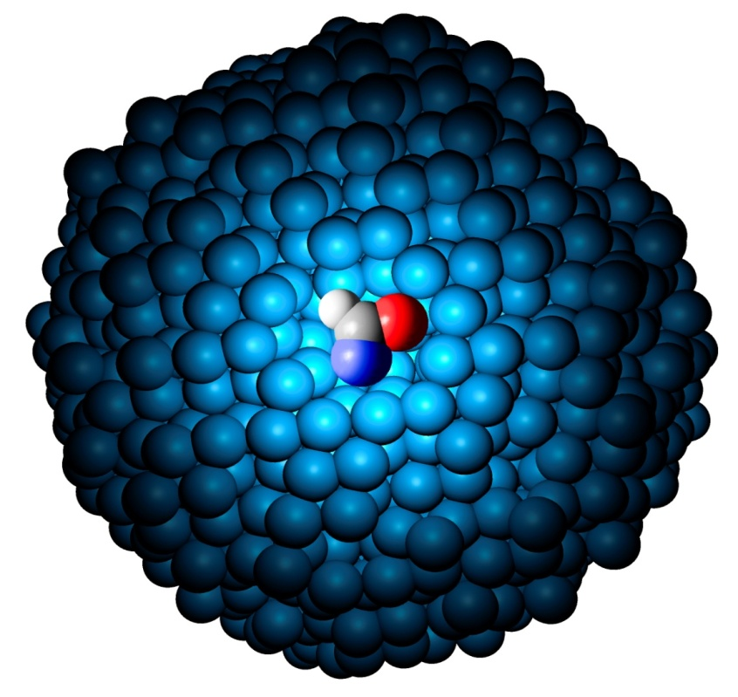
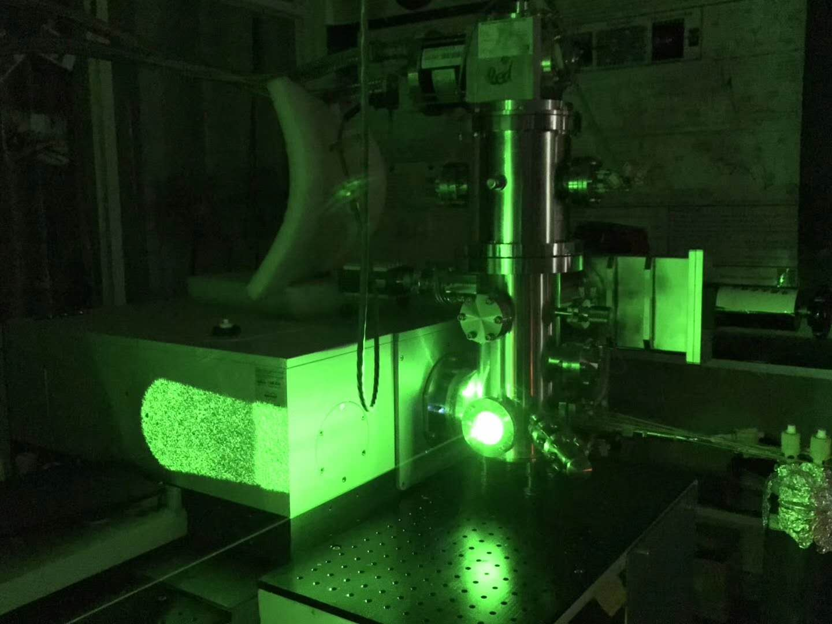

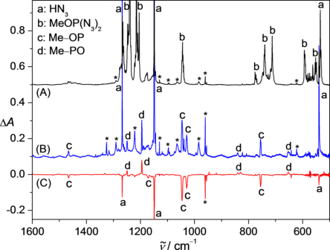
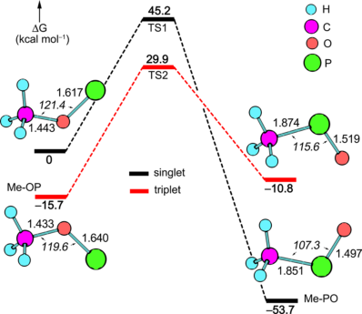
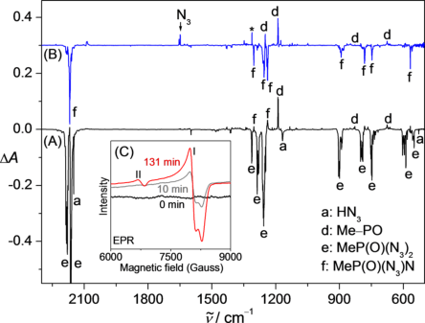
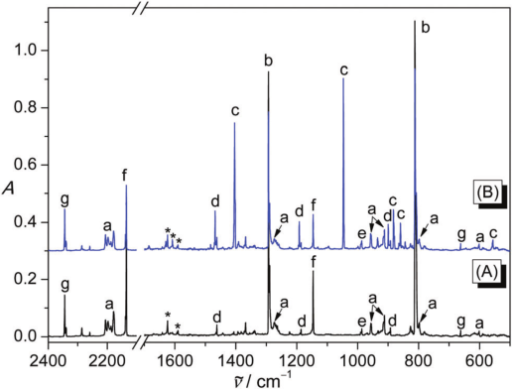
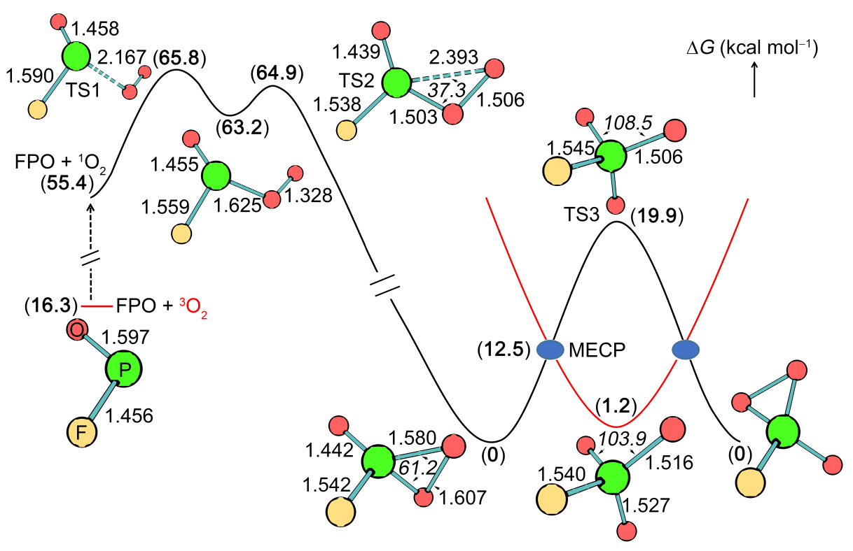
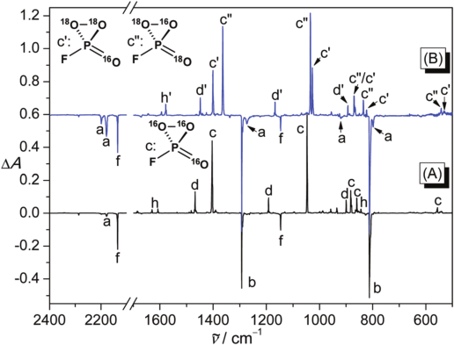
Spectroscopic Detection of Elusive Oxyphosphinidene
Xianxu Chu, Xiaoqing Zeng*
College of Chemistry, Chemical Engineering and Materials Science, Soochow University, Suzhou, China.
E-maile: xqzeng@suda.edu.cn
.
Introduction Low-valent phosphorus compounds, such as phosphinidene R-P and phosphinidene oxides R-P=O, are highly reactive. Very recently, aryl phosphinidenes^{[1]} have been detected by matrix-isolation spectroscopy. Although, microwave spectroscopy has been applied for structural characterization of H-PO, the spectroscopy, structure, and reactivity of other phosphinidene oxides (R-PO), the key intermediates in the oxidation of phosphines and decomposition of flame-retardant phosphonates, remain barely explored. Unlike alkyl-, aryl-, vinyl-, silyl-, phosphino-, and amino-phosphinidenes, oxyphosphinidenes such as methoxyphosphinidene Me-OP have been barely investigated; only the intriguing parent molecule H-OP has been computationally explored. Herein, we report the first-time detection and observation of its isomerization with methoxyphosphinidene (Me-OP).^{[2]} Furthermore, the oxygen scrambling process during the oxygenation of prototypic phosphinidene oxide (FPO)^{[3]} has also been observed by means of cryogenic matrix-isolation infrared spectroscopy.
Methods
Results
Figure 1. (A) IR spectrum of Ne-matrix isolated MeOP(N₃)₂. (B) IR spectrum of the Ne-matrix isolated 266 nm laser photolysis (95 min) products of MeOP(N₃)₂. (C) IR difference spectrum reflecting the change of the Ne-matrix upon the 193 nm laser irradiation (6 min). The bands of unknown species are marked with asterisks.
Figure 2. Calculated potential energy profiles for the interconversion between Me-OP and Me-PO in the singlet and triplet states at the CCSD(T)/aug-cc-pVTZ//B3LYP/6-311++G(3df,3pd) levels. Molecular structures (bond lengths in Å, angles in ° in italics) calculated at the CCSD(T)/cc-pVTZ level are given.
Figure 3. (A) IR difference spectrum reflecting the change of the N₂- matrix isolated MeP(O)(N₃)₂ upon the 193 nm laser irradiation (13min). (B) IR difference spectrum reflecting the change of the N₂- matrix upon subsequent 365 nm UV light irradiation (10 min). (C) EPR spectra of the 266 nm laser photolysis products of MeP(O)(N₃)₂ in solid toluene at 5 K.
Figure 6. A) IR difference spectrum showing of the change of the matrix containing the flash vacuum pyrolysis products of a mixture of FP(=O)(N₃)₂, O₂, and Ar upon a 266 nm laser photolysis. B) IR difference spectrum showing of the change of the matrix containing the flash vacuum pyrolysis products of a mixture of FP(=O)(N₃)₂, ¹⁸O₂, and Ar upon a 266 nm laser photolysis. The IR bands of FP(=O)(N₃)₂ (a), FP=O (b), cyclic FP(=O)(O₂) (c), FP(=O)₂ (d), HN₃ (f), and HONO (h) are labeled.
Figure 4 (A) IR spectrum of the flash vacuum pyrolysis products of a mixture of FP(=O)(N₃)₂, O₂, and Ar at 10 K. (B) IR spectrum of the matrix after 266 nm laser photolysis (50 min) at 10 K. The IR bands of FP(=O)(N₃)₂ (a), FP=O (b), cyclic FP(=O)(O₂) (c), FP(=O)₂ (d), F₃PO (e), HN₃ (f), CO₂ (g), and H₂O (*) are labeled.
Figure 5. B3LYP/6-311+G(3df) calculated potential energy profiles for the oxidation of FP=O by singlet O₂ and the oxygen-exchange in cyclic FP(=O)(O₂) in the singlet (black curve) and triplet (red curve) states. The calculated bond lengths (Å), angles (°, italics), and relative energies (bold in parentheses) are given.
Conclusion
Reference
1.The generation of the oxyphosphinidene (Me-OP) and phosphinidene oxide (Me-PO) isomers which are observed at low temperature matrices for the first time.
2. Oxidation of FPO characterized by matrix-isolation IR.
3. Quantum chemical calculations suggest that the scrambling happens via the intermediacy of the low-lying triplet FPO₃ by passing minimum energy crossing points (MECPs).
[1] (a) A. V. Akimov; Y. S. Ganushevich; D. V. Korchagin; V. A. Miluykov; E. Y. Misochko Angew. Chem., Int. Ed. 2017, 56, 7944−7947. (b) A. Mardyukov; D. Niedek and P. R. Schreiner, J. Am. Chem. Soc. 2017, 139, 5019−5022.
[2] X. X. Chu, Y. Yang, B. Lu, Z. Wu, W. Y. Qian, C. Song, X. F. Xu, M. Abe and X. Q. Zeng, J. Am. Chem. Soc., 2018, 140, 13604–13608.
[3] X. X. Chu, C. Song, Y. Yang and X. Q. Zeng. Chem. Commun. 2019, 55, 245-248.
Acknowledgement
This work was supported by the National Natural Science Foundation of China (21673147), and the Priority Academic Program Development of Jiangsu Higher Education Institutions (PAPD).

