Slide 1
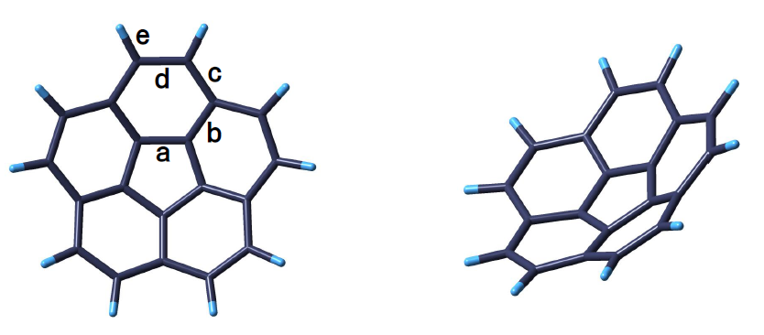
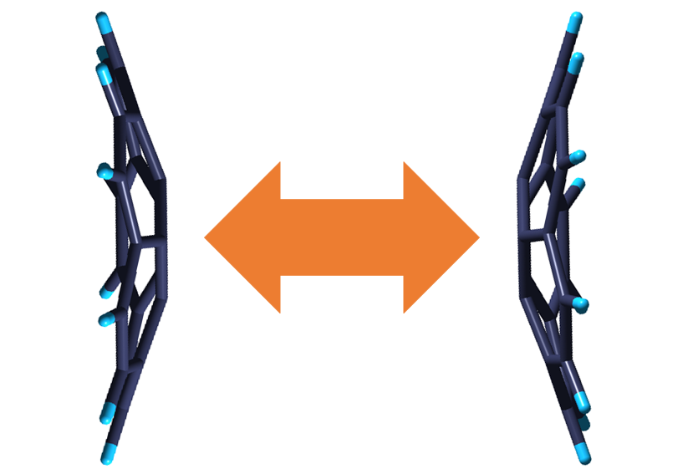
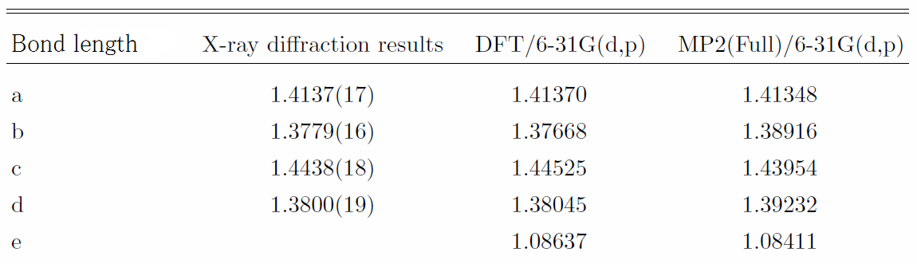

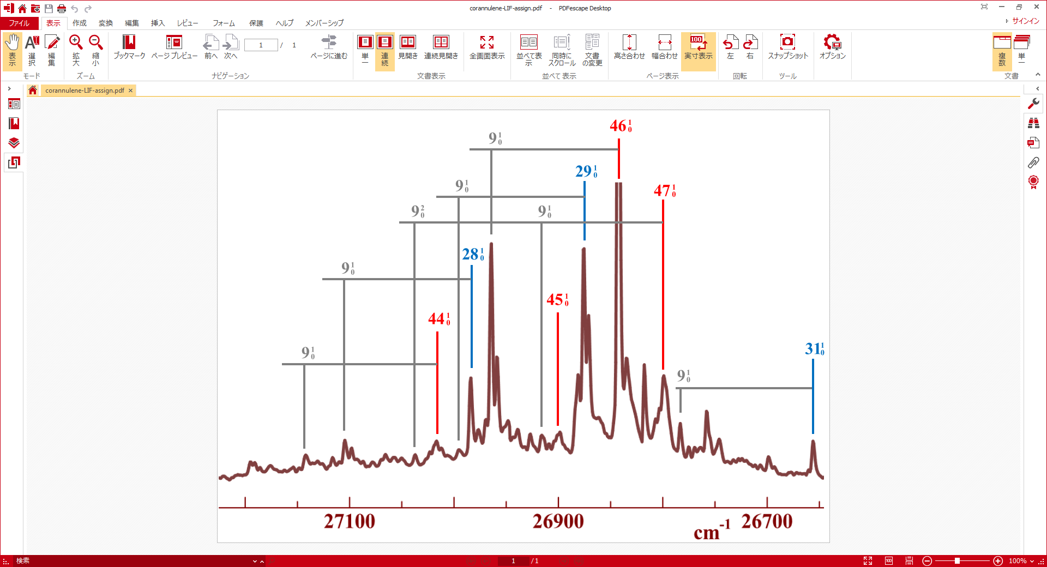
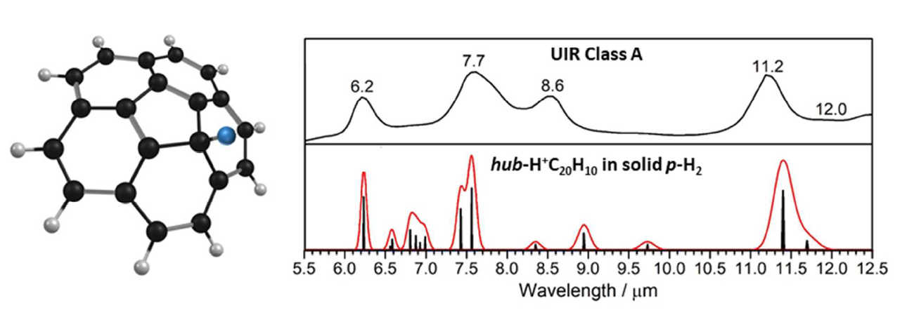
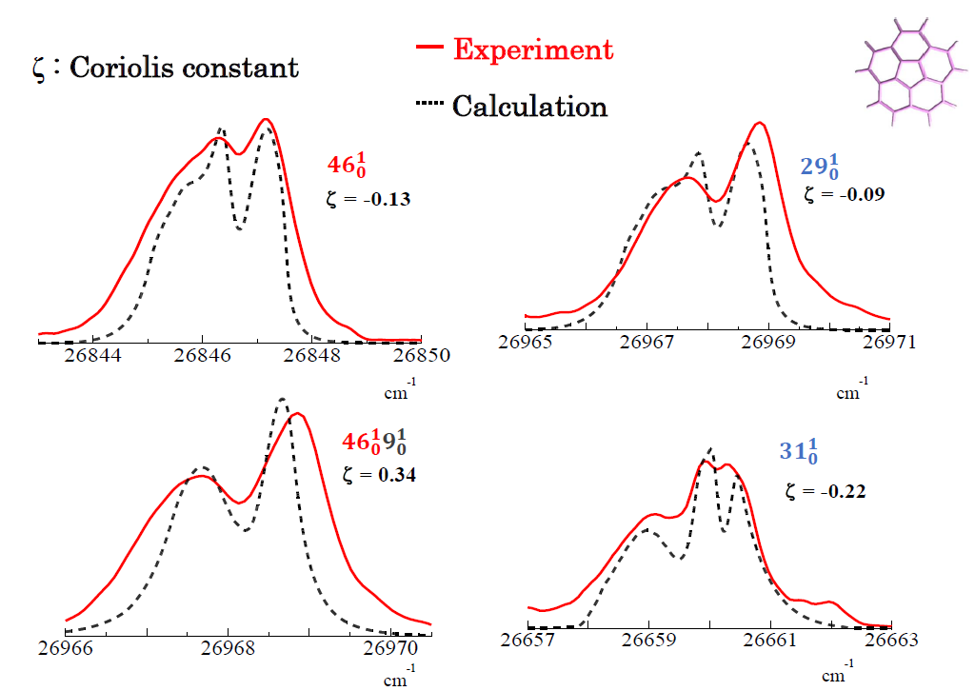
Structure and Excited-state Dynamics of Corannulene
Ayumi Kanaoaka¹, Masaaki Baba¹, Masatoshi Misono², Masashi Tsuge³, Pavithraa Sundararajan⁴, and Yuan-Pern Lee⁴
¹Kyoto University, Japan, ²Fukuoka University, Japan, ³Hokkaido University, Japan, ⁴National Chiao Tung University, Taiwan
Introduction
Structure
Corannulene (C_{5V}) is one of the prototypical molecules of Bucky bowl, which is a polyaromatic hydrocarbon (PAH) with nonplanar π conjugate system. It is composed of one five-membered ring and five six-membered rings and molds its unique character which is derived from out-of-plane vibration like bowl-to-bowl inversion. We analyzed the vibronic bands of S₁-S₀ transition in a supersonic jet and investigated structure and excited-state dynamics. The S₁ state was assgined to ¹E₂. We also analyzed the infrared bands of corannulene in solid para-H₂. Two protonated molecules H⁺C₂₀H₁₀ were confirmed by electron bombardment during deposition of a mixture. Some resemblance is attained for the observed infrared spectrum and UIR intersteller emission bands.
(i)
(ii)
Bucky ball and Bucky bowl
Fig. 1 : Corannulene (i) just above (ii) oblique
.
hub
spoke
flank
rim
Bowl-to-bowl inversion
TABLE 1 : Bond lengths and angles calculated by DFT/6-31G(d,p) and MP2/6-31G(d,p) comparing with X-ray diffraction results.
Results and Discussion
1. In Supersonic Jet
2. In Solid para-H₂
vibrational levels
―― e₁
―― e₂
―― a₁
Fig. 4 : Infrared spectrum of corannulene in solid para-H₂.
The infrared spectrum of corannulene in solid para-H₂ was well assigned on the basis of B3PW91/6-311++G(2p,2d) calculation. The shift by crystal field is very small in such cold matrix. Weak bands (indicated by pink) are assigned to hot bands or combination bands.
Fig. 2 : Fluorescence excitation spectrum of corannulene in a supersonic jet.
Assuming that the S₁ state is E₂ as predicted by SAC-CI calculation, we can assign the vibronic bands to e₁ and e₂ modes. If the S₁ state is A₂ as predicted by TDDFT calculation, a₂ and e₁ modes should be appear in the spectrum. The out-of-plane vibrational modes (ν ₉ (a₁): bowl-to-bowl inversion mode） are active for combination bands. It suggests that the bowl-to-bowl inversion is enhanced by the UV excitation to vibrational levels in the S₁ state.
Band contour strongly depends on vibrational modes because of Coriolis interaction. The coupling constants were calculated by normal coordinates, and the calculated contour resemble observed ones.
Fig. 5 : Infrared spectra of hub -H⁺C₂₀H₁₀ and UIR Class A.
Two protonated corannulene molecules ( hub-H⁺C₂₀H₁₀ and rim-H⁺C₂₀H₁₀ ) were produced by electron bombardment during the deposition of a mixture. The IR bands of hub-H⁺C₂₀H₁₀ resembled Class-A UIR intersteller bands. The product ratio is in good coincidence with energy calculation of each active species. We also found some hydrogenated molecules and are analyzing their infrared spectra.
Fig. 3 : Vibronic band contour with Coriolis interaction

