Slide 1
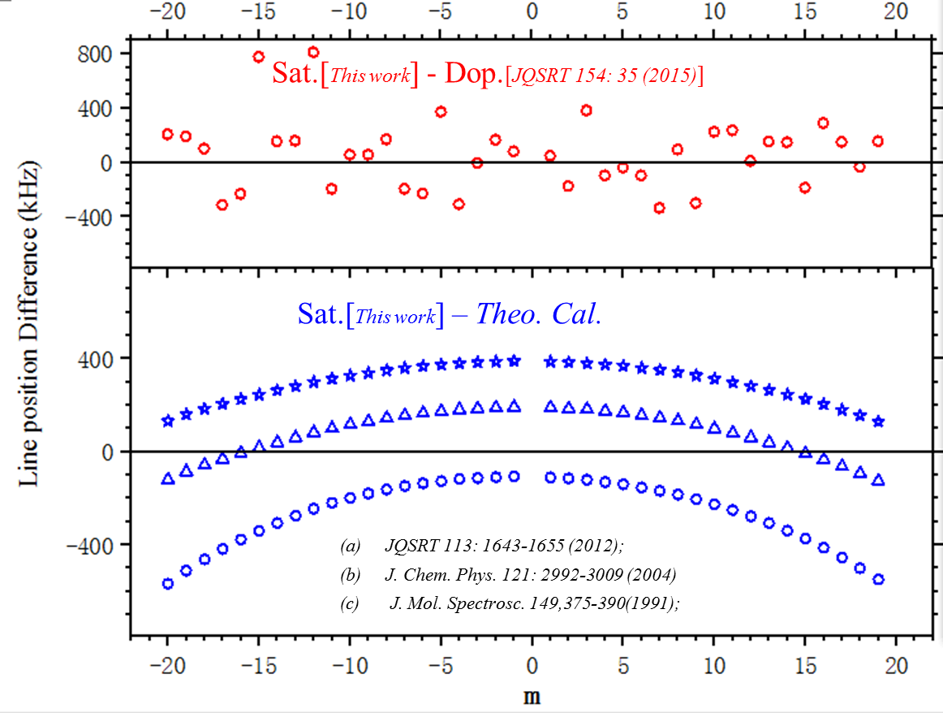
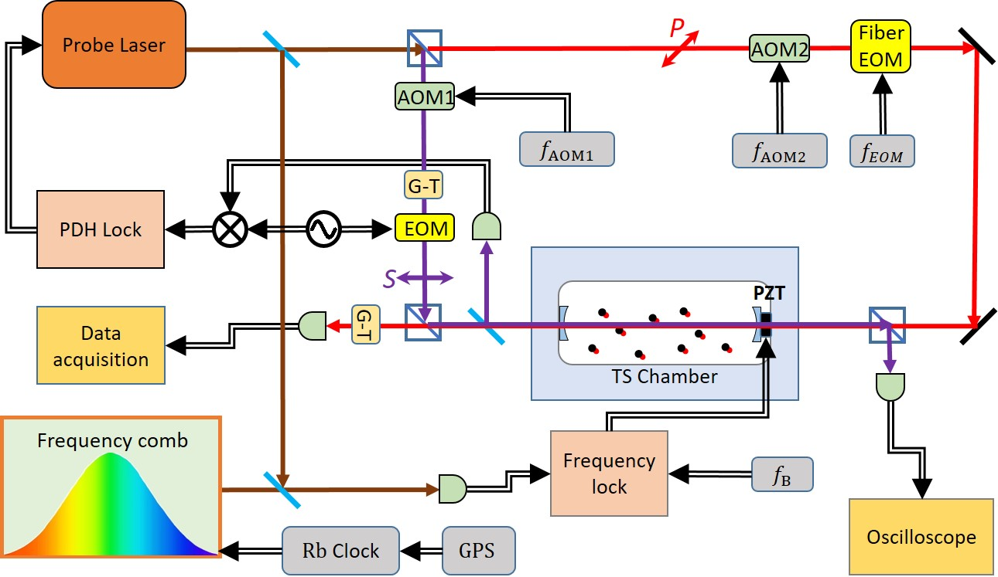



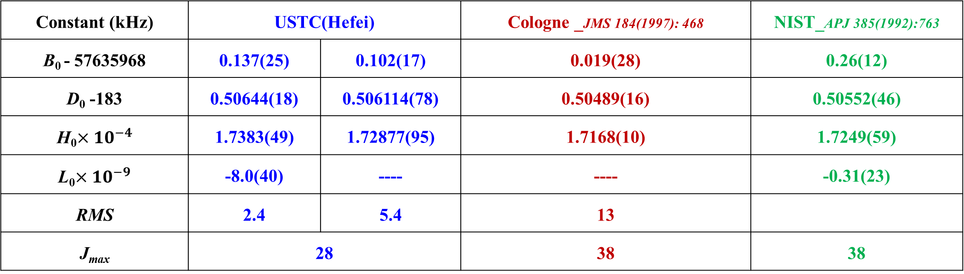
High Precision Rotational Constants of ¹²C¹⁶O Determined by
Ro-vibrational Transitions
Jin Wang*, Yu Robert Sun, Changle Hu Anwen Liu*, Shuiming Hu
Hefei National Laboratory for Physical Sciences at Microscale, University of Science and Technology of China, Hefei 230026, China. *Email: jinwang@ustc.edu.cn, awliu@ustc.edu.cn
Introduction
Results
CO is one of the most abundant molecule in the universe. Precise spectrum of the carbon monoxide molecule is great importance in astrophysical observation and in the test of the quantum chemistry model. High precision rotational constant can also be obtained. Ro-vibrational transitions of ¹²C¹⁶O in the second overtone band were measured by a comb-locked cavity ring-down saturated spectrometer [1-4]. The line positions were determined with sub-kHz accuracy, or relatively 10⁻¹² level. Refined molecular constants were obtained for the ground and second-overtone vibrational states. The calculated pure rotational frequency agree well with the experimental values within the claimed uncertainties. By comparing the calculated and experimental results, we present perspectives of the precision spectroscopy of the carbon monoxide molecule in the determination of bond length of CO and the atom mass of ¹⁷O by the Dunham-Watson model with first-order Born-Oppenheimer breakdown parameters [5-6].
Simulation
Experimental
Experimental Setup
Ground state constant
Constant (kHz) | USTC(Hefei) |  | Cologne _JMS 184(1997): 468 | NIST_APJ 385(1992):763
B₀ - 57635968 | 0.137(25) | 0.102(17) | 0.019(28) | 0.26(12)
D₀ -183 | 0.50644(18) | 0.506114(78) | 0.50489(16) | 0.50552(46)
H₀$×{10}^{−4}$ | 1.7383(49) | 1.72877(95) | 1.7168(10) | 1.7249(59)
L₀$×{10}^{−9}$ | -8.0(40) | ---- | ---- | -0.31(23)
RMS | 2.4 | 5.4 | 13
J_{max} | 28 |  | 38 | 38
¹²C¹⁶O V=3-0 P(28) Lamp dip
References
[1] Wang, J.; Sun, Y.R.; Tao, L-G.; Liu, A.-W.; Hu, S.-M. J. Chem. Phys. 2017, 147: 091103.
[2] Golubiatnikov, G. Yu.; Belov, S.P.; Leonov, I.I.; Andriyanov, A.F.; Zinchenko, I.I.; Lapinov, A.V.; Markov, V.N.; Shkaev, A.P.; Guarnieri, A. Radiophys. Quant. Electron. 2014, 56: 599-609.
[3] Farrenq, R.; Guelachvili, G.; Sauval, A.J.; Grevesse, N.; Farmer, C.B. J. Mol. Spectrosc. 1991, 149: 375-390.
[4] Velichko, T.I.; Mikhailenko, S.N.; Tashkun, S.A. J. Quant. Spectrosc. Radiat. Trans. 2012, 113: 1643-1655.
[5] Brianna J. Mount, Holger S. P. Muller, Matthew Redshaw, and Edmund G. Myers. PHYSICAL REVIEW A, 81, 064501 (2010).
[6] Brianna J. Mount, Matthew Redshaw, Edmund G. Myers. Hyperfine Interact (2011) 199:327–335.
Acknowledgement
Line intensity: 4.39E-26 cm/molecule
Saturated Power: ~2kW/cm²
Input power: 2.2mW
Gas pressure: 1Pa

