Slide 1



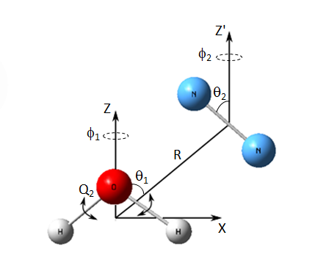
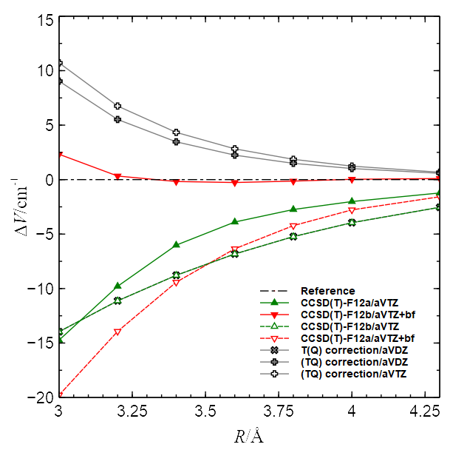

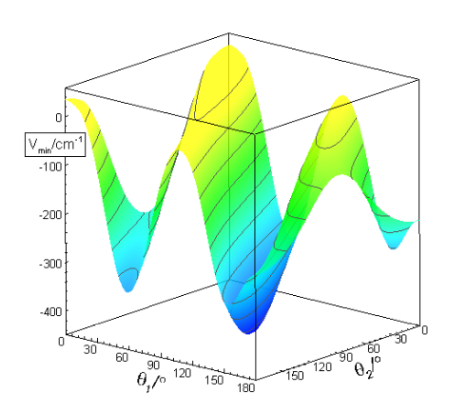
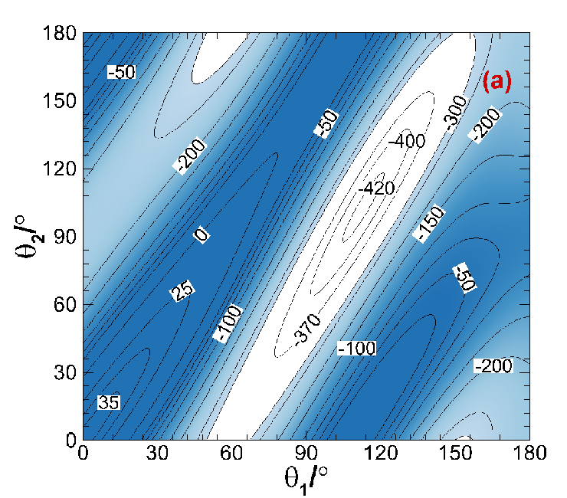
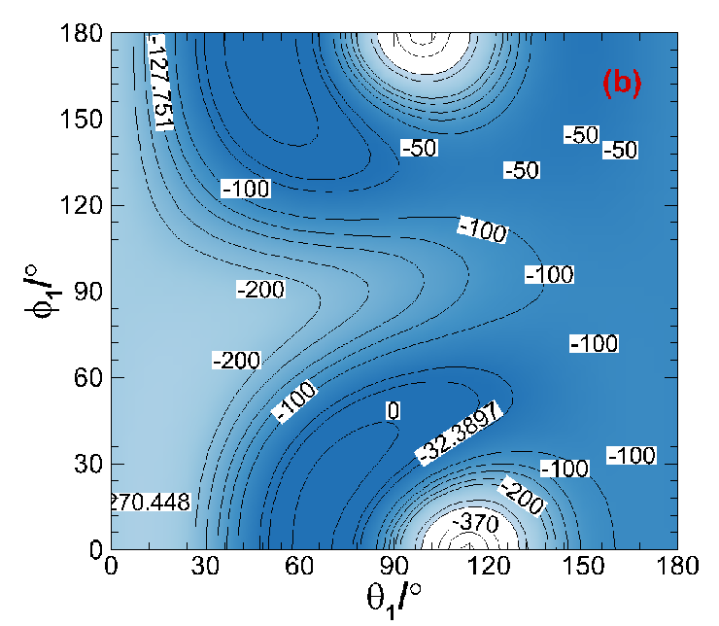
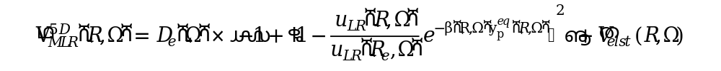



The inter- and intra-molecular potential energy surface
and predicted infrared spectra for
H₂O-N₂ dimer
Lu Wang, Xiao-Long Zhang, and Hui Li*
Laboratory of Theoretical and Computational Chemistry, Institute of Theoretical Chemistry, Jilin University,
Changchun, 130023, China. E-mail: Prof_huili@jlu.edu.cn
Introduction
Ab initio calculations
The H₂O-N₂ dimer is one of the major topics of debate among the van der Waals complex because it is a symmetric top-linear molecule dimer which can describe the features about all intra- and inter-molecular potential as well as vibration states. What’s more, the infrared (IR) spectra and intensities of the water and nitrogen complex have been already probed, providing much information, such as the structures and intermolecular forces.
In this work, we report a first effective six-dimensional ab initio potential energy surface (PES) for H₂O-N₂ van der Waals complex, which explicitly incorporates dependence on the Q₂ bending normal-mode coordinate of the H₂O monomer. The infrared spectra for H₂O-N₂ dimer is predicted for the first time based on the resulting vibrationally averaged PES and the results are in good agreement with the experimental values.
FIG. 1. Coordinate system used for H₂O–N₂ .
FIG. 2. One-dimensional cuts of the interaction potentials for global minimum of the H₂O-N₂ complex computed at different levels of theory.
Potential energy surface
FIG. 3. Minimum energy on our vibrationally averaged 5D VMLR PES for H₂O(ν₃ = 0)–N₂ as a function of angles θ₁ and θ₂ with φ₁ and φ₂ ﬁxed at their equilibrium values corresponding to the global minimum, for the optimized value of R.
FIG. 4. 2D cut contour plots of our vibrationally averaged 5D VMLR PES for H₂O( ν₃ = 0)–N₂ : (a) as a function of angles θ₁ and θ₂ and (b) as a function of θ₁ and φ₁ with other angular variables ﬁxed at their equilibrium values corresponding to the global minimum, for the optimized value of R.
Conclusions
References
For H₂O-N₂ complex, a new six-dimensional intermolecular PES is obtained by non-linear-least-squares fit of 40890 points to the Morse/long-range potential function form. This fit has the root-mean-square (RMS) deviation of 0.98 cm⁻¹ for the interaction energy less than 2000.0 cm^{-1.}
We can find from the calculations that the global minimum of the 5D PES corresponds to a structure with intermolecular separation R = 3.81 Å and θ₁ = 113.4°, θ₂ = 103.9°, φ₁ = φ₂ = 0° with a binding energy of 424.3162 cm⁻¹
[1] P. Sandler, J. oh Jung, M. M. Szczȩs̀niak , and V. Buch , J. Chem. Phys. 101, 1378 (1994)
[2] A. S. Tulegenov, R. J. Wheatley, M. P. Hodges, and A. Harvey , J. Chem.
Phys. 126, 094305 (2007)
[3] P. R. B. Barreto, A. F. Albernaz, A. Capobianco, F. Palazzetti, A. Lombardi,
G. Grossi, and V. Aquilanti, Comput. Theor. Chem. 990, 53 (2012)
[4] Xiao-Gang Wang, and Tucker Carrington , J. Chem. Phys. 143 , 024303 (2015)
[5] H. O. Leung, M. D. Marshall, R. D. Suenram, and F. J. Lovas, J. Chem. Phys.
90, 700 (1989)

