Slide 1



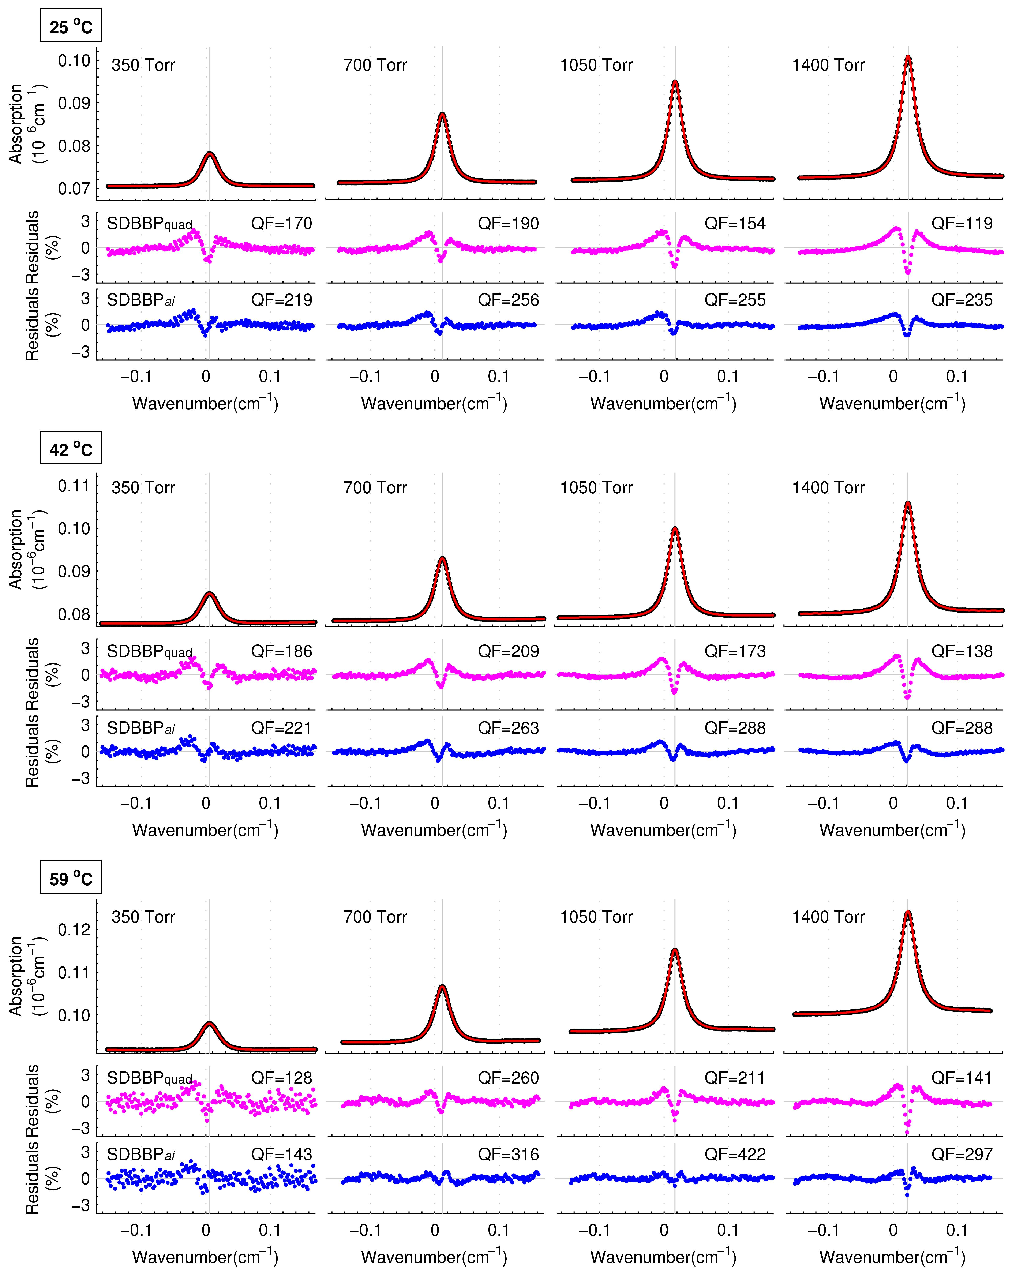




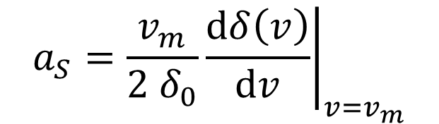
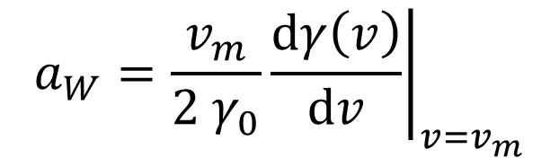
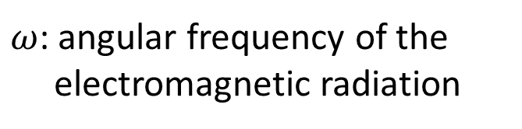
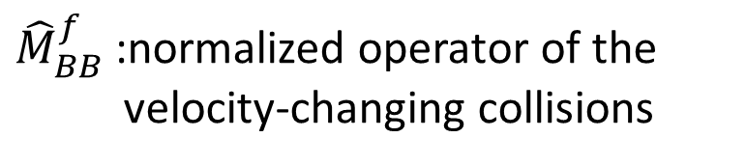
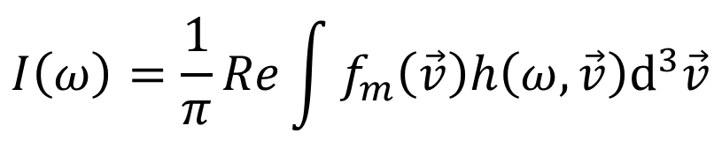

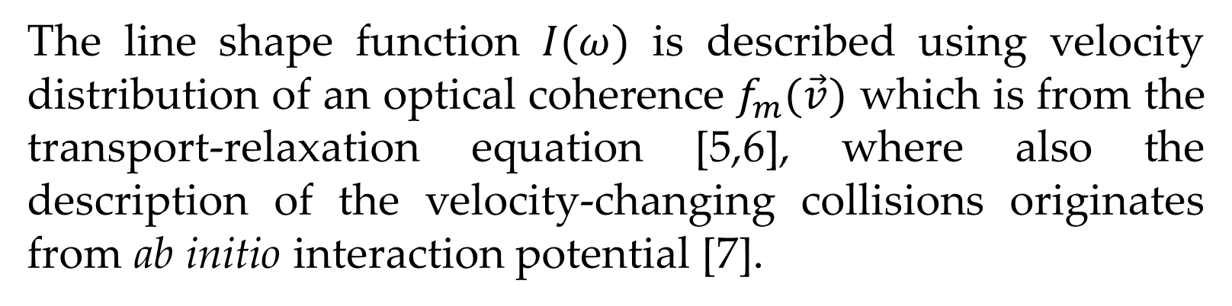
Accurate Line Shape Measurement of D₂-He and Comparison with ab initio Calculation
A. Nishiyama^{1,2}, F. Thibault³, M. Słowiński¹, M. Zaborowski¹, N. Stolarczyk¹, D. Charczun¹, A. Cygan¹, S. Wójtewicz¹,
G. Kowzan¹, P. Masłowski¹, R. Ciuryło¹, D. Lisak¹, P. Wcisło¹
Institute of Physics, Faculty of Physics, Astronomy and Informatics, Nicolaus Copernicus University in Toruń, Grudziadzka 5, 87-100 Torun, Poland
Department of Engineering Science, Graduate School of Informatics, The University of Electro-Communications (UEC), 1-5-1 Chofugaoka, Chofu, Tokyo 182-8585, Japan
Institut de Physique de Rennes, UMR CNRS 6251, Université de Rennes 1, Campus de Beaulieu, Bật. 11B,35042 Rennes, France.
Introduction
Experimental Setup
The speed-dependent billiard-ball profile (SDBBP) based on ab initio calculation have provided proper line shapes of H₂, and H₂-Ar spectra [1,2]. In this work, we applied the line shape calculation to D₂-He system. We measured S(2) transition of 2-0 band of D₂ in He at different temperatures (from 25 - 59ºC) and pressures (350 - 1400 Torr) using optical frequency comb (OFC) linked frequency-stabilized cavity-ring down spectroscopy (FS-CRDS) [3]. And we compared the experimental spectra with line shape simulations.
Thermal stabilization system
Polarizer
Ring down signal
EOM2
(scan)
PD
AOM1
(switching)
EOM1
(PDH)
Sample: D₂-He
D₂ concentration of 5%
PD
Cavity length lock
AOM2
(scan)
I₂ stabilized
Nd:YAG
time
ECDL
1.6 μm
Probe laser lock
PD
Temperature: 25, 42, 59 ºC
Pressure: 350, 700, 1050, 1400 Torr
ab initio Calculation
The high finesse cavity (finesse = 600 000, FSR = 200 MHz) is in the thermal stabilization system which realizes 50 mK stability [4]. The cavity is filled with a sample gas, and locked to a iodine stabilized Nd:YAG. An external cavity diode laser (ECDL) is stabilized to the cavity by Pound-Drever-Hall lock (PDH), and the absolute frequency is precisely calibrated with an OFC referenced to UTC(AOS) frequency standard. The acousto-optic modulator (AOM1) is used for fast switching off the ECDL output to generate ring-down signals. In each sampling point, 100 ring-down decay signals are averaged. The frequency of ECDL was scanned by using electro-optic modulator (EOM2) with a step of cavity FSR, and the cavity length is also scanned by frequency tuning of the AOM2. We averaged 25 scans, and the measurement took 5 hours for each pressure-temperature combination. Each scan covered about 10 GHz spectrum with 50 MHz point spacing.
The line shape function $I(ω)$ is described using velocity distribution of an optical coherence $f_{m}(\vec{v})$ which is from the transport-relaxation equation [5,6], where also the description of the velocity-changing collisions originates from ab initio interaction potential [7].
OFC
$$I\left(ω\right)=\frac{1}{π}Re\int{f_{m}\left(\vec{v}\right)h\left(ω,\vec{v}\right)d^{3}\vec{v}}$$
$ω$: angular frequency of the
electromagnetic radiation
Table 1. Calculated line shape parameters of S(2) transition of 2-0 band in D₂-He system. γ₀, δ₀ and ν_{opt} parameters are in 10⁻³cm⁻¹/amg., a_{W} and a_{S} are unitless.
$$1=−i\left(ω−ω_{0}−\vec{k}\vec{v}\right)h\left(ω,\vec{v}\right)−{\hat{S}}^{f}h\left(ω,\vec{v}\right)$$
Summary
$${\hat{S}}^{f}=−γ\left(v\right)−iδ\left(v\right)+v_{opt}{\hat{M}}_{BB}^{f}$$
${\hat{M}}_{BB}^{f}$ :normalized operator of the
velocity-changing collisions
Temperature | 25 ºC | 42 ºC | 59 ºC
γ₀ | 3.952 | 4.192 | 4.428
δ₀ | 14.436 | 15.039 | 15.615
a_{W} | 0.360 | 0.361 | 0.363
a_{S} | 0.303 | 0.300 | 0.298
Re{ν_{opt}} | 25.825 | 26.144 | 26.445
Im{ν_{opt}} | -6.571 | -6.742 | -6.900
We showed comparison of experimental spectra and simulated line shapes of S(2) transition of 2-0 band of D₂ perturbed by helium.
We measured accurate line shapes of the D₂ transition at several conditions. The OFC linked FS-CRDS employing extraordinary high finesse cavity realized highly precise and high SNR spectral acquisition, and thermal stabilization system provide accurate temperature conditions.
We calculated line shape parameters of the transition of He-perturbed D₂ using ab initio calculation.
The resulting spectra from the ab initio calculations show good agreements with measured line-shape profiles. After the fitting of area and unperturbed center frequencies, residuals peaks were around 2 %. We conclude that our calculation provided the most accurate line-shape profile for the D₂-He system.
We computed the terms of operator ${\hat{S}}^{f}$ from ab initio calculation, and obtained line shape parameters (Table 1).
In the comparisons with experimental line shapes, we used SDBBP [1,2] to simulate the shapes of the D₂–He system. We also used S-matrices resulting from ab initio calculation to calculate the line-shape parameters [8]. In addition, to take into account D₂-D₂ coupling, we also used line shape parameters determined from pure D₂ line shape observation [9].
where:
$$a_{W}=\frac{v_{m}}{2 γ_{0}}{\left.\frac{dγ\left(v\right)}{dv}\right|}_{v=v_{m}}$$
$$a_{S}=\frac{v_{m}}{2 δ_{0}}{\left.\frac{dδ\left(v\right)}{dv}\right|}_{v=v_{m}}$$
Comparison
Simulated spectra (red) from the ab initio calculation were compared with experimental spectra (black). We fitted only area of the line, unperturbed central frequency of the line and experimental background (linear function of frequency, no etalons were fitted). All the line shape parameters originates from our ab initio calculations and also were not fitted.
25 ºC
References
Wcisło P., Tran H., Kassi S., Campargue A., Thibault F., and Ciuryło R., 2014, J. Chem. Phys. 141, 074301.
Wcisło P., Thibault F., Cybulski H., and Ciuryło R., 2015, Phys. Rev. A 91, 052505.
Cygan A., Wójtewicz S., Kowzan G., Zaborowski M., Wcisło P., Nawrocki J., Krehlik P., Śliwczyński Ł., Lipiński M., Masłowski P., Ciuryło R., and Lisak D., 2016, J. Chem. Phys. 144, 214202.
Zaborowski M., Wcisło P., Thibault F., Wójtewicz S., Cygan A., Kowzan G., Masłowski P., Lisak D., and Ciuryło R., 2017, J. Phys. Conf. Ser. 810, 012042-1.
Ciuryło R., Shapiro A. D., Drummond R. J., and May D. A., 2002, Phys. Rev. A 65, 012502.
Wcisło P., Cygan A., Lisak D., and Ciuryło R., 2013, Phys Rev. A 88, 012517.
F. Thibault, P. Wcisło, and R. Ciuryło, 2016, Eur. Phys. J. D 70, 236.
Thibault F., Patkowski K., Żuchowski S. P., Jóźwiak H., Ciuryło R., and Wcislo P., 2017, JQSRT, 202, 308
Wcisło P., Thibault F., Zaborowski M., Wójtewicz S., Cygan A., Kowzan G., Masłowski P., Komasa J., Puchalski M., Pachucki K., Ciuryło R., and Lisak D., 2018 JQSRT 213, 41.
42 ºC
59 ºC
Acknowledgments
This work has the support of National Science Center, Poland project numbers: 2014/15/D/ST2/05281, 2015/18/E/ST2/00585, 2015/19/D/ST2/02195 and of the COST Action, CM1405 MOLIM.
Contact
Nikodem Stolarczyk/ Akiko Nishiyama
Institute of Physics, Faculty of Physics, Astronomy and Informatics
Nicolaus Copernicus University in Toruń
Grudziądzka 5, 87-100 Torun, Poland
Mail: nist@stud.umk.pl/a-nishiyama@uec.ac.jp

