Slide 1


The International Center for Fabry Disease
Department of Genetics & Genomic Sciences
Icahn School of Medicine at Mount Sinai
New York, NY
Phone: 800-322-7963; Email: fabry.disease@mssm.edu
Dana Doheny, MS, CGC
Certified Genetic Counselor
Diana Moglia, MS, CGC
Certified Genetic Counselor
(Formerly at Icahn School of Medicine at Mount Sinai)
Robert J. Desnick, PhD, MD
Dean for Genetic & Genomic Medicine
Professor & Chairman Emeritus
Icahn School of Medicine at Mount Sinai
Department of Genetics & Genomic Sciences
New York, NY
Updated: 9/17/2016

Slide 2
The International Center for Fabry Disease
Department of Genetics & Genomic Sciences
Icahn School of Medicine at Mount Sinai
New York, NY
Phone: 800-322-7963
This tutorial was designed to help people understand Fabry disease, including the genetics, symptoms, and treatment. This tutorial is not meant to take the place of personalized medical advice or to dictate treatment decisions for those affected by Fabry disease. All males with Fabry disease and female heterozygotes should be followed by a team of health care professionals specializing in the care of patients with Fabry disease.
To proceed to the next slide, please click anywhere on the slide.

Slide 3

What is Fabry disease?
Fabry disease is an inherited genetic metabolic storage disease:
  Fabry disease is inherited.
    Fabry disease is passed on from one generation to the next.
  Fabry disease is a genetic disorder.
    Fabry disease is caused by mutations (or alterations) in a specific gene.
  Fabry disease is a metabolic disease.
    Fabry disease is caused by the inability to break down particular substances, called glycolipids, in the cells of the body.
  Fabry disease is a storage disease.
    The glycolipids that are not broken down are stored in the cells of the body.

Slide 4



Overview
Fabry disease is caused by a genetic change in the gene that tells the body how to make the enzyme, α-galactosidase A (or α-Gal A).
A change in this gene causes the enzyme α-Gal A to be absent or markedly decreased in the cells of the body.
The function of α-Gal A is to break down glycolipids (sugary-fats) called globotriaosylceramide (GL-3; also known as Gb3 and Lyso-Gb3).
When there is not enough working α-Gal A, GL-3 builds up in the cells and body fluids.
The build-up of GL-3 causes the symptoms of Fabry disease.
Some of the symptoms of
Fabry disease include:
    Burning Pain
    Decreased Sweating
    Angiokeratoma (skin lesions)
    Corneal Whorls
    Chronic Fatigue
    High Frequency Hearing Loss
    Kidney Disease
    Heart Disease
    Stroke
Enzyme Replacement Therapy is a commercially available treatment option that improves quality-of-life for patients with Fabry disease.

Slide 5



Fabry Disease Background Information
Fabry disease is caused by a mutation (or alteration) in a gene called GLA.
When this gene works properly, the body uses the gene’s information to make a specific enzyme (a type of protein) called α-galactosidase A.
This enzyme is also called α-Gal A enzyme.
GLA gene
α-Gal A enzyme

Slide 6

Fabry Disease Background Information
When a person has Fabry disease, there is a mutation (or alteration) in the GLA gene.
Only one mutation is needed to cause disease, but there are many different mutations that can occur in different places in the GLA gene.
A mutation in the GLA gene makes the body unable to produce a properly working α-Gal A.
GLA gene
with mutation
α-Gal A enzyme
NONE

Slide 7
Fabry Disease Background Information
α-Gal A
GL-3
α-Gal A functions as an enzyme.
GL-3
Enzymes are proteins that help metabolism (steps to make, keep, and break down substances in the body).
α-Gal A’s normal function as an enzyme is to break down a specific lipid (a sugary-fat) called globotriaosylceramide (or GL-3).
GL-3
GL-3
α-Gal A is found in a special compartment of the cell called the lysosome.
GL-3
The lysosome is the digestive system of the cell.
GL-3
GL-3
The lysosome contains many proteins that help the cell break down substances to be used later or to be destroyed. α-Gal A is one of those proteins.

Slide 8

Fabry Disease Background Information
When there is a mutation in the GLA gene, the body cannot make properly working α-Gal A, so GL-3 builds up in the lysosomes inside the cells of the body.
Without α-Gal A , GL-3 continues to build up. The build-up of GL-3 causes the symptoms of Fabry disease.
The build-up of GL-3 occurs in the cell’s lysosomes and body fluids, including blood plasma and urine and the GL-3 stays in the lysosomes and body fluids. This is why Fabry disease is called a LYSOSOMAL STORAGE DISEASE.
Normal Cell
Cell in person with Fabry disease
Lysosome
GL-3
GL-3
GL-3
GL-3
GL-3
GL-3
GL-3
GL-3
GL-3
GL-3
GL-3
GL-3
GL-3
GL-3

Slide 9
Subtypes of Fabry Disease
Subtype classification for a specific GLA gene mutation is determined by:
the type of GLA gene mutation,
symptoms and enzyme activity of affected males with that specific mutation, and
laboratory studies that determine the effect of the mutation on the α-Gal A enzyme
There are two major clinical subtypes of Fabry disease: “Classic” and “Later-Onset”.
The clinical picture of these two subtypes differ in age of onset, the amount of working α-Gal A, and clinical symptoms.
Both subtypes lead to kidney failure, heart disease, and/or strokes in adults.
There are some GLA gene mutations that are “Benign”; that is, they do not affect the production of α-Gal A and, therefore, do not cause Fabry disease.
There are additional mutations for which there is not enough information to determine the subtype. These are called “Variants of Unknown Significance” (VUS).

Slide 10
Subtypes of Fabry Disease
Classic Fabry disease
Males have little or no working α-Gal A.
In males, onset of symptoms occurs in early childhood or adolescence.
Males have significant GL-3 accumulation starting prior to birth.
Childhood symptoms in males include decreased sweating, burning pain in the extremeties, angiokeratoma (skin lesions), and digestive problems.
In males, kidney and heart problems begin in the 20s, and strokes may occur after 30.
In females, there is a range of severity from no symptoms throughout life to rarely being as severe as affected male relatives. The variation in severity is due primarily to random X-chromosomal inactivation.
Later-Onset Fabry disease
Males have residual α-GalA activity and less GL-3 accumulation.
Males typically do not have the childhood symptoms seen in males with Classic Fabry disease.
Males typically develop kidney and heart disease in the third to sixth decades of life.
For females, limited information is available about their clinical picture. Typically they do not have symptoms, but may have symptoms similar to their affected male relatives. The variation in severity is due primarily to random X-chromosomal inactivation.

Slide 11


Symptoms of Fabry Disease
The build-up of GL-3 causes the symptoms of Fabry disease.
Since the build-up of GL-3 occurs over time, the symptoms of Fabry disease tend to get worse with age.
Four important things to know about the symptoms of Fabry disease:
  Not everyone who has Fabry disease will experience all of these symptoms.
  Even people in the same family who have the same mutation can have different symptoms, with different severity.
  The symptoms of Fabry disease can change throughout a person’s life – some symptoms may become milder with age, while other symptoms may get worse.
  Males are generally more severely affected than females.

Slide 12
Symptoms of “Classic” Fabry Disease Decreased Sweating
  Males with Classic Fabry disease
  sweat very little or not at all.
  Hypohidrosis - A condition where someone sweats very little.
  Anhidrosis - A condition where someone does not sweat at all.
Because they sweat less than
normal or not at all, males
with Classic Fabry disease tend to:
  Get overheated more easily
  Feel worse when the weather is hot

Slide 13
Symptoms of “Classic” Fabry Disease
Pain
There are two types of Fabry pain:
Acroparesthesia: a nagging burning or tingling pain that is most often felt in the hands and/or feet.
Fabry crisis: a period of intense pain that is usually first felt in the hands and/or feet, spreads to other parts of the body, and can last from minutes to hours to several weeks.
  Pain is the most common symptom in childhood and adolescence.
  Pain is often the first symptom.
  Pain typically begins in early childhood.
Fabry pain is typically triggered by:
Weather Changes
Stress
Fever
Exercise
Fatigue

Slide 14
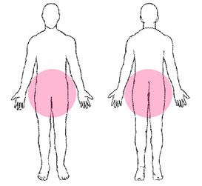
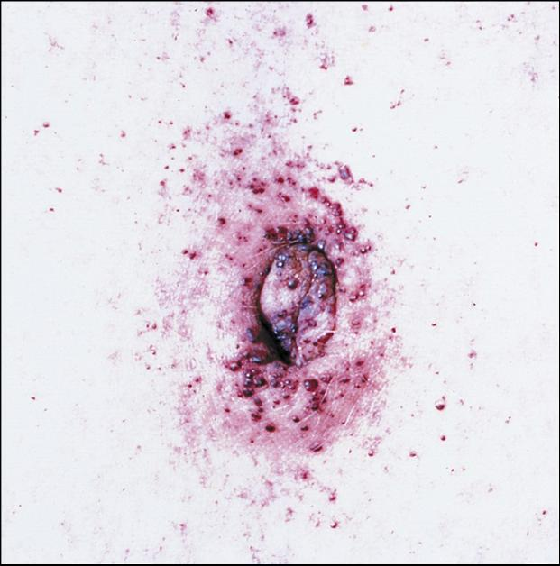
Symptoms of “Classic” Fabry Disease Angiokeratomas
Patients with Fabry disease often develop a very specific type of rash that is reddish to red/purple in color. Most often the rash is found in the bathing suit area (between the belly button and the knees – in both the front and the back). These spots are called
Angiokeratomas
Bathing Suit Area
Front
Back
Angiokeratomas

Slide 15


Symptoms of “Classic” Fabry Disease
Hearing
Patients with Classic Fabry disease may experience:
High-frequency hearing loss
Tinnitis (ringing in the ears)
Eye Findings
Many patients with Classic Fabry disease have a distinct starburst pattern in the cornea of the eye called Corneal Whorls,Corneal Verticillata, or Corneal Dystrophy.
An eye doctor can see this during a
slit-lamp examination.
Vision is not affected by the corneal whorls.

Slide 16
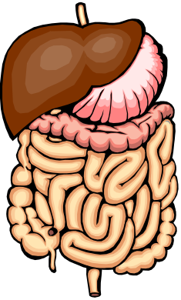
Symptoms of “Classic” Fabry Disease
Gastrointestinal Discomfort
Patients who have Classic Fabry disease often have some of the following symptoms:
  Abdominal Pain
  Cramping, particularly after meals
  Nausea
  Frequent Bowel Movements
  Diarrhea
  Constipation
Chronic Fatigue
Many patients with Classic Fabry disease get tired more easily and more often than other people.

Slide 17




Symptoms of “Classic” Fabry Disease
Life Threatening Organ Damage
With increasing age, the continued accumulation of GL-3 causes the blood vessels to get narrower.
Therefore, blood does not flow as well through vessels as they get narrower.
As a result, serious and life-threatening damage can occur to these organs.
Eventually, these vessels become blocked and parts of organs, such as the kidneys, heart and brain, do not get the nourishment they need to work properly.

Slide 18
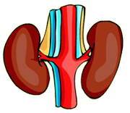
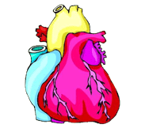
Symptoms of “Classic” Fabry Disease
Life Threatening Organ Damage
Heart Problems
Heart problems can occur as a part of Fabry disease.
Heart problems may include:
Kidney Damage & Kidney Failure
The gradual build-up of GL-3 in the kidneys causes damage and leads to reduced kidney function (impaired filtering of the blood).
There can be an increased amount of protein in the urine.
This is called Proteinuria.
Continued build-up of GL-3 can lead to kidney failure.
Cardiomyopathy (enlarged heart)
Left Ventricular Hypertrophy (LVH)
Hypertrophic Cardiomyopathy (HCM)
Heart Failure
Heart Attack
Arrhythmia (irregular heartbeat)
Valve Problems

Slide 19
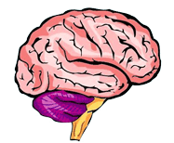
Symptoms of “Classic” Fabry Disease
Life Threatening Organ Damage
Central Nervous System
The Central Nervous System includes
the brain and spinal cord.
Fabry disease can effect the Central Nervous System, particularly the blood vessels in the brain, so patients may experience:
Transient Ischemic Attacks (TIAs)
Strokes

Slide 20
Symptoms of “Classic” Fabry Disease
Emotional Issues
Patients with Fabry disease may become depressed and/or anxious. They may experience denial, hopelessness and feelings of not fitting in. It is normal for a person to feel this way from time to time when their health is affected by a chronic, life-long disease.
It is often helpful to speak to a genetic counselor or psychologist.
A genetic counselor is a health care professional who can explain Fabry disease and how it is inherited. A genetic counselor, psychologist or psychiatrist can also help patients cope with their emotional reactions to having Fabry disease.

Slide 21



Symptoms of “Classic” Fabry Disease
In summary: Affected Males
Childhood
Adolescence
Adulthood
Burning Pain
Angiokeratomas
Decreased Sweating
Heat/Cold Sensitivity
Corneal Whorls
Burning Pain gets worse
Angiokeratomas may get more dense
Decreased Sweating
Heat/Cold Sensitivity
Corneal Whorls
Digestive Problems
Chronic Fatigue
Often less Burning Pain
Angiokeratomas may get more dense
Decreased Sweating
Heat/Cold Sensitivity
Corneal Whorls
Digestive Problems
Chronic Fatigue
Tinnitus & Dizziness
High-Frequency Hearing Loss
Heart disease
Premature Stroke
Kidney Failure
Without Treatment, Early Death

Slide 22

Symptoms of “Classic” Fabry Disease
In summary: Heterozygous Females
Heterozygous females have a less predictable disease course than affected males, with much more variability in symptoms, even within the same family. This variability is due to random X-chromosomal inactivation.
Some heterozygous female have no symptoms.
Some females have symptoms as severe as affected males.
Some are mildly affected and may experience Fabry pain and gastrointestinal problems.
Some heterozygotes don’t develop symptoms until later in life; they can have kidney disease, stroke and/or heart disease.
Usually, heterozygous females have a milder form of the kidney and heart problems than affected males.
Most Classic heterozygotes have corneal findings and some angiokeratomas.
Because of this variability, it is important for a heterozygous female to be followed by a doctor who is familiar with Fabry disease, even if she seems healthy and does not have any symptoms of Fabry disease.

Slide 23
Symptoms in Heterozygous Females
Random X-Chromosome Inactivation
Heterozygous females can be symptomatic or asymptomatic due to a phenomenon called
random X-chromosomal inactivation.
Every human starts as a one cell embryo.
A female will have two X chromosomes in that cell.
One X chromosome is from her mother, and one X chromosome is from her father.
That one cell will then go through a series of divisions.
Maternal X-chromosome
Paternal X-chromosome

Slide 24


Symptoms in Heterozygous Females
Random X-Chromosome Inactivation
An embryo that is female has two X chromosomes. When the female embryo is heterozygous for Fabry disease, one of the X chromosomes has a normal GLA gene while the other X chromosome has a mutated GLA gene.
The first cell divides to make 2 cells…those cells divide again to make 4…then 8, 16, 32…
During this division process
--early in fetal development—
one X chromosome in each cell gets turned off (inactivated) randomly. This process is called random X-chromosomal inactivation.
Cell with normal GLA gene turned off; mutated GLA gene is active
Cell with mutated GLA gene turned off; normal GLA gene is active
The severity of the symptoms of Fabry disease in a heterozygous female depends on how many normal versus mutated GLA genes are left “turned on” (not inactivated) after random X-chromosomal inactivation.
= X chromosome with normal GLA gene
= X chromosome with mutated GLA gene
= Inactive X-chromosome (turned off)

Slide 25
Symptoms in Heterozygous Females
Random X-Chromosome Inactivation
7 : 1
5 : 3
4 : 4
3 : 5
1 : 7
Cell with mutated GLA gene turned off; normal GLA gene is active
Cell with normal GLA gene turned off; mutated GLA gene is active
Less Severely Affected
More Severely Affected
After random X-chromosomal inactivation, if most cells have mutated GLA genes inactivated and, therefore, most cells have normal GLA genes that are active and producing α-Gal A enzyme, then there may be no symptoms or the symptoms may be less severe.
After random X-chromosomal inactivation, if most cells have normal GLA genes inactivated and, therefore, most cells have mutated GLA genes that are active and not producing α-Gal A enzyme, then the symptoms may be more severe.

Slide 26

Symptoms in Heterozygous Females
Random X-Chromosome Inactivation
The overall ratio of cells with normal GLA genes to cells with mutated GLA genes is important and explains why some females are more severely affected than others, even those females with the same GLA gene mutation, including heterozygous females in the same family.
Brain
This ratio also determines how severely each organ will be affected. Different organs can have different ratios of active normal GLA genes to mutated GLA genes. This ratio is determined by which of the original cells go on to form each organ.
Heart
Kidneys
In this example, we would expect the female’s kidneys to be the most severely affected organ and the heart to be the least severely affected organ.
= cell with normal GLA gene
= cell with mutated GLA gene

Slide 27
“Later-Onset” Fabry Disease
Some people have certain mutations in the GLA gene that result in slightly more α-Gal A (“residual enzyme”) than those with Classic Fabry disease.
In other words, they have Fabry disease, but their symptoms appear later in life than patients with “classic” Fabry disease.
These individuals have
“Later-Onset” Fabry disease.
One lesson that has been learned from finding Later-onset mutations is that Fabry disease can present differently due to different mutations.

Slide 28
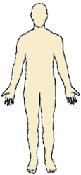
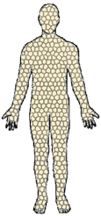
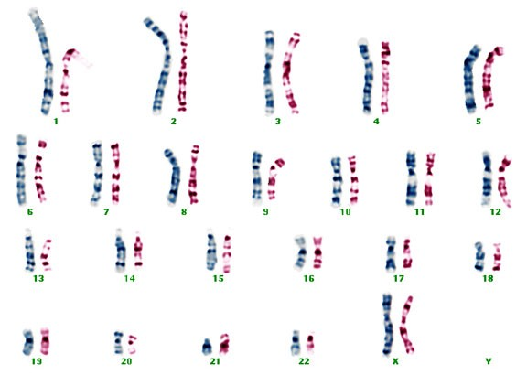

Genetics & Inheritance
To better understand Fabry disease and how it is inherited, it is helpful to understand some basic genetic concepts.
The human body is made up of billions of cells.
Each cell contains 46 chromosomes organized into 23 pairs.
One chromosome in each pair comes from a person’s father.
The other chromosome in each pair comes from a person’s mother.
All chromosome pictures are the property of
Brynn Levy, Ph.D., Mount Sinai School of Medicine

Slide 29
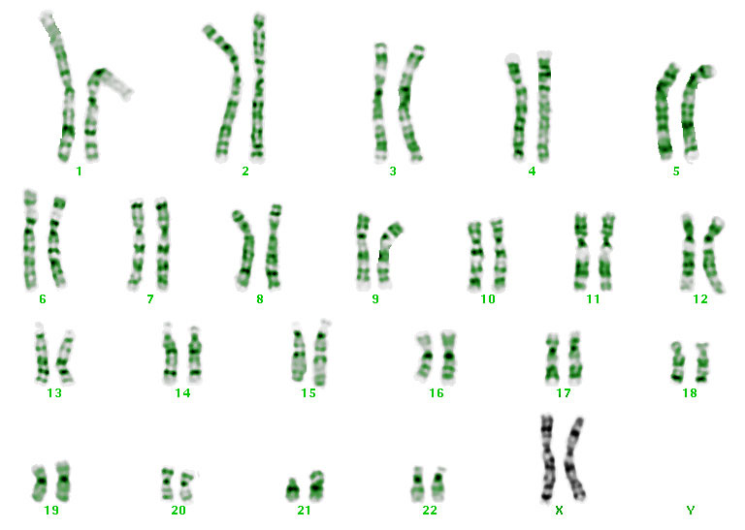
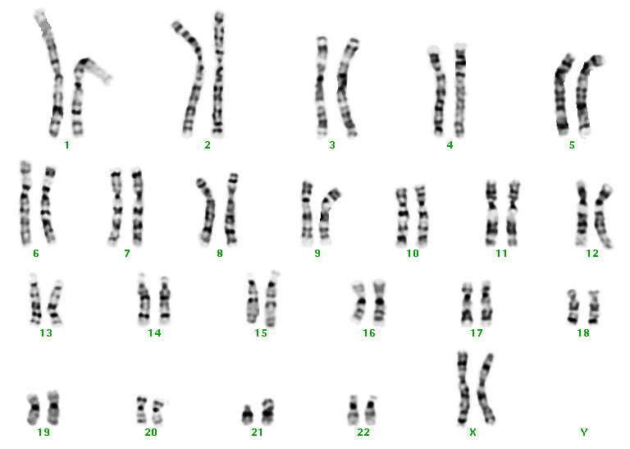
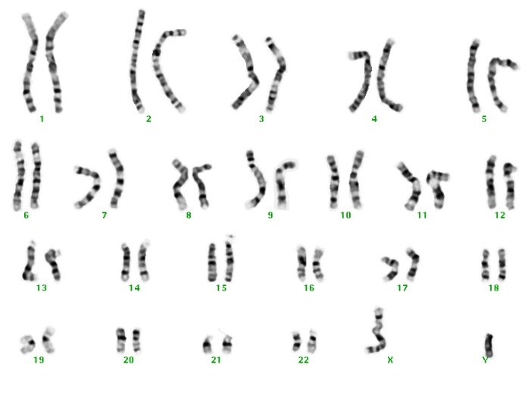
Genetics & Inheritance
FEMALE
The first 22 pairs of chromosomes are called autosomes. These chromosomes determine a person’s physical appearance and tell the body how to function day-to-day.
The 23rd pair of chromosomes are called the
sex chromosomes.
Parts of these chromosomes determine whether an individual will be male or female.
The sex chromosomes also carry additional important information.
MALE
A female has two X chromosomes (XX).
A male has one X chromosome and one Y chromosome (XY).

Slide 30






Genetics & Inheritance
Each chromosome contains the DNA sequence of thousands of genes.
Sex Chromosomes
Since the chromosomes come in pairs, the genes also come in pairs.
X
X
This means that the genes that are found on one chromosome in each pair are the SAME as the genes that are found on the other chromosome in that pair.
The sex chromosomes are an exception.
The genes that are located on the X chromosome are DIFFERENT from most of the genes that are located on the Y chromosome
α-Gal A gene
For example, the α-Gal A gene is on the X chromosome, but is NOT on the Y chromosome.
X
Y

Slide 31
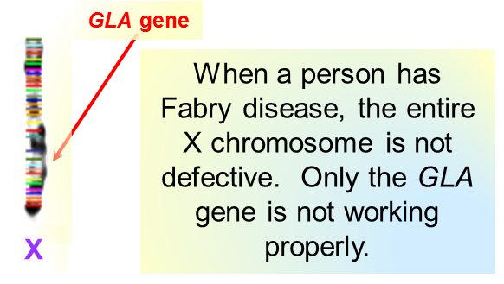
Genetics & Inheritance
Each gene is a set of instructions that tells the cell how to make a specific product, called a protein. Some proteins are enzymes.
These proteins have the job of telling the body how to grow and develop as well as how to do all the things that are necessary for the body to work properly every day.
Any change in one of these genes may interfere with the body’s ability to make one of these necessary proteins.
A gene change is called a mutation.
The gene that is changed when a person has Fabry disease (the GLA gene) is on the X chromosome.

Slide 32
Genetics & Inheritance
The gene responsible for Fabry disease (the GLA gene) is located on the X chromosome. Therefore, Fabry disease follows an X-linked pattern of inheritance.
Male with GLA mutation
Female with GLA mutation
Males have only one X chromosome in each cell.
Females have two X chromosomes in each cell.
Y
X
X
X
GLA gene without mutation
This one still works!
GLA gene with mutation
A male with a mutation in the GLA gene is said to be “affected” because there is no functioning GLA gene.
Since males have only one X chromosome in each cell, they also have only one copy of the GLA gene in each cell.
Since females have two X chromosomes in each cell, they have two copies of the GLA gene in each cell (one on each X chromosome).
A female with a mutation in one of her two GLA genes is called a “heterozygote” because she can still make some α-Gal A by the normal GLA gene on her other X chromosome.
Heterozygotes can be symptomatic or asymptomatic.

Slide 33


Genetics & Inheritance
X-linked Inheritance
XY
XX
XX
XY
XX
XY
For every pregnancy a couple, both the mother and father, will each pass onto each child one of their two sex chromosomes (the X and Y chromosomes). So, there are 4 possible combinations.
The father will pass either his X chromosome or his Y chromosome. With each pregnancy, there is a 50% chance that he will pass his X chromosome and a 50% chance that he will pass his Y chromosome.
The mother will pass one of her X chromosomes. There is a 50% chance with each pregnancy that she will pass one of her X chromosomes and a 50% chance that she will pass her other X chromosome.

Slide 34
Genetics & Inheritance
Inheritance of Fabry Disease
If an affected male has children with an unaffected female…
X* = X chromosome with GLA gene mutation
X = X chromosome with working GLA gene
X* Y
XX
Affected Male
Unaffected Female
X*X
XY
X*X
XY
Female Heterozygote
Unaffected Male
Female Heterozygote
Unaffected Male
For each pregnancy, there is a 50% chance that the affected male will pass his X chromosome with the mutated GLA gene and a 50% chance that he will pass his Y chromosome.
If he passes his X-chromosome, that child will be a female with the GLA gene mutation, and, thereby, will be a female heterozygote.
If he passes the Y chromosome, that child will be a male and will not have Fabry disease because he received his X chromosome with a normal GLA gene from his unaffected mother.
All female children of an affected male will be heterozygous for the Fabry gene and all male children will be unaffected.
In other words, it is impossible for a male with Fabry disease to pass the mutated GLA gene to his sons, but he will pass it to all his daughters.

Slide 35
Genetics & Inheritance
Inheritance of Fabry Disease
If a heterozygous female has children with an unaffected male…
X* = X chromosome with GLA gene mutation
X = X chromosome with normal GLA gene
XY
X*X
Unaffected Male
Female Heterozygote
XX*
X*Y
XX
XY
Female Heterozygote
Affected Male
Unaffected Female
Unaffected Male
With each pregnancy, there is a 50% chance that the female will pass on her X chromosome with the mutated GLA gene and a 50% chance that she will pass on her X chromosome with the normal GLA gene.
There are four possible outcomes with each pregnancy:
25% chance of having an daughter who is a heterozygote.
25% chance of having an affected son.
25% chance of having an unaffected daughter.
25% chance of having an unaffected son.
There is also a 50% chance that her partner will pass on his X chromosome with a normal GLA gene and a 50% chance that he will pass on his Y chromosome.

Slide 36
Inheritance of Fabry Disease
Important Summary Points
When an affected male has children,
ALL of his DAUGHTERS will be heterozygotes and NONE of his SONS will have Fabry disease.
When a heterozygous female has children, she has a 50% chance of passing her mutated GLA gene onto each child. So, with each pregnancy, a female heterozygote has
a 25% chance of having a son with Fabry disease,
a 25% chance of having a daughter who is heterozygous, and a 50% chance of having an unaffected child, male or female.
Past pregnancy outcomes do not affect future pregnancy outcomes. The probability of having an affected son or a heterozygous daughter is the same for each pregnancy.

Slide 37
Inheritance of Fabry Disease
Additional Important Points
The inheritance of Fabry disease is complicated and it is often
helpful to meet with a Medical Geneticist and/or Genetic Counselor.
A Medical Geneticist is a medical doctor with an expertise in the diagnosis and treatment of genetic disorders.
A Genetic Counselor is a health care professional with special training and experience in counseling and medical genetics.
Both provide support and educate families with genetic disorders and individuals who are at risk for inherited conditions.
Both can track the defective GLA gene through the family and help patients to understand who in their family is at risk.
Both help patients understand the chances of passing genetic conditions to their children.
Both can review available testing and treatment options with the family.

Slide 38


Diagnosis of Fabry Disease
There are two types of testing that can be done to determine if a male has Fabry disease or if a female is heterozygous for Fabry disease.
Enzyme Analysis
Enzyme analysis is performed on a blood sample.
The blood sample is assayed to determine the amount of functional α-Gal A.
Males with Fabry disease will have little or no functional α-Gal A activity. Therefore, for males, this is a reliable diagnostic test.
This test is not diagnostic for females because a female can have normal levels of α-Gal A activity and still be heterozygous.
DNA Analysis
DNA analysis can be performed on a sample of blood, saliva, buccal cells, or extracted DNA.
The sample is analyzed to determine the presence or absence of a GLA gene mutation.
Identification of a mutation in a person’s GLA gene confirms the diagnosis of Fabry disease. Therefore, it is considered a diagnostic test for Fabry disease for males and females.
Identification of a specific GLA mutation is important to determine the subtype of a person’s Fabry disease, and, therefore is important to determine prognosis, monitoring, and treatment as well as appropriate genetic counseling.
Once a mutation is identified in a patient, other family members who are at-risk for also having Fabry disease may undergo Targeted Mutation Analysis to determine whether they have the family’s GLA gene mutation.

Slide 39
Treatment for Fabry Disease
Enzyme replacement therapy (ERT) is the primary treatment for Fabry disease. ERT provides a commercially-made source of the normal α-Gal A enzyme.
Prior to the commercial availability ERT, the treatment of FD was non-specific and supportive.
There are two available ERT products: Fabrazyme® made by Genzyme, Inc., Cambridge, MA, and Replegal® made by Shire Human Genetic Therapies, Lexington, MA. Fabrazyme® is approved and commercially available in the US; both drugs are approved and commercially available in Europe and elsewhere in the world.
Additional medications are often useful to manage Fabry pain and gastrointestinal symptoms, as well as heart, kidney, lung, and cerebrovascular complications.
Kidney dialysis and/or transplantation may be needed for treatment of kidney insufficiency.
All affected males and heterozygous females should be followed by a physician who is familiar with Fabry disease (preferably a Fabry Disease Specialist) to monitor their health and provide treatment. They should see this doctor regularly.

Slide 40
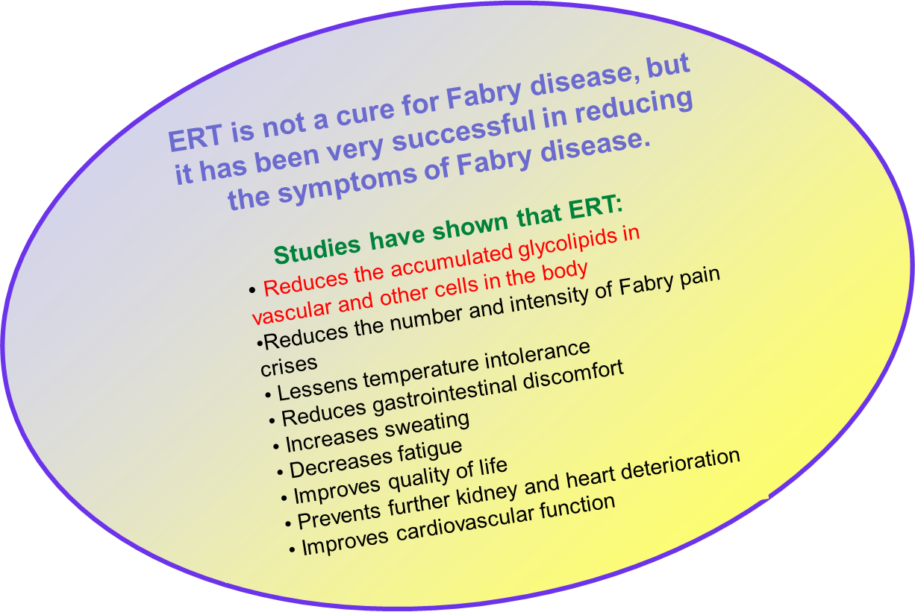
Enzyme Replacement Therapy
Benefits
Additional symptom-specific treatments may also be helpful.

Slide 41
Enzyme Replacement Therapy
General Information
ERT is not a cure for Fabry disease, but it has been very successful in reducing the symptoms of Fabry disease.
Studies have shown that ERT clears GL-3 from the vascular lysosome and cells in various organs.
ERT is not a pill or a shot – it is an intravenous drug (given by intravenous infusion) that must be administered by a health care professional.
An infusion of enzyme is given approximately every two weeks; a single infusion takes 2-4 hours.
It is important that ERT be maintained on a regular 2-week basis to provide optimal benefit.
ERT needs to be given for a patient’s entire life…or until another safe and effective treatment becomes available.
Home infusions may be an option after an appropriate number of initial infusions in a hospital setting to establish the patient-specific regimen and identify possible infusion-related reactions.

Slide 42
Enzyme Replacement Therapy
Initiation of Treatment
Recommendations for Initiation of ERT
A US Fabry Expert Pediatric Panel in 2016 recommended that ERT be started for boys and girls with Classic Fabry disease at the first of symptoms, typically acroparesthesias.
For Classically affected boys without symptoms, ERT should be started at 8-10 years of age.
For adult Classically affected males, ERT should be started as soon as possible after diagnostic confirmation.
For Later-onset patients, ERT should be started at the first sign of renal, cardiac or cerebrovascular disease.
Home infusions may be an option after an appropriate number of initial infusions in a hospital setting to establish the patient-specific regimen and identify possible infusion-related reactions.

Slide 43

Glossary
Acroparesthesia – pain; burning or tingling sensations (usually in the hands and feet)
α-galactosidase A (α-Gal A) – an enzyme that is usually present in the lysosomes in the cells of the body and that is not present in sufficient amounts in individuals with Fabry disease; normally α-Gal A breaks down GL-3 into smaller particles that can leave cells, enter the bloodstream, and eventually be eliminated from the body or reused.
Angiokeratoma – a reddish to red/purple skin rash usually found in the bathing suit area
Anhidrosis – a condition where someone does not sweat at all
Arrhythmia – any disturbance in the rhythm of the heartbeat
Asymptomatic – without obvious signs or symptoms of disease
Autosome - any chromosome not considered as a sex chromosome, or is not involved in sex determination; in humans, there are 44 autosomes, organized in pairs, numbered 1 - 22
Cardiomegaly – enlarged heart
Cardiomyopathy – disease of the heart muscle, such that the heart muscle becomes enlarged, thick, or rigid, sometimes being replaced by scar tissue
Cardiovascular – of or relating to the heart
Chromosome – the hereditary structures on which genes (the smallest unit of inheritance) are located

Slide 44
Glossary (cont’d)
Cornea – the clear covering of the eye
Corneal verticillata ( also called corneal whorls or corneal dystrophy) – characteristic finding in many people with Fabry disease, marked by a star-burst type pattern on the eye’s cornea which does not affect vision, seen by an ophthalmologist or optometrist by slit-lamp eye examination
Dialysis – a treatment that is used for patients with severe kidney disease in which waste products are removed from the blood. The kidneys are responsible for filtering the blood, but when they don’t work properly, a machine can be used to do their job.
DNA – deoxyribonucleic acid, a molecule that carries the genetic instructions used in the growth, development, functioning and reproduction of all known living organisms and many viruses
Enzyme – a protein that aids a biological process (such as digestion or breaking down or building other proteins)
Fabry crisis (also called “pain crisis”) – an episode of intense pain in a person with Fabry disease
Female Heterozygote - a genetic term that describes females who have inherited a disease gene found on the X chromosome. Female heterozygotes may be asymptomatic or may have mild to severe clinical symptoms based on random X-chromosomal inactivation
Gene - a locus (or region) of DNA which is made up of nucleotides, the molecular unit of heredity which act as instructions to make molecules called proteins.
Genetic – of or related to genes or heredity

Slide 45
Glossary (cont’d)
Genetic counselor – a healthcare professional with specialized graduate degrees and experience in the areas of medical genetics and counseling, who provides patients and relatives at risk of an inherited disorder of the consequences and nature of the disorder, the probability of developing or transmitting it, and the options open to them in management and family planning.
GLA (galactosidase alpha) gene – the gene that provides instructions for making the enzyme called alpha-galactosidase A
Globotriaosylceramide (GL-3, Gb3) – a type of lipid (sugary fat) that builds-up in the lysosomes of the cells of a person with Fabry disease
Heterozygous – having one normal copy and one defective copy of a particular gene
Hypertrophic cardiomyopathy (HCM) - a disease in which a portion of the myocardium (heart muscle) is enlarged without any obvious cause, creating functional impairment of the heart
Hypohidrosis – sweating less than normal
Left ventricular hypertrophy (LVH) – enlargement and thickening (hypertrophy) of the walls of the heart's main pumping chamber (left ventricle).
Lyso-GL-3 (or Lyso-Gb3) – Globotriaosylsphingosine or deacelated Gb-3, a type of lipid (sugary fat) that builds up in the plasma of a person with Fabry disease
Lysosome – a special structure in each cell that contains enzymes. Each enzyme is responsible for breaking down substances that the body no longer needs to their basic building blocks so that the building blocks can be reused (recycled)
Metabolic – relating to metabolism, the whole range of biochemical processes that occur within living organism

Slide 46
Glossary (cont’d)
Mutation – a change in the genetic material (DNA) that interferes with its function
Proteins – large molecules that perform a vast array of functions within organisms, including making and breaking up other molecules in the body, DNA replication, response to stimuli, and transporting molecules from one location to another
Proteinuria – literally means “protein in the urine”; a sign of reduced kidney function
Random X- chromosomal inactivation - the process by which all X chromosomes in a cell, in excess of one, are turned off on a random basis
Renal – of or relating to the kidneys
Sex chromosome - particular chromosomes that are involved in determining the sex of an organism; in humans, these are the 23rd pair of chromosomes, identified as the X- and Y-chromosomes; males have one X-chromosome and one Y-chromosome, females have 2 X-chromosomes
Stroke – a condition that occurs when the blood supply to part of your brain is interrupted or severely reduced, depriving brain tissue of oxygen and nutrients, and causing brain cells to die.
Tinnitus – ringing in the ears
Transient ischemic attack (TIA) – also known as “mini-stroke”, when blood flow to part of the brain stops for a short period of time, can mimic stroke-like symptoms.
X-linked inheritance - the mode of inheritance when the gene causing the trait or the disorder is located on the X chromosome

Slide 47
If you have suggestions, comments, or would like to use the Fabry Disease Tutorial (in part or in totality) for any purposes, please contact the International Center for Fabry Disease (866-322-7963 or 212-659-6700; fabry.disease@mssm.edu)
Credits
Diana Moglia Tully, MS, CGC Dana Doheny, MS, CGC
Certified Genetic Counselor Certified Genetic Counselor
Formerly, Department of Genetics & Genomic Sciences Department of Genetics & Genomic Sciences
Icahn School of Medicine at Mount Sinai, NY, NY Icahn School of Medicine at Mount Sinai, NY, NY
Robert J. Desnick, PhD, MD
Dean of Genetics & Genomic Medicine
Professor & Chairman Emeritus
Department of Genetics & Genomic Sciences
Icahn School of Medicine at Mount Sinai, NY, NY
Brian Tully Sherry Boyar, MS, CGC
Formerly, President, New York Networking & Design, NY, NY Certified Genetic Counselor
Department of Genetics & Genomic Sciences
Icahn School of Medicine at Mount Sinai NY, NY

