Slide 1
Introduction to Time Series Analysis

Slide 2

Cross-Sectional and Time Series Data
Cross-sectional data contains values of a characteristic of many subjects at the same point or approximately the same point in time.
Time Series data contain values of a characteristic of a subject over time.

Slide 3
Cross-section or Time Series?
no. | Fund Type | Net Asset Value ($) | 5-Year Average Return (%) | Expense Ratio (%) | Morning Star Rank
1 | IE | 14.37 | 30.52 | 1.41 | 3-star
2 | FI | 10.73 | 3.33 | 0.49 | 4-star
3 | DE | 24.95 | 10.88 | 0.98 | 3-star
4 | DE | 16.92 | 15.67 | 1.18 | 2-star
5 | DE | 35.73 | 15.85 | 1.2 | 4-star
…
25 | DE | 35.41 | 13.98 | 1.19 | 4-star
Notes:
Cross sectional data

Slide 4
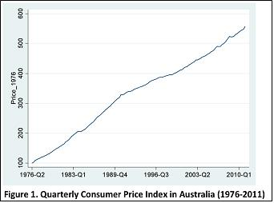
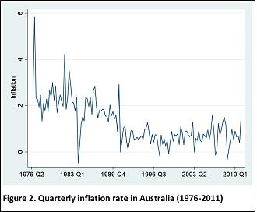
Cross-section or Time Series?
Reference: Significance Magazine
(Predicting inflation rates: part one. Author: Eoin O'Connell.)
Notes:
Time series

Slide 5
Time Series analysis and Forecasting
A forecast is a prediction of some future event or events.

Slide 6
Forecasting problems occur in many fields:
Business and industry
Economics
Finance
Environmental sciences
Social sciences
Political sciences

Slide 7
Forecasting Problems
Short-term
Predicting only a few periods ahead (hours, days, weeks)
Typically based on modeling and extrapolating patterns in the data
Medium-term
One to two years into the future, typically
Long-term
Several years into the future

Slide 8
Most forecasting problems involve a time series:
Figure 1: Time Series plot of the market yield on U.S Treasury Securities at 10-year constant maturity.
(Source: U.S. Treasury, Introduction to Time Series Analysis and Forecasting 2E, 2015 MJK)
Notes:
For time series data, the data is collected at equally spaced time periods.
Y₁ y₂ y₃ the space between them should the qual.

Slide 9
Many business applications of forecasting utilize daily, weekly, monthly, quarterly, or annual data, but any reporting interval may be used.
The data may be instantaneous, such as the viscosity of a chemical product at the point in time where it is measured; it may be cumulative, such as the total sales of a product during the month; or it may be a statistic that in some way reflects the activity of the variable during the time period, such as the daily closing price of a specific stock on the New York Stock Exchange.

Slide 10
What to forecast?
Product sales
Demand for services
Returns from investment
GDP
Population growth
Unemployment rate
Interest rate
Inflation
Job growth
Consumption
Population
Time spent at the service line
Number of people at the store
Weather
etc.

Slide 11
Two broad types of methods:
Quantitative forecasting methods
Makes formal use of historical data
A mathematical/statistical model
Past patterns are modeled and projected into the future
Qualitative forecasting methods
Subjective
Little available data (new product introduction)
Expert opinion often used

Slide 12
Quantitative Forecasting Methods
Regression methods
Smoothing methods
Formal time series analysis methods
Notes:
A.
Regression model: y=beta₀+beta₁x+error term
Normal distribution:
1.error is normally disributed
2. Error term are independent-----s
3. VaR(error term) is constant=cigama2=s2=MSE
4. E(error term)=0
For cross sectional data, You never test 2, but for time series data, you can not ignore 2, need to test and understand why is independent.
B. Smoothing methods:

Slide 13
Examples of time series: Uncorrelated data, constant process model
Figure 2: Pharmaceutical product sales.
Reference: Introduction to Time Series Analysis and Forecasting 2E, 2015 MJK

Slide 14
Autocorrelated data
Figure 3: Chemical process viscosity readings.

Slide 15
Trend
Figure 4: The U.S. annual production of blue and gorgonzola cheeses. (Source: USDA-NASS.)

Slide 16
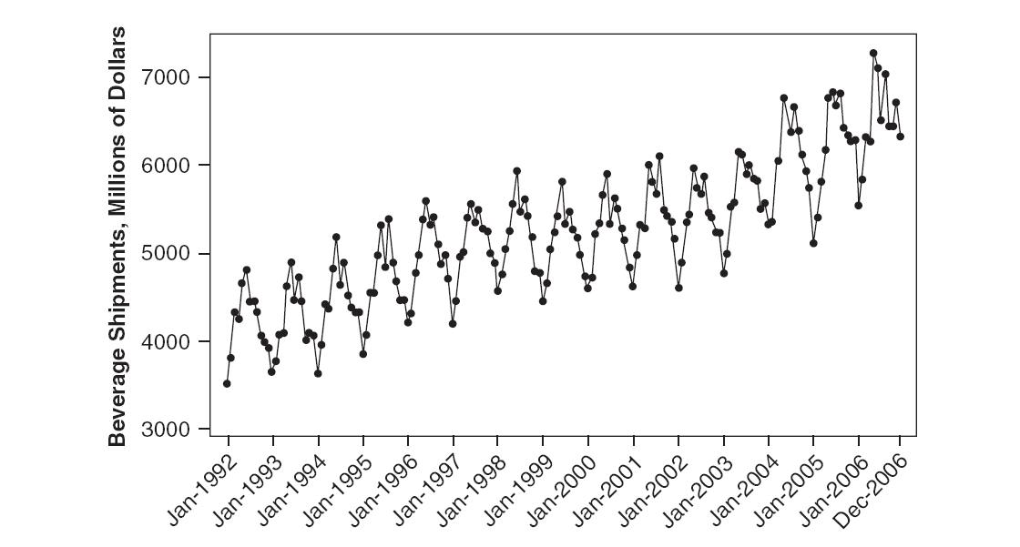
Cyclic or seasonal data
Figure 5: The U.S. beverage manufacturer monthly product shipments (Source: U.S. Census Bureau.)

Slide 17
Nonstationary data
Figure 6: Global mean surface air temperature annual anomaly. (Source: NASA-GISS.)

Slide 18
Figure 7: Whole Foods Market stock price, daily closing adjusted for splits.

Slide 19
A mixture of patterns
Figure 8: Monthly unemployment rate--full-time labor force. (Source: U.S. Department of Labor-BLS.)

Slide 20
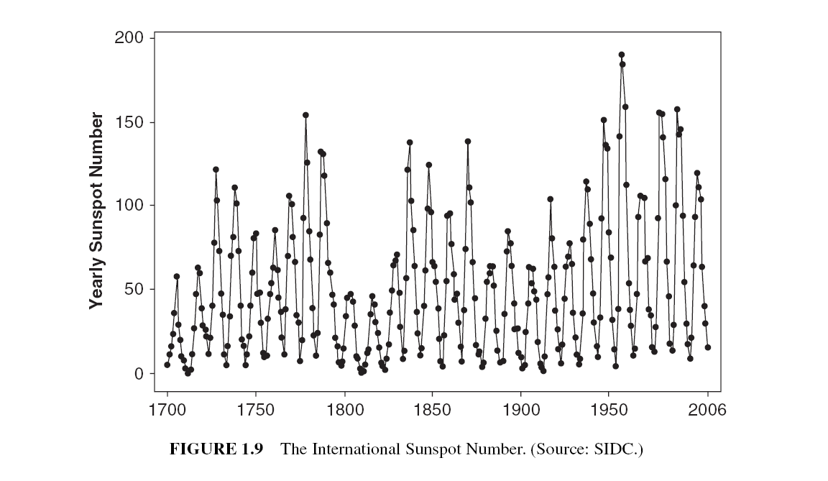
Cyclic patterns of different magnitudes
Figure 9: The international Sunspot Number. (Source: SIDC.)

Slide 21
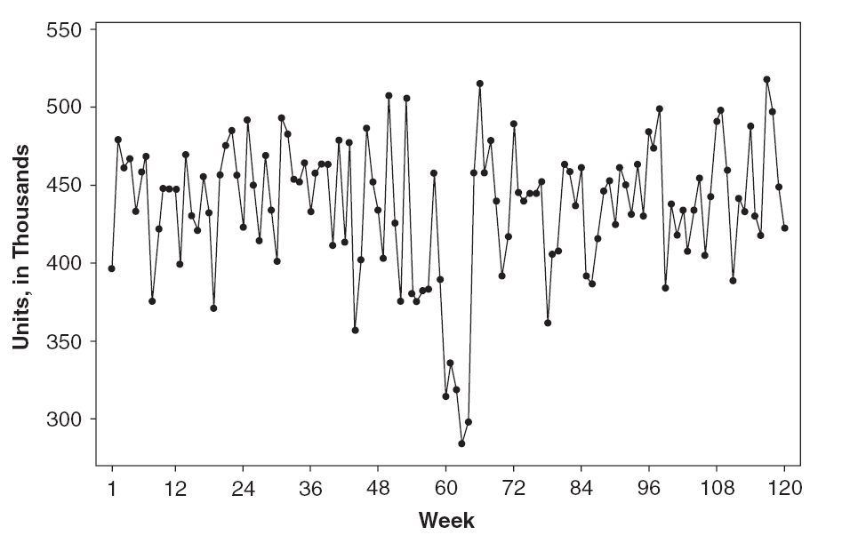
Atypical events
Figure 10: Pharmaceutical product sales.
Figure 11: Chemical process viscosity readings, with sensor malfunction

Slide 22
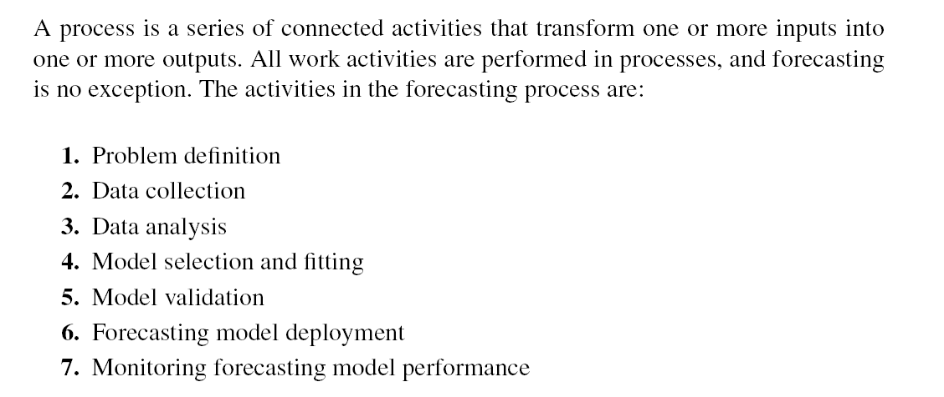
The Forecasting Process
Figure 12: The forecasting process.

Slide 23
Data Quality
Accuracy
Timeliness
Completeness
Representativeness
Consistency

Slide 24
Some useful resources:
Journal of Forecasting
International Journal of Forecasting
Journal of Business Forecasting Methods and Systems
Journal of Business and Economics Statistics
Management Science
Naval Research Logistics
Operations Research
International Journal of Production Research
Journal of Applied Statistics

Slide 25
Software
R
Minitab
SAS
JMP
Matlab
S-Plus

