Slide 1

Time Series Data

Slide 2
Time Series Data
Example: The number of international passenger bookings (in thousands) per month on an airline (Pan Am) in the United States from 1949 – 1960.
The company used the data to predict future demand before ordering new aircraft and training aircrew.
The data (AirPassengers) are available as time series in R.

Slide 3
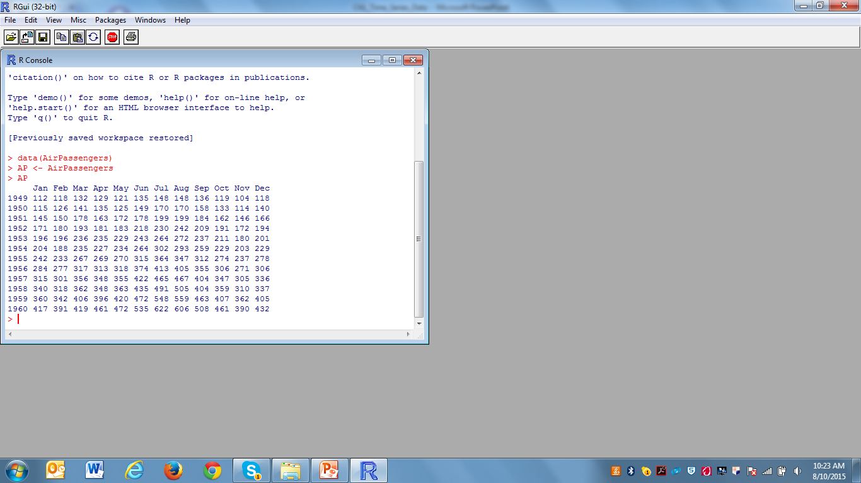
Time Series Data
#Open and read the data AirPassengers in R
#Assign the data to a variable AP

Slide 4
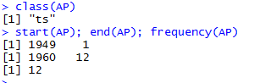
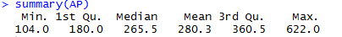

Slide 5
# Check what class of object AP

Slide 6
ts = ‘time seires’

Slide 7
#The command start(seriesname) returns the date of the first observation in the series.
#The command end(seriesname) returns the date of the last observation in the series.
#The command frequency(seriesname) returns the frequency of observation (e.g. 12 for monthly, 4 for quarterly etc) in the series.

Slide 8
# Check what class of object AP
ts = ‘time seires’
#The command start(seriesname) returns the date of the first observation in the series.
#The command end(seriesname) returns the date of the last observation in the series.
#The command frequency(seriesname) returns the frequency of observation (e.g. 12 for monthly, 4 for quarterly etc) in the series.

Slide 9
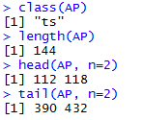
??? How about commands length, head and tail?

Slide 10
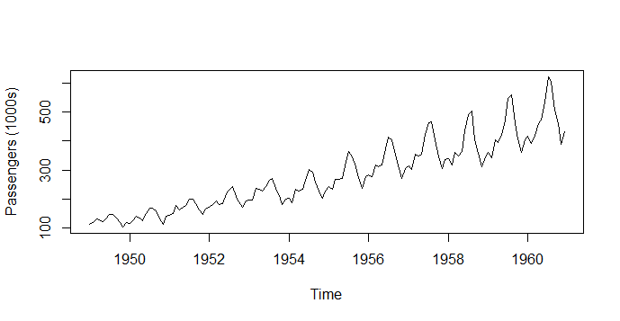
Time Series Plot
> plot(AP, ylab = "Passengers (1000s)")
#The command plot(seriesname) plots the series observations against time.

Slide 11
Time Series Plot
> plot(AP, ylab = "Passengers (1000s)")
#The command plot(seriesname) plots the series observations against time.
Question: What pattern you observe from this plot?

Slide 12
Aggregate the data
To get a clearer view of the trend, the seasonal effect can be removed by aggregating the data to the ________ level.
This can be achieved by using function aggregate in R.

Slide 13
Aggregate the data
To get a clearer view of the trend, the seasonal effect can be removed by aggregating the data to the annual level.
This can be achieved by using function aggregate in R.

Slide 14
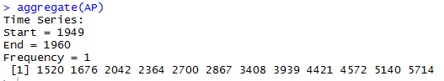
Aggregate the data
# The command aggregate(seriesname) sums the observations in each period (e.g. annual sums for monthly or quarterly data) of seriesname.

Slide 15
Boxplot
A summary of the values for each season can be viewed using a boxplot, with a cycle function being used to extract the seasons for each item of data.

Slide 16
Plots
The command cycle(seriesname) can be used to extract values at common time points across the time of the series (e.g. all January values in a monthly series).
The command plot(seriesname) plots the series observations against time.
The command boxplot(seriesname) creates a box plot from the observations of the series

Slide 17
> layout(1:2)
> plot(aggregate(AP))
> boxplot(AP ~ cycle(AP))
The command layout(1:x) divides the graphics window into x panes.
Plot aggregated (annual) data.
Create a box plot with summarized data for each month.

Slide 18
# The command window(seriesname, start=, end= ) can be used to extract the portion of the series between the start time and the end time defined by the user.
> AP4952=window(AP, start=c(1949,1), end=c(1952,12))
> AP5860=window(AP, start=c(1958,1), end=c(1960,12))
> layout(1:2)
> boxplot(AP4952~cycle(AP4952))
> boxplot(AP5860~cycle(AP5860))

Slide 19
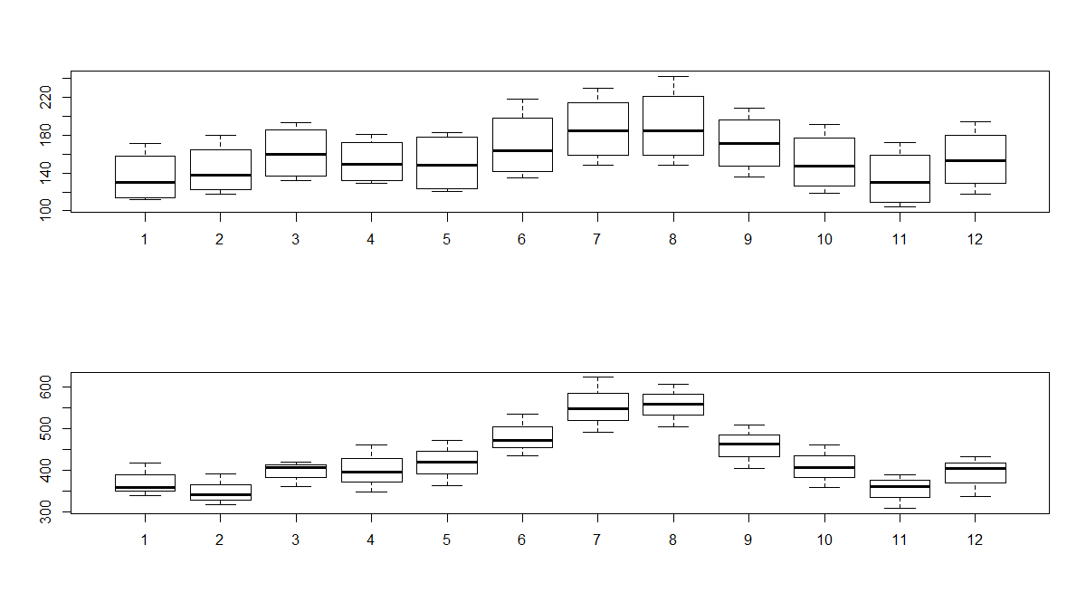
Note: This is to compare seasonal fluctuation in early years versus later years.
Notes:
1/24/2018

Slide 20
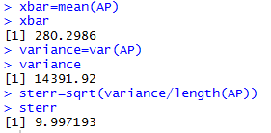
Descriptive statistics
# The command mean(seriesname) returns the average of the observation in the series.
# The command var(seriesname) returns the variance of the observations in the series.

Slide 21
Example: Maine unemployment
The monthly unemployment rate of the US state of Maine from January 1996 until August 2006.
Note: The first row in the file contains the name of the variable (unemploy),
which can be accessed directly once the attach command is given.
Note: Also, the header parameter must be set to TRUE so that R treats the first row as the variable name rather than data.
unemploy
6.700000000e+000
6.700000000e+000
6.400000000e+000
5.900000000e+000
5.200000000e+000
4.800000000e+000
4.800000000e+000
4.000000000e+000
4.200000000e+000
4.400000000e+000
5.000000000e+000
5.000000000e+000
6.400000000e+000
…
3.900000000e+000

Slide 22
According to the book, we can access the data using the command below.
www <- "http://staff.elena.aut.ac.nz/Paul-Cowpertwait/ts/Maine.dat"
Maine.month <- read.table(www, header = TRUE)
attach(Maine.month)
However, the data is no longer available from the suggested site.
We use the command below instead.
Maine.month <- read.table("C:/MA_TS/R/Maine.dat", header = TRUE)
attach(Maine.month)
#The command read. table(…) is to read data into a data frame.
Notes:
Header=True the first line is the header of the data, rather than the data.

Slide 23
> class(Maine.month)
[1] "data.frame”
Note: The “class” is not time series but data.frame. The ts function is used to convert the data to a time series object. The following command creates a time series object.
> Maine.month.ts <- ts(unemploy, start = c(1996,1), freq =12)
Note: We can specify an earlier end date using the parameter end.
The following command is to find a mean annual rate.
> Maine.annual.ts <- aggregate(Maine.month.ts)/12
Notes:
Maine.month.ts <- ts(unemploy, start = c(1996,1), freq =12) frequency means the monthly data? (Quartely data, freq=4)
If the data start from Feb, it suppose to be “start = c(1996,2)” freq still be 12
TO END------ end=c(2005,12),
Maine.annual.ts <- aggregate(Maine.month.ts)/12
Aggregate=Sum up

Slide 24
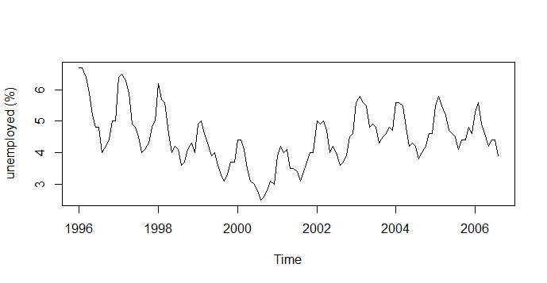
> plot(Maine.month.ts, ylab = "unemployed (%)")
Note: It seems that the February figure is typically about 20% more than
the annual average, whereas the August figure tends to be roughly 20% less.

Slide 25
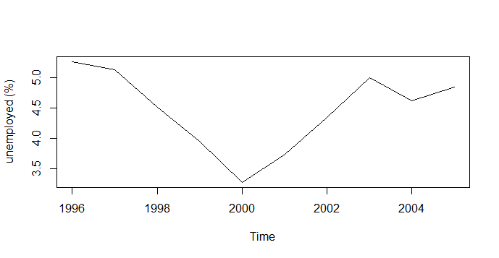
> plot(Maine.annual.ts, ylab = "unemployed (%)")
Notes:
Because of annual, we dont have 2006

Slide 26
Calculating Ratios
Function “window” will extract that part of the time series between specified start
Start and end points and will sample with an interval equal to frequency if its argument
Is set to TRUE.
> Maine.Feb <-window(Maine.month.ts, start = c(1996,2), freq = TRUE)
> Maine.Aug <-window(Maine.month.ts, start = c(1996,8), freq = TRUE)
> Feb.ratio <- mean(Maine.Feb)/mean(Maine.month.ts)
> Aug.ratio <- mean(Maine.Aug)/mean(Maine.month.ts)
> Feb.ratio
[1] 1.222529
> Aug.ratio
[1] 0.8163732
On average, unemployment rate is 22% higher in February and 18% lower in August.

Slide 27
Example 2: Multiple Time Series
The monthly supply of electricity (million of kWh), beer (MI), and
chocolate-based production (tonnes) in Australia over the period
January 1958 to December 1990.
> CBE <- read.table("C:/MA_TS/R/cbe.dat", header = T)
> CBE[1:4, ]
choc beer elec
1 1451 96.3 1497
2 2037 84.4 1463
3 2477 91.2 1648
4 2785 81.9 1595
class(CBE)
[1] "data.frame”
Notes:
header = T(true) because the first row is header.
> CBE[1:4, ] ------- to see the first 4 rows-----> CBE[row:column, ] leave it blank means would like to see it all. Here we would like to see all the columns.

Slide 28
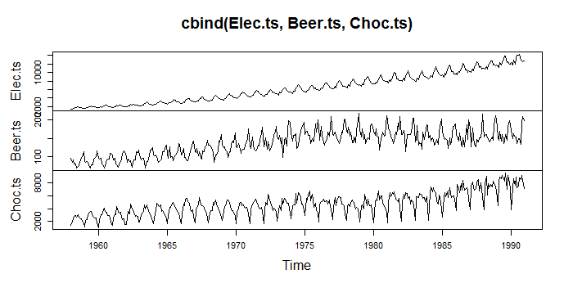
Now create time series objects for the electricity, beer and chocolate data.
If you omit end, R uses the full length of the vector, and if you omit the month in start,
R assumes 1. You can use plot with cbind to plot several series on one figure.
> Elec.ts <- ts(CBE[, 3], start = 1958, freq =12)
> Beer.ts <- ts(CBE[, 2], start = 1958, freq =12)
> Choc.ts <- ts(CBE[, 1], start = 1958, freq =12)
> plot(cbind(Elec.ts, Beer.ts, Choc.ts))
Notes:
ts(CBE[, 3], ---------ts for time series
Cbind------combined all the data into one

