Slide 1

Correlation
Notes:
1/24/2018
ACF/autocorrelation function plot

Slide 2
Expectation and the ensemble
Expected value
Covariance
Sample covariance
Notes:
Covariance, linear relationship between two variables.

Slide 3
Example
Sixteen air samples from Herald square in Manhattan and recorded the carbon monoxide concentration (x, in parts/million) and benzoapyrene concentration (y, in micrograms per thousand cubic metres) for each sample.

Slide 4
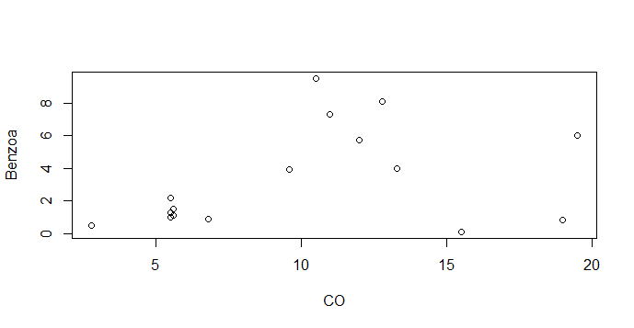
Herald.dat <- read.table("C:/MA_TS/R/Herald.dat", header = T)
attach (Herald.dat)
plot(Herald.dat)
CO Benzoa
2.8 0.5
15.5 0.1
19 0.8
6.8 0.9
5.5 1
5.6 1.1
9.6 3.9
13.3 4
5.5 1.3
12 5.7
5.6 1.5
19.5 6
11 7.3
12.8 8.1
5.5 2.2
10.5 9.5

Slide 5
Covariance in R
> x <- CO; y <- Benzoa; n <- length(x)
> sum((x-mean(x))*(y-mean(y)))/(n-1)
[1] 5.511042
> mean((x-mean(x))*(y-mean(y)))
[1] 5.166602
> cov(x,y)
[1] 5.511042

Slide 6
Correlation
Correlation
Sample correlation
Notes:
Sample correlation = r
Population correlation=Gamma.

Slide 7
Correlation in R
> cov(x,y)/(sd(x)*sd(y))
[1] 0.3550973
> cor(x,y)
[1] 0.3550973

Slide 8
The ensemble and stationary
The mean function of a time series model is
and, in general, is a function of t.

Slide 9
Stationary Time Series
Stationary data
Data is strictly stationary if its properties are not affected by a change in time origin
The joint probability density function does not change if the time interval changes

Slide 10
Stationary data:
Reference: Introduction to Time Series Analysis and Forecasting 2E, 2015 MJK

Slide 11
Second-order stationary
In the study of time series models, a key role is played by the second-order properties, which include mean, variance, and serial correlation.
Notes:
3 conditions for second-order stationary time series
u=E(x_{t}); same for all t
VaR(x_{t})=cigama², same for all t. fix variance
Corr/Cov(x_{t},x_{t+K}) depends on k not t

Slide 12
The ensemble and stationary
If the mean function is constant, we say that the time series model is stationary in the mean. The sample estimate of the population mean, μ, is the sample mean

Slide 13
Variance function
The variance function of a time series model that is stationary in the mean is
If we assume the model is stationary in the variance, this constant population variance, σ², can be estimated from the sample variance

Slide 14
Autocorrelation
Consider a time series model that is stationary in the mean and the variance. The variables may be correlated, and the model is second-order stationary if the correlation between variables depends only on the number of time steps separating them.
Note that the number of time steps between the variables is known as the lag.
Notes:
Lag between y_{t} and y_{t+k} is k

Slide 15
Autocorrelation
A correlation of a variable with itself at different times is known as autocorrelation.
Notes:
Correlation with itself

Slide 16
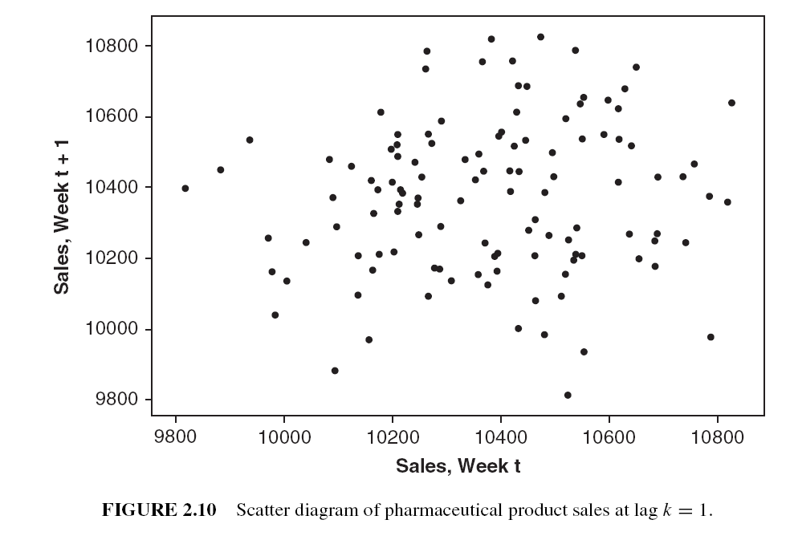
Reference: Introduction to Time Series Analysis and Forecasting 2E, 2015 MJK
Notes:
Lag scatterplot to see the relationship between t and t+1

Slide 17
Reference: Introduction to Time Series Analysis and Forecasting 2E, 2015 MJK
Notes:
Positive relating, strong positive relationship.

Slide 18
Autocorrelation
If a time series model is second-order stationary, we can define an autocovariance function (acvf) at lag k:
The collection of the values of
is called the autocovariance function.
At lag k =0, cigama²=
Notes:
Cov(x_{t},x_{t+1}) =Cov(x_{t+1},x_{t+2}) =Cov(x_{t-1},x_{t}) Lag=1
Gamma_{k} is an autocovariance coefficient

Slide 19
Autocorrelation
The acvf can be estimated from a time series by sample acvf
Notes:
-1<=C_{k}/C₀<=1

Slide 20
Autocorrelation
The autocorrelation coefficient at lag k is
It follows from the definition that
The collection of the values of
is called the autocorrelation function (ACF).
Notes:
Cigama_{x}=cigama_{x+k}
Cigama²=roul so roul₀=1

Slide 21
Properties of ACF
Dimensionless?
Symmetric around zero?
Notes:
Properties of roul(k) will be in the note that posted on bb

Slide 22
Autocorrelation
The lag k autocorrelation function (acf),
is defined by
It follows from the definition that

Slide 23
Autocorrelation
The acf can be estimated from a time series by sample acf
A good rule of thumb is that at least 50 observations are required to give reliable estimate of the ACF, and the individual sample autocorrelations should be calculated up to lag K, where K is about T/4.
Reference: Introduction to Time Series Analysis and Forecasting 2E, 2015 MJK
Notes:
r₀=1

Slide 24
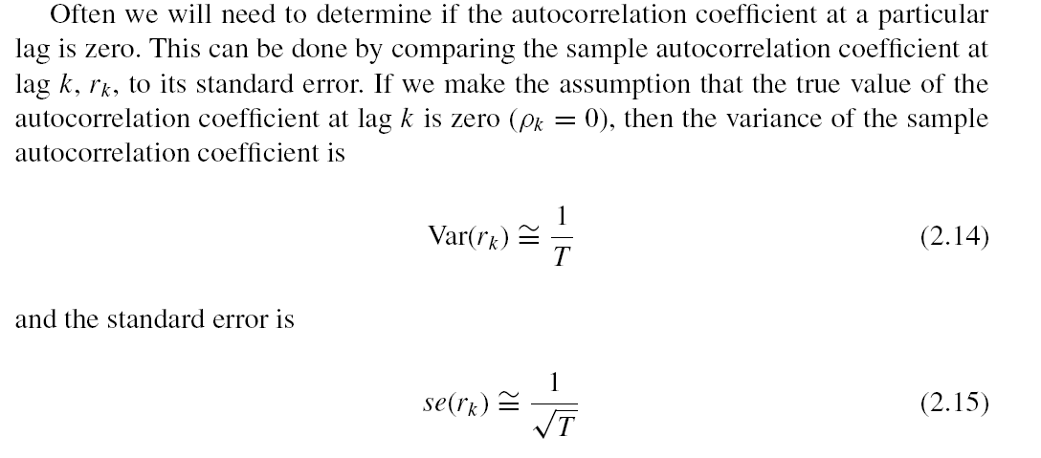
Reference: Introduction to Time Series Analysis and Forecasting 2E, 2015 MJK
Notes:
ACF plot=correlogram

Slide 25
Example: chemical process viscosity data
Time Period | Reading | Time Period | Reading | Time Period | Reading | Time Period | Reading
1 | 86.7418 | 26 | 87.2397 | 51 | 85.5722 | 76 | 84.7052
2 | 85.3195 | 27 | 87.5219 | 52 | 83.7935 | 77 | 83.8168
3 | 84.7355 | 28 | 86.4992 | 53 | 84.3706 | 78 | 82.4171
4 | 85.1113 | 29 | 85.6050 | 54 | 83.3762 | 79 | 83.0420
5 | 85.1487 | 30 | 86.8293 | 55 | 84.9975 | 80 | 83.6993
6 | 84.4775 | 31 | 84.5004 | 56 | 84.3495 | 81 | 82.2033
7 | 84.6827 | 32 | 84.1844 | 57 | 85.3395 | 82 | 82.1413
8 | 84.6757 | 33 | 85.4563 | 58 | 86.0503 | 83 | 81.7961
9 | 86.3169 | 34 | 86.1511 | 59 | 84.8839 | 84 | 82.3241
10 | 88.0006 | 35 | 86.4142 | 60 | 85.4176 | 85 | 81.5316
11 | 86.2597 | 36 | 86.0498 | 61 | 84.2309 | 86 | 81.7280
12 | 85.8286 | 37 | 86.6642 | 62 | 83.5761 | 87 | 82.5375
13 | 83.7500 | 38 | 84.7289 | 63 | 84.1343 | 88 | 82.3877
14 | 84.4628 | 39 | 85.9523 | 64 | 82.6974 | 89 | 82.4159
15 | 84.6476 | 40 | 86.8473 | 65 | 83.5454 | 90 | 82.2102
16 | 84.5751 | 41 | 88.4250 | 66 | 86.4714 | 91 | 82.7673
17 | 82.2473 | 42 | 89.6481 | 67 | 86.2143 | 92 | 83.1234
18 | 83.3774 | 43 | 87.8566 | 68 | 87.0215 | 93 | 83.2203
19 | 83.5385 | 44 | 88.4997 | 69 | 86.6504 | 94 | 84.4510
20 | 85.1620 | 45 | 87.0622 | 70 | 85.7082 | 95 | 84.9145
21 | 83.7881 | 46 | 85.1973 | 71 | 86.1504 | 96 | 85.7609
22 | 84.0421 | 47 | 85.0767 | 72 | 85.8032 | 97 | 85.2302
23 | 84.1023 | 48 | 84.4362 | 73 | 85.6197 | 98 | 86.7312
24 | 84.8495 | 49 | 84.2112 | 74 | 84.2339 | 99 | 87.0048
25 | 87.6416 | 50 | 85.9952 | 75 | 83.5737 | 100 | 85.0572
Reference: Introduction to Time Series Analysis and Forecasting 2E, 2015 MJK

Slide 26
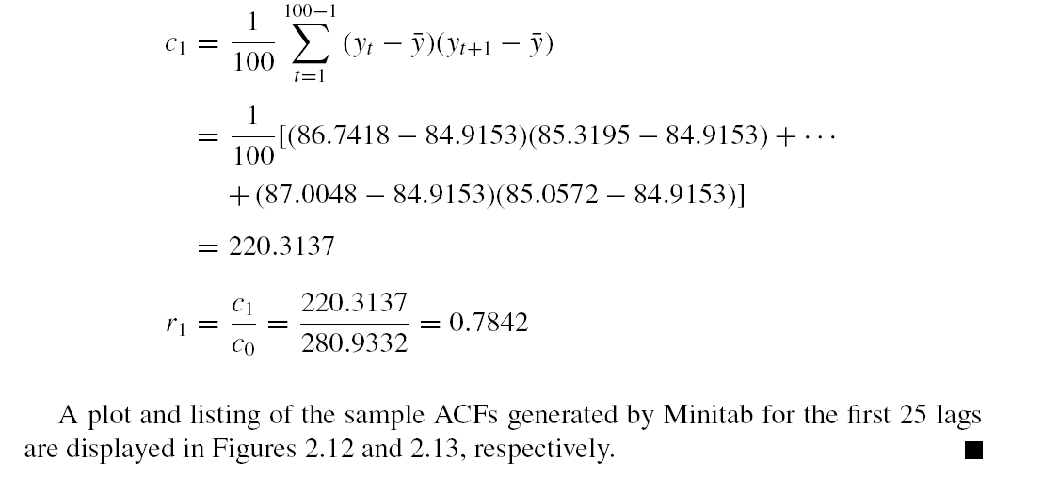
Reference: Introduction to Time Series Analysis and Forecasting 2E, 2015 MJK

Slide 27
Reference: Introduction to Time Series Analysis and Forecasting 2E, 2015 MJK
Notes:
To test which roul_{k} is signifivsnt; k=1, 2, 3, ….

Slide 28
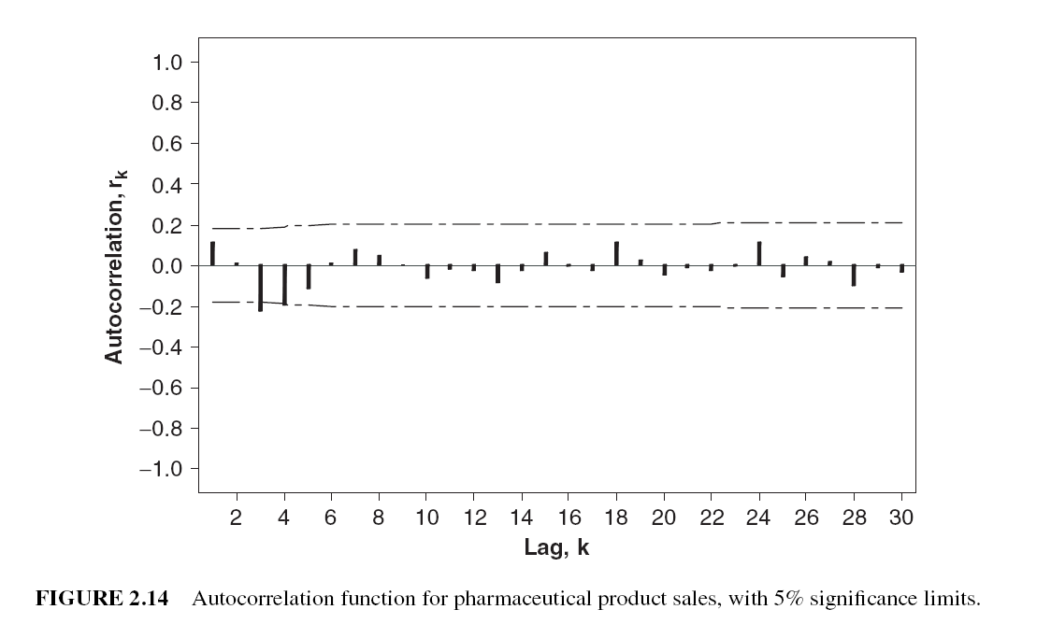
Reference: Introduction to Time Series Analysis and Forecasting 2E, 2015 MJK

Slide 29
Example
A time series of wave heights (mm relative to still water level) measured at the center of a wave tank. There is no trend and no seasonal period, so it is reasonable to suppose that time series is a realization of a stationary process.

Slide 30
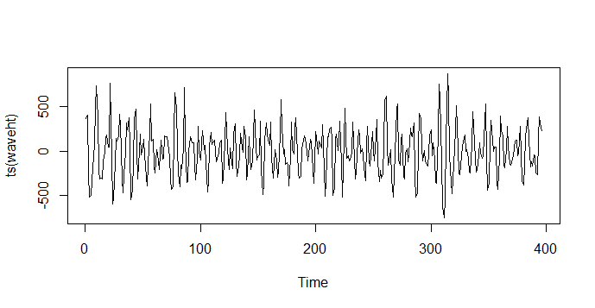
www <- "http://staff.elena.aut.ac.nz/Paul-Cowpertwait/ts/wave.dat"
wave.dat <- read.table(www, header = T)
attach (wave.dat)
plot(ts(waveht))
Figure 1: The entire time series

Slide 31
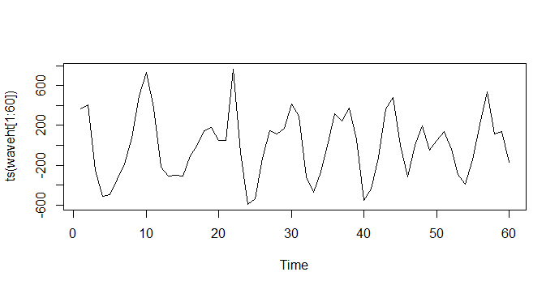
plot(ts(waveht[1:60]))
Figure 2: The first sixty wave heights

Slide 32
Autocorrelation in R
The autocorrelation of x are stores in the vector acf(x)$acf, with the lag k autocorrelation located in acf(x)$acf[k+1]. For example, the lag 1 autocorrelation for waveht is
acf(waveht)$acf[2]
[1] 0.4702564

Slide 33
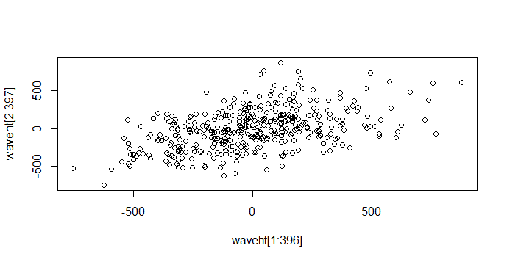
Plot between x_{t} and x_{t+1}
plot(waveht[1:396],waveht[2:397])
Figure 3: Wave height pairs separated by a lag of 1.

Slide 34
Autocovariance in R
acf(waveht, type = c("covariance"))$acf[2]
[1] 33328.39

Slide 35
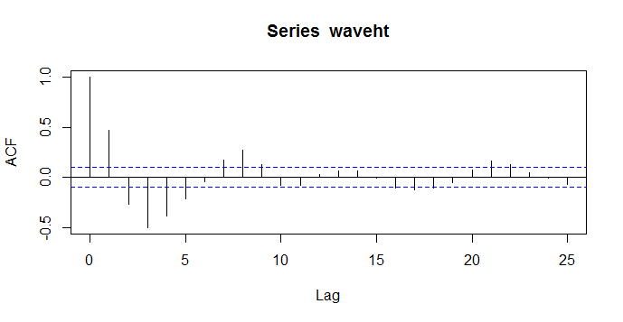
Correlogram
By default, the acf function produces a plot of r_{k} against k, which is called correlogram.
acf(waveht)
Figure 4: Correlogram of wave heights.

Slide 36
Correlogram
The x-axis gives the lag (k) and the y-axis gives the autocorrelation at each lag.
If ρ_{k} = 0, the sampling distribution of is approximately normal, with mean of -1/n, and a variance of 1/n. The dotted lines on the correlogram are drawn at
, and are oftern approximated to
Note: If falls outside these lines, we have evidence against the null hypothesis that ρ_{k} = 0 at the 5% level.
The lag 0 autocorrelation is always 1.

Slide 37
Nonstationary Time Series
Reference: Introduction to Time Series Analysis and Forecasting 2E, 2015 MJK

