Slide 1

SpectrumWiFi测试分享
测试部：Tessie.Hou

Slide 2
01
SpectrumWiFi Architecture
02
SpectrumWiFi Traffic Flows
03
SpectrumWiFi WAG Setup
04
Expansions
05
Demo

Slide 3
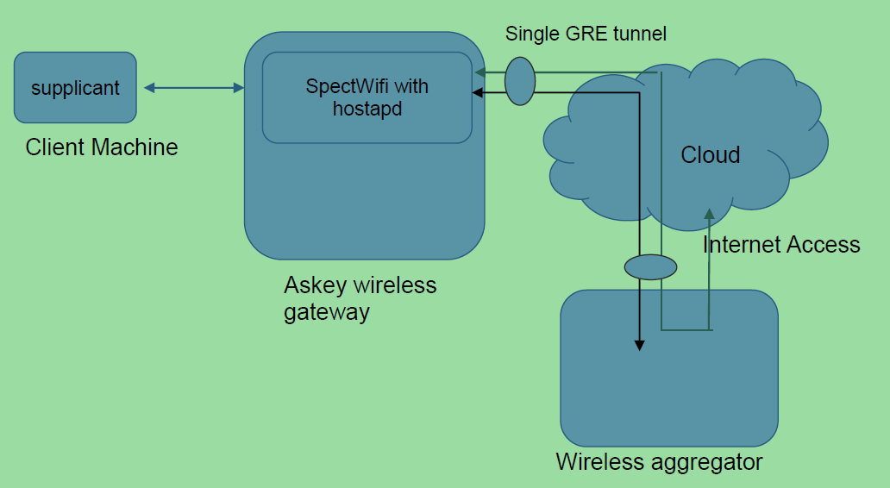
Architecture

Slide 4
Traffic Flows
user authentication process
01
All EAP messages are encapsulated by hostapd in Radius request and sent over the GRE tunnel.
This ensures that even these trusted control packets remain isolated from the home traffic.
ip address acquisition
02
The DHCP packets from clients will be transparently bridge at L2 over GRE tunnel to remote DHCP server running on WAG.
Because of transparent bridging both DHCP clients and server will see each other on the same LAN.
internet access
With respect to spectrumwifi, WAG is also the internet access server. In our design, all data traffic from clients will be transparently bridged over GRE to WAG.
03

Slide 5
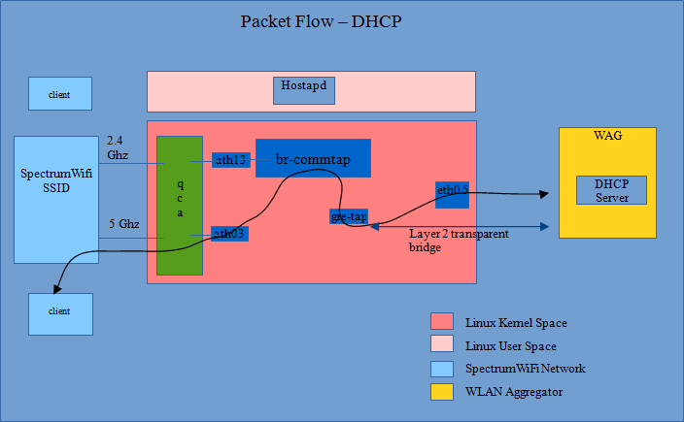
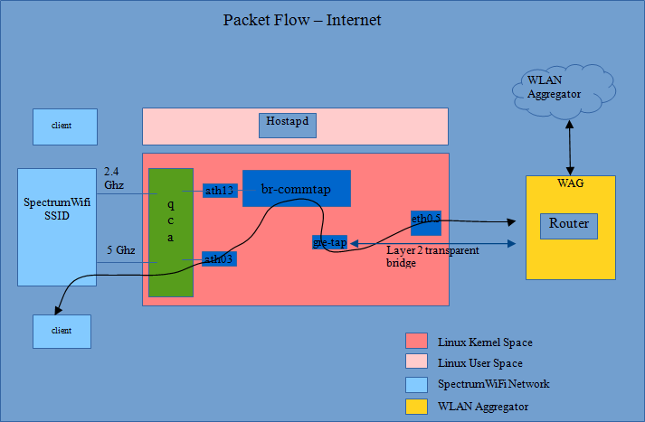
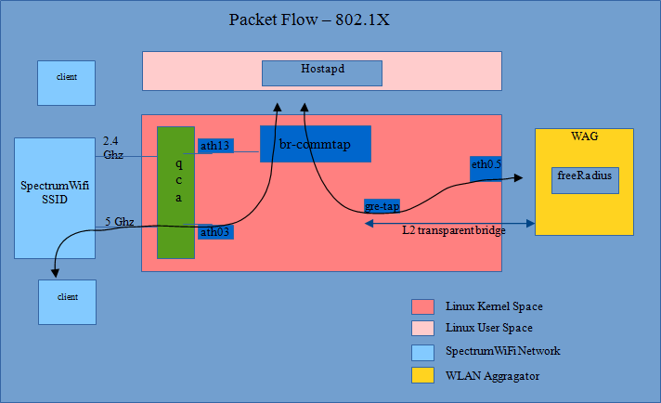
Packet Flow
Notes:
br-commtap
This is a classic linux software bridge which ensure that all the spectrumwifi related traffic is switched at layer 2 and remain sparate from home traffic.
gre-tap
The layer 2 gretap interface which is used to create layer 2 transparent bridging across WAN and WAG.

Slide 6
Interface Components
Interfaces
Commands
l2 bridge (br-tap / br-com)
gre-tap
pip (veth0/veth1)
vlan (veth1.x)
ip link / ip -6 link
ifconfig
brctl
vconfig
brctl (apt install bridge-utils)
vconfig (apt install vlan)

Slide 7
Service Components
Services
Application
AAA
DHCPv4
GRE tunnel
freeradius
isc-dhcp-server
GRE interface
freeradius (apt install freeradius)。
isc-dhcp-server (apt install isc-dhcp-server)。

Slide 8
Interface Configuration
ip link add gretap_secr type gretap local 10.8.6.222 remote 10.8.6.176
ip addr add 10.8.6.222/24 dev ens33
brctl addbr br-tap / brctl addif br-tap gretap_secr / brctl addif br-tap veth0
ip link add veth0 type veth peer name veth1
brctl addbr br-com / brctl addif br-com veth1 / ip addr add 12.0.0.2/24 dev br-com
ifconfig veth0 veth1 ens33 br-tap br-com up / ip link set dev gretap_secr up
ip addr show ens33
ip -6 link add gretap6_secr type ip6gretap local 2001:db1::2 remote 2001:db1::1
ip -6 addr add 2001:db1::2/64 dev ens33
brctl addbr br-tap / brctl addif br-tap gretap_secr / brctl addif br-tap veth0
ip link add veth0 type veth peer name veth1
brctl addbr br-com / brctl addif br-com veth1 / ip addr add 12.0.0.2/24 dev br-com
ifconfig veth0 veth1 ens33 br-tap br-com up / ip -6 link set dev gretap6_secr up
ip addr show ens33

Slide 9
Service Configuration
freeradius的配置：
添加关联密钥
vim /etc/freeradius/clients.conf
...
client 10.8.6.0/24 {
secret = secret123
shortname = spectrumwifi
}
添加用户密码
vim /etc/freeradius/users
...
“test" Cleartext-Password := “test"
Reply-Message = "Hello, %{User-Name}“
...
isc-dhcp-server的配置：
绑定监听接口
vim /etc/default/isc-dhcp-server
...
INTERFACES = “br-com”
添加分配网段
vim /etc/dhcp/dhcpd.conf
...
subnet 12.0.0.0 netmask 255.255.255.0 {
range 12.0.0.10 12.0.0.120;
option broadcast-address 12.0.0.255;
option routers 12.0.0.2;
}
...
创建日志文件
touch /var/lib/dhcp/dhcpd.leases

Slide 10
NAT configuration
echo 1 > /proc/sys/net/ipv4/ip_forward
vim /etc/sysctrl.conf
net.ipv4.ip_forward=1
net.ipv6.conf.all.forwarding=1
iptables -A FORWARD -i br-com -o ens33 -j ACCEPT
iptables -A FORWARD -i ens33 -o br-com -m state --state ESTABLISHED,RELATED -j ACCEPT
iptables -t nat -A POSTROUTING -o ens33 -j MASQUERADE

Slide 11
拓展延伸
SSID VLAN && Uplink VLAN
01
02
GRE Keepalive
Support Domain
06
03
DHCP Relay
Band Steering && Fast Roaming
DSCP Marking && ATF
05
04
注：del GRE over IPSec
Notes:
IPv6 LDRA (IPv6 DHCPv6 relay agent)

Slide 12
THANK YOU !
感谢聆听

