Slide 1
CS6650 Midterm Project Shopping Microservice Under Load

Slide 2
Architecture
Gateway (FastAPI) – single entrypoint with /buy
Inventory (FastAPI, in-memory) – total of 600 products; supports GET /products, and the order flow: POST/ reserve → POST/ commit / POST /release
Payment (FastAPI) – intentionally slow to create stress (random multi-second delays, occasional 500s)
Modes:
BROKEN: arrive rate > payment capacity
FAILFAST: Gateway caps the queue (MAX_QUEUE = 150) and returns 503 immediately when full
GET Inventory /products/{id}
Check price
Gateway /buy
Client
POST Inventory /reserve
Hold stock
POST Payment /pay
Slow !!
POST Inventory /commit
Commit or release on failure

Slide 3
Broken Mode
The gateway accepts requests even when it’s already saturated (no queue cap)
Long timeouts: gateway waits up to 60s on payment
Slow dependency: payment randomly sleeps several seconds and sometimes 500s
Mechanism of failure
Incoming rate exceeds payment capacity
Unbounded queue: calls to payment pile up in the gateway, new arrivals keep joining the queue
Many requests hit the long timeouts, then fail together

Slide 4
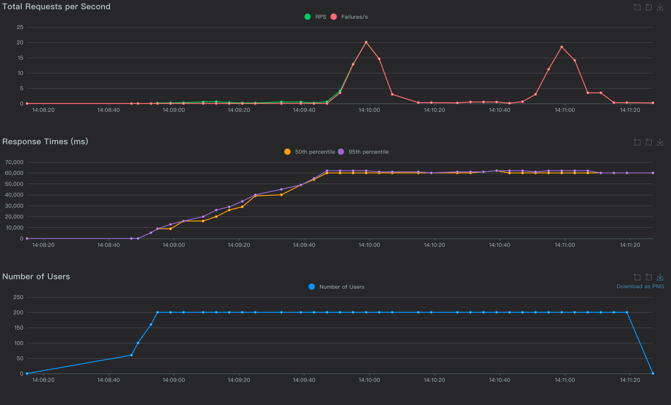
p50/p95 ramp to 60s → queue saturation + timeout
Failures: two big spikes while RPS stays low → gateway is busy waiting, then errors burst when timeout hit
200 Users, ramp at rate 20

Slide 5
Fix: Fail-Fast
Bound the pending queue at the gateway with MAX_QUEUE (e.g., 150)
When full → return HTTP 503 immediately (don’t enqueue)
Keep short downstream timeouts (2–5s) and release inventory on failure
Trade-off: more fast 503s under overload, but no meltdown

Slide 6
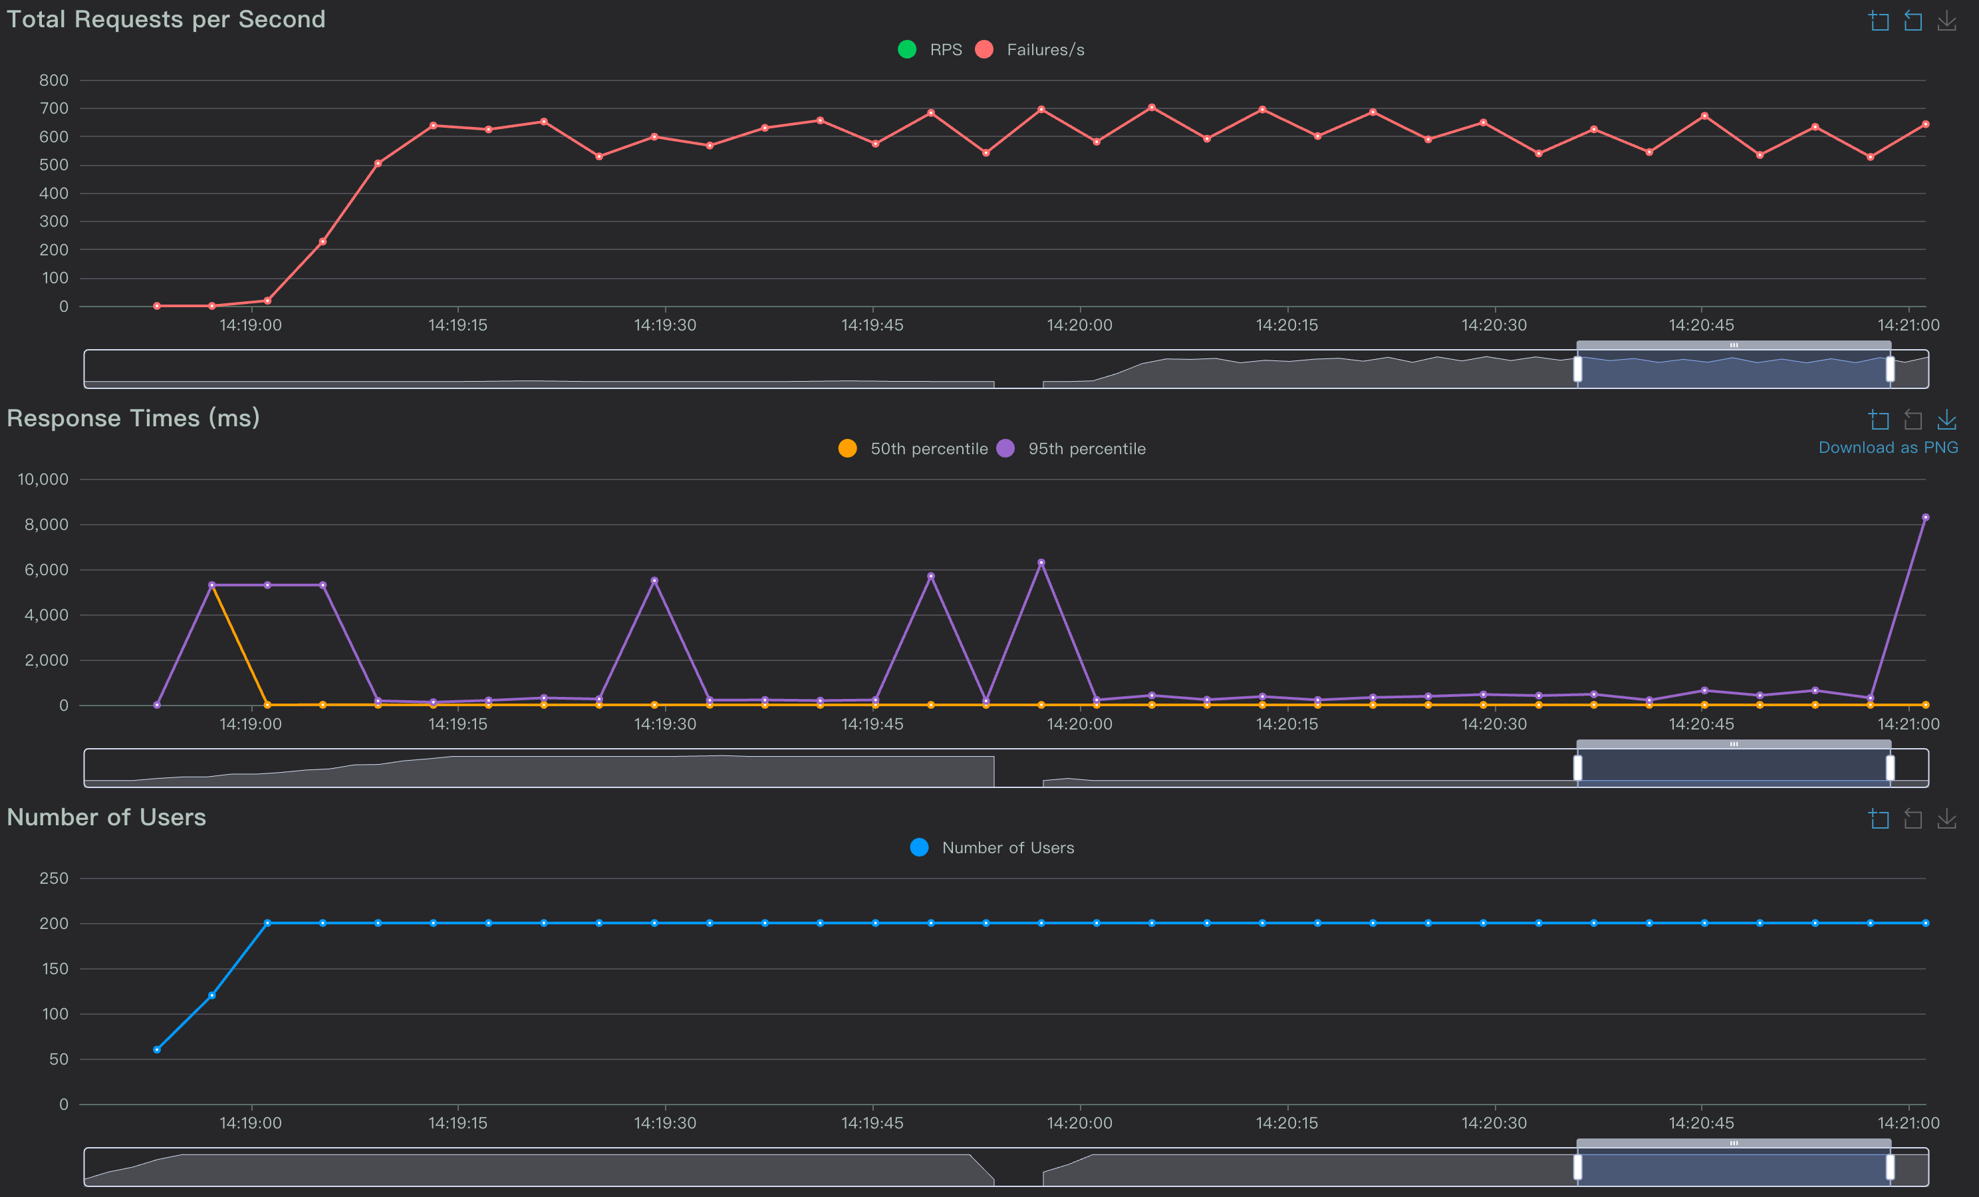
Locust: p50 ≈ 0 ms most of the time (instant 503s), periodic p95 ≈ 5–6 s (payment timeout)
Interpretation: graceful degradation instead of collapse

