Slide 1
Compressing deep neural network
Jackie Wu (Kan Wu)

Slide 2
Catalogue
Motivation
Dataset
Neural Network Architecture
Approach
Results and Analysis
Improvement

Slide 3
Motivation
Reduce the number of parameters in the fully-connected layers
Explore the relation between the classification accuracy and compression rate
Improve the performance in compression

Slide 4
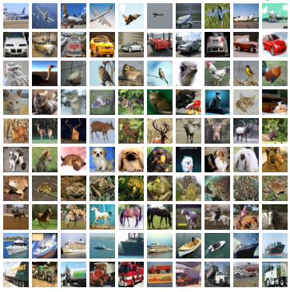
CIFAR-10 dataset
32 x 32 color images
10 classes
In train set:
Number of samples: 50000
5000 images per class
In test set:
Number of samples: 10000
1000 images per class

Slide 5
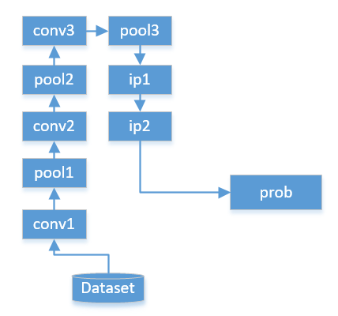
Neural Network Architecture for CIFAR-10
ip: InnerProduct(Full-connected) layer
Conv: Convolutional layer
Pool: Pooling layer
Prob: Probability per class
Full-connected Layer
Layer Name | input | output
ip1 | 1024 | 64
ip2 | 64 | 10
cifar10_quick in caffe

Slide 6
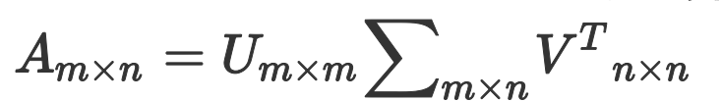


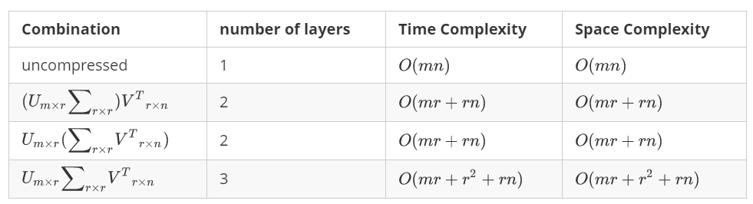
Approach
Decompose the parameter matrix by Singular Value Decomposition (SVD)
Decompose matrix:

Slide 7






Approach
SVD compression has less parameters over uncompressed. when , namely
A full-connected layer:
x
W,b
y
SVD compression:
x
Z,0
U,b
y

Slide 8


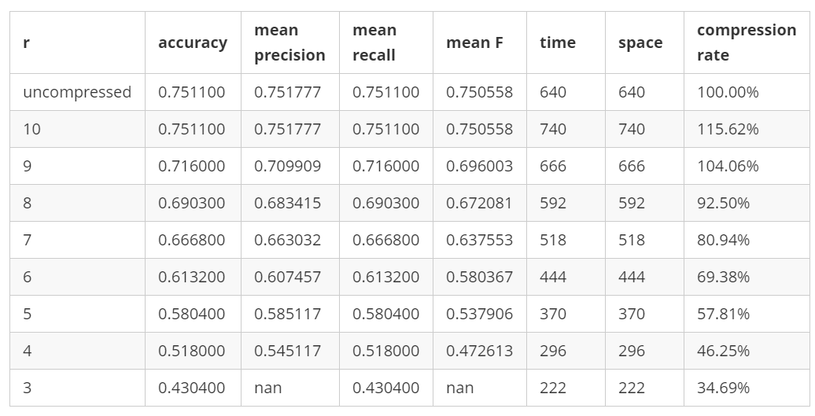
Results and Analysis
Compress ip2 Layer

Slide 9
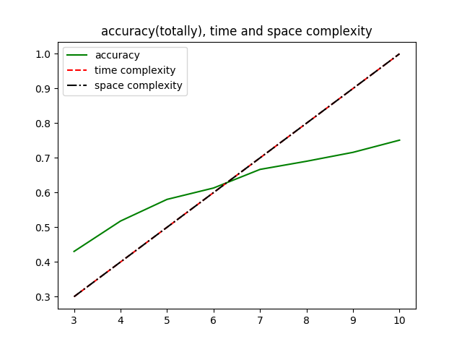
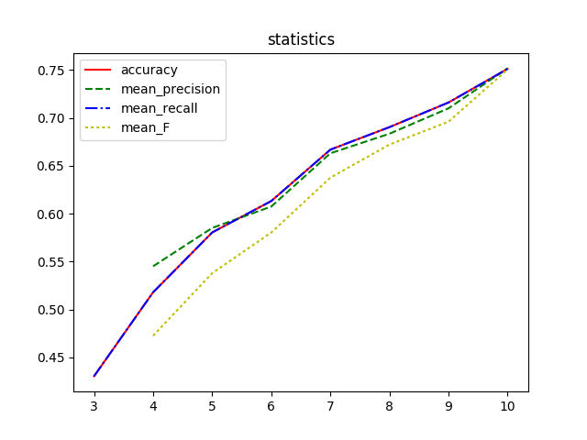
Results and Analysis
Compress ip2 Layer

Slide 10

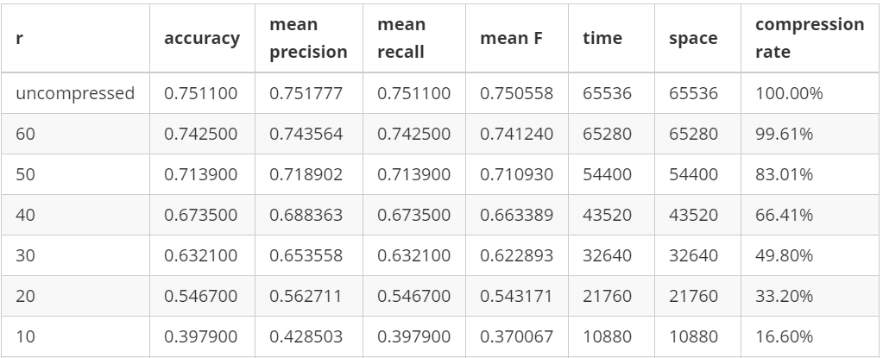
Results and Analysis
Compress ip1 Layer

Slide 11
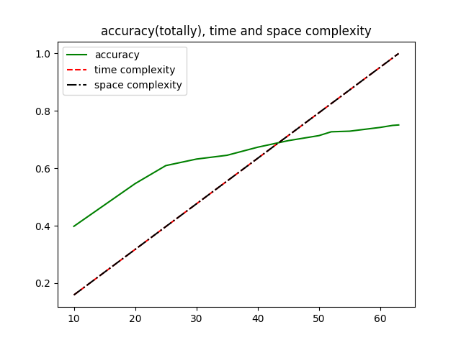
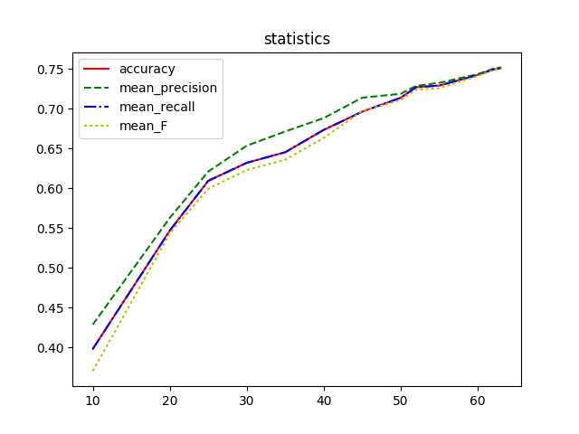
Results and Analysis
Compress ip1 Layer

Slide 12
Results and Analysis
Method | Accuracy | original size | Compression Rate | Space Saving
Compress ip1 | 0.696 | 1024 x 64 | 74.71% | 16574
Compress ip2 | 0.690 | 64 x 10 | 92.50% | 48
Compressing large-scale of full-connected layer
brings a better performance.

Slide 13
Improvement
Adjust zero bias vector
Retraining based current parameters
Compress full-connected layer automatically
Pruning, Quantization and Huffman Coding

Slide 14






Improvement
x
y
Adjust zero bias vector
Z,0
U,b
A full-connected layer:
SVD compression:
For each example:
Overall Error:
Minimize J, so:
However, g is close to zero vector.
This method is unuseful.

Slide 15
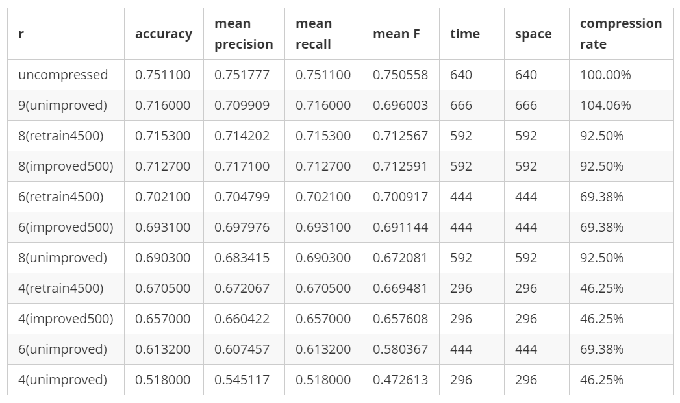
Improvement
Retraining based current parameters

Slide 16



Improvement
Compress full-connected layer automatically
The larger the singular value is,
The more important the singular vector is.
The singular values ordered by descending:
If
i is minimum value meeting that
Then r = i

Slide 17
Improvement
Pruning
Deleting the connection whose weight is less than threshold value.
Quantization
Using K-means method to cluster the weights. When updating the weights of network, update the shared weights.
Huffman Coding
Code the IDs of different clusters using Huffman Code.
Quoting from Song Han, Huizi Mao, William J. Dally. Deep Compression: Compressing Deep Neural Networks with Pruning, Trained Quantization and Huffman Coding. Arxiv, 1510.00149. 2016.

Slide 18
Reference
[1] Zichao Yang,Marcin Moczulski,Misha Denil,Nando de Freitas,Alex Smola,Le Song,Ziyu Wang. Deep Fried Convnets. Arxiv, 1412.7149, 2015
[2] Song Han, Huizi Mao, William J. Dally. Deep Compression: Compressing Deep Neural Networks with Pruning, Trained Quantization and Huffman Coding. Arxiv, 1510.00149. 2016.
[3] LeftNotEasy, 机器学习中的数学(5)-强大的矩阵奇异值分解(SVD)及其应用, http://www.cnblogs.com/LeftNotEasy/archive/2011/01/19/svd-and-applications.html

Slide 19
Thank you ☺

