Slide 1
Compressing deep neural network 2
Jackie Wu (Kan Wu)

Slide 2
Catalogue
Dataset
Neural Network Architecture
Approach
Compression by SVD
Compression by K-means Clustering
Compression by Reduced-Precision
Improvement

Slide 3
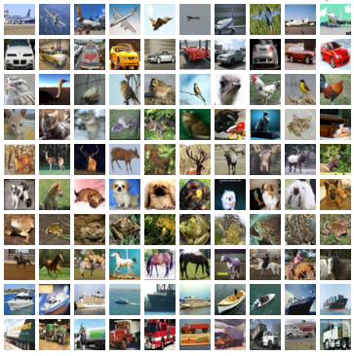
CIFAR-10 dataset
32 x 32 color images
10 classes
In train set:
Number of samples: 50000
5000 images per class
In test set:
Number of samples: 10000
1000 images per class

Slide 4
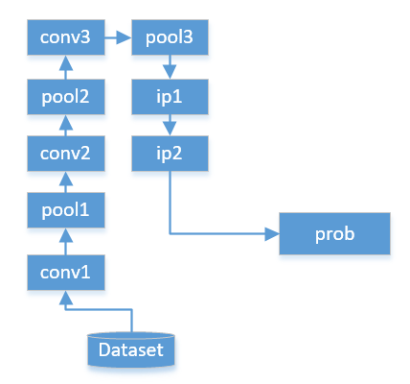
Neural Network Architecture for CIFAR-10
Layer Name | Parameters | Output
data | - | 1x3x32x32
conv1 | 32x3x5x5 | 1x32x32x32
pool1 | - | 1x32x16x16
conv2 | 32x32x5x5 | 1x32x16x16
pool2 | - | 1x32x8x8
conv3 | 64x32x5x5 | 1x64x8x8
pool3 | - | 1x64x4x4
ip1 | 64x1024 | 1x64
ip2 | 10x64 | 1x10
Accuracy:0.7577
ip: InnerProduct(Full-connected) layer
Conv: Convolutional layer
Pool: Pooling layer
Prob: Probability per class
Layer | Number of parameters | Percentage
Convolution | 79200 | 54.5%
InnerProduct | 66176 | 45.5%
cifar10_quick in caffe

Slide 5
Approach
Compression by SVD
Compression by K-means Clustering
Compression by Reduced-Precision
Replacing Convolutional Layer

Slide 6
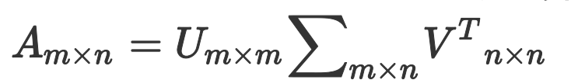





Compression by SVD
Decompose the parameter matrix by Singular Value Decomposition (SVD)
A full-connected layer:
x
W,b
y
SVD compression:
x
Z,0
U,b
y

Slide 7
Compression by SVD
Accuracy Loss
Fine Tuning (Iteration: 20000 times)
Original Accuracy:0.7577
Method | Accuracy | Compressed Size | Original Size | Compression Rate | Space Saving
Compress ip1 | 0.6132 | 64x6+6x1024 | 64x1024 | 9.96% | 59008
Compress ip2 | 0.6804 | 10x4+4x64 | 10x64 | 46.25% | 222
Method | Accuracy
Compress ip1 | 0.7178
Compress ip2 | 0.7105
Method | Accuracy
Retrain ip1 | 0.7155
Retrain ip2 | 0.6804

Slide 8
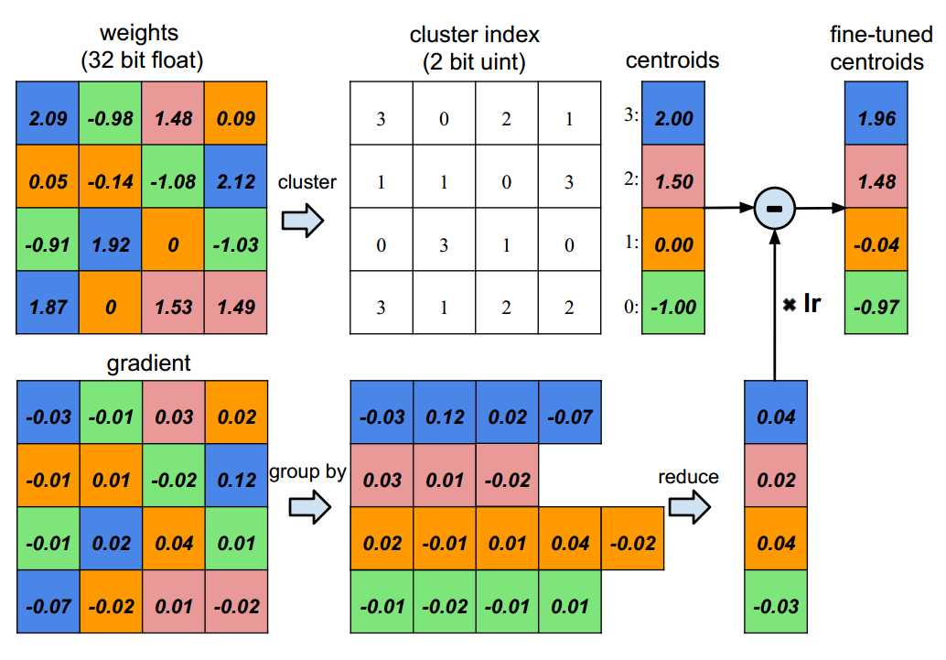
Compression by K-means Clustering
Reference: Song Han, Huizi Mao, William J. Dally. Deep Compression: Compressing Deep Neural Networks with Pruning, Trained Quantization and Huffman Coding. Arxiv, 1510.00149. 2016.

Slide 9
Compression by K-means Clustering
Cluster the weights of ip1 layer which had SVDed
Original Accuracy: 0.7577
Fine-tuned Accuracy: 0.7178
Number of Clusters | Accuracy
5 | 0.6972
8 | 0.7161
16 | 0.7174
20 | 0.7161
32 | 0.7201
50 | 0.7176
100 | 0.7180
200 | 0.7174

Slide 10
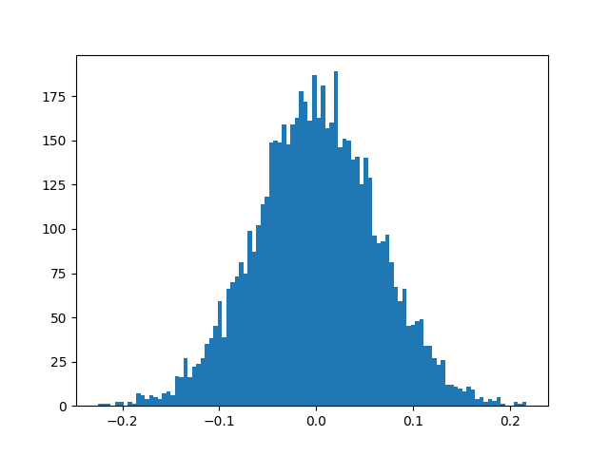
Compression by Reduced-Precision
The weights of ip1 layer which had SVDed
Histogram
Statistics | Value
count | 6144
mean | 0.000260
std | 0.063288
min | -0.225779
25% | -0.041734
50% | -0.000137
75% | 0.042516
max | 0.217526

Slide 11

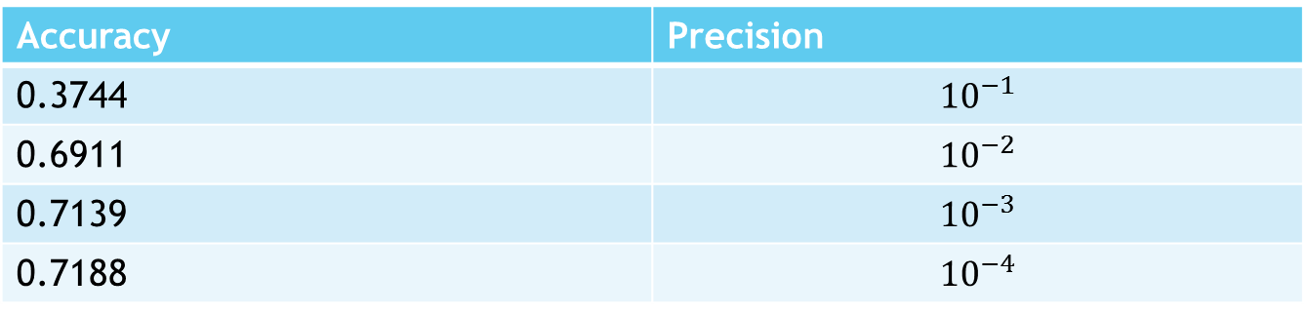
Compression by Reduced-Precision
The weights of ip1 layer which had SVDed
Original Accuracy: 0.7577
Fine-tuned Accuracy: 0.7178
Accuracy | Precision
0.3744 | $${10}^{−1}$$
0.6911 | $${10}^{−2}$$
0.7139 | $${10}^{−3}$$
0.7188 | $${10}^{−4}$$
$$\log_{1/2}{10}^{−4}≈13.288 bits<2 bytes$$
Using 2 bytes to represent a weight.

Slide 12
Mixed Method
Compressing ip1 layer
Original Type: float(4 bytes)
Number of Clusters: 16
Index per weight: 4 bits(half bytes)
Weight: 2 bytes
Method | Accuracy | Space Size (bytes) | Compression Rate
Origin | 0.7577 | 262144 | 100%
SVD6 + fine-tuning | 0.7178 | 26112 | 9.96%
SVD6+fine-tuning+cluster16 | 0.7174 | 3328 | 1.27%
SVD6+fine-tuning+cluster16 +reduced-precision | 0.7188 | 3296 | 1.26%

Slide 13
Improvement
Using two 3x3 convolution kernels to replace 5x5 convolution kernels [1]
Pruning [2]
Deleting the connection whose weight is less than threshold value.
Huffman Coding [2]
Code the IDs of different clusters using Huffman Code.
Compressing parameter matrix of Convolution Layer
Reference:
[1] Christian Szegedy, Vincent Vanhoucke, Sergey Ioffe, Jonathon Shlens, Zbigniew Wojna. Rethinking the Inception Architecture for Computer Vision. Arxiv, 1512.00567. 2015.
[2] Song Han, Huizi Mao, William J. Dally. Deep Compression: Compressing Deep Neural Networks with Pruning, Trained Quantization and Huffman Coding. Arxiv, 1510.00149. 2016.

Slide 14
Reference
[1] Zichao Yang,Marcin Moczulski,Misha Denil,Nando de Freitas,Alex Smola,Le Song,Ziyu Wang. Deep Fried Convnets. Arxiv, 1412.7149, 2015
[2] Song Han, Huizi Mao, William J. Dally. Deep Compression: Compressing Deep Neural Networks with Pruning, Trained Quantization and Huffman Coding. Arxiv, 1510.00149, 2016.
[3] LeftNotEasy, 机器学习中的数学(5)-强大的矩阵奇异值分解(SVD)及其应用, http://www.cnblogs.com/LeftNotEasy/archive/2011/01/19/svd-and-applications.html
[4] Christian Szegedy, Vincent Vanhoucke, Sergey Ioffe, Jonathon Shlens, Zbigniew Wojna. Rethinking the Inception Architecture for Computer Vision. Arxiv, 1512.00567, 2015.
[5] Jian Xue, Jinyu Li, and Yifan Gong. Restructuring of Deep Neural Network Acoustic Models with Singular Value Decomposition. In Interspeech,2013

Slide 15
Thank you ☺

