Slide 1
An Analysis of Contemporary American Poetry
Using K means Clustering & NLTK
Huiru Jiang - Nov 2015

Slide 2
Specific Aim
For this project I applied Natural Language Processing methods to break down the corpus of Contemporary American Poems as scraped from the Academy of American Poets website into numerical representations of the text in terms of style.
Then I used an unsupervised learning method, K-means clustering, to see if these poems would naturally cluster into groups that may or may not represent meaningful stylistic differences.

Slide 3
Design
Libraries Used
Scrapy
Pymongo
Pandas
Numpy
SciKit Learn
NLTK
Seaborn
Data Storage
Mongodb
Extract From Academy of American Poets Website using Scrapy project
Store in Mongo Database with two collections: Poets & Poems
Use Ipython notebooks & create script which contains all the methods necessary to clean, transform, & extract feature variables from the Poets and Poems collection separately, then merge and pickle the useful data
Unpickle & query the data for errors, revise methods
Visually inspect the data for outliers and kill them
Run Kmeans Cluster analysis
Validate analysis
Refine

Slide 4
About the Raw Data
1,467 poems were scraped from twenty 21st century poetic movements and represent the works of 349 poets published between 1900 and 2015
There were many different ways of obtaining this data using Scrapy but I chose to scrape only the works from poets that were tagged to a specific movement
I also scraped the biographical and geographical (if any) information from the poets because why not? Perhaps something could be done with that information if not now, then later
Some poets and their works had additional movement tags

Slide 5
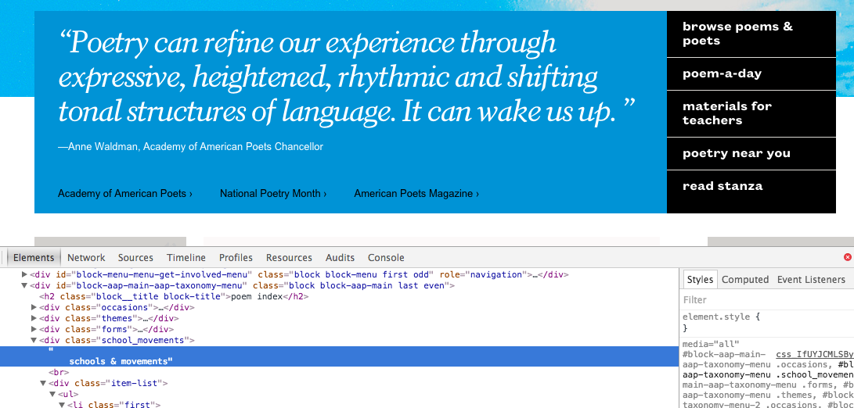
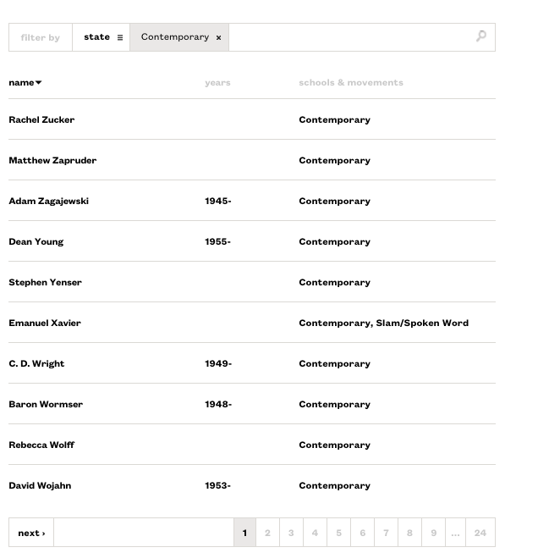
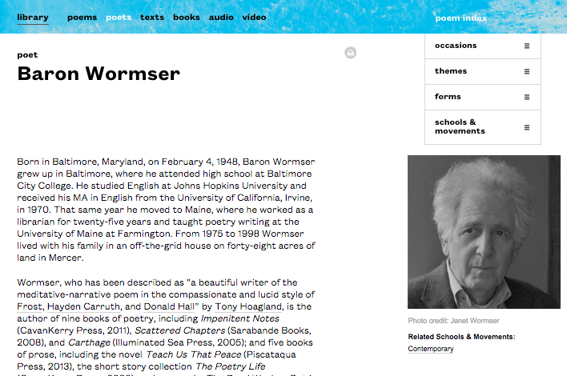
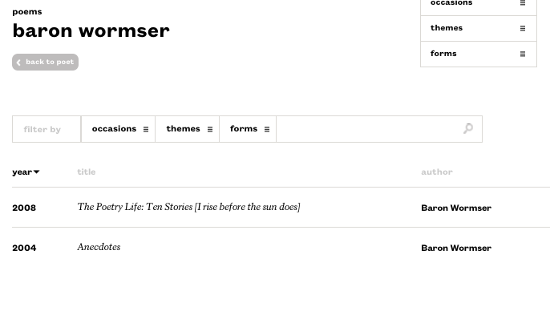
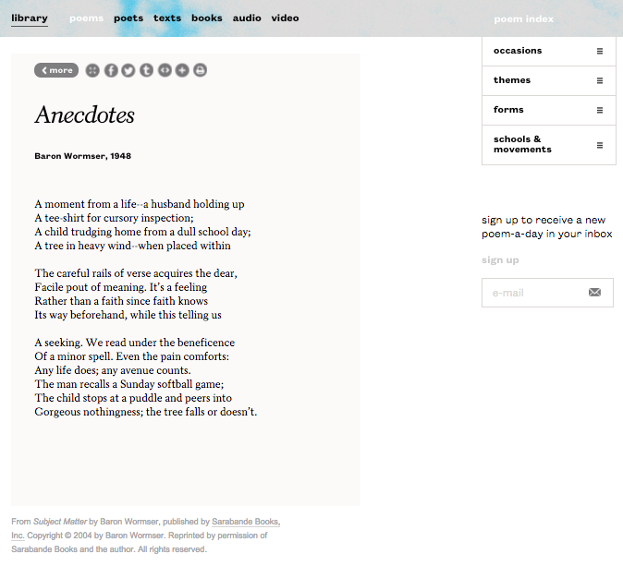
Scrapy Project Walkthrough
My spider started crawling from the main page. I saw in the html that there was a hidden part that listed movement names and their links and crawled each link
1
2
3
4
5
Notes:
To discuss: I didn’t understand how scrapy crawled and initially ended up with pretty messy data, e.g. after scraping, I saw that the poets and poems didn’t match up.

Slide 6
Transforming the Data
Because I was bent on grabbing as much information as each poet as possible, I spent some time wrestling with the difficulties of directly importing from Mongodb collection to a pandas dataframe and cleaning peculiarities from the scrape
Poet information such as birth, death, origin of geographic location were in one column of lists
Because poets were also tagged with multiple movements, those extra tags were brought in as a list too
I didn’t have an immediate need for any of that information
☹

Slide 7
Transforming the Data
I accidentally scraped poem audio & later on, video links so I had to get rid of them
Weird unicode such as “\xc2\xa0\xa…..”
u\2014, u\2018, u\2019
Solution:
string.encode(‘ascii’, ‘ignore’)

Slide 8
Feature Variables
What makes a poem, a poem?
What makes a poems from a particular movement distinct from others?
Craft
Visual representation – how the poem looks on the page
Sound – number of syllables, rhymes, assonance, etc.
phrasing – idea of the breath
Affect – evoking emotions
Imagery – sensory words
Content – Political, cultural, and subjective experiences
Reader engagement – Using language in such a way to allow readers to form meaning instead of the poet as a subject
Challenging traditional ideas of poetry and/or returning to them

Slide 9
Feature Variables (Assumptions)
Average line per stanza
Enjambent Score
Type Token Ratio
Abstraction Score
Lesk Abstraction Score
Title Lesk Abstraction Score
Pronoun Score
Conjunction Score
Noun, Verb, and Adjective Phrase Ratio
Average Noun, Verb, and Adjective Phrase Complexity Score
1 word, 2 word, and 3 word noun phrase frequency ratio
Notes:
Quickly walk through what some of these mean

Slide 10
Inspiration
I did not come up with all of these feature variables on my own
Kao & Jurafsky’s research on building a logistic regression model to classify Amateur versus Professional poetry
Jonathin Chin’s Poetry Tool Kit extension of NLTK
Notes:
Please see links provided on git and at the end of this presentation

Slide 11
Extracting the Feature Variables
Regex
NLTK.tokenize – used to tokenize sentences, words, tag them with parts of speech, so that I could use nltk’s implementation of RegexpParser to parse out noun, adjective, and verb phrases
sent_tokenize()
word_tokenize()
pos_tag()
RegexpParser()

Slide 12
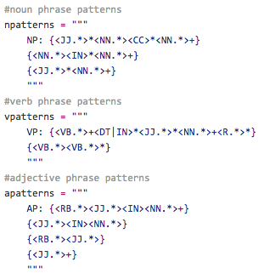
Noun, Verb, and Adjective Phrases
What is a noun phrase?
A phrase where a noun is the head or main word
"head of lettuce", "creaky door", "Fred's bagel express”
Noun, Adjective + Preposition/subordinating Conjunction + Noun, etc.
What is an adjective phrase?
An adjective phrase (or adjectival phrase) is a phrase whose head word is an adjective
“very happy”, “quite upset about it”
Adjective, Adverb + Adjective, Adverb + Adjective + Preposition + Noun, etc.
What is a verb phrase?
A verb phrase is a syntactic unit composed of at least one verb and its dependents—objects, complements and other modifiers—but not always including the subject.
“moved quickly”, “flashing lights”, “Mary had sung her heart out”
Verb, Verb + Adverb, etc.
Notes:
SOURCE: WIKIPEDIA

Slide 13
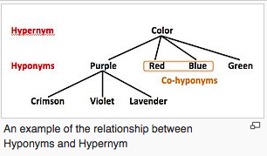
NLTL.Corpus.wordnet
What is wordnet?
Wordnet is a lexical database that groups words into sets of synonyms called Synsets
All synsets are connected to other synsets through semantic relationships
There’s a lot in there but for the purposes of my project, I only cared about two relationships for measuring how abstract the nouns are in a poem to quantify how abstract the poem is
Hypernyms
Hyponyms
Synset.Closure
Notes:
SOURCE: WIKIPEDIA

Slide 14
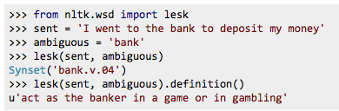
Word Sense Disambiguation
What is word sense disambiguation?
It is the process of figuring out what sense of a word means within the context of a sentence or phrase
There are a number of different algorithms to use and ways of solving for the exact sense
I used NLTK.wsd.Lesk() which implements a simple lesk algorithm
I did this on top of computing abstraction at the extension recommendation of Jonathan Chin’s Poetry Tool Kit

Slide 15
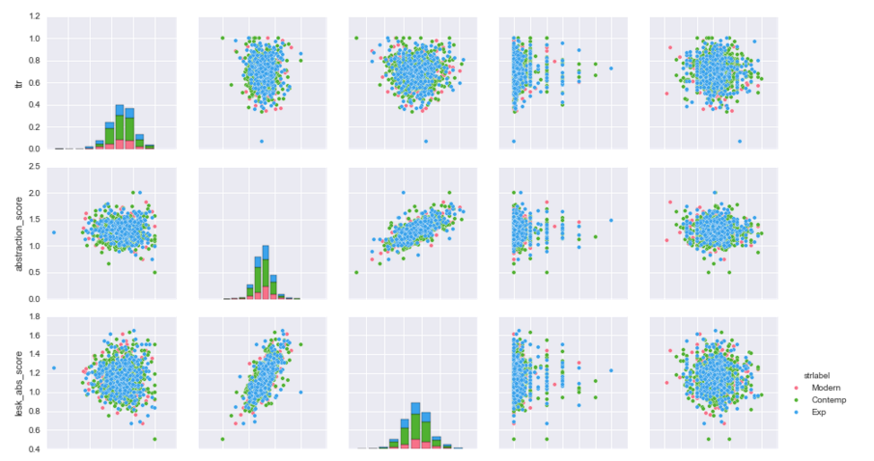
Feature Selection
Before I could do any real analysis, I had to get rid of outliers as much as possible, knowing that for Kmeans cluster analysis, they could really skew the cluster centroids. I found them either by doing simple plots or by aggregating and querying
Then I used seaborn’s pairplot to visualize my all of my feature variables (like we did in one of the homeworks/labs) so that I can get rid of sparse data
Notes:
Talk about SKLEARN’s PREPROCESSING

Slide 16
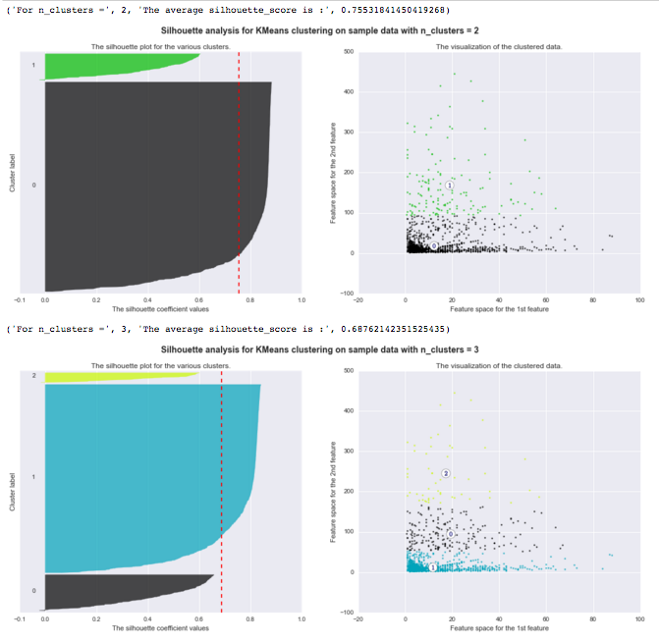
K Means Clustering
Cleaned Data – 1287 poems, 307 poets
The Elbow Method of Choosing my K, k=2
Ran the model with the best K then performed visual examination of centroids plotted against the K means labeled data
Tried sifting through the different things these clusters might mean… e.g. the detailed movement tags or by specific poets
Notes:
KMEANS = unsupervised learning method, greedy classifier. Silhouette coefficient tells us the cohesion and separation of clusters

Slide 17


K Means Clustering
Cluster validation against external index
Because I only scraped poems that were classified with a movement tag, I used that to benchmark
NOTE:
The data was uneven, as in the group of poems that were tagged as Contemporary took up half the data set. Although I tried different ways of breaking up those tags, the simplest was just to say either a poem was tagged Contemporary or not
Simple Confusion Matrix – IT WAS TERRIBLE!
Notes:
SOURCE: http://www.cs.kent.edu/~jin/DM08/ClusterValidation.pdf

Slide 18
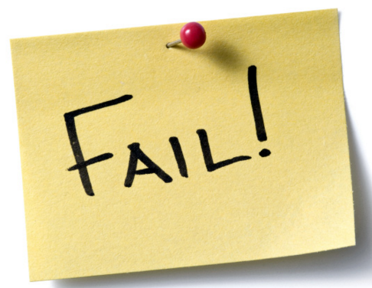
Back to Feature Selection
I realized that my variables had high variance and that K means clustering analysis does not work well with this
So as a last ditch attempt, I used SciKit Learn’s preprocessing.scale() to convert my feature variables to have unit variance
Then I reran K means cluster analysis on that data
Result? Just in finding my optimum K made me see that there was no inherent structure in the data

Slide 19
What Went Wrong?
Many things!
Are my calculated feature variables independent?
Just how clean is the text? Did I correctly parse the lines from stanzas?
All my feature variables were derived from the text of each poem in the set of poems using NLTK
The parts of speech tagger is heavily reliant on the correct sentence tokenizing and correct word tokenizing… any failures is and will impact the analysis

Slide 20
Future Work
Try using other things such as doctovec or term frequency-inverse document frequency (tf-idf)
Make use of all the data I scraped on the poets themselves
Look into graphing tools to doing more visualizing of the data and of the results
Review all the methods I wrote for the project, especially in calculating feature variables
Supplement my data with untagged poems from Poets.org and Poetry Foundation aka Poetry Magazine site
All work relating to this project including this presentation can be found on my github account
https://github.com/huiruru/FinalProject
Due to time constraints, I was not able to detail all my reasoning for the feature variables and provide a nice data dictionary but I hope to finish it soon
Please see the following slide of links for sources I found extremely helpful to my project and hopefully may be of use to others as well

Slide 21
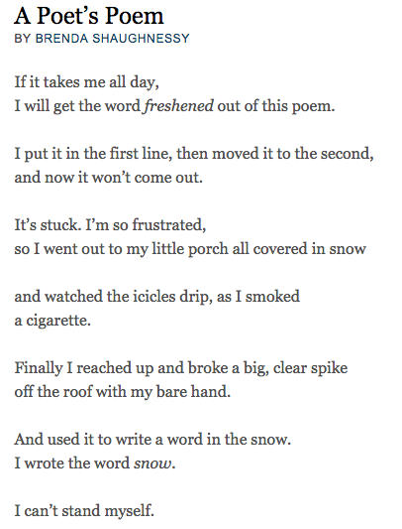
Notes:
http://www.poetryfoundation.org/poem/182964

Slide 22
Helpful Links
Cluster Validation http://www.cs.kent.edu/~jin/DM08/ClusterValidation.pdf
Kmeans Clustering is not a free lunch http://varianceexplained.org/r/kmeans-free-lunch/
Wikipedia - Hyponymy Hypernymy https://en.wikipedia.org/wiki/Hyponymy_and_hypernymy
Wikipedia Noun Phrases https://en.wikipedia.org/wiki/Noun_phrase
Wikipedia Verb Phrases https://en.wikipedia.org/wiki/Verb_phrase
Wikipedia Adjective Phrases https://en.wikipedia.org/wiki/Adjective_phrase
Type Token Ratio http://www.sltinfo.com/type-token-ratio/
100 Best Github for Word Sense Disambiguation http://meta-guide.com/software-meta-guide/100-best-github-word-sense-disambiguation/
StackOverflow Word Sense Disambiguation http://stackoverflow.com/questions/3699810/word-sense-disambiguation-in-nltk-python
Penn Tree Bank Parts of Speech http://www.ling.upenn.edu/courses/Fall_2003/ling001/penn_treebank_pos.html
NLTK Wordnet http://www.nltk.org/howto/wordnet.html
Ipython Chunking Tutorial http://nbviewer.ipython.org/github/lukewrites/NP_chunking_with_nltk/blob/master/NP_chunking_with_the_NLTK.ipynb
Nltk How to Chunk (REGEXPARSER EXPLANATION) http://www.nltk.org/howto/chunk.html
NLTK Word Sense Disambiguation http://www.nltk.org/howto/wsd.html
Sklearn Preprocessing Module http://scikit-learn.org/stable/modules/preprocessing.html
Sklearn Kmeans Demo http://scikit-learn.org/stable/auto_examples/cluster/plot_kmeans_digits.html#example-cluster-plot-kmeans-digits-py
Guide to Confusion Matrix http://www.dataschool.io/simple-guide-to-confusion-matrix-terminology/
Scrapy Library http://scrapy.org/
Scrapy Tutorial http://doc.scrapy.org/en/latest/intro/tutorial.html

