Slide 1
Decoupling Cores, Kernels and Operating Systems
Gerd Zellweger, Simon Gerber, Kornilios Kourtis, Timothy Roscoe
Systems Group, ETH Zürich
|
|

Slide 2
Outline
Motivation
Trends in hardware and software
Booting and shutting down cores dynamically
Decoupling the kernel state
Evaluation
Kernel updates, specialized kernels
|
|

Slide 3
What’s happening to hardware
Constrained by power consumption
Reconfigurable cores (dynamically changed behavior)
DVFS, Turbo Boost, SMT
Core Fusion [ISCA ‘07]
Dark silicon [ISCA ‘10]
Heterogeneous cores
Fast and power hungry vs. slow and power efficient
Asymmetric multiprocessing
Conservation Cores [ASPLOS ‘10]
|
|
Notes:
动态的调整处理器核的行为：
DVFS 即动态电压频率调整、超频加速、同步多线程
Core Fusion 汇集缓存核功能单元，将多个独立的核汇集在一起
Dark silicon 暗硅 因为散热能力跟不上，大量的晶体管处于暗态 没有工作
理器遇到了类似“功耗墙”、“利用率墙”等一系列可扩展性问题， 国外有学者形象的总结为“dark silicon”
异构的处理器核心
快速能耗搞 低速能耗低
非对称处理器
将片上的暗硅转变位大量的函数加速器部件，比如Conservation Cores

Slide 4








What current operating systems look like
Application Application Application
Kernel
CPU CPU CPU CPU
|
|
4

Slide 5
What current operating systems look like
Application Application Application
Kernel
CPU CPU CPU
|
|
4

Slide 6
What’s happening to software
OS needs to adapt to different workloads
Adapting at build-, boot-, and run-time
Debugging support: profiling, tracing etc.
Real-time support
On-the-fly kernel updates
KSplice (Linux) [EuroSys ‘09]
▪ K42 [ATC ‘07]
|
|
Notes:
系统要适应不同的工作负载 ，需要动态的调整硬件资源
支持debug
Ksplice 实现Linux内核二进制补丁无需重启， 通过比较生成的目标代码 来 更换整个功能的工作原理。

Slide 7













Multikernel [SOSP ‘09]
Application
Application
Application
OSNode
OSNode OSNode
OSNode
Async.
Async.
Async.
Messages
Messages
Messages
Kernel
Kernel Kernel
Kernel
CPU
CPU
CPU
CPU
|
|

Slide 8
Implementation
Barrelfish OS
Treating cores as pluggable devices
Booting a core dynamically with boot drivers
Shutting down a core
Decoupling Cores, Kernels and the Operating System
Externalizing kernel state
|
|

Slide 9
Booting a core with boot drivers
OS service for target core management
Dynamically chooses kernel for core based on runtime information
Boots any core with any suitable kernel
Run any OSNode on any compatible core
Implements boot, shutdown, reboot protocol
|
|

Slide 10
Shutting down a core
Harder than booting a core
Need to deal with per-core state: Scheduler queues, memory pools, page-tables…
Takes time (and energy)
However, we want to remove the core as fast as possible
General approach (cf. Chameleon [ASPLOS ’12])
Get state out of the way quickly
Dismantle it later, lazily (if needed)
|
|
Notes:
Dismantle 拆除；取消；解散

Slide 11
Shutting down a core
Application
Application
OSNode OSNode
Kernel Kernel
CPU CPU
Application
OSNode
OSNode
Kernel
Kernel
CPU
CPU
|
|
10

Slide 12
Shutting down a core
Application
Application
OSNode OSNode
Kernel Kernel
CPU CPU
Application
OSNode
OSNode
Kernel
CPU
|
|
10

Slide 13

Shutting down a core
Application
Application
Application
OSNode OSNode OSNode Kernel Kernel
CPU CPU
OSNode
Kernel
CPU
|
|
10

Slide 14
Shutting down a core
Application
Application
Application
OSNode OSNode OSNode Kernel Kernel
CPU CPU
OSNode
OSNode Scheduler
Kernel
CPU
|
|
10

Slide 15
Shutting down a core
Application
Application
Application
OSNode OSNode OSNode Kernel Kernel
CPU CPU
Parking
OSNode
OSNode
OSNode Scheduler
Kernel
CPU
|
|
10

Slide 16
Shutting down a core
Application
Application
Application
OSNode OSNode OSNode Kernel Kernel
CPU CPU
Parking
OSNode
OSNode
OSNode Scheduler
Kernel
CPU
Highly scalable, only two cores involved
|
|
10

Slide 17
What is the OSNode?
OSNode: All state for a single core and kernel
How do we capture this OSNode?
Capabilities:
Tracks all application state
Tracks all OS state
cf. seL4, EROS, KeyKOS
KCB (Kernel control block)
Hardware specific state
Entry point to capability tree
Represented as a capability itself
Scheduler State Cap Derivation Tree Timer Offset IRQ State KCB | ... Frame Frame Frame Frame CNode PCB | ... Frame Frame Frame CNode CNode PCB | ... Null Frame Frame Frame
... ... ...
Frame Frame Null
Frame Frame Frame Scheduler State Frame Frame Frame Cap Derivation Tree Frame CNode Frame
Timer Offset
IRQ State CNode CNode
KCB PCB PCB
... ... ...
Frame Frame Null
Frame Frame Frame Scheduler State Frame Frame Frame Cap Derivation Tree Frame CNode Frame
Timer Offset
IRQ State CNode CNode
KCB PCB PCB
|
|
Notes:
IRQ全称为Interrupt Request，即是“中断请求”的意思

Slide 18

Decoupling Cores, Kernels and Operating Systems
State externalization & dynamic core booting is a much more general mechanism
OSNode
OSNode
Kernel
Kernel
CPU
CPU
|
|
12
Notes:
分离内核执行状态

Slide 19


Decoupling Cores, Kernels and Operating Systems
State externalization & dynamic core booting is a much more general mechanism
OSNode OSNode Kernel
Kernel
CPU
CPU
|
|
12

Slide 20
Decoupling Cores, Kernels and Operating Systems
State externalization & dynamic core booting is a much more general mechanism
OSNode
OSNode
Kernel
Kernel
CPU
CPU
|
|
12

Slide 21
Decoupling Cores, Kernels and Operating Systems
State externalization & dynamic core booting is a much more general mechanism
OSNode
OSNode
Kernel
CPU
CPU
|
|
12

Slide 22
Decoupling Cores, Kernels and Operating Systems
State externalization & dynamic core booting is a much more general mechanism
OSNode
OSNode
Kernel
Kernel
CPU
CPU
|
|
12

Slide 23
Evaluation
Core management
Adding and removing cores in the system
Kernel updates
Hot-swapping the kernel
Specialized kernels
e.g., eliminate OS jitter
|
|

Slide 24
Core management (Haswell, 1x4 cores, no HT)
Booting a core | No Load | Load
Linux 3.13 | 14 ms | 20 ms
Barrelfish/DC | 7.5 ms | 7.5 ms
Removing a core | No Load | Load
Linux 3.13 | 46 ms | 2542 ms
Barrelfish/DC | 0.0008 ms | 0.0008 ms
|
|

Slide 25
Use-case: Kernel Updates
Shut-down target core
Application
OSNode Kernel
CPU
CPU
|
|
15

Slide 26
Use-case: Kernel Updates
Shut-down target core
Reboot core with a new kernel image
Application
OSNode
Kernel
Kernel
CPU
CPU
|
|
15

Slide 27
Use-case: Kernel Updates
Shut-down target core
Reboot core with a new kernel image
Dispatch previous OSNode
Application
Application
OSNode
OSNode
Kernel
Kernel
CPU
CPU
|
|
15

Slide 28
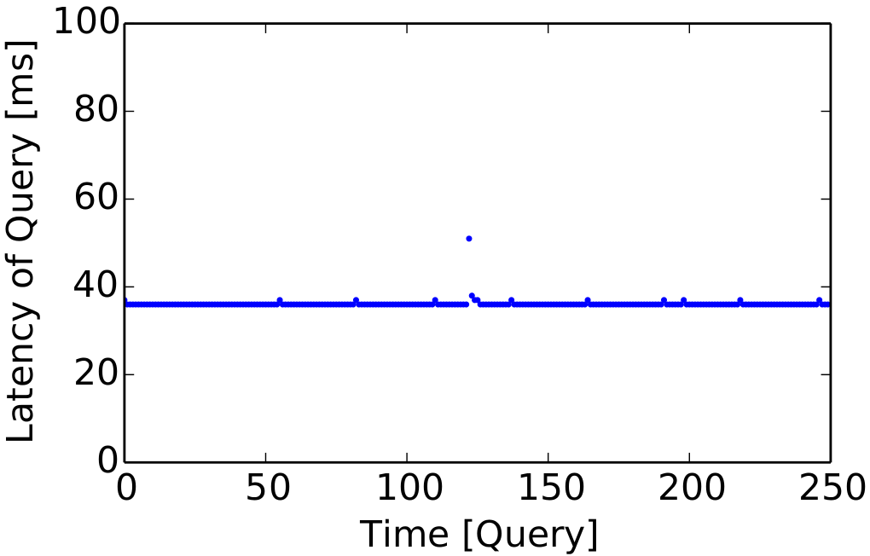
Kernel updates: PostgreSQL & TPC-H
Hot-swapping the kernel
|
|

Slide 29
Use-case: Temporary real time task
A thread that needs to run with hard real time performance
E.g., phone baseband stack, control application, robotics etc.
A lot of effort spent to make this work in a general purpose OS
Many real time OS for embedded systems (RTLinux, LynxOS, QNX, …)
|
|

Slide 30

Use-case: Real time application
OS
OS
OS
OS
OS
OS
OS
OS
|
|
18

Slide 31
Use-case: Real time application
RT Kernel
OS
OS
OS
OS
OS
OS
OS
|
|
18

Slide 32
Use-case: Specialized kernels
Shut-down target core
Application
OSNode Kernel
CPU
CPU
|
|
19

Slide 33
Use-case: Specialized kernels
Shut-down target core
Temporarily park the target OSNode
Application
Application OSNode OSNode
Kernel
CPU
CPU
|
|
19

Slide 34
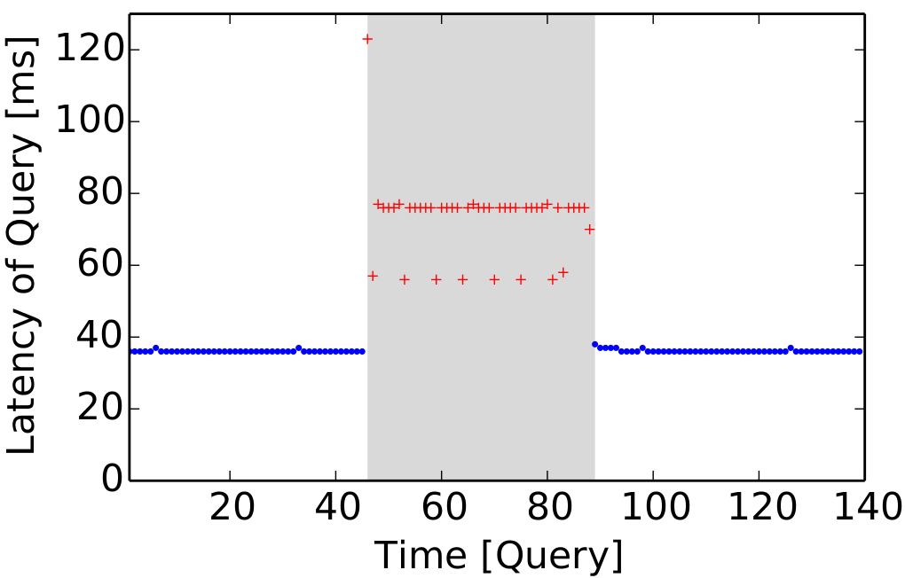
Evaluation: PostgreSQL & TPC-H
Parked OSNode (2 OSNodes per core)
Move OSNode back to original core
One OSNode per core
|
10/6/2014
|
20

Slide 35



Use-case: Specialized kernels
Shut-down target core
Temporarily park the target OSNode
Boot simple real-time kernel that runs just one application
Does not take interrupts
No timers
No scheduler
Temporarily provides task with hard real time guarantees
Application
Application OSNode OSNode
Kernel
RT Application
OSNode
RT Kernel
CPU
CPU
|
|

Slide 36
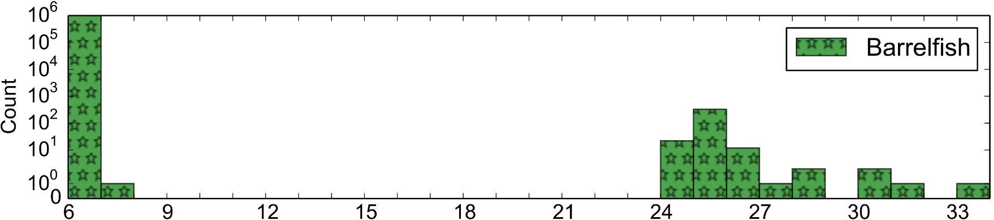
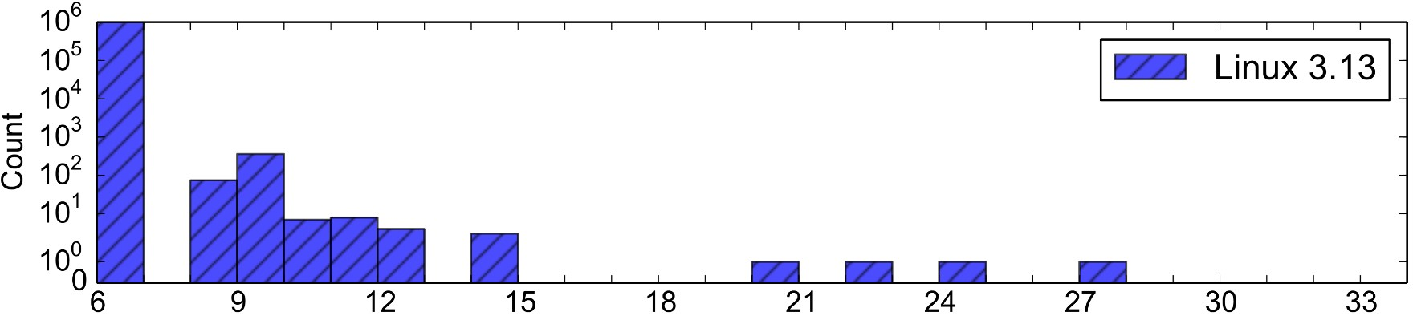
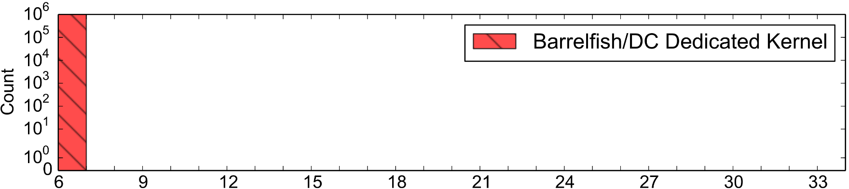
Almost all samples between 6-7k
# cycles for 1k memory stores
Outliers (OS jitter)
No samples outside of 6-7k range
|
|
Notes:
每迭代3000次操作为一次采样
好多的抖动（jitter）

Slide 37
Future Work & Applications
Transfer OSNodes between power efficient and high performance cores
Dynamic OS instrumentation
Profiling, tracing kernels
A/B kernel testing
Specialized kernel to run applications in guest ring 0
cf. Arrakis
|
|

Slide 38
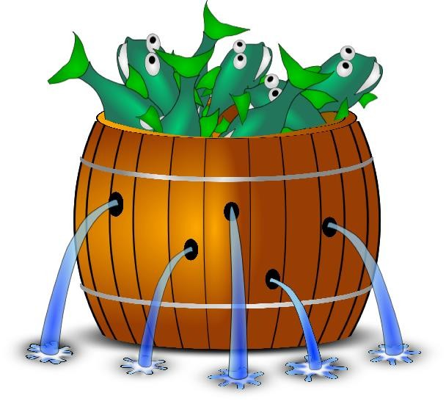
Conclusion
Decoupling the kernel state
Result: highly dynamic OS architecture
Kernels can be rebooted, updated and specialized
Cores can be allocated and de-allocated arbitrarily
For many versions of the “dark silicon” hardware, this may be the only way for system software
www.barrelfish.org
|
|
Notes:
任意分配、回收处理器核

Slide 39
Backup
|
| 25
Notes:
补充说明 辅助

Slide 40
Dealing with interrupts
Timers, etc. local to core and CPU driver
Handled internally to CPU driver
Inter-processor interrupts (IPIs)
Indirection table of OSNodes → physical cores
Device interrupts
Must be re-routed to new core
|
| 27

Slide 41











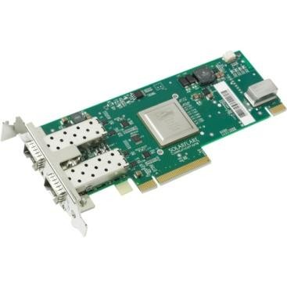




Device interrupts
Device driver
kernel 1
IRQh
core 2
core 1
vectors
IOAPIC
|
| 28

Slide 42




Device interrupts
Device driver
Kernel masks
kernel 2
interrupts
core 2
core 1
vectors
IOAPIC
|
| 29

Slide 43





Device interrupts
New kernel initializes
Device driver
IRQh
kernel 2
core 1
vectors
vectors
core 2
IOAPIC
|
| 30

Slide 44




Device interrupts
"Register interrupts"
message
Device driver
IRQh
kernel 2
core 1
vectors
vectors
core 2
IOAPIC
|
| 31

Slide 45





Device interrupts
Device driver
IRQh
kernel 2
Interrupt rerouted
core 1
vectors
core 2
IOAPIC
|
| 32

Slide 46
Decoupling Cores, Kernels and Operating Systems
Thanks

