Slide 1

ClickOS and the Art of Network Function Virtualization
Joao Martins*, Mohamed Ahmed*, Costin Raiciu§, Roberto Bifulco*, Vladimir Olteanu§, Michio Honda*, Felipe Huici*
* NEC Labs Europe, Heidelberg, Germany
§ University Politehnica of Bucharest firstname.lastname@neclab.eu, firstname.lastname@cs.pub.ro

Slide 2
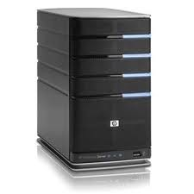
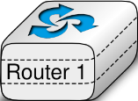
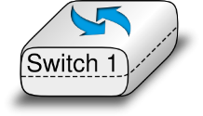
The Idealized Network
Application
Application
Transport
Transport
Network
Network
Network
Datalink
Datalink
Datalink
Datalink
Physical
Physical
Physical
Physical

Slide 3
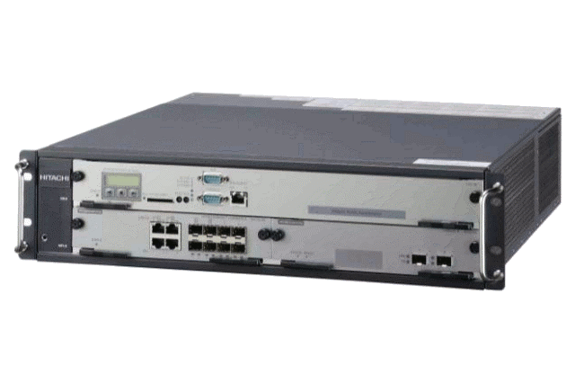
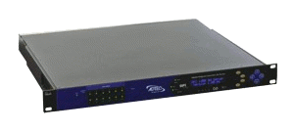
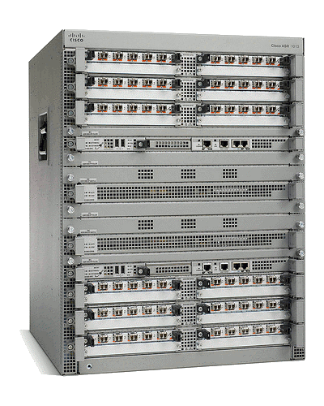
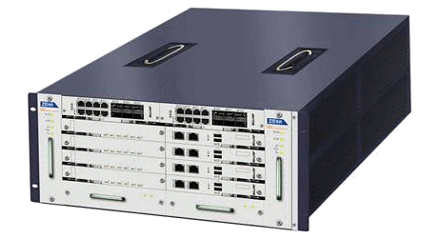
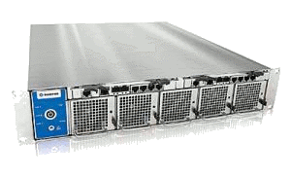
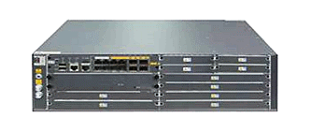
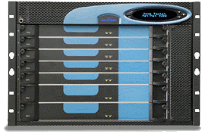
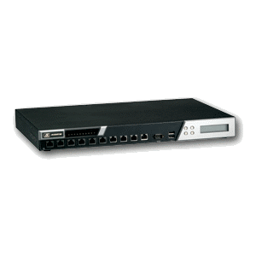
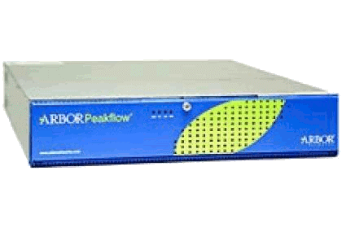
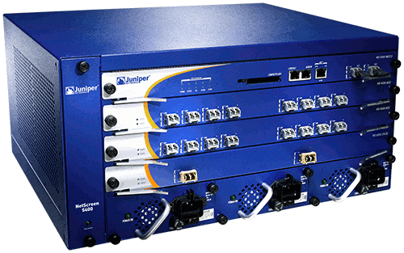
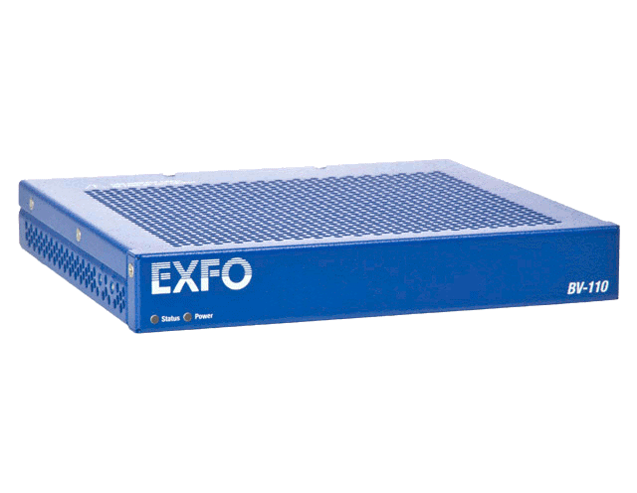
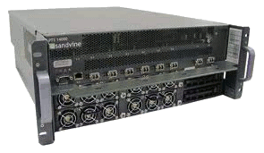
A Middlebox World
ad insertion
WAN accelerator
BRAS
transcoder
session border controller
IDS
carrier-grade NAT
load balancer
DDoS protection
firewall
DPI
QoE monitor

Slide 4
Hardware Middleboxes - Drawbacks
▐ Expensive equipment/power costs
▐ Difcult to add new features (vendor lock-in)
▐ Difcult to manage
▐ Cannot be scaled on demand (peak planning)

Slide 5
Shifting Middlebox Processing to Software
▐ Can share the same hardware across multiple users/tenants
▐ Reduced equipment/power costs through consolidation
▐ Safe to try new features on a operational network/platform
▐ But can it be built using commodity hardware while still achieving high performance?
▐ ClickOS: tiny Xen-based virtual machine that runs Click

Slide 6

From Thought to Reality - Requirements
ClickOS
30 msec boot times 5MB when running provided by Xen 10Gb/s line rate*
45 μsec delay
provided by Click
▐ Fast Instantiation
▐ Small footprint
▐ Isolation
▐ Performance
▐ Flexibility

Slide 7
What's ClickOS ?
domU
ClickOS
apps
guest OS
paravirt
Click
mini OS
paravirt
▐ Work consisted of:
Build system to create ClickOS images (5 MB in size)
Emulating a Click control plane over MiniOS/Xen
Reducing boot times (roughly 30 milliseconds)
Optimizations to the data plane (10 Gb/s for almost all pkt sizes)
Implementation of a wide range of middleboxes

Slide 8
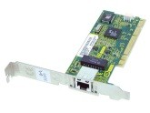
Performance analysis
packet size (bytes)
10 Gbit/s rate
64
14.88 Mp/s
128 8.4 Mp/s
256 4.5 Mp/s
512 2.3 Mp/s
1024 1.2 Mp/s
1500 810 Kp/s
Driver Domain (or Dom 0)
ClickOS Domain
netback
Xen bus/store
netfront
Click
NW driver
OVS
vif
Event channel
FromDevice
ToDevice
Xen ring API (data)
300* Kp/s
350 Kp/s
225 Kp/s
* - maximum-sized packets

Slide 9
Performance analysis
Driver Domain (or Dom 0)
ClickOS Domain
netback
Xen bus/store
netfront
Click
NW driver
OVS
vif
Event channel
FromDevice
ToDevice
Xen ring API
~3.4 us (3)
772 ns (1)
~600 ns (2)
▐
Copying packets between guests greatly afects packet I/O (1)
▐
Packet metadata allocations (2)
▐
Backend switch is slow (3)
▐
MiniOS netfront not as good as Linux

Slide 10
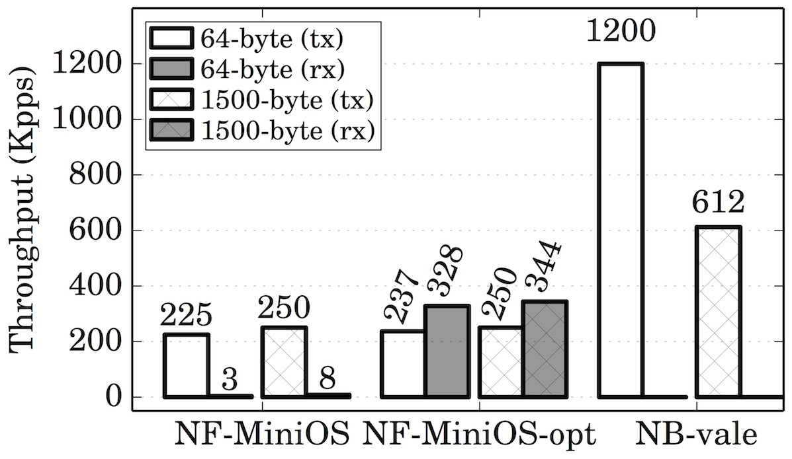
Optimizing Network I/O – Backend Switch
Driver Domain (or Dom 0)
ClickOS Domain
NW driver
netback
Xen bus/store
Event channel
netfront
Click
(netmap mode)
VOAVLSE
port
FromDevice
ToDevice
Xen ring API
(data)
▐
Reuse Xen page permissions (frontend)
▐
Introduce VALE[1] as the backend switch
▐
Increase I/O requests batch size
[1] VALE, a switched ethernet for virtual machines, ACM CoNEXT'2012 Luigi Rizzo, Giuseppe Lettieri
Universita di Pisa

Slide 11
Optimizing Network I/O
Driver Domain (or Dom 0)
ClickOS Domain
netback netback
Xen bus/store
netfront
Click
NW driver
VALE
Event channel
FromDevice
port
ToDevice
_{N}Xen_{tm}r_{a}in_{p}g_{API} I (data)
slots | KB (per ring) | # grants (per ring)
64 | 135 | 33
▐ Minimal memory requirements
–
For max. throughput a guest only needs 4 MB of memory
128 | 266 | 65
256 | 528 | 130
512 | 1056 | 259
1024 | 2117 | 516
2048 | 4231 | 1033
▐ Breaks other (non-MiniOS) guests
–
But we have implemented Linux netfront driver

Slide 12
ClickOS Prototype Overview
▐ Click changes are minimal ~600 LoC
▐ New toolstack for fast boot times
▐ Cross compile toolchain for MiniOS-based apps
▐ netback changes comprise ~500 LoC
▐ netfront (Linux/MiniOS) around ~600 LoC
▐ VALE switch extended to:
– Connect NIC ports and modular switching

Slide 13
EVALUATION

Slide 14
Experiments
▐ ClickOS Instantiation
▐ State reading/insertion performance
▐ Delay compared with other systems
▐ Memory footprint
▐ Switch performance for 1+ NICs
▐ ClickOS/MiniOS performance
▐ Chaining experiments
▐ Scalability over multiple guests
▐ Scalability over multiple NICs
▐ Implementation and evaluation of middleboxes
▐ Linux Performance

Slide 15
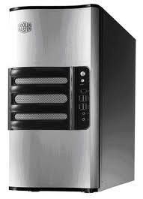
ClickOS Base Performance
ClickOS
Measurement Box
10Gb/s direct cable
Intel Xeon E1220 4-core 3.2GHz (Sandy bridge) 16GB RAM, 1x Intel x520 10Gb/s NIC.
One CPU core assigned to VMs, the rest to the Domain-0 Linux 3.6.10

Slide 16
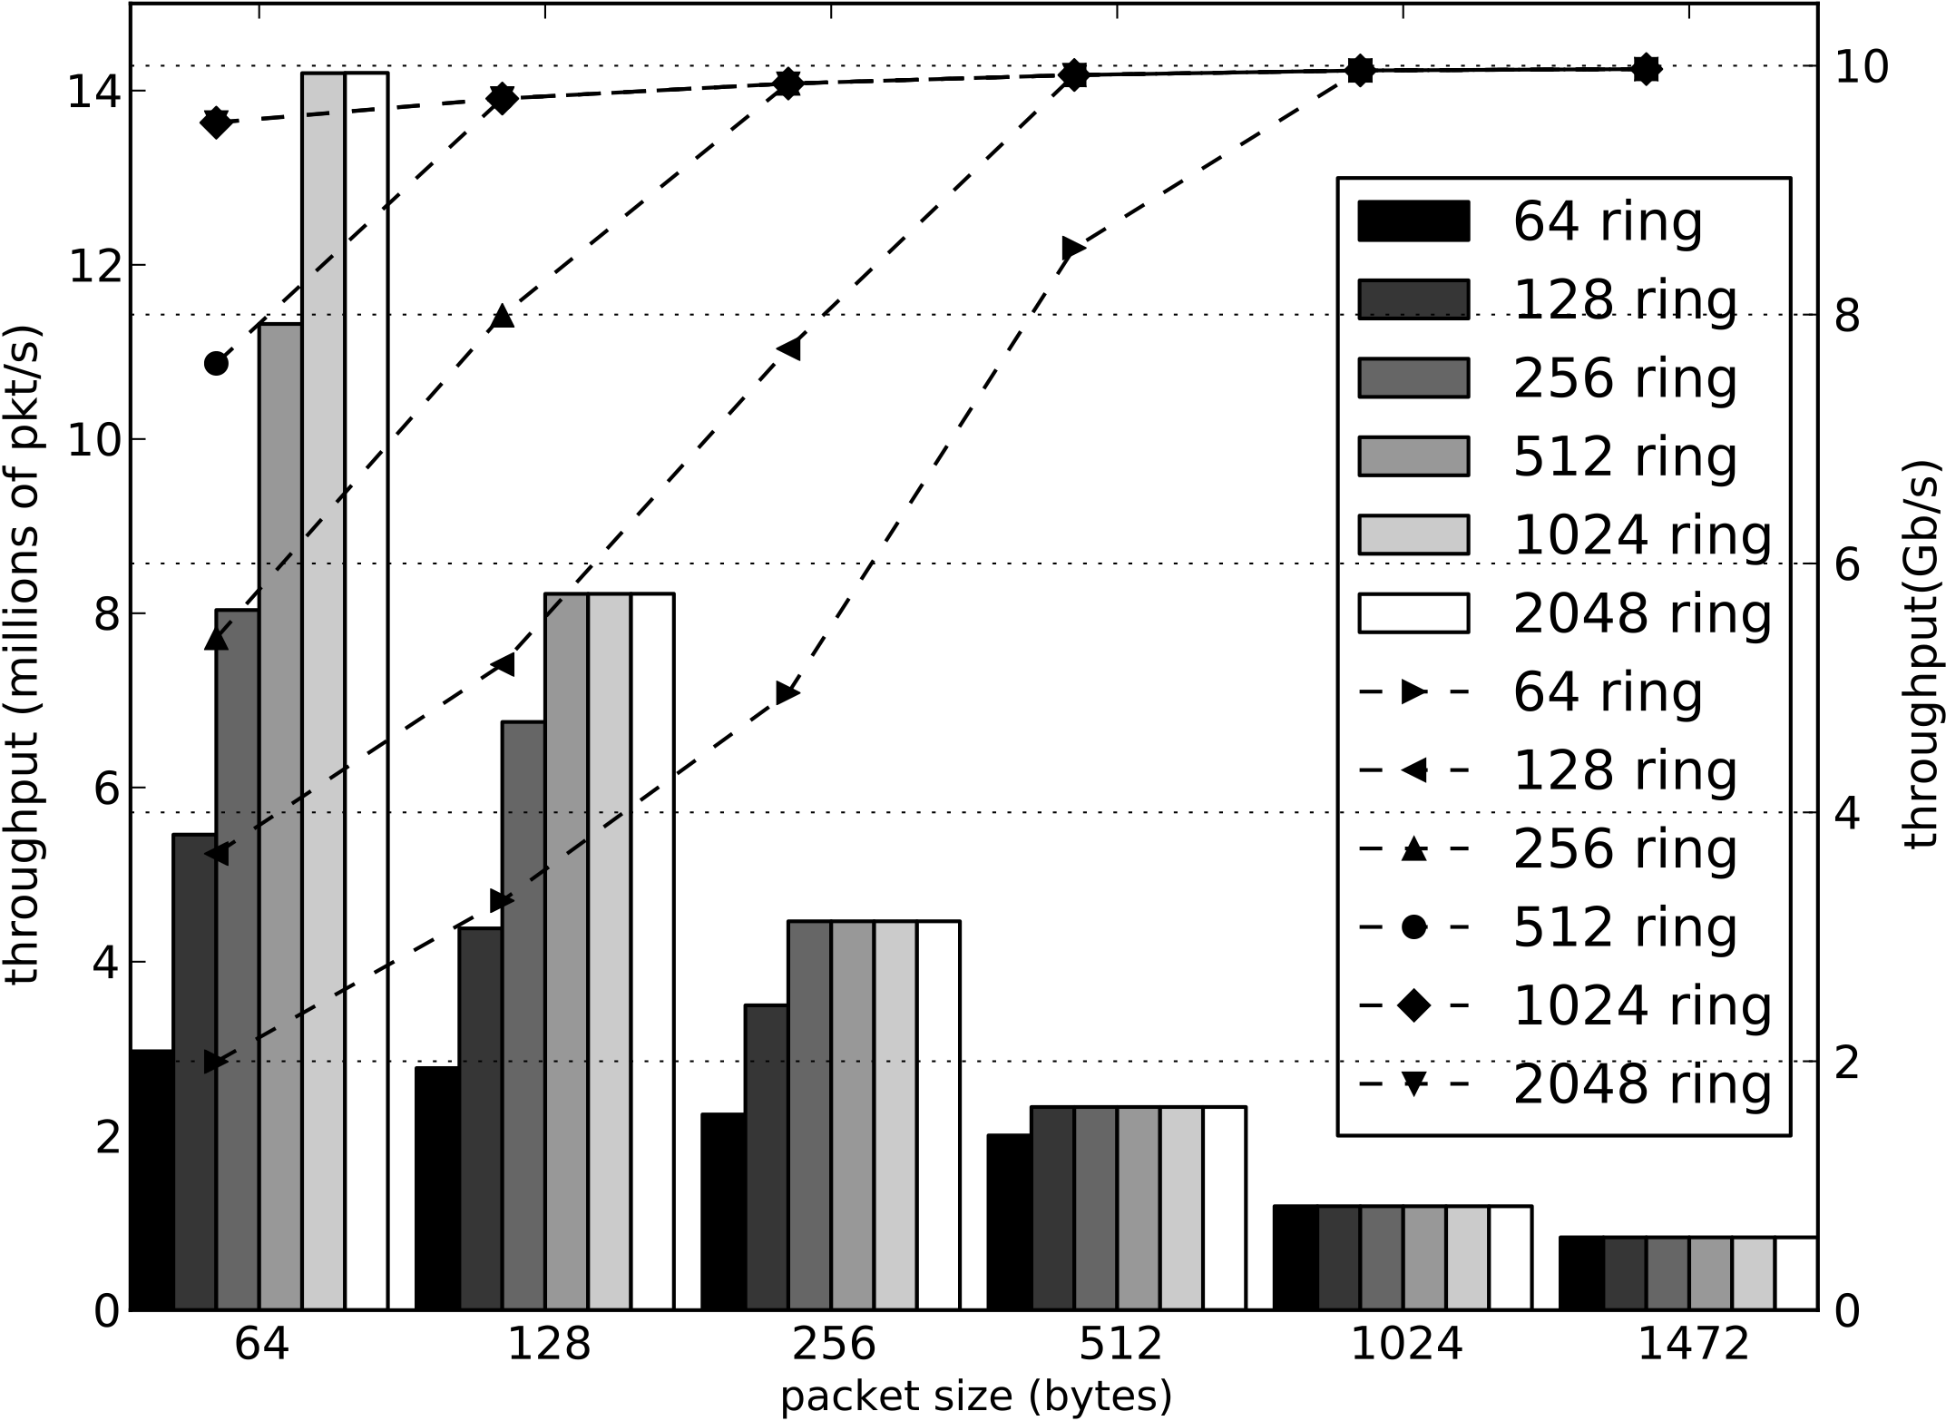
ClickOS Base TX Performance

Slide 17
ClickOS (virtualized) Middlebox Performance
10Gb/s direct cable
10Gb/s direct cable
Host 1
ClickOS
Host 2
Intel Xeon E1220 4-core 3.2GHz (Sandy bridge) 16GB RAM, 2x Intel x520 10Gb/s NIC.
One CPU core assigned to Vms, 3 CPU cores Domain-0 Linux 3.6.10

Slide 18
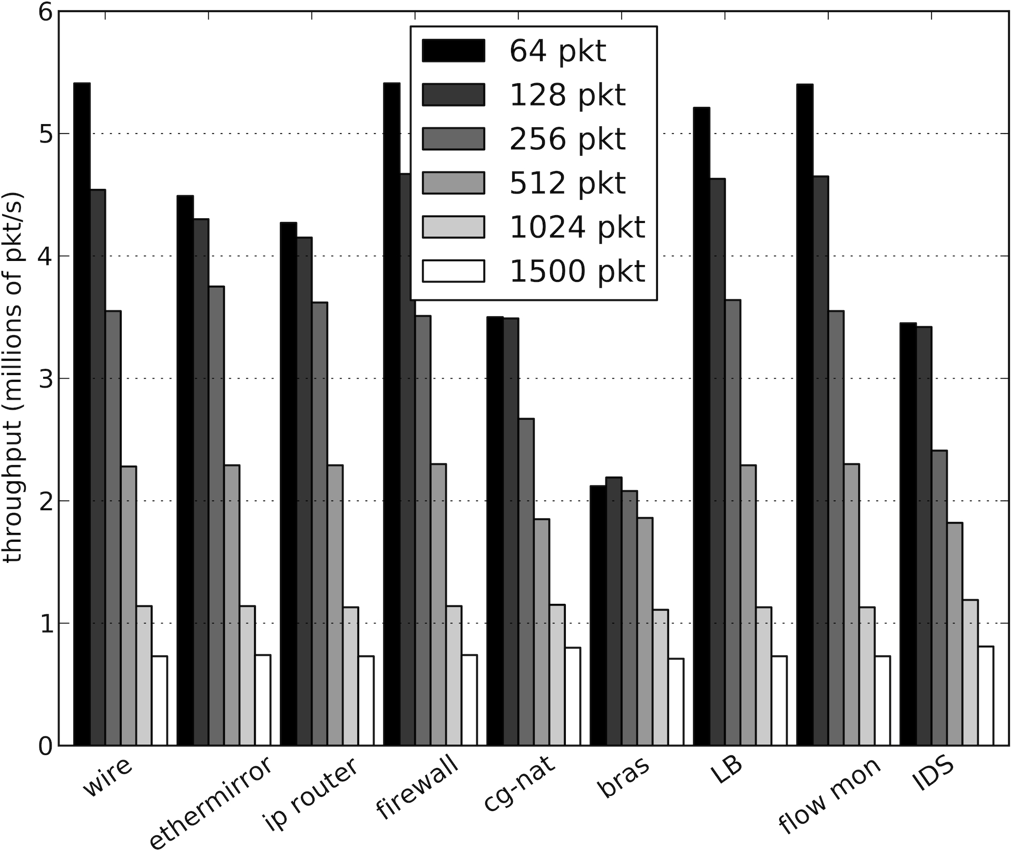
ClickOS (virtualized) Middlebox Performance

Slide 19
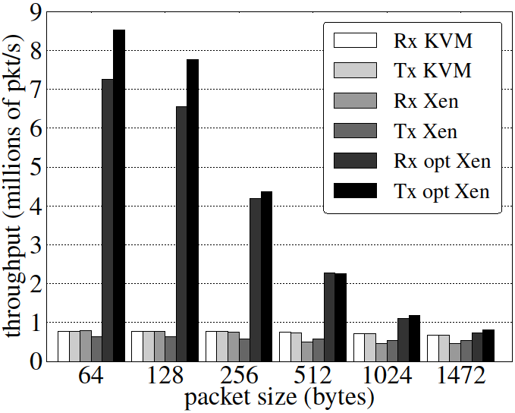
Linux Guest Performance
▐ Note that our Linux optimizations apply only to netmap-based applications

Slide 20
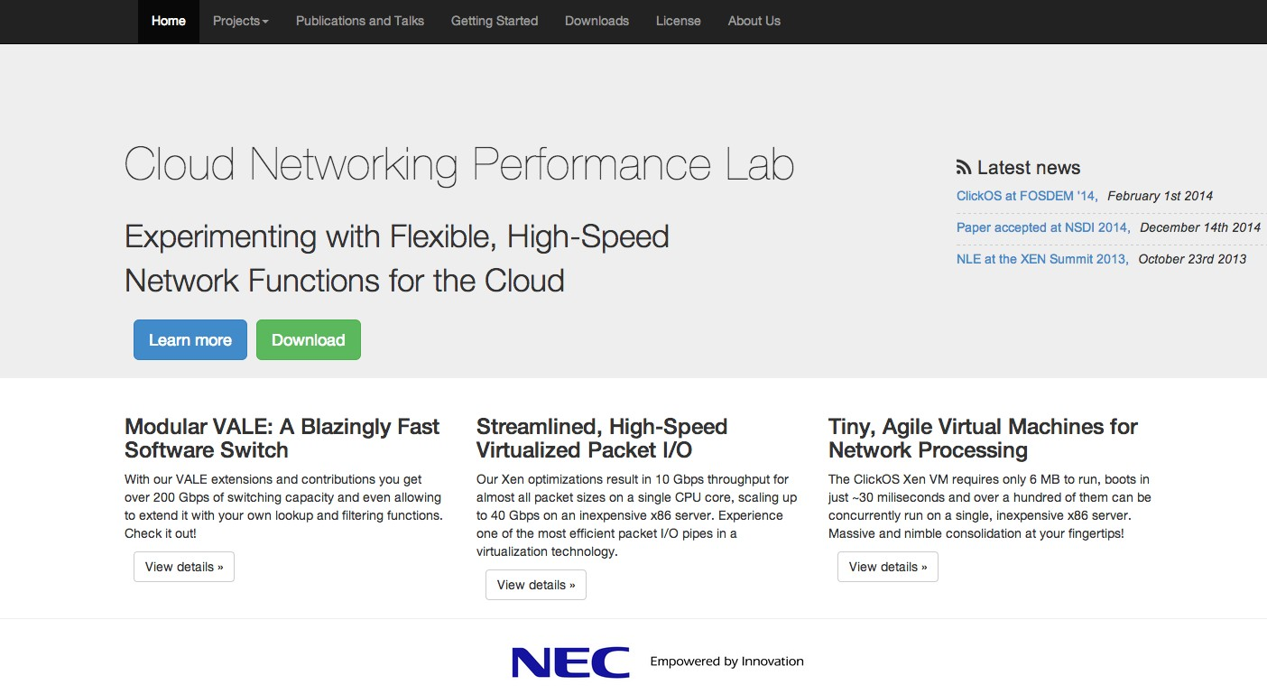
It's Open Source!
Checkout http://cnp.neclab.eu
ClickOS, Backend Switch, Xen optimizations and more!
Github ( https://github.com/cnplab )
Tutorials
Better performance!

Slide 21
Conclusions
▐ Virtual machines can do fexible high speed networking
▐ ClickOS: Tailor-made operating system for network processing
Small is better: Low footprint is the key to heavy consolidation
Memory footprint: 5MB
Boot time: 30ms
▐ Future work:
Massive consolidation of VMs (thousands)
Improved Inter-VM communication for service chaining
Reactive VMs (e.g., per-fow)

Slide 23
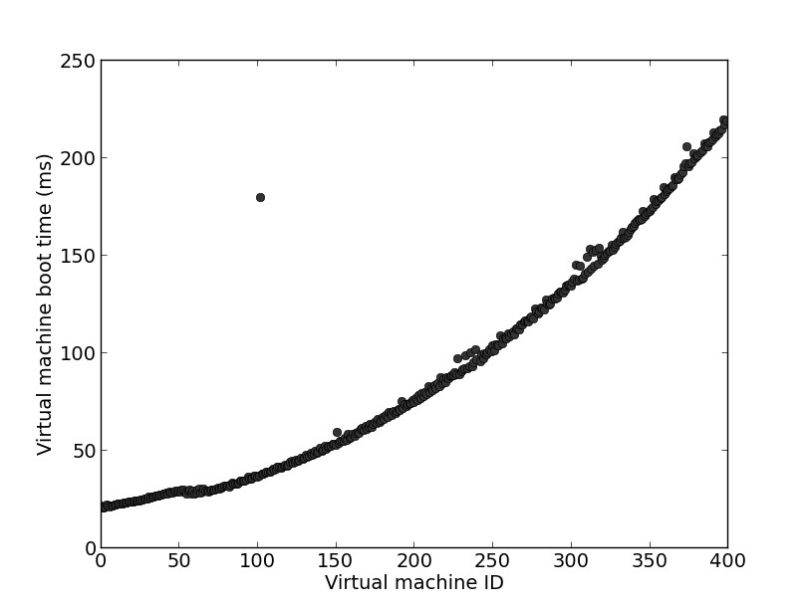
ClickOS Boot times
220 milliseconds
30 milliseconds

Slide 24
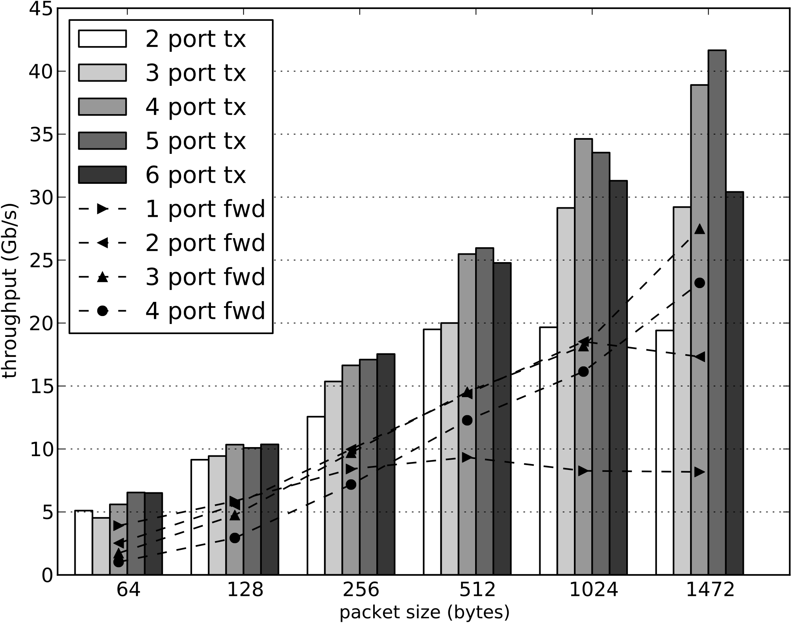
Scaling out – Multiple NICs/VMs
Host 1
ClickOS
Host 2
6x 10Gb/s direct cable
6x 10Gb/s direct cable
Intel Xeon E1650 6-core 3.2GHz, 16GB RAM, dual-port Intel x520 10Gb/s NIC. 3 cores assigned to VMs, 3 cores for dom0

Slide 25
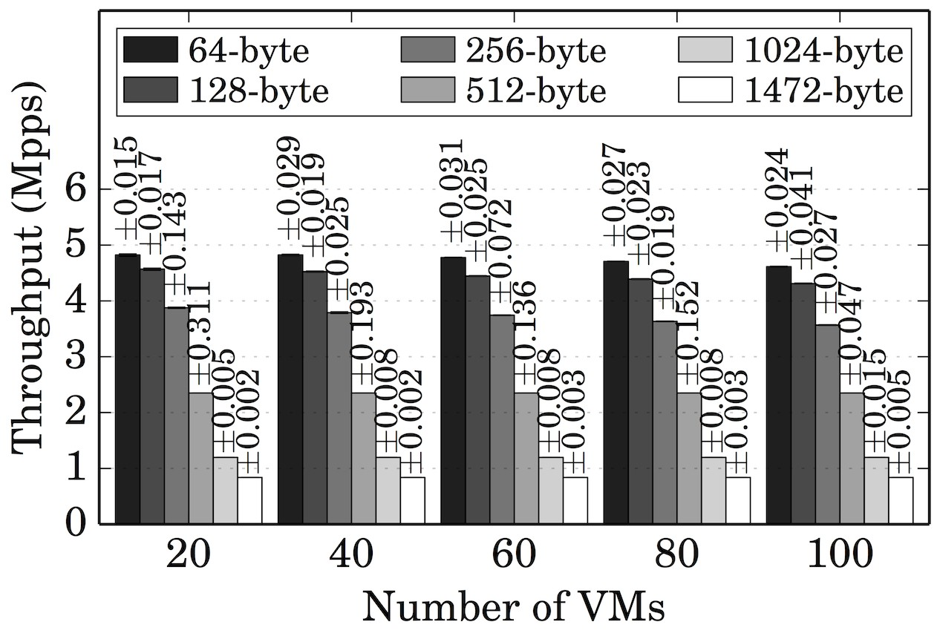
Scaling out – 100 VMs Aggregate Throughput
Intel Xeon E1650 6-core 3.2GHz, 16GB RAM, dual-port Intel x520 10Gb/s NIC. 3 cores assigned to VMs, 3 cores for dom0

Slide 26
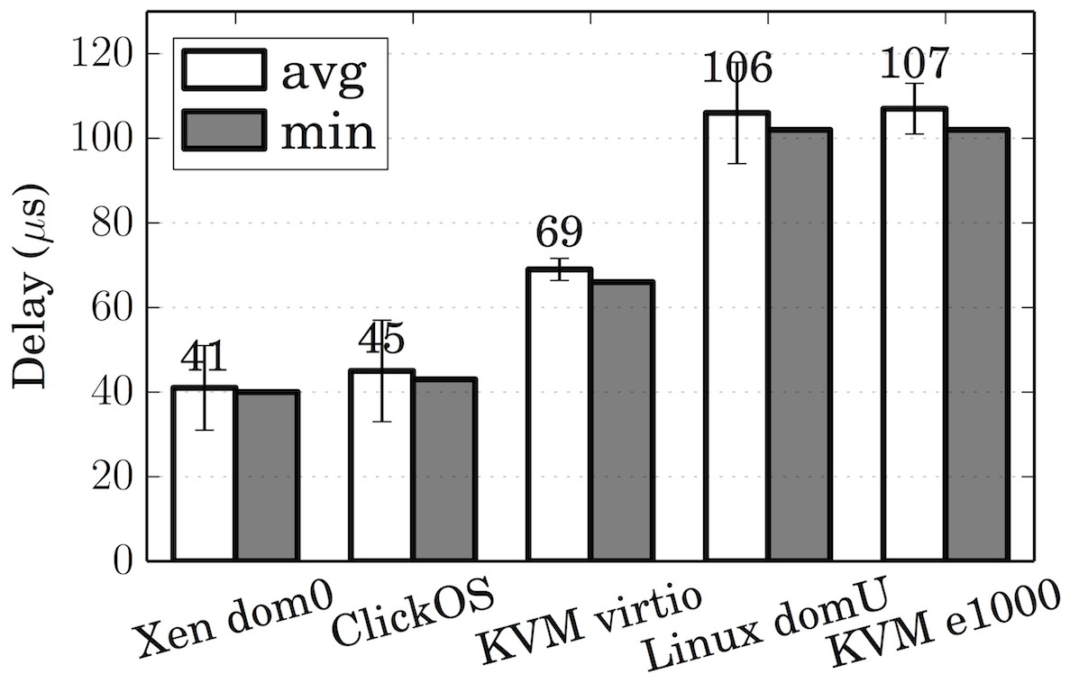
ClickOS Delay vs. Other Systems

