Slide 1
PHP 基础速成班
2020-07-17 共思社

Slide 2
PHP advantage and disavantage
Flexible

Slide 3
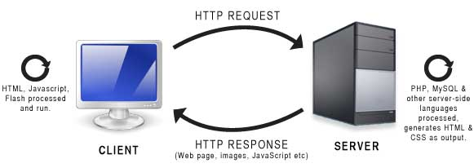
服务器端 VS 客户端 Server side VS client side

Slide 4
Chapter 1: Syntax + Data type
Comment 注释
Variable 变数 + variable scope
String 字串（单引号 vs 双引号）
Concatenated string 串联字串
Integer 数字
Operator 运算符
Constant 固定值

Slide 5
Chapter 2: Syntax + Data type
Comparison operators 比较运算符
Function 函数
Array 阵列
Foreach loop 循环
Namespace 命名空间

Slide 6
强弱类型 Strong typed VS Weak typed
0 == ‘’
1 != ‘abc’
true == ‘abc’
empty(‘0’) == true
empty(‘ ’) == false （因为引号中间有空格）

Slide 7
Chapter 4: PHP 表格
$_REQUEST
$_POST
$_GET
$_FILES

Slide 8
PHP 特别变数
$GLOBALS
$_SERVER
$_REQUEST
$_POST
$_GET
$_FILES
$_ENV
$_COOKIE
$_SESSION

Slide 9
Chapter 5: 类与特性 Class & Trait

Slide 10
复习 / 练习
https://www.w3schools.com/php
https://www.codecademy.com/courses/learn-php

Slide 11
Chapter 6: Composer
getcomposer.org
composer init
composer require xxx/xxx
composer update
composer install
composer dumpautoload

Slide 12
Chapter 7: 简易 MVC
index.php
pages/index.php
page.php
pages/about.php
controllers
views

Slide 13
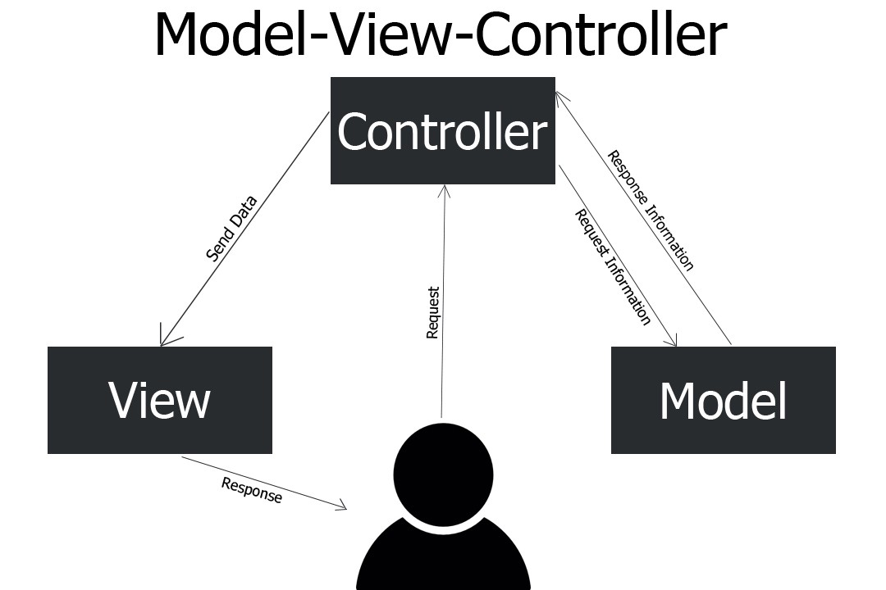
Chapter 7: MVC
基本上呢，不是 controller，也不是 view 的 class，都是 models
Notes:
database model - db manipulate
non-database model - business logic
view - html / css / js , and display/interface logic
controller - as a middle man to link them, and also as a middle man between user and the application.

Slide 14
Chapter 8: 用 Codeception 做 Unit Test
codeception.com

Slide 15
Chapter 8: Slim framework
composer create-project slim/slim-skeleton:dev-master lesson7
Reference: http://www.slimframework.com/

