Slide 2
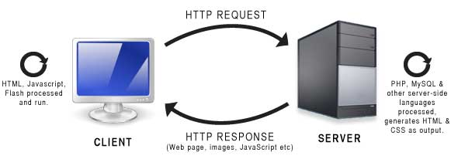
服务器端 VS 客户端 Server side VS client side

Slide 3
Chapter 1: Syntax
Comment 注释
Variable 变数
String 字串
Concatenated string 串联字串
Integer 数字
Operator 运算符
Constant 固定值

Slide 4
Chapter 2: Syntax
Comparison operators 比较运算符
Function 函数
Array 阵列
Foreach loop 循环

Slide 5
强弱类型 Strong typed VS Weak typed

Slide 6
PHP 表格

Slide 7
PHP 特别变数
$GLOBALS
$_SERVER
$_REQUEST
$_POST
$_GET
$_FILES
$_ENV
$_COOKIE
$_SESSION

Slide 8
复习 / 练习
https://www.w3schools.com/php
https://www.codecademy.com/courses/learn-php

Slide 9
Chapter 7: 简易 MVC
index.php
pages/index.php
page.php
pages/about.php
controllers
views

Slide 10
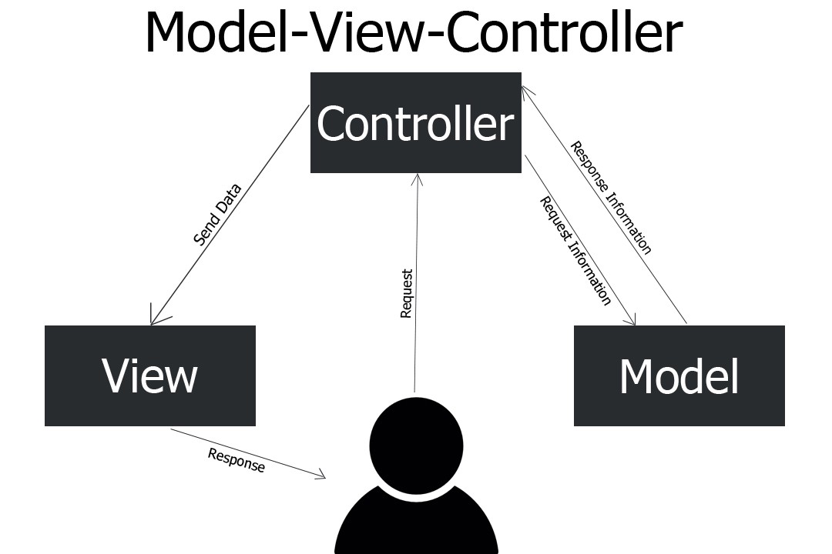
Chapter 7: MVC
基本上呢，不是 controller，也不是 view 的 class，都是 models

Slide 11
Chapter 8: Slim framework
composer create-project slim/slim-skeleton:dev-master lesson7
Reference: http://www.slimframework.com/

