Slide 1
Predicting Political Affiliation for Comments on PTT
Group 23
110062511 倪滙渝
110062544 呂晨瑀
Jan 10, 2023

Slide 2
Outline
Introduction
Method
Experiment
Demo

Slide 3

Introduction
State-sponsored cyber armies
Disseminating fake news or propaganda to mislead the public
Manipulating public opinion on social media by posting pro-party content
Launching cyber attacks against rival parties to disrupt their websites or resources
→ Influence voters' decision-making
Picture: https://memes.tw/wtf?tag=%E7%B6%B2%E8%BB%8D&page=2
Ref: How political candidates are targeting you on social media based on your music tastes, shopping habits and favorite TV shows Casey Tolan By Casey Tolan, CNN

Slide 4
Introduction
Predicting Political Affiliation
Base on the certain account’s comments on the public forum e.g. PTT
Using articles from news media with a clear political stance as a representation e.g. 三立 (DPP), 中天 (KMT)

Slide 5
Method
Tools for implementing parallelization
Web scraper
Multi-thread
Language Model Training & Testing
Distributed Data Parallel in pytorch

Slide 6
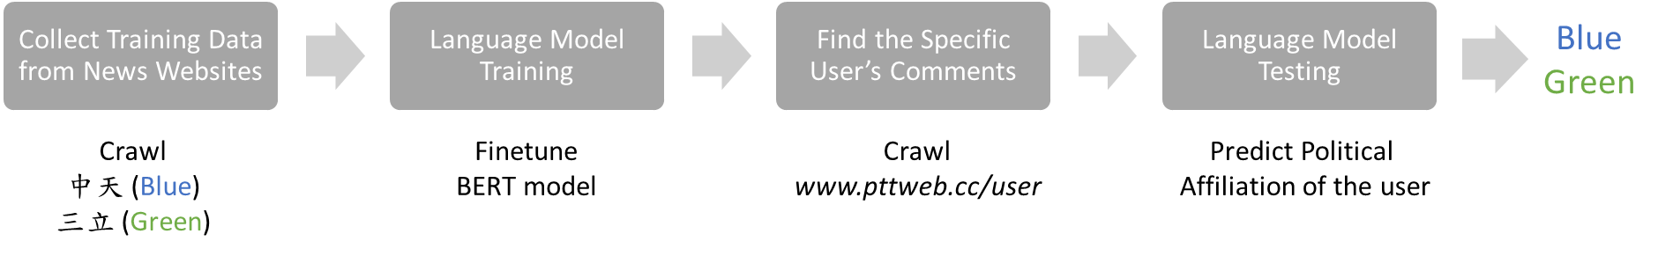
Method
Workflow

Slide 7
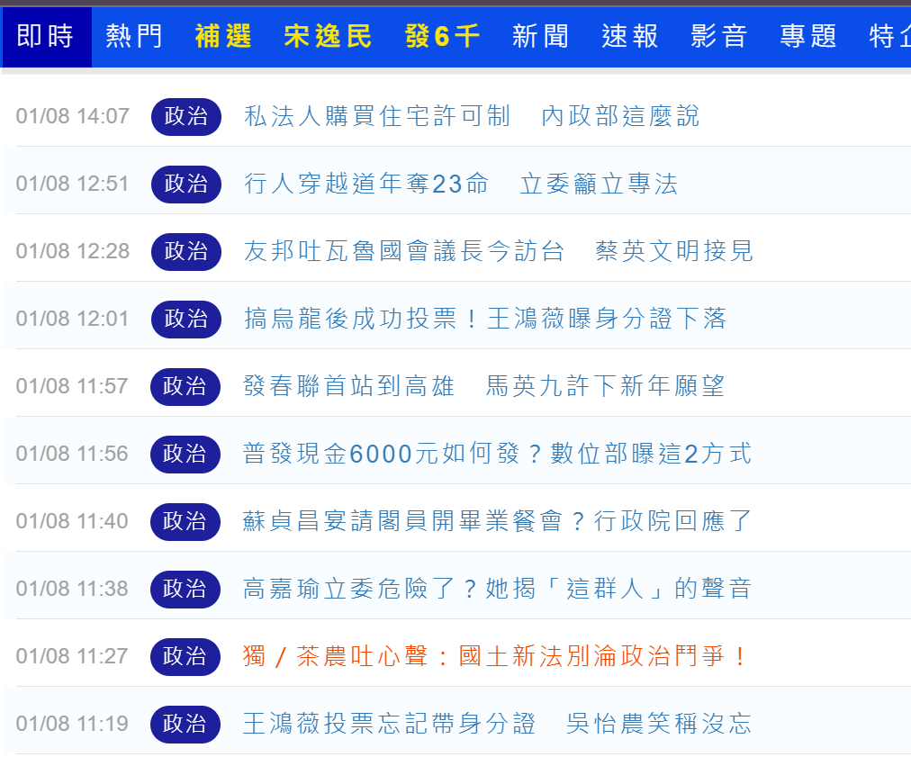
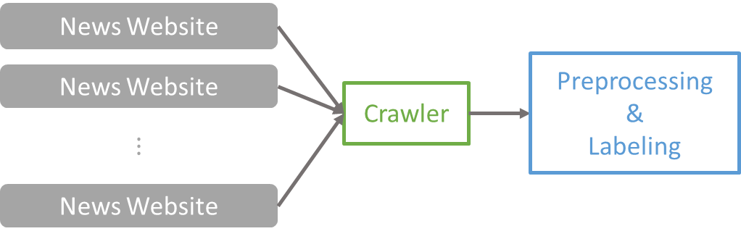
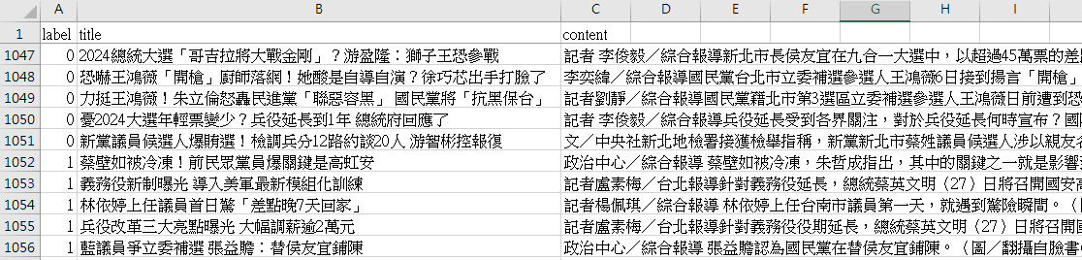
Method
Step 1: Collect Training Data from News Websites
Selenium + BeautifulSoup
Launching parallel tasks by concurrent.futures

Slide 8
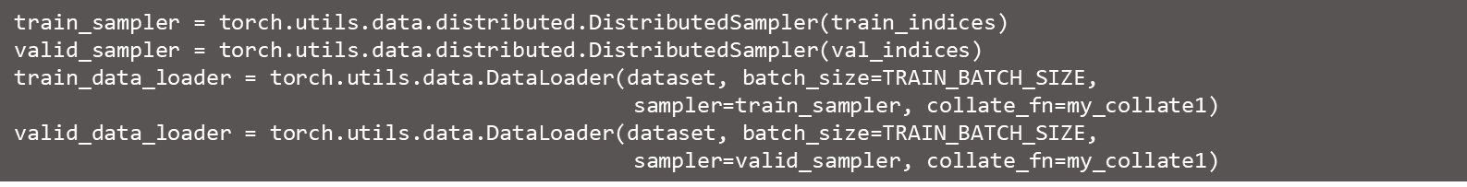
Method
Step 2: Language Model Training
Load BERT tokenizer
Create distributed data samplers and loaders
Build distributed BERT model
Train the model for 30 epoch
Save the model with the best validation performance

Slide 9
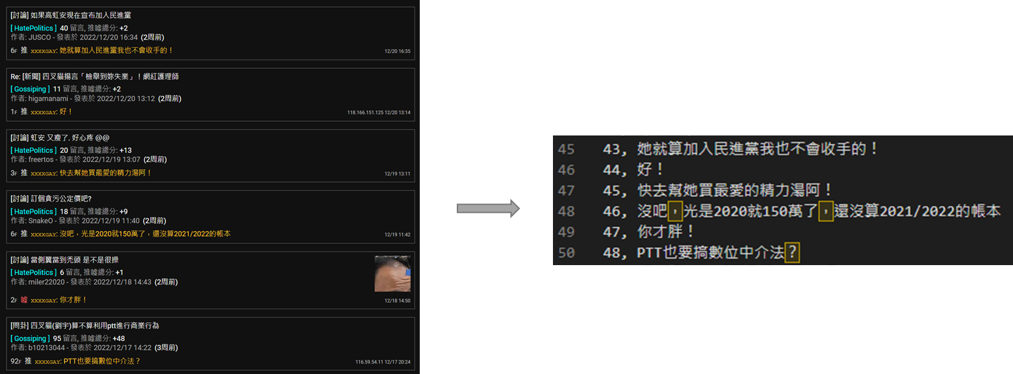
Method
Step 3: Find the Specific User’s Comments
Fetch all the data on specified pages of PPT by a web scraper tool
csv file
https://www.pttweb.cc/user/{USER}?t=message&page={PAGE}

Slide 10
Method
Step 4: Language Model Testing
Load BERT tokenizer
Create distributed data samplers and loaders
Build distributed BERT model
Predict samples
Aggregate the results from different GPUs

Slide 11
Experiment
Implementation details
Environment: NCHC
AMD EPYC 7302P 16-Core Processor
GeForce RTX 3070 Ti × 2
Collective communications library: NCCL
Pretrain language model: bert-base-Chinese
Batch size of training & testing : 3
Epoch: 30
Optimizer: AdamW
Learning rate: 5e-6
It’s not ok

Slide 12
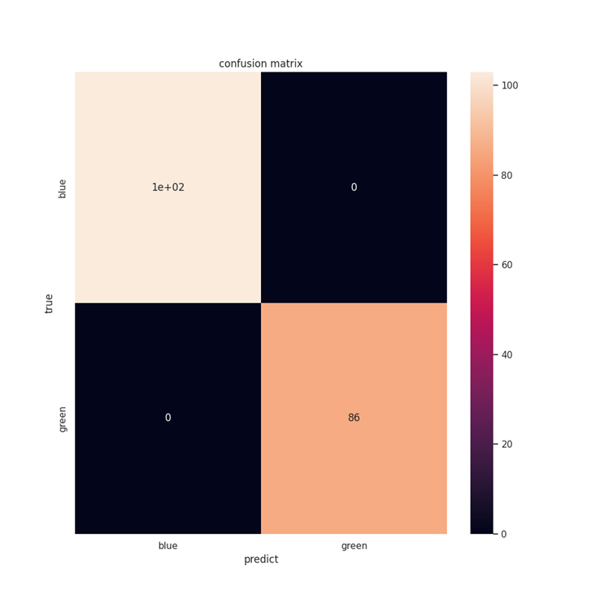
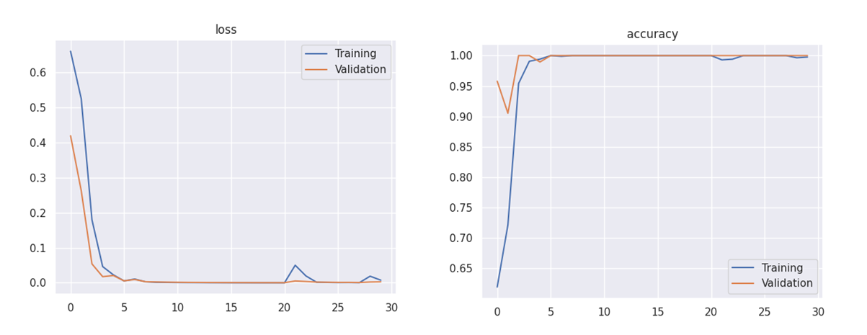
Experiment
Training logger

Slide 13
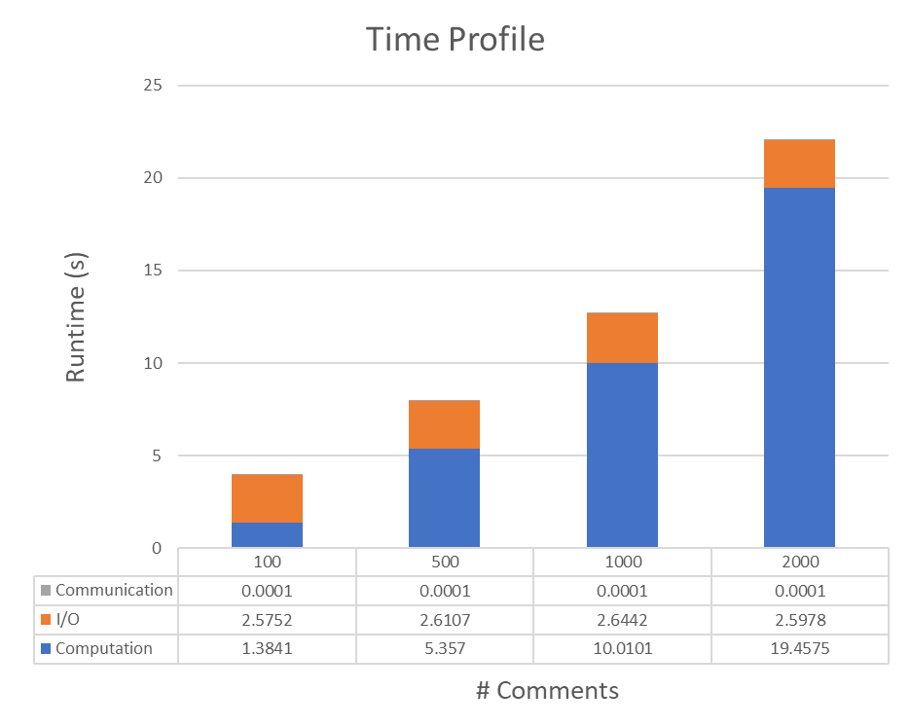
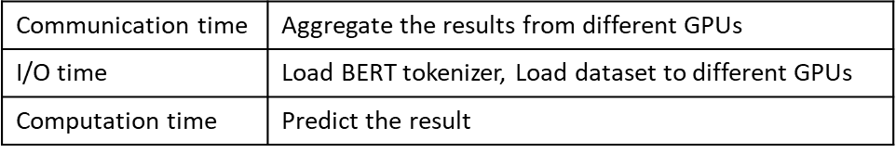
Experiment
Testing

Slide 14
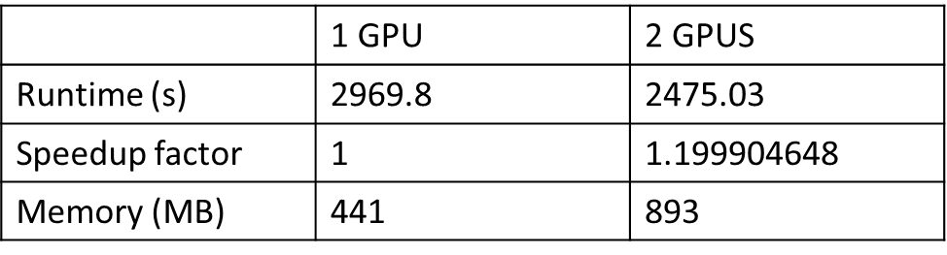
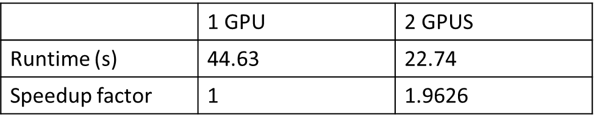
Experiment
Training Speedup
1891 news
Testing Speedup
2000 comments

Slide 15
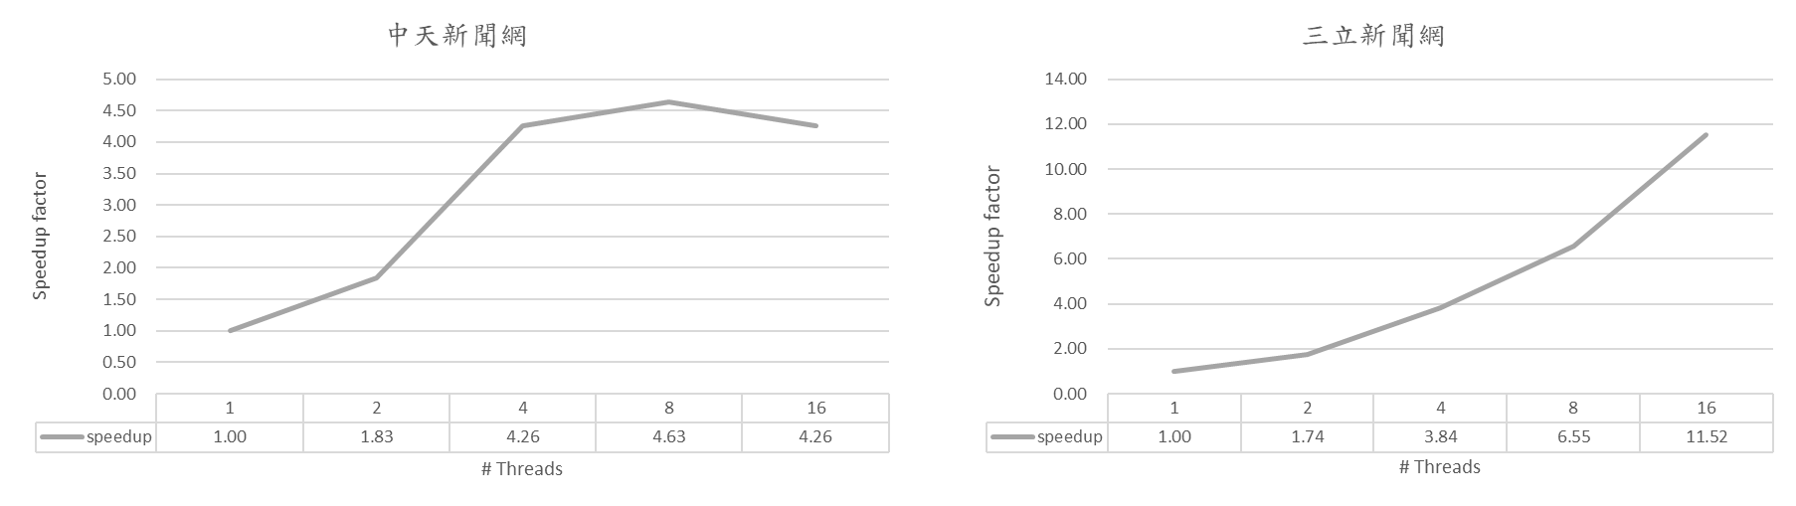
Experiment
Crawler
中天 : 1050 news
三立 : 840 news

Slide 16
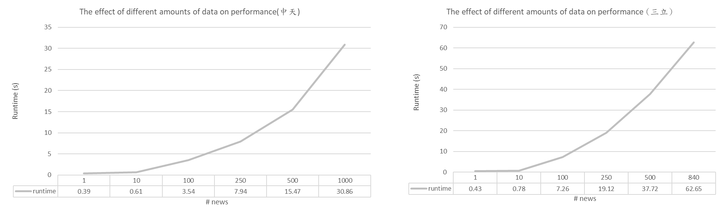
Experiment
Crawler
Threads = 16

Slide 17
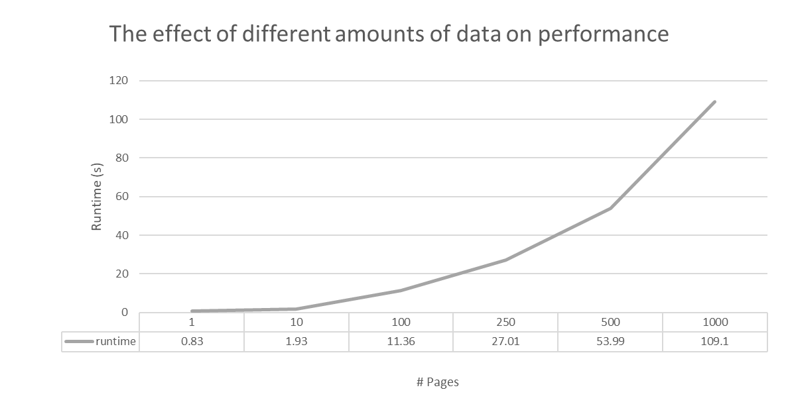
Experiment
Crawler
Threads = 32

Slide 18
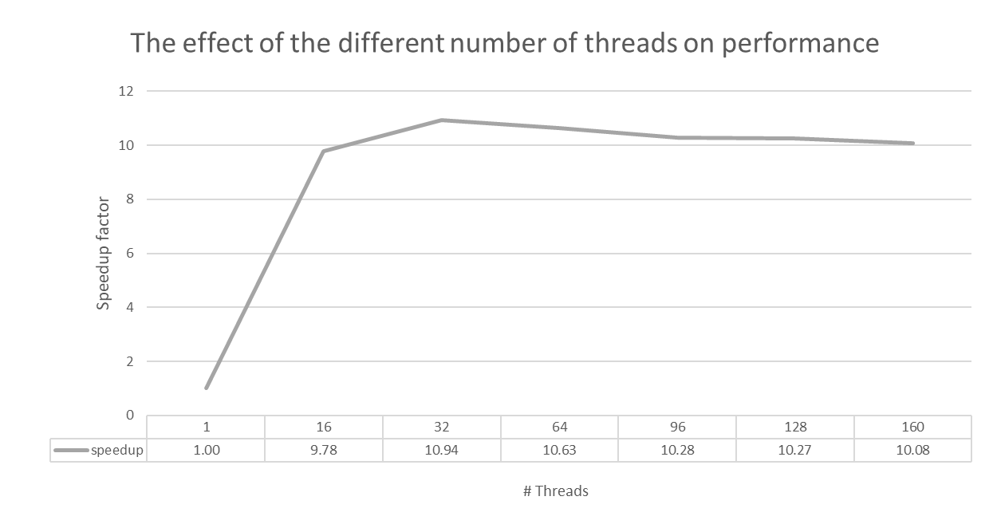
Experiment
Crawler
Pages = 2000

Slide 19
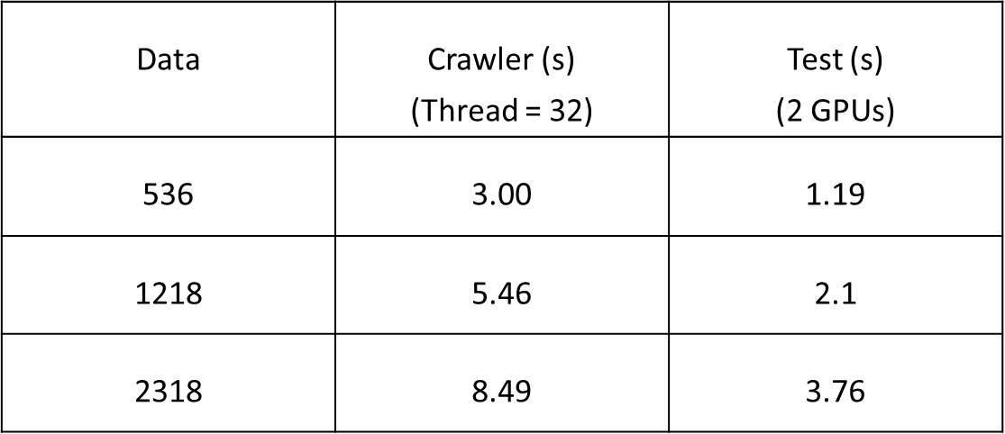
Experiment

Slide 20
Demo

Slide 21
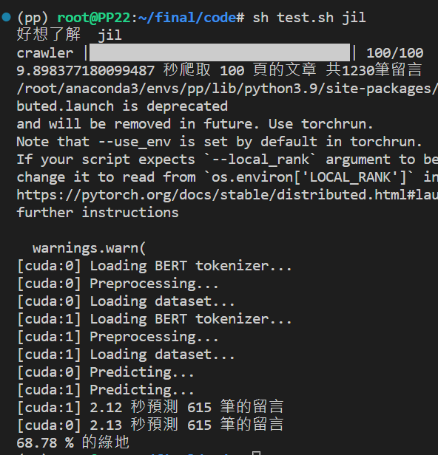
Experiment
Testing result
User : jil

Slide 22


