Slide 1
ReSQM: Accelerating Database Operations Using ReRAM-based Content Addressable Memory
Huize Li, Hai Jin, Long Zheng, Xiaofei Liao
Huazhong University of Science and Technology
September 20-25, 2020
Virtual Conference

Slide 2
Outline
Background and Motivation
Our Approach
Evaluation

Slide 3

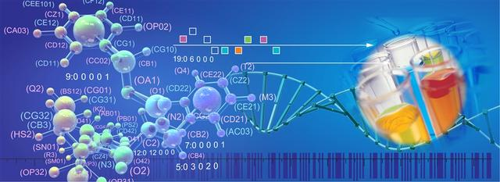






Database Applications Is Ubiquitous
Data Analysis
Genetic Engineering
Scientific Computing
Every Aspect of Life

Slide 4
Existing Database Operations Accelerators
GPU and FPGA Accelerators
On GPU: StoreGPU, ADSM, DFT-based, CUDA-based
On FPGA: Using FPGA accelerate select, sort, and join.
NDP and PIM Accelerators
Smart SSD, JAFAR, RRAM-based, NVQuery
These efforts suffer from the
well-known “memory-wall” problem
These efforts suffer from the
scalability problem

Slide 5
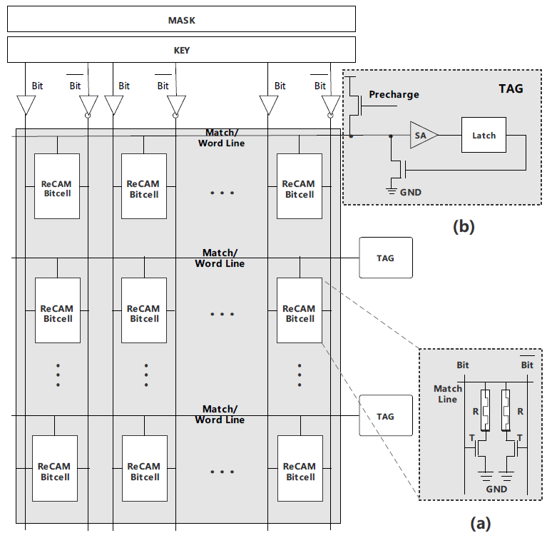
ReRAM-based Content Addressable Memory (ReCAM)
Mask: column selecting
Key: stored data to be write or compared
ReCAM-bitcell: store tables
TAG: stored results of comparisons
(a), A sketch of
ReCAM bitcell
(b), TAG register organization

Slide 6
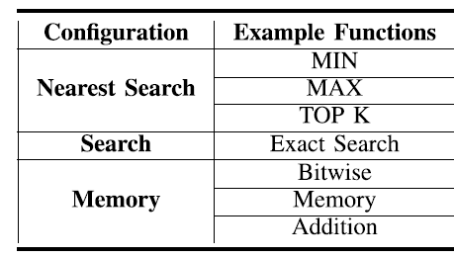
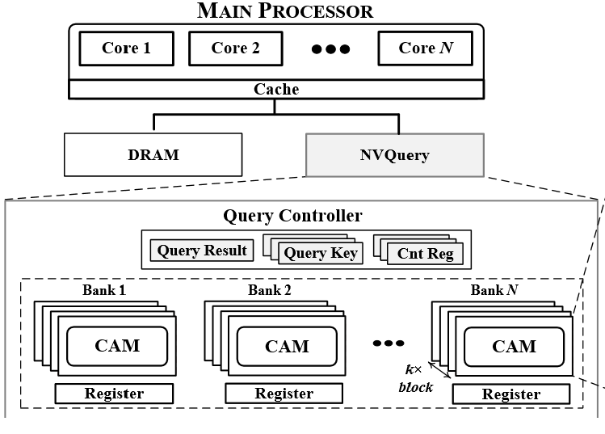
NVQuery
The first ReCAM-based accelerator that uses heterogeneous solution to boot the performance of database operations.
They designed NVQuery to accelerate a wide range of database operations.
NVQuery can support approximate
computing.

Slide 7
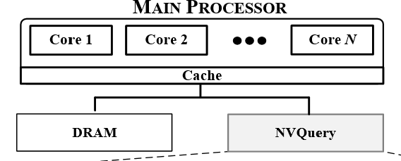
Problems
Heterogeneous
Off-chip transmission still exists and hurts the performance of database queries.
Poor support to sort
Near-distance search can’t scale well to support sort queries.
Performance limitation on join
They use look-up tables to process exact
search so as to support equi-join, so the
number of table lookups will be too much.

Slide 8
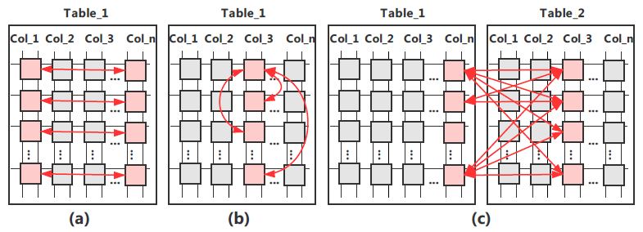
Motivation and Chanllenge
NVQuery: Well support for lots of database operations
Table data mapping is natural on ReCAM array
Straightly process queries in memory can eliminate off-chip transmission.
In-situ computing need protect original data.
Specific sort and inequality join algorithm
for ReCAM.

Slide 9
Outline
Background and Motivation
Our Approach
Evaluation

Slide 10
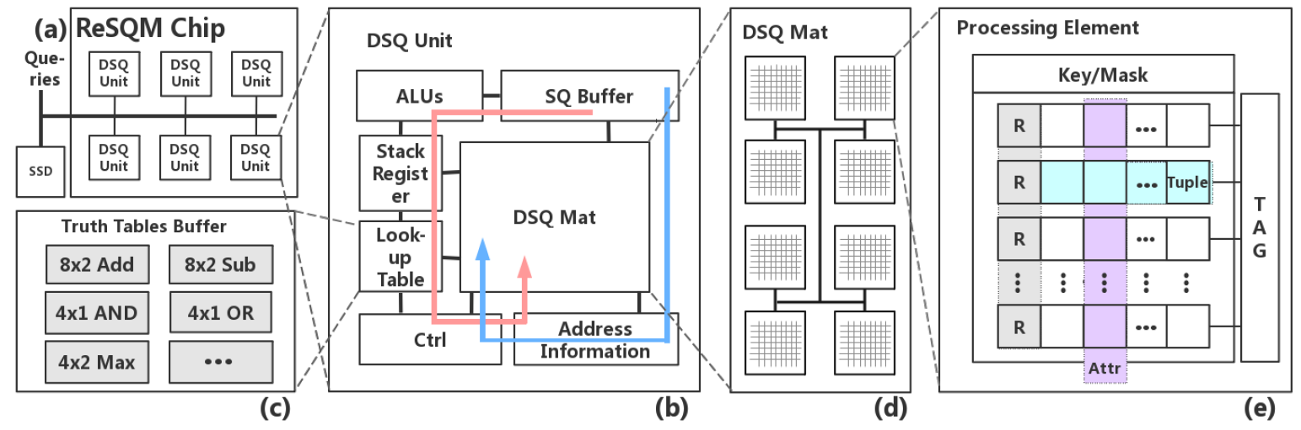
ReSQM
A ReCAM-based Structured Query Accelerator
Transport instructions to memory rather than transport data to off-chip processor.
Overall Review of ReSQM

Slide 11
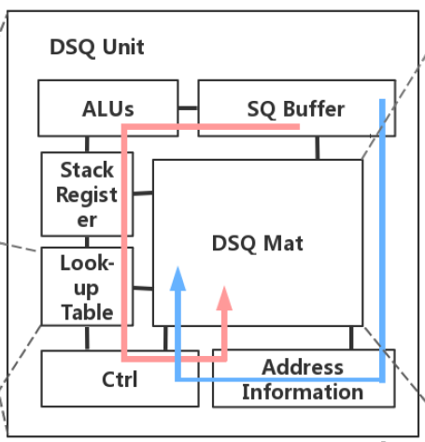
ReSQM—DSQ Unit
SQ Buffer
store query instructions
ALUs
parsing query instructions
LUT
support basic arithmetic and logic operations
Ctrl
manage components in DSQ Unit
AI
record attributes address

Slide 12
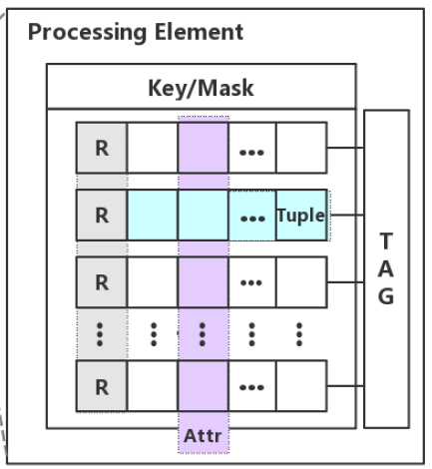
ReSQM—PE
Key and Mask
receive signals from Ctrl and control CAM array
Rows
stored a tuple
columns
stored an attribute
R region
stored intermediate results and assist processing it

Slide 13
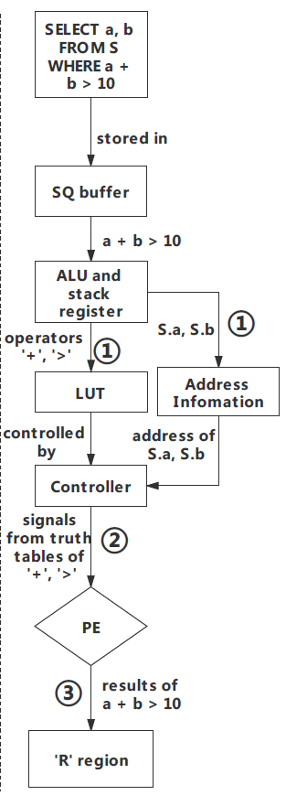
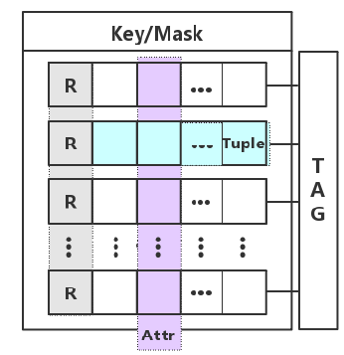
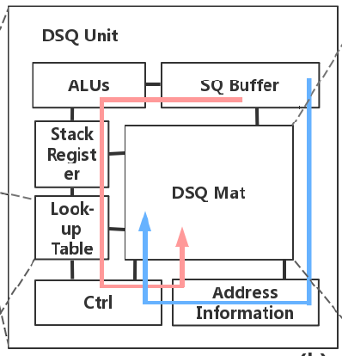
Accelerating Selection Queries
KEY design
R region design
ALUs and stack register
Process
Parse instructions and distribute operators and operands
Using look-up tables generate control signals
Store the results

Slide 14
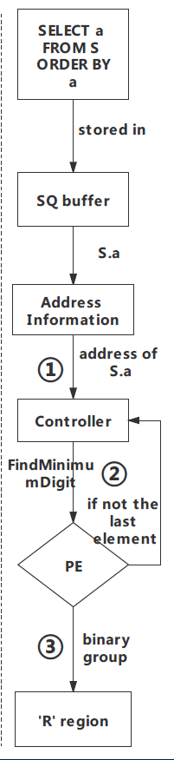
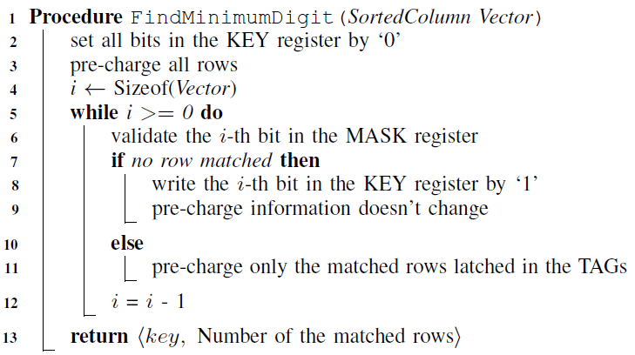
Accelerating Sort Queries
KEY design
Without row swapping
Count-based algorithm
FindMinimumDigit
Design b-groups to reduce writing
Process
Search sorted attribute
Iterate to find the min
Construct b-groups and stored

Slide 15
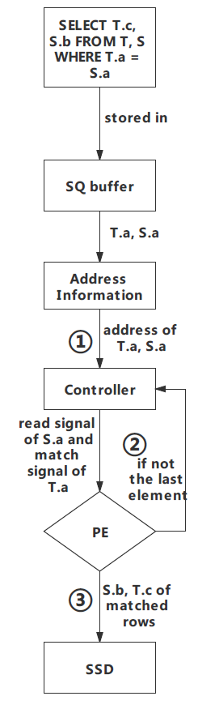
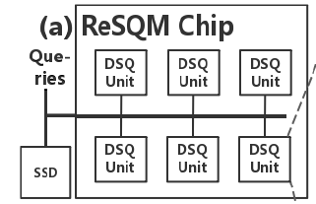
Accelerating Equi-join Queries
KEY design
Avoid to use look-up tables
A pre-read process
Part of results are stored in SSD
Process
Search 2 attributes to be joined
Iterate to merge their attributes
Construct new tuples and stored in SSD

Slide 16
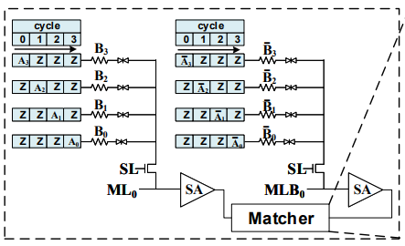
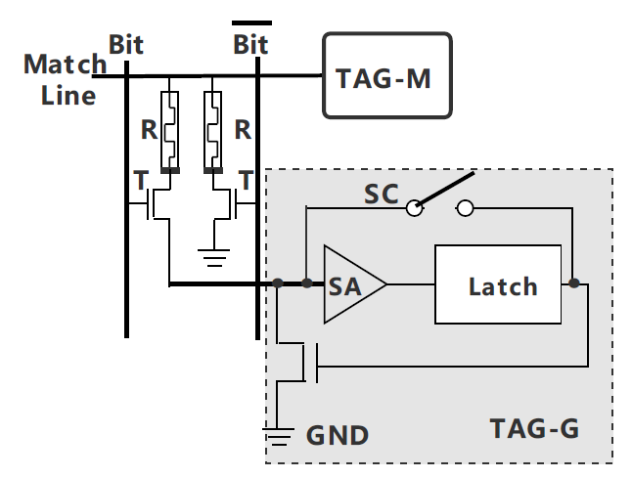
Accelerating Inequality Join Queries
The Process diagram is same to the equi-join
Problems and KEY design
ReCAM array can’t process
relational comparison
RFAcc present a relational
comparator for random forest
Current relational comparator can’t work well in database area
We modified ReCAM bitcell to support relational comparison in database

Slide 17
Computational Complexity
FindMinmumDigit
Its complexity is O(MN)
Where N is the number of elements and M is the number of elements with duplicates
It can be finished in N cycles under ReSQM
Join
It need O(NM) matchings
Where N and M represent the lengths of
two joined attributes
It can be finished in N cycles under ReSQM

Slide 18
Outline
Background and Motivation
Our Approach
Evaluation

Slide 19
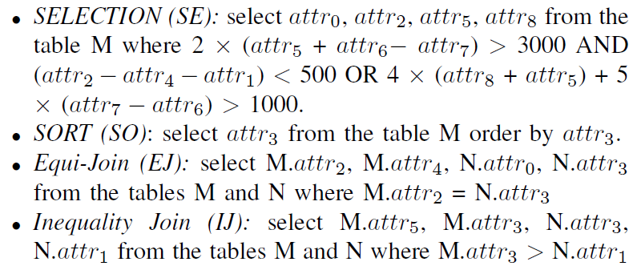
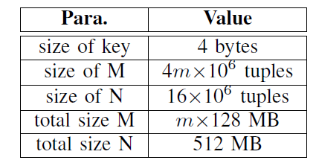
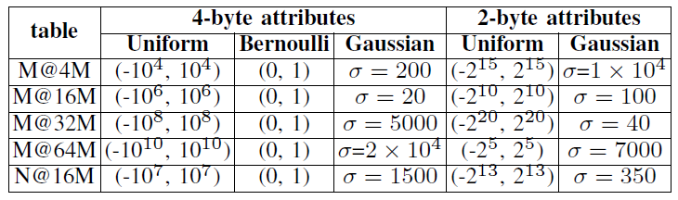
Setup
Typical benchmarks
10 different queries
for each query type
Workloads
Shown as below

Slide 20
Setup
CPU-based baselines
10-core Intel Xeon E5-2630v4 CPU@2.2GHz, 25MB Cache, 68.3GB/s, and 85Watt TDP.
Applications running on baseline platforms
Selection—SQLite selection
Sort—radix sort
Equijoin—sort-merge join
Inequality join—PostgreSQLv9.4

Slide 21
Setup
ReSQM configuration
1GHz with 12 DSQ units and each PE 512x512.
We use SPICE simulation to obtain the energy consumption, area parameters, and performance.
Each DSQ unit has 437.5MB memory and 200Watt power
Read latency is 8.31ns and write latency is 17.42ns.
Cycle-Accurate Simulation
Data mapping
Decompose a database query into a serial of
arithmetics and data communication operations.
Convert arithmetic operations into ReSQM
atomic operations

Slide 22
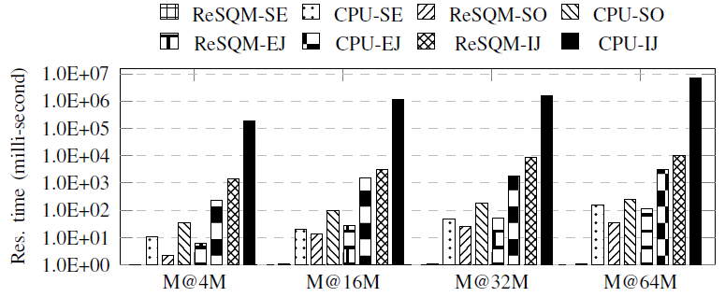
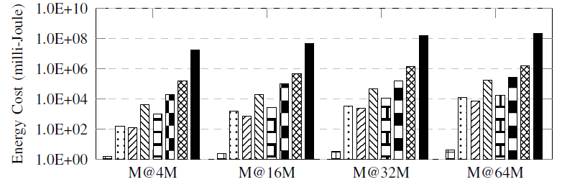
Overall Evaluation
Speedup--Throughput
M@4M: 445x, 13x, 41x, and 229x for SE, SO, EJ, and IJ, respectively.
M@64M: 721x, 25x, 95x, and 471x for SE, SO, EJ, and IJ, respectively.
Energy consumption
M@4M: 164x, 12x, 21x, and 114x for SE, SO, EJ, and IJ, respectively.
Response time of ReSQM against CPU
Energy consumption of ReSQM against CPU

Slide 23
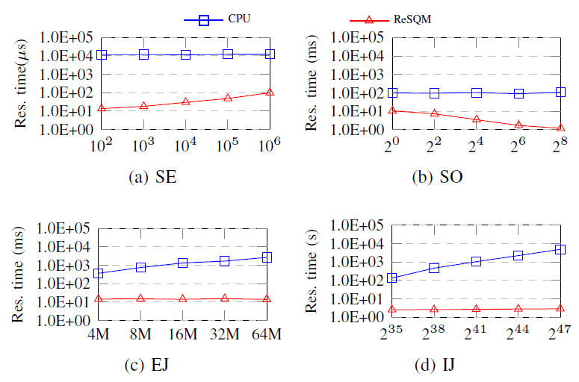
Systematic Impact of Query Result Size
SE—ReSQM is more sensitive than CPU to the query result size
SO—The performance on ReSQM of SO being better when the repetition times grows
EJ and IJ—CPU baseline performance decrease while the result size grows
Response time of ReSQM against CPU with varying query result sizes. All results are obtained on M@16M

Slide 24
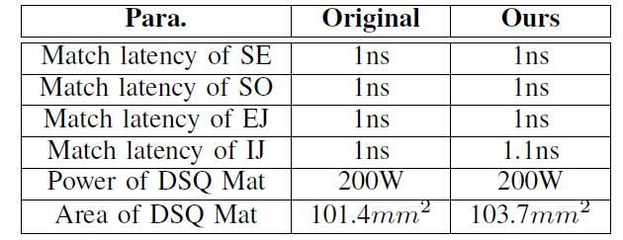
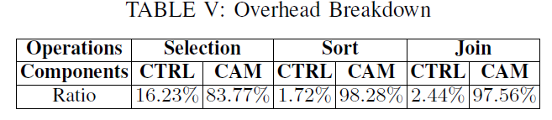
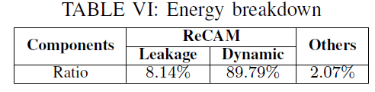
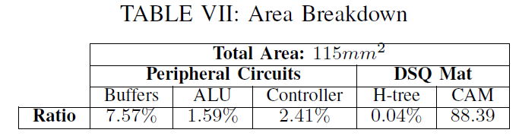
Overheads and Breakdown
TAG-G Overheads
No influence to Energy consumption
0.1ns latency to IJ and 2.3mm² to area
Controller Overheads
Shown as right table
Energy and Area Breakdown
Shown as right table
Comparisons between the original ReCAM array and our modified array

Slide 25
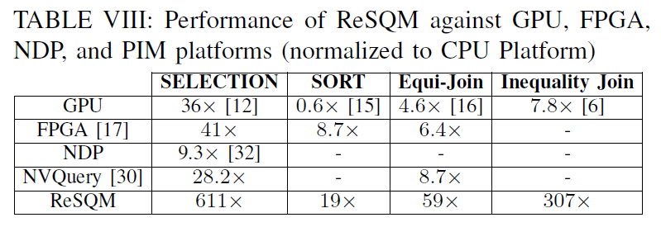
Compared to Other Platforms
GPU configuration:
NVIDIA GTX1080@1733 MHz, 2560 CUDA Cores, 2MB shared L2 Cache, 8GB Graphic Memory, and 180Watt TDP.
All other platforms
FPGA-based, NDP-based, PIM-based platforms.
Performance
ReSQM shows the best performance by the speedups of
15x, 2.2x, 6.8x, and 39x over the better performance
among GPU, FPGA, NDP, and PIM platforms.

Slide 26
Conclusion
ReSQM: A ReCAM-based Structured Query Accelerator
ReSQM is the first ReCAM-based architecture that can process database queries in memory effectively and efficiently without the assistance of CPU
We develop a series of hardware-algorithm co-design to improve the efficiency of
performance acceleration on different
database operations
We conduct a comprehensive evaluation

Slide 27
Thanks! Q&A

