Slide 1
OmicsOne-streamlit installation
Yingwei Hu
09/25/2025

Slide 2
Install anaconda
https://www.anaconda.com/download
Download anaconda and install it in Windows

Slide 3
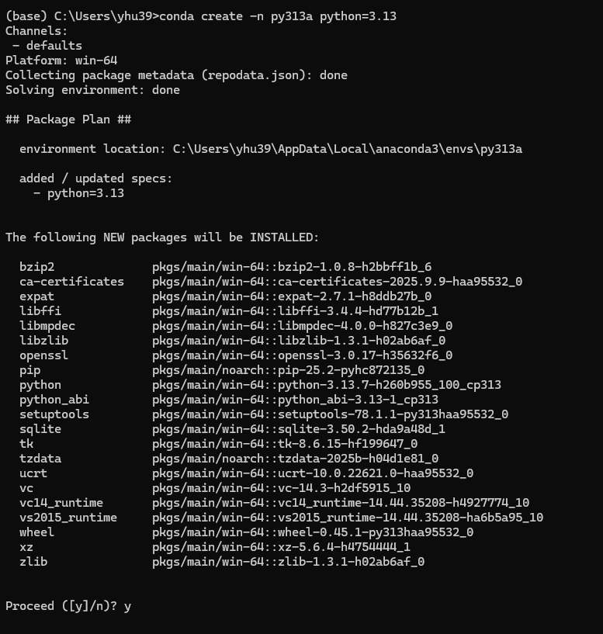
Install python 3.13

Slide 4
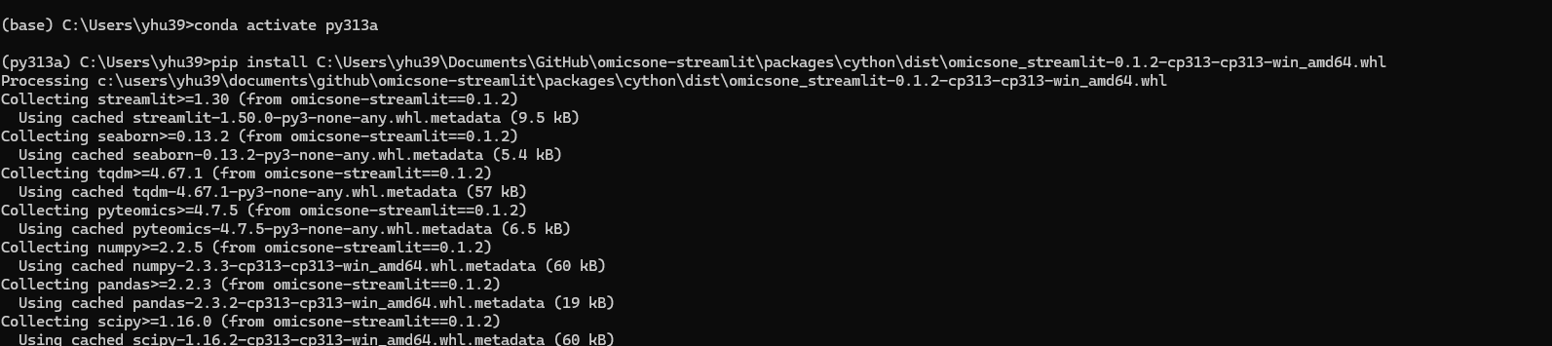
Activate python environment & Install omicsone-streamlit using whl

Slide 5
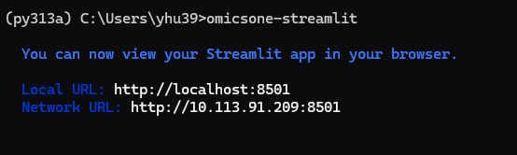
Start omicsone-streamlit
The webpage of omicsone-streamlit should be opened automatically.
If not, please visit http://localhost:8501 in your web browser (e.g. Chrome, Edge, etc.)

Slide 6
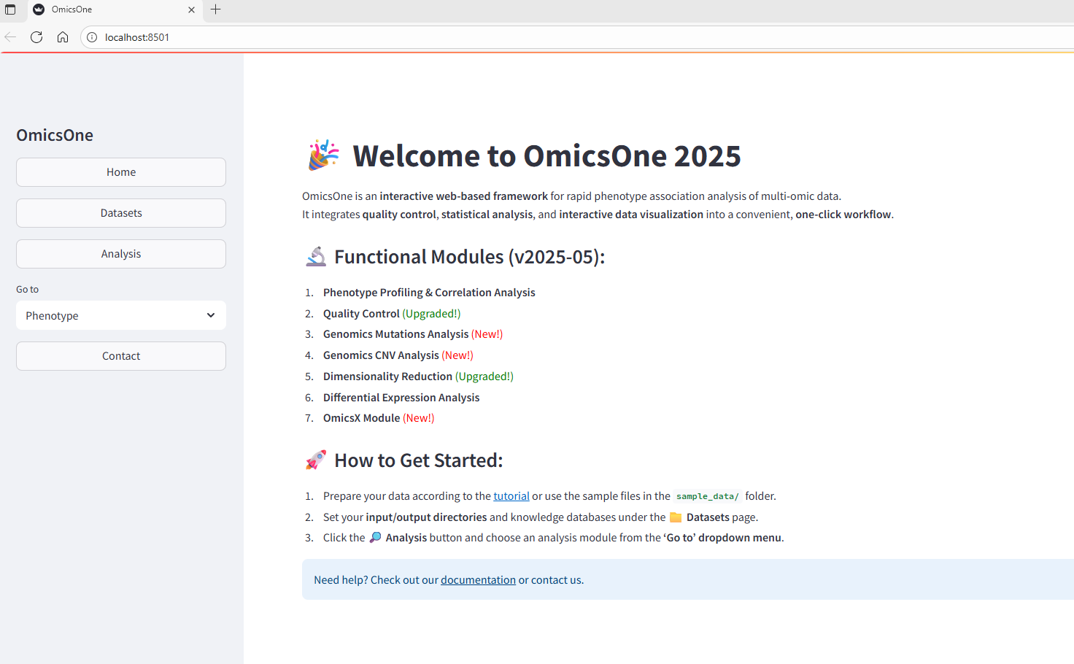

Slide 7
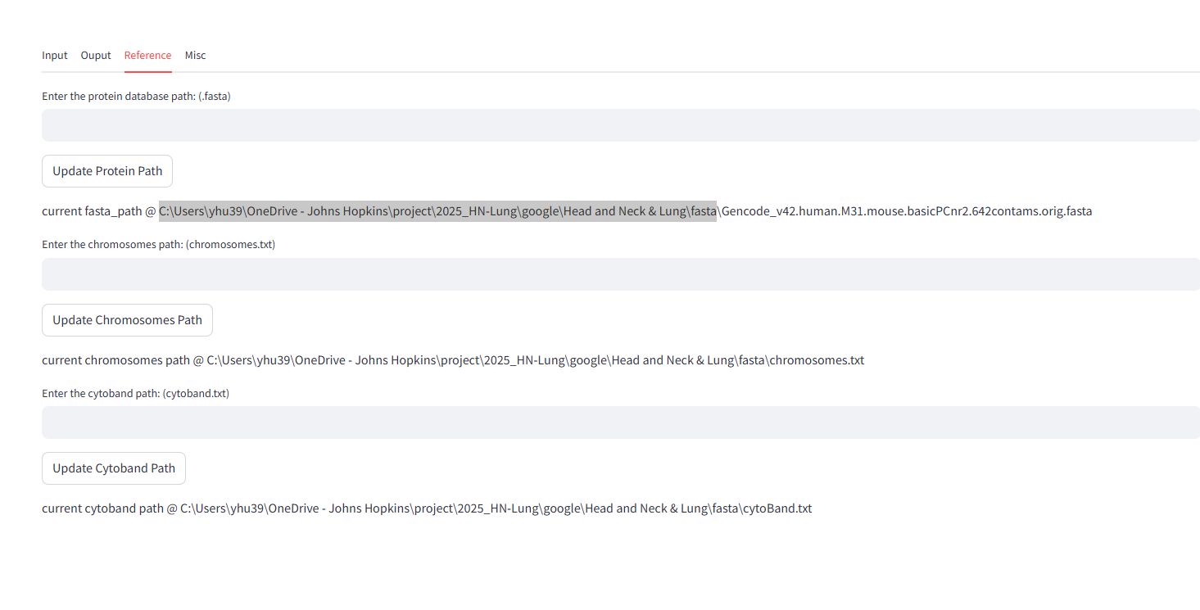
Please copy and paste the input file path to the reference paths input boxes to update them pointed to your path

