Slide 1
2017 - Artificial Intelligence Vision Common work streams across the enterprise
#1
Recognized Artificial Intelligence leader in Healthcare
Attain and Sustain Resources
Best in Class – Reinforcement Learning – Leverage Innovation
+
+
+
+
Scalable Infrastructure
Data Management and Assets
Analytics and Data Science
Business Value/ Opportunities
Leverage scalable tools and solutions to access, integrate, analyze, and compute capabilities to create rapid value.
Identify, source, integrate and enrich data from internal and external sources; linking and making data accessible for exploration, modeling and reporting.
Data science in core disciplines, including AI, ML, Deep Learning, visualization and NLP, methods and tools.
Working closely with users to understand their opportunities, helping them utilize new resources; designing and building solutions that bring business value.

Slide 2
Artificial Intelligence for UHC
Creating a new value engine for UHC will require us to adapt our current data and analytics to predict and influence healthcare decision making.
Natural Language Processing for Healthcare
Apply Artificial Intelligence to spoken and written language to understand meaning, discover patterns, and prescribe actions
Consumer Decision Intelligence
Apply Artificial Intelligence and Research to uncover patterns in consumer decision making to better understand, target and simplify their decision making process
Intelligent Adjudication Platform:
Integrate artificial intelligence into adjudication platforms to enhance auto adjudication rate and accuracy
2

Slide 3
Capability Deep-Dive
Natural Language Processing

Slide 4
Natural Language Processing (NLP)
Capability Overview
Capability | Description | Maturity | Comments
Document Ingestion | To perform text analytics / text mining, data in the form of text must first be available. Often, such text is not readily available and must be derived from documents such as contracts, appeals etc. | Prototype | Used open source OCR libraries to read text from Provider contracts with near exact levels of replication.
Entity Recognition & Fuzzy Matching | Locate and classify entities such as names of persons, organizations, locations etc. from unstructured text, and look-up those entities in a database. | Advanced-Deployed | Built a web crawler that is being used for PI use-cases
Sentiment Analysis | Perform sentiment analysis on tweets, survey verbatim etc. using simple corpus-based approach to advanced Machine Learning-based approach | Advanced-Deployed | Performed sentiment analysis on tweets and UES comments
Topic Modeling | Discover “topics” or “themes” in documents where documents could be comments or any unstructured text – “What are people talking about?” | Advanced-Deployed | Extracted key themes from NPS comments and tweets
Natural Language Understanding | Utilize latest developments in chat bot technology to build simple bots for applications in the call center space or for deployment on apps | Prototype | Chat bots can aid call center agents or help members with guided interactions on apps
Voice To Text and Speech Recognition | Use open source or commercial libraries to convert calls to text – this is to enable the business to answer the fundamental question “Why did a member call us?” | Exploration | Having call transcripts for all calls enables us to perform granular root cause analyses
Intelligent Automation | Target “document heavy processes” i.e. processes where a human being “looks” at a document and takes a decision. Combine NLP and Deep Learning to automate such processes. | Exploration | NLP with AI / ML can take automation beyond the current rule-based paradigm

Slide 5
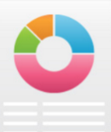






I. Optical Character Recognition [OCR]
Capability Overview & Results
Objective | Digitize handwritten or printed images from a scanned document into machine readable form based on image processing and artificial intelligence techniques
OCR uses the Tesseract library for image processing
Conversion to Machine readable data formats
Storage
Image processing
PDF
XML
Reporting
Artificial Intelligence
DOC
Search
XLS
TXT
Image (JPEG,PNG…)
XPS document
Scanned PDF
Data compression
Area |  | Use cases under investigation
Provider Data |  | Digitize paper contracts for fast scan and information retrieval from the documents Enrichment of NDB
A&G RMO |  | Enable automated Appeals and Grievance identification for faster and accurate volume routing
Clinical Ops |  | Find Compliance in UHC provider contracts w.r.t CMS mandate

Slide 6

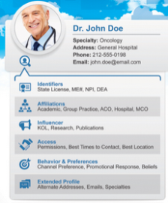






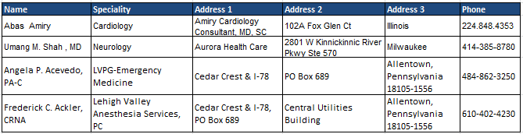
II. Entity recognition
Web Crawler
Objective | Develop a web crawling, entity recognition and fuzzy match capability to address multiple use-cases centered around extracting Physician information from various web based articles
Web Crawler Process overview
Websites on Healthcare or FWA information
Python based scraping and entity recognition
Fuzzy matching based on provider name and demog
Identify relevant FWA articles from websites
Scrape provider details only
Map provider information to NDB
Web Crawler Output

Slide 7
II. Entity recognition
Web Crawler – Use cases
Use case |  | Usage of web crawler (with sample data sets)
Fraud Provider data universe |  | Objective – Use websites publishing fraud related news and create a database of all Known fraud providers which can be leveraged in various Payment integrity applications Process LIVE for smartbrief.com and justice.gov, which Crawls these websites for articles Scrapes the fraudulent provider data via Entity recognition Matches it with UHG provider data (NBD) Stores provider details in the Web Crawler data universe (BDPaas)
Emergency room scheduling fraud |  | Objective – Identify providers who offer emergency room scheduling The crawler was used to search and scrape data for facilities offering ER scheduling option via their websites 468 facilities were scraped from Google search results and were shared with the legal team for further investigation 10 out 26 manually checked facilities offered ER scheduling
Adeptus Free standing ER ratings |  | Objective – Enable UHC Investigations to identify the relevant Employer Group Plans whose members have been adversely impacted by Adeptus, from which UHC has incurred substantial exposure in claims paid. bbb.org was used to find the user ratings and member comments for all the businesses related to Adeptus, and details were shared with the legal team.

Slide 8

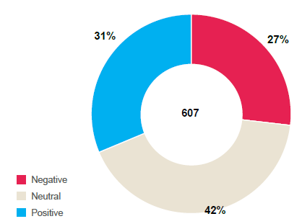
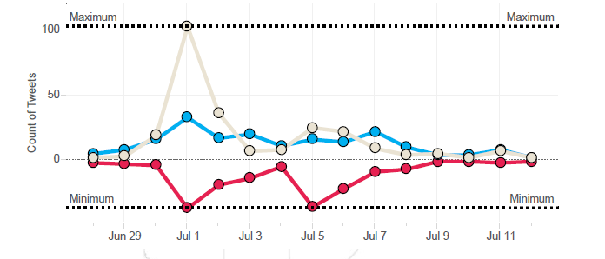
III. Sentiment analysis
Twitter
Objective | Leveraging 1) Natural language processing techniques 2) state of art sentiment tagging and 3) Topic modeling to determine member sentiment for UHG specific tweets
Solution Approach
Goal is to understand member and provider feedback / experiences as they use social media as a way of communicating their views Use Twitter API to extract tweets and user information related to UHG on a weekly basis Sentiment analysis on unstructured data by – Lexicon based tagging Root (driver) word identification Emoticon processing Extracted tweets are also classified into 5 major themes using topic modelling based on a statistical algorithm
UHG Twitter Sentiment analysis dashboard
Overall Sentiment
Timeframe:
In production since August 2016
Tweets per day
Dashboard capabilities
Ability to view the overall number of tweets, their sentiment, Avg. tweets per day, etc. Ability to drill down till a single tweet based on the theme, geolocation, sentiment and time Monitor spike in UHG specific topics and “State” specific sentiments
Dashboard link

Slide 9

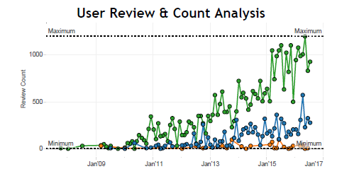
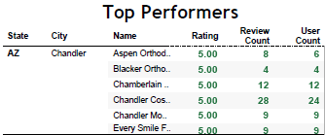
III. Sentiment analysis
Yelp
Objective | Evaluating customer sentiment/ rating across UHC’s provider network at diverse levels by capitalizing reviews on Yelp app.
Solution Approach
Yelp is an app to review business related to hospitality and service. Members use this platform to rate the services from UHG provider network Mapping of providers from specialty level to their business name can be leveraged for identifying the reason for a negative customer sentiment and fraud. One time data from a Yelp competition is used to create a sample dashboard to track provider and facility related ratings
Yelp Sentiment Analysis Dashboard
Dashboard capabilities
Dashboard features include reviews for various providers, facilities and businesses Provider search option to track the nos. of reviews and sample comments Demographic map of all competitors in and around a provider
Dashboard link

Slide 10
IV. Topic Modeling
Unstructured Data Mining
Applying advance text analytics on unstructured data in form of member feedbacks, agent comments etc. to derive intelligent insights
Member Issues with UHC & Customer Service
Member Call Reasons
Auto-tagging HIX member complaints
Drivers for Detractors
NPS Survey Data
`
Custom dictionaries
Sometimes all the paperwork is confusing. ...explain the paperwork
better. It's all overwhelming.…
Printed horizontally instead of
vertically. Very difficult to read
& follow.
Tokenization
1
Stopword removal
Stemming & Lemmatization
United Experience Survey
Exploratory
Analysis
Stop making me submit your the
claims two times …. want all sorts of information……. get your act together.
It's terrible dealing with UHC.
Advanced
Text Analytics
Engine
POS
Tagging
Agent Call Notes - MIIM
2
Vectorization
& Feature Engineering
member calling about bill she rcvd for 194.3?. she has a 250 ded for
procedure on dec 16, 2015. tried to
call silver back, no answer, tried to
call dr, no answer.memebr
will call back
Classification
Algorithms
HICS – HIX Member Complaints
3
Topic
Modelling
Stop making me submit your the
claims two times …. want all sorts of
N-Gram
Search

Slide 11




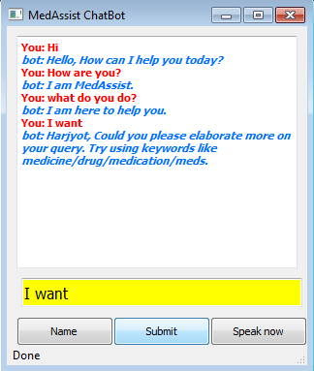
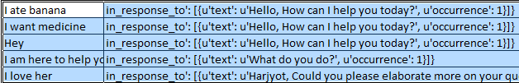

V. Natural Language Generation
ChatBot
Objective | ChatterBot is a Python library that helps to generate automated responses to a user’s input by using a selection of machine learning algorithms to produce different types of responses.
LogicAdaptor1
Output 1
User Input
“I am feeling sleepy”
LogicAdaptor2
Output 2
LogicAdaptorN
Output N
Output
The Input statement is processed by each of the declared logic adapters
Response with highest confidence is chosen as the final reply
Access Application via a simple frontend
This is self learning as it
learns and maintains a database of all interaction that takes place
“MedAssist”
Demo

Slide 12


VI. Speech To Text / Voice Recognition
Rationale and Approach
What ?
Developing the ability to identify words and phrases in spoken language and convert them to a machine-readable format.
Acoustic & Language Modelling to identify linguistic units of speech from audio signals
Human + AI Customer Service is the future and has led to dramatic improvements in companies which are leveraging them
How ?
Why ?
‘Speech to Text’ Applications
Call Center Operations - Real-time Call Risk Assessment & automated transfers/escalations , Voice based member identification
Chat Bots- Automated query resolution through introduction of bots in Websites and Mobile applications
What are our options to leverage speech recognition & transcription capabilities at UHC . . .
Several UHC Vendors leverage speech technology but several consider the transcription data proprietary. - VOCI , Mattersight.
Nexedia Deployed for ~5% M&R Calls. Converts voice to text and provides keyword search
Clarabridge + VOCI Clarabridge provides end user text analytics on top of VOCI data
To leverage the full benefits of this technology, we need more than what exists today
Capabilities Under Test Currently
Low Accuracy transcription basis R&D
Training Data-
One time transcript cost
$ 150K
10K Calls
Requires in-house customization
Build In-house speech transcription capabilities
Low Accuracy transcription basis R&D
One time transcription cost
$ 150K
10K Calls
Requires in-house customization
Cost-effective
No data security concerns
Fully customizable
Capability Development
Time to Market
Deployment concerns
Effectiveness unknown until development

