Slide 1
强化学习后训练

Slide 2
环境配置
硬件：
8*Ascend-910B3
8*22核 CPU
8*194 GB 内存
quay.io/openeuler/vllm-ascend:0.9.1rc1-torch_npu2.5.1-cann8.1.rc1-python3.10-oe2203lts
软件：
CANN算子库 HCCL通信库
Pytorch2.5.1 torch_npu 2.5.1
强化学习框架 veRL 0.6.1
强化学习推理引擎 vLLM-Ascend 0.9.1rc1
code-server-linux-arm64
基础模型：Qwen2.5-7B-Instruct

Slide 3
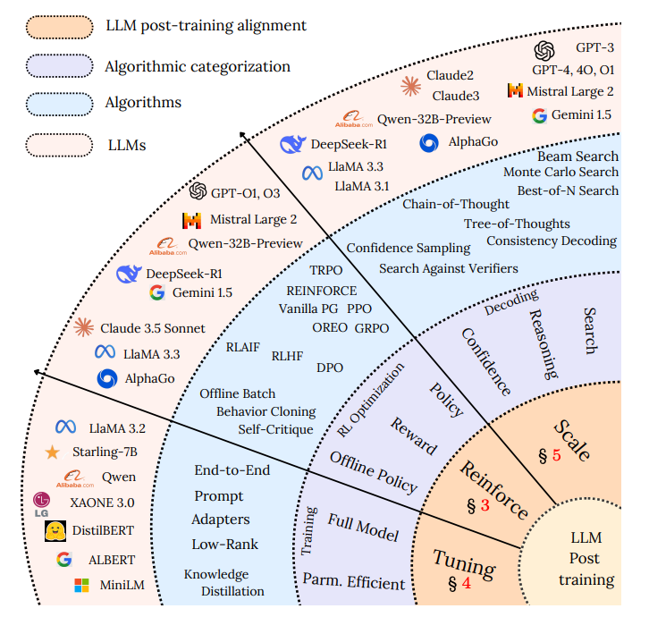
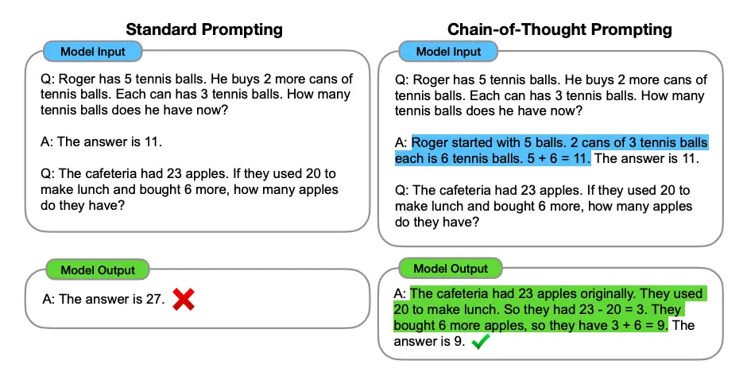
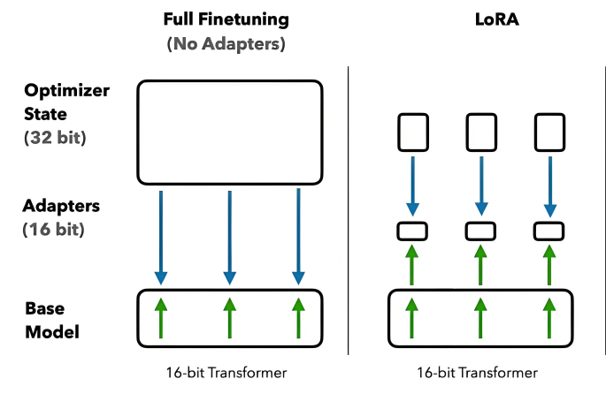
Tuning-Reinforcement
Prompt-engineering
Fine-tuning: SFT

Slide 4
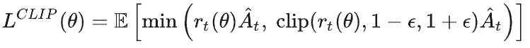
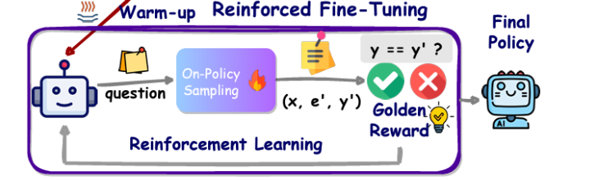
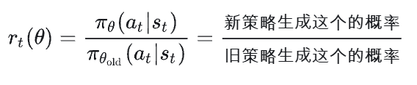
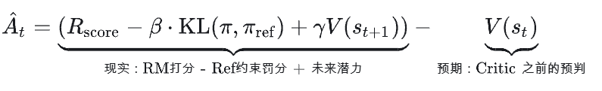
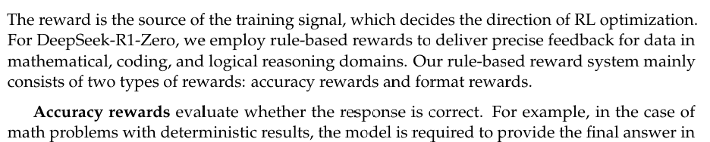
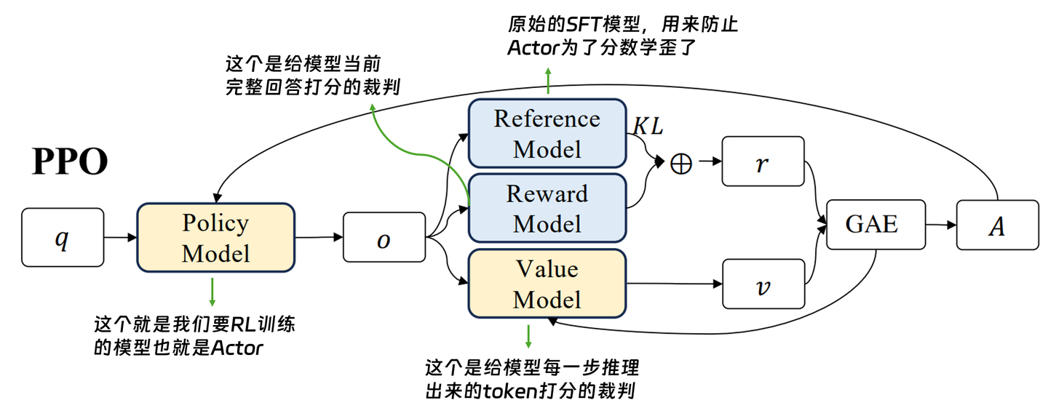
RLHF、RLVR

Slide 5
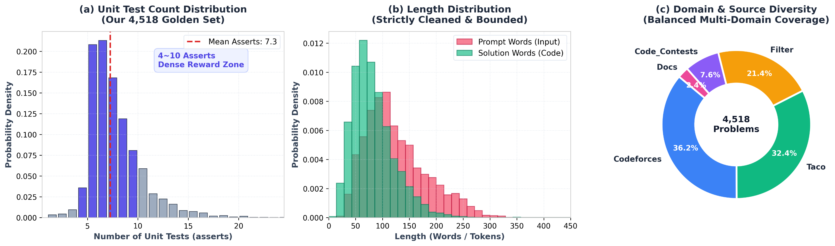
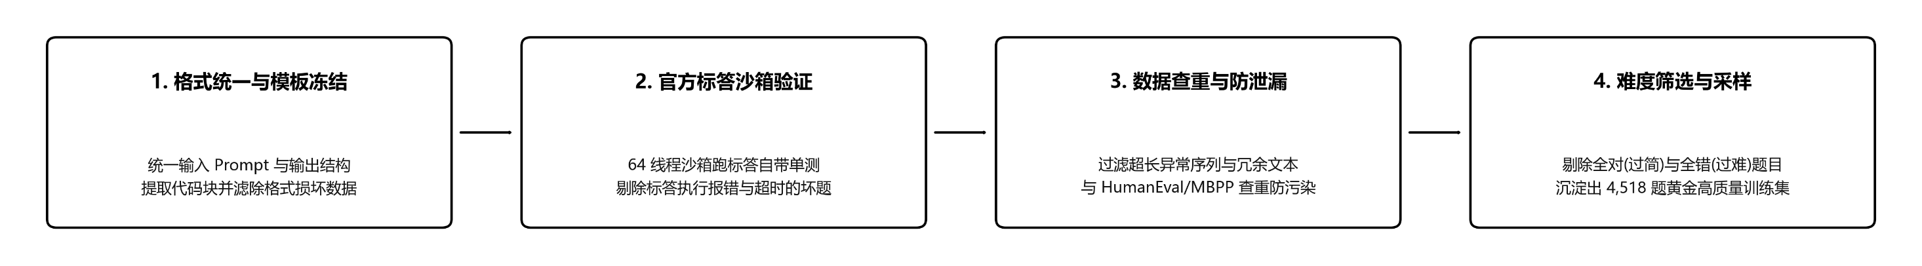
训练数据集 KodCode
https://huggingface.co/datasets/KodCode/KodCode-V1

Slide 6
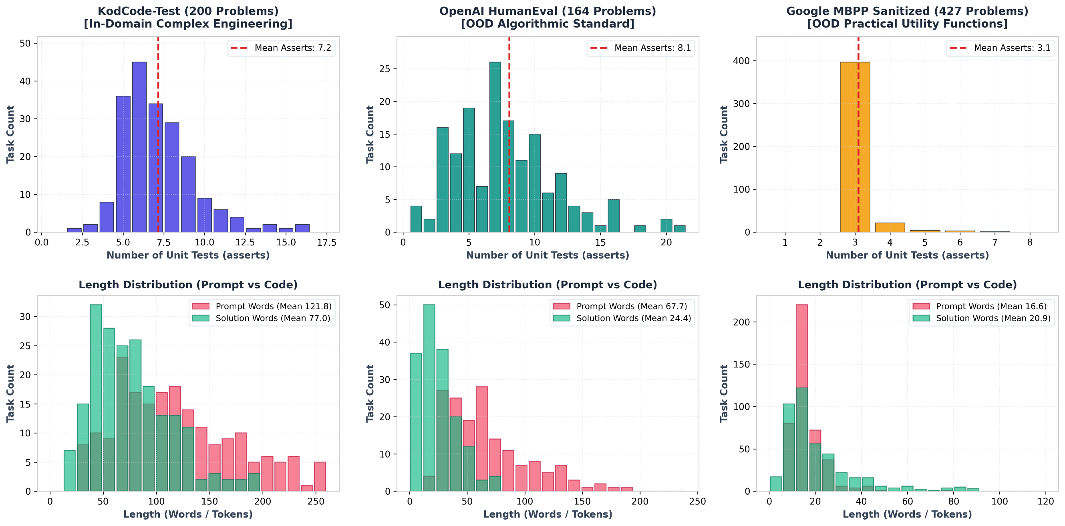
Benchmark
openai/openai_humaneval · Datasets at Hugging Face
https://huggingface.co/datasets/KodCode/KodCode-V1
Muennighoff/mbpp · Datasets at Hugging Face

Slide 7

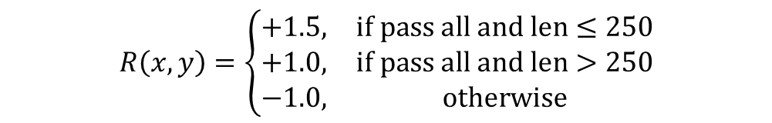
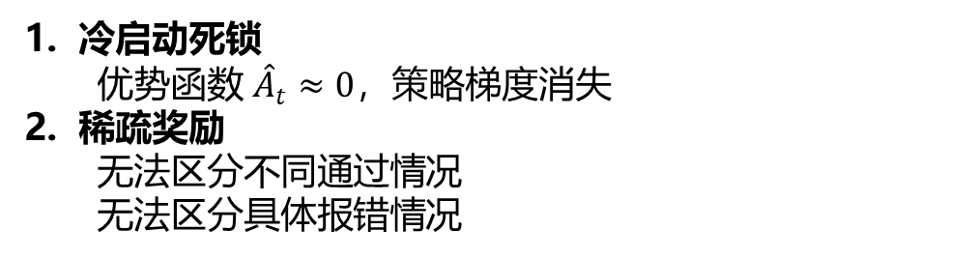
稀疏奖励
$$ℒ^{\text{CLIP}}\left(θ\right)={\overset{ˆ}{𝔼}}_{t}\left[\min\left(\frac{π_{θ}\left(a_{t}|s_{t}\right)}{π_{\text{old}}\left(a_{t}|s_{t}\right)}{\overset{ˆ}{A}}_{t}, \text{clip}\left(\frac{π_{θ}\left(a_{t}|s_{t}\right)}{π_{\text{old}}\left(a_{t}|s_{t}\right)},1−ε,1+ε\right){\overset{ˆ}{A}}_{t}\right)\right]$$
$$R_{\text{score}}\left(x,y\right)=\left\{\begin{matrix}+1.0, & if pass all \\ 0.0, & \text{otherwise}\end{matrix}\right.$$
$$R\left(x,y\right)=\left\{\begin{matrix}+1.5, & \text{if pass all and len}≤250 \\ +1.0, & \text{if pass all and len}>250 \\ −1.0, & \text{otherwise}\end{matrix}\right.$$
冷启动死锁
  优势函数 ${\hat{A}}_{t}≈0$，策略梯度消失
稀疏奖励
  无法区分不同通过情况
  无法区分具体报错情况
负优势和阶梯优势
  正梯度、负梯度
多种情况讨论
  考虑代码长度、运行超时、语法错误等情况

Slide 8
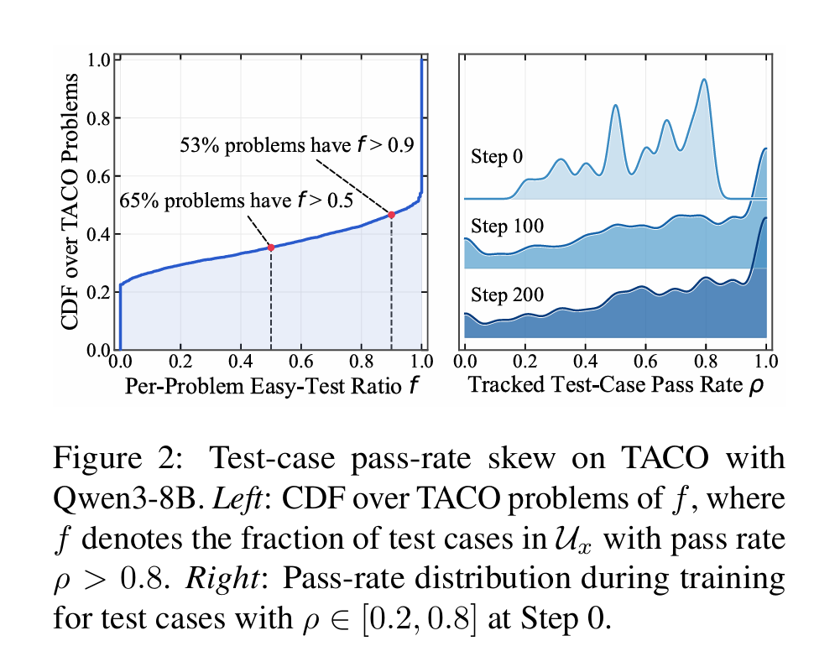

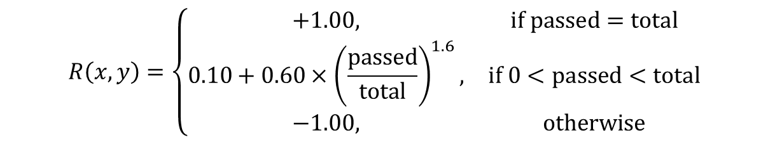
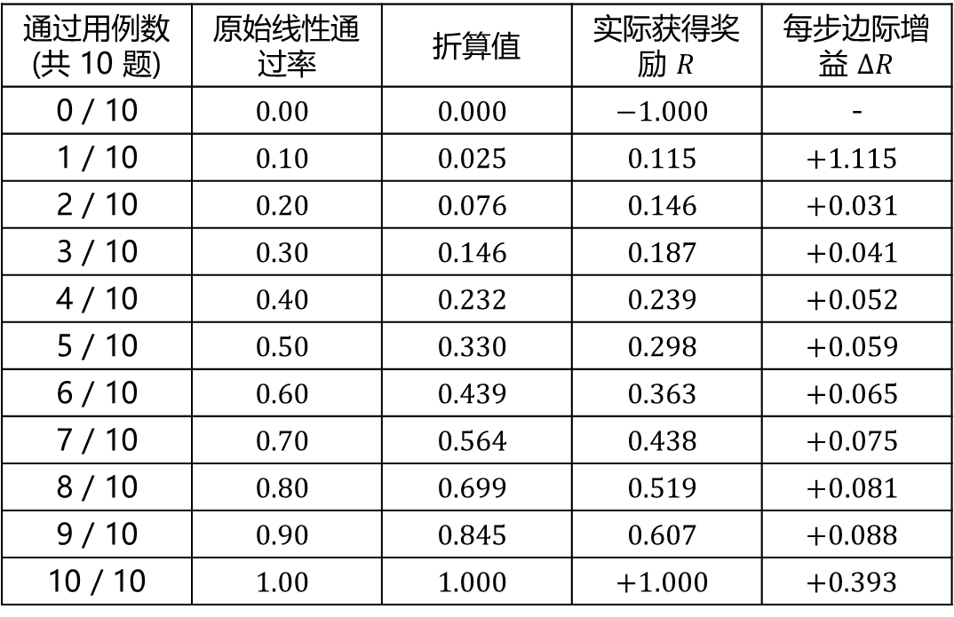
稠密奖励
Beyond Binary: Turning Partial Success into Dense Verifiable Rewards for Reinforcement Learning in Code Generation
$$R\left(x,y\right)=\left\{\begin{matrix}+1.00, & \text{if passed}=\text{total} \\ 0.10+0.60×{\left(\frac{\text{passed}}{\text{total}}\right)}^{1.6}, & \text{if }0<\text{passed}<\text{total} \\ −1.00, & \text{otherwise}\end{matrix}\right.$$
$$R_{\text{linear}}=\frac{\text{passed}}{\text{total}}$$
1. 题目中简单基础用例占绝大多数
2. 完全作对的边际回报低
通过用例数 (共 10 题) | 原始线性通过率 | 折算值 | 实际获得奖励 $R$ | 每步边际增益 $ΔR$
0 / 10 | $$0.00$$ | $$0.000$$ | $$−1.000$$ | -
1 / 10 | $$0.10$$ | $$0.025$$ | $$0.115$$ | $+1.115$
2 / 10 | $$0.20$$ | $$0.076$$ | $$0.146$$ | $$+0.031$$
3 / 10 | $$0.30$$ | $$0.146$$ | $$0.187$$ | $$+0.041$$
4 / 10 | $$0.40$$ | $$0.232$$ | $$0.239$$ | $$+0.052$$
5 / 10 | $$0.50$$ | $$0.330$$ | $$0.298$$ | $$+0.059$$
6 / 10 | $$0.60$$ | $$0.439$$ | $$0.363$$ | $$+0.065$$
7 / 10 | $$0.70$$ | $$0.564$$ | $$0.438$$ | $$+0.075$$
8 / 10 | $$0.80$$ | $$0.699$$ | $$0.519$$ | $$+0.081$$
9 / 10 | $$0.90$$ | $$0.845$$ | $$0.607$$ | $+0.088$
10 / 10 | $$1.00$$ | $$1.000$$ | $$+1.000$$ | $+0.393$

Slide 9
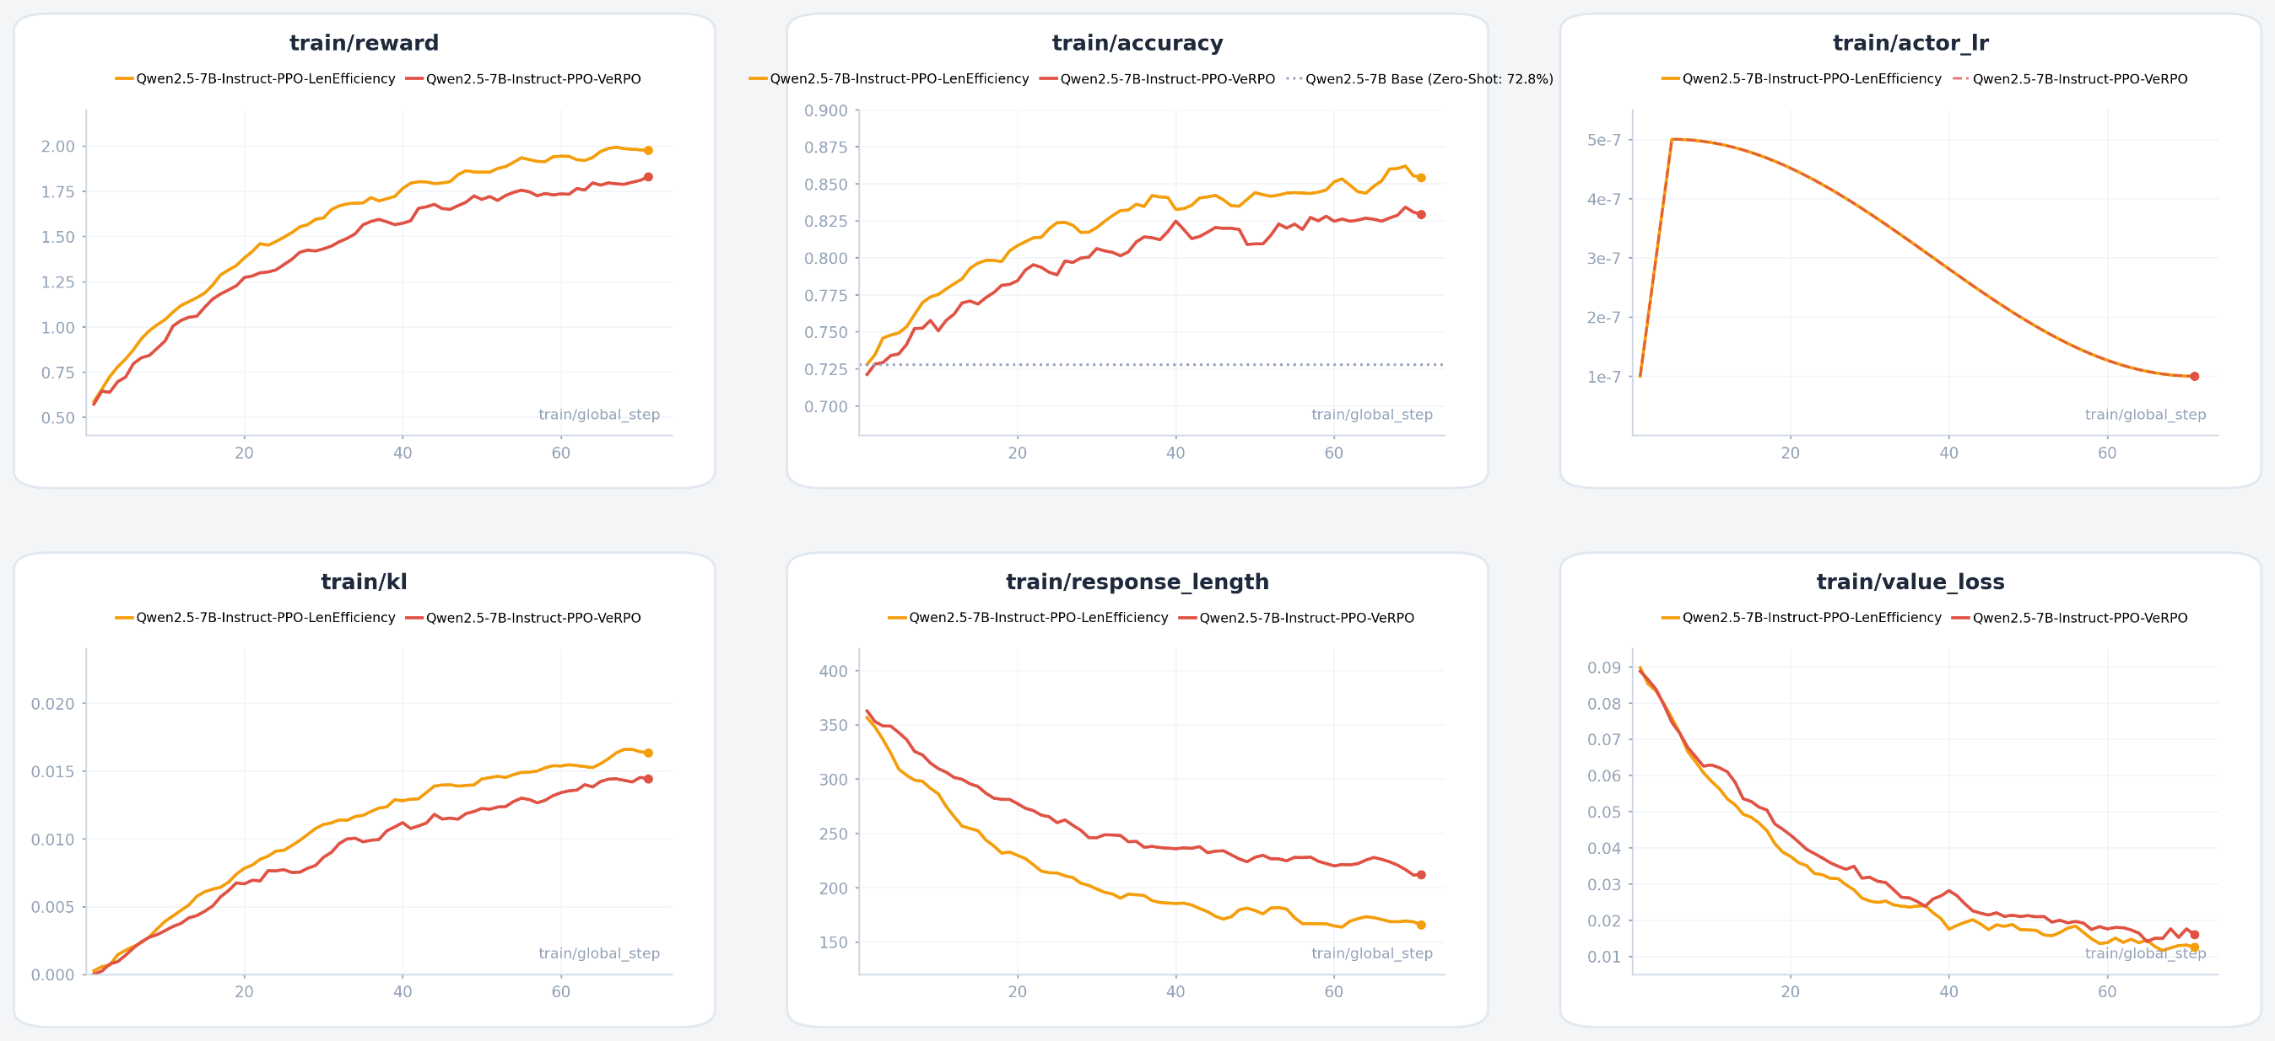
实验结果

Slide 10
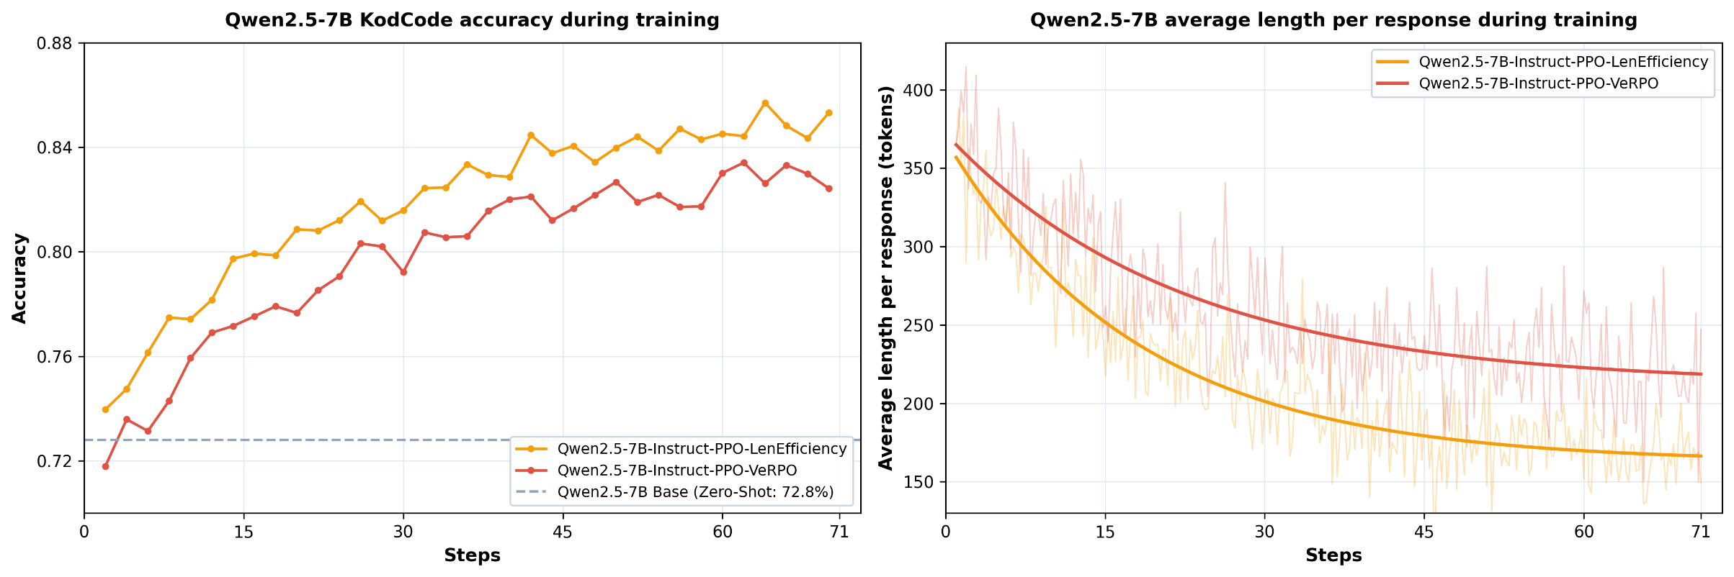
Benchmark
模型 | KodCode (200 题) | HumanEval (164 题) | MBPP Sanitized (427 题) | 总通过率 | 平均代码长度 | 致命运行时崩溃
Qwen2.5-7B-Instruct (Base) | 74.50% (149) | 79.27% (130) | 69.56% (297) | 576 / 791 (72.82%) | 382.1 tokens | 24 次 (12.0%)
Qwen2.5-7B-Instruct-PPO-LenEfficiency | 81.00% (162) | 84.76% (139) | 75.88% (324) | 625 / 791 (79.01%) | 162.4 tokens | 3 次 (1.5%)
Qwen2.5-7B-Instruct-PPO-VeRPO | 80.00% (160) | 84.76% (139) | 74.94% (320) | 619 / 791 (78.26%) | 212.3 tokens | 2 次 (1.0%)

Slide 11
谢谢

