Slide 1

使用RxJava 简化异步操作
ReactiveX
https://github.com/ReactiveX/RxJava

Slide 2


Rxjava?What?
Languages
Java: RxJava
JavaScript: RxJS
C#: Rx.NET
C#(Unity): UniRx
Scala: RxScala
Clojure: RxClojure
C++: RxCpp
Lua: RxLua
Ruby: Rx.rb
Python: RxPY
Groovy: RxGroovy
JRuby: RxJRuby
Kotlin: RxKotlin
Swift: RxSwift
PHP: RxPHP
Explains:
RxJava
– Reactive Extensions for the JVM
– a library for composing
asynchronous and event-based programs using observable sequences for the Java VM.

Slide 3

Why To Use?
一个字：简洁
一句话：逻辑越复杂，使用越清晰

Slide 4
new Thread() { @Override public void run() { // 开启子线程 super.run(); for (File folder : folders) { // 循环每个文件夹 File[] files = folder.listFiles(); for (File file : files) { // 循环文件夹下的每个文件 if (file.getName().endsWith(“.png”)) { // 筛选png图片 final Bitmap bitmap = getBitmapFromFile(file); getActivity().runOnUiThread(new Runnable() { @Override public void run() { // 切换到主线程，显示图片 imageCollectorView.addImage(bitmap); } }); } } } } }.start();

Slide 5
Observable.from(folders) .flatMap(new Func1<File, Observable<File>>() { @Override public Observable<File> call(File file) { return Observable.from(file.listFiles()); } }) .filter(new Func1<File, Boolean>() { @Override public Boolean call(File file) { return file.getName().endsWith(".png"); } }) .map(new Func1<File, Bitmap>() { @Override public Bitmap call(File file) { return getBitmapFromFile(file); } }) .subscribeOn(Schedulers.io()) .observeOn(AndroidSchedulers.mainThread()) .subscribe(new Action1<Bitmap>() { @Override public void call(Bitmap bitmap) { imageCollectorView.addImage(bitmap); } });

Slide 6
Lambda写法
Observable.from(folders) .flatMap((Func1) (folder) -> { Observable.from(file.listFiles()) }) .filter((Func1) (file) -> { file.getName().endsWith(".png") }) .map((Func1) (file) -> { getBitmapFromFile(file) }) .subscribeOn(Schedulers.io()) .observeOn(AndroidSchedulers.mainThread()) .subscribe((Action1) (bitmap) -> { imageCollectorView.addImage(bitmap) });

Slide 7
相关设计模式
观察者模式
建造者模式
函数式编程

Slide 8
典型的观察者模式
class NumObservable extends Observable { private int data = 0; int getData() { return data; } void setData(int i) { data = i; setChanged(); notifyObservers(); } }
class NumObserver implements Observer { @Override public void update(Observable observable, Object object) { NumObservable numObservable = (NumObservable) observable; System.out.println("Data changed: " + numObservable.getData()); } } public static void main(String[] args) { NumObservable number = new NumObservable(); number.addObserver(new NumObserver()); number.setData(1); number.setData(2); number.setData(3); }

Slide 9
建造者模式
class Computer { private ComputerParams params; // 构造方法 private Computer(Builder builder) { params = builder.params; } // 内部类 static class Builder {
ComputerParams params; Builder() { params = new ComputerParams(); } Builder setBrand(String brand) {
params.brand = brand; return this; } Builder setSize(String size) { params.size = size; return this; } Builder setOS(String os) { params.os = os; return this; } //返回产品实例 Computer create() { return new Computer2(this); } } } // 使用方法
Computer computer=new Computer.Builder()
.setBrand(“MacBook").setSize("13.3").setOS("OSX")
.create(); System.out.println(computer2.toString());

Slide 10
函数式编程
List<Integer> list = Arrays.asList(1, 2, 3, 4, 5);
// 路人甲写法
List<String> resultList = new ArrayList<>(); for (Integer integer : list) { resultList.add("Item " + integer * 10); }
// 文艺青年写法
List<Integer> list = Arrays.asList(1, 2, 3, 4, 5); List<String> result = Fn.map(new Func1<Integer, String>() { @Override public String call(final Integer integer) { return "Item " + integer * 10; } }, list);
//文艺青年写法 with Lambda in Java8
List<Integer> list = Arrays.asList(1, 2, 3, 4, 5); List<String> result = Fn.map(integer -> "Item " + integer * 10, list);

Slide 11
函数式编程
Fn.map() 源码：
public static <T, R> List<R> map(
Func1<? super T, ? extends R> func, List<T> list) { List<R> r = new ArrayList<>(); for (T l : list) { r.add(func.call(l)); } return r; }

Slide 12
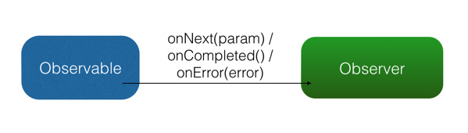
扩展的观察者模式
Observable
被观察者
Observer(Subscriber)
观察者
subscribe
订阅
Event
事件

Slide 13
Observer/Subscriber
Observer<String> observer
= new Observer<String>() { @Override public void onNext(String s) { Log.d(TAG, "Item: " + s); } @Override public void onCompleted() { Log.d(TAG, "Completed!"); } @Override public void onError(Throwable e) { Log.d(TAG, "Error!"); } };
Subscriber<String> subscriber
= new Subscriber<String>() { @Override public void onStart() { super.onStart(); } @Override public void onNext(String s) { Log.d(TAG, "Item: " + s); } @Override public void onCompleted() { Log.d(TAG, "Completed!"); } @Override public void onError(Throwable e) { Log.d(TAG, "Error!"); } };

Slide 14
Observable
// 基础方法
Observable observable = Observable.create(
new Observable.OnSubscribe<String>() { @Override public void call(Subscriber<? super String> subscriber) { subscriber.onNext("Hello"); subscriber.onNext("RxJava"); subscriber.onCompleted(); } });
// 衍生方法
String[] words = {"Hello", "RxJava"}; Observable observable = Observable.from(words); // 将会依次调用： // onNext("Hello"); // onNext(" RxJava "); // onCompleted();

Slide 15
建立连接
内部实现（伪代码）
private static Subscription subscribe(subscriber, observable) {
// 回调初始方法
subscriber.onStart();
// 回调观察者的三个方法，next(), completd(), error()
hook.start (observable.onSubscribe).call(subscriber);
// 返回订阅控制器，便于unsubscribe return hook. return(subscriber);
}

Slide 16
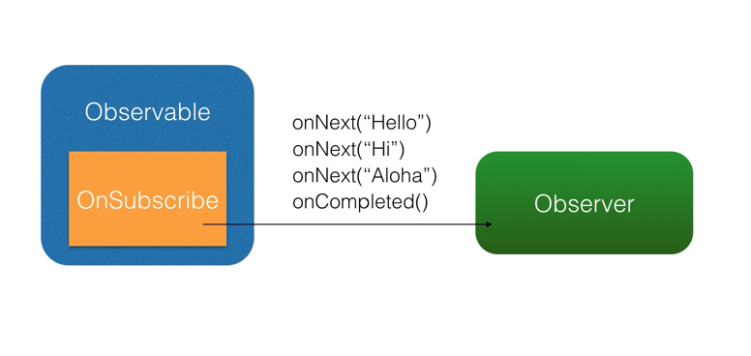
subscribe
observable.subscribe(subscriber);

Slide 17
应用实例
打印字符串数组：
String[] names = {"aa", "bb", "cc", "dd", "ee"}; Observable.from(names) .subscribe(new Action1<String>() { @Override public void call(String name) { Log.d(TAG, name + "\n"); } });

Slide 18
应用实例2
获取并显示图片：
final int drawableRes = R.mipmap.ic_launcher; final ImageView imageView = (ImageView) findViewById(R.id.imageIv);
Observable.create(new Observable.OnSubscribe<Drawable>() { @Override public void call(Subscriber<? super Drawable> subscriber) { Drawable drawable = getTheme().getDrawable(drawableRes); subscriber.onNext(drawable); subscriber.onCompleted(); } }).subscribe(new Observer<Drawable>() { @Override public void onNext(Drawable drawable) { imageView.setImageDrawable(drawable); } @Override public void onCompleted() { } @Override public void onError(Throwable e) { Toast.makeText(context, "Error!", Toast.LENGTH_SHORT).show(); } });

Slide 19

回归主题
RxJava是可以轻松实现异步操作的观察者模式
关键：Scheduler

Slide 20
线程控制
Schedulers.immediate(): 当前线程运行，默认的 Scheduler。
Schedulers.newThread(): 启用新线程。
Schedulers.io(): I/O 操作（读写文件、读写数据库、网络信息交互等）所使用的 Scheduler，内部实现是是一个线程池，可以重用空闲的线程。
Schedulers.computation(): 计算所使用的 Scheduler，固定的线程池，大小为 CPU 核数。
AndroidSchedulers.mainThread()：Android专用，主线程运行。

Slide 21
Scheduler例子
打印字符串数组（改进版）：
String[] names = {"aa", "bb", "cc", "dd", "ee"}; Observable.from(names)
// 指定数据产生在 IO 线程 .subscribeOn(Schedulers.io())
// 指定事件回调发生在主线程
.observeOn(AndroidSchedulers.mainThread()) .subscribe(new Action1<String>() { @Override public void call(String name) { Log.d(TAG, name + "\n"); } });

Slide 22
Scheduler例子2
打印字符串数组（高级版）：
String[] names = {"aa", "bb", "cc", "dd", "ee"}; Observable.from(names)
.observeOn(Schedulers.newThread()) .map(mapOperator) // 新线程 .observeOn(Schedulers.io()) .map(mapOperator2) // IO 线程 .observeOn(AndroidSchedulers.mainThread()) .subscribe(new Action1<String>() { @Override public void call(String name) { Log.d(TAG, name + "\n"); } });

Slide 23
事件变换map
变换——就是将事件序列中的对象或整个序列进行加工处理，转换成不同的事件或事件序列。
// 将图片uri转换成bitmap
Observable.just("images/logo.png") // 输入类型 String .map(new Func1<String, Bitmap>() { @Override public Bitmap call(String filePath) { // 参数类型 String return getBitmapFromPath(filePath); // 返回 Bitmap } }) .subscribe(new Action1<Bitmap>() { @Override public void call(Bitmap bitmap) { // 参数类型 Bitmap showBitmap(bitmap); } });

Slide 24
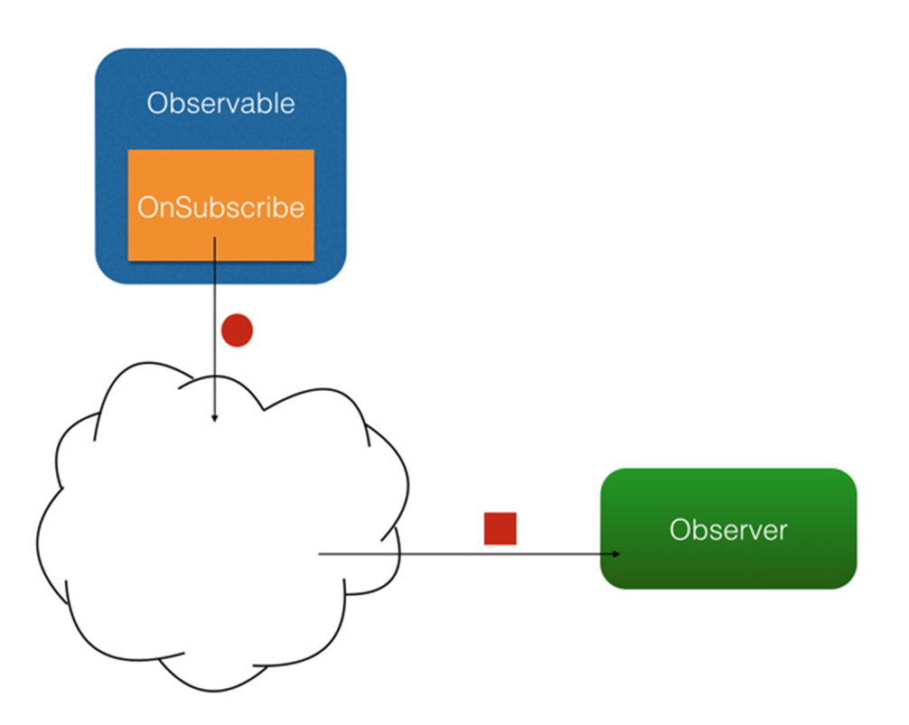
map图示

Slide 25
事件变换flatMap
// 从学生数组中得到每个学生的多门课程
Student[] students = {…..}; Observable.from(students) .flatMap(new Func1<Student, Observable<Course>>() { @Override public Observable<Course> call(Student student) { return Observable.from(student.getCourses()); } }) .subscribe(new Action1<Course>() { @Override public void call(Course course) { Log.d(TAG, course.getName()); } });

Slide 26
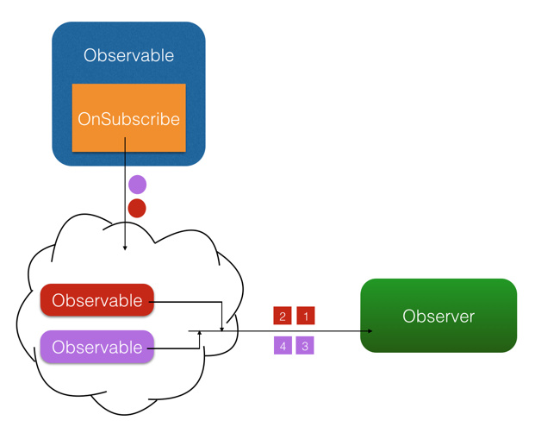
flatMap图示

Slide 27

变换原理
如何实现异步？

Slide 28
变换原理
lift
observeOn
flatMap
zip
map

Slide 29
变换原理
内部实现（伪代码）
public Observable lift(Operator operator) {
return new Observable(new OnSubscribe() { @Override public void call(Subscriber subscriber) {
// hook出一个新的 subscriber
Subscriber subscriber2= hook.onLift(operator).call(subscriber);
subscriber2.onStart(); onSubscribe.call(subscriber2);
}
}
}

Slide 30
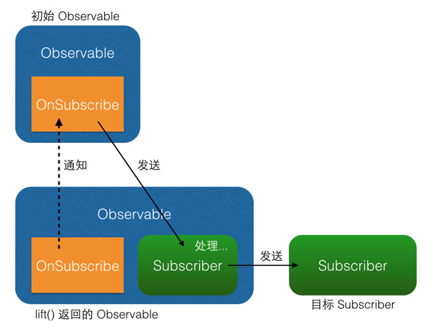
变换原理

Slide 31
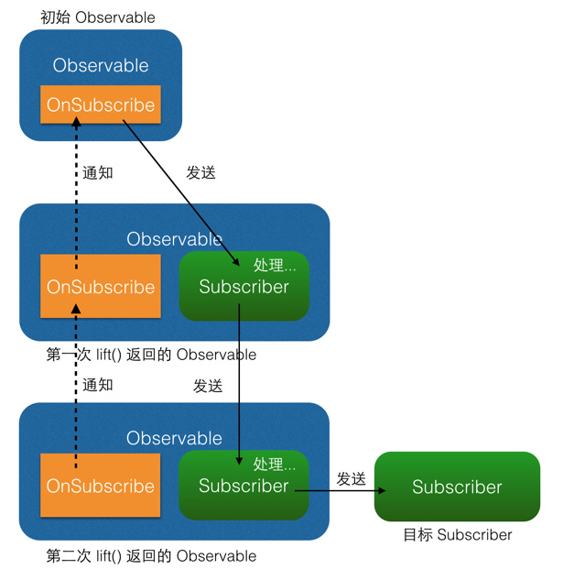
变换原理

Slide 32
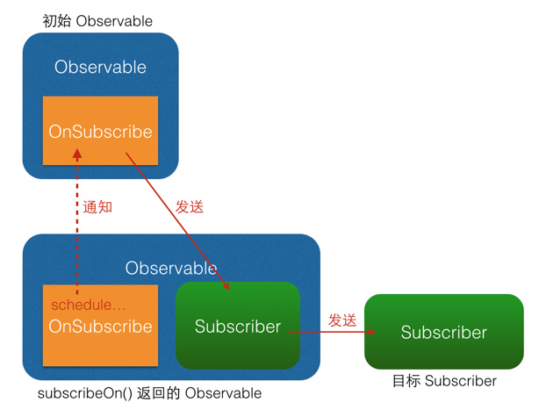

线程切换原理
subscribeOn() observeOn()

Slide 33
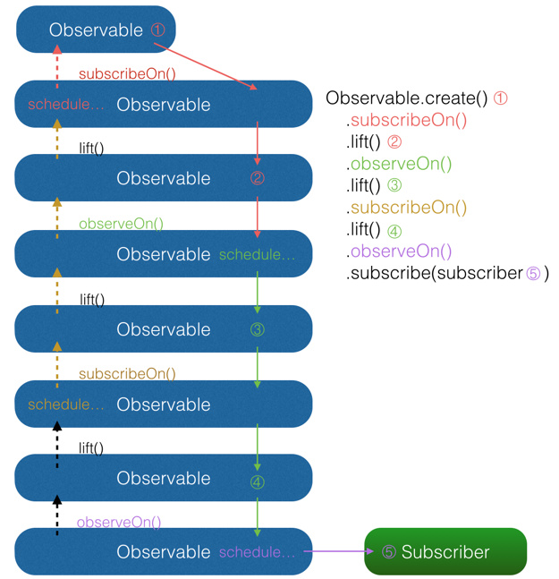

Slide 34
Retrofit + RxJava
RxJava
Retrofit
A type-safe HTTP client
for Android and Java

Slide 35
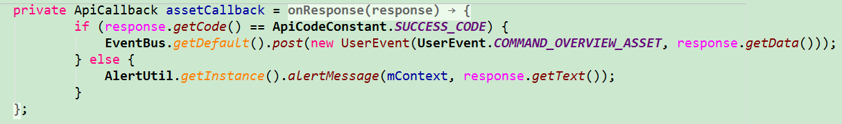
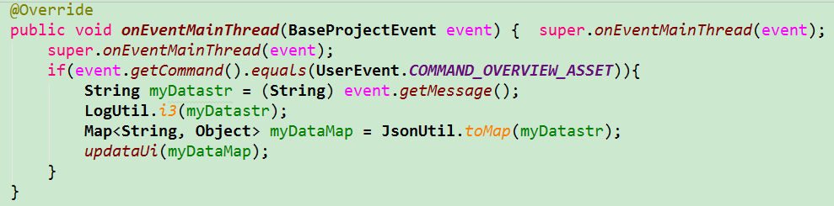
应用实例before
场景：用户资产总览

Slide 36
应用实例after
场景：用户资产总览
@POST(PATH + "/myAssets") @FormUrlEncoded Observable<ApiResult<MyAssetsBean>> myAssets(@Field(TOKEN) String token);
RetrofitHelper.getInstance() .create(MyAccountApis.class, true) .myAssets(SharedPreferencesUtil.getInstance().getToken()) .compose(RxUtil.<MyAssetsBean>compose(mContext)) .subscribe(new APISubscriber<MyAssetsBean>() { @Override public void onNext(MyAssetsBean myAssetsBean) { updateUi(myAssetsBean); } });

Slide 37
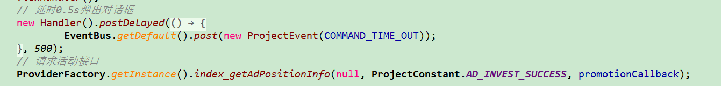
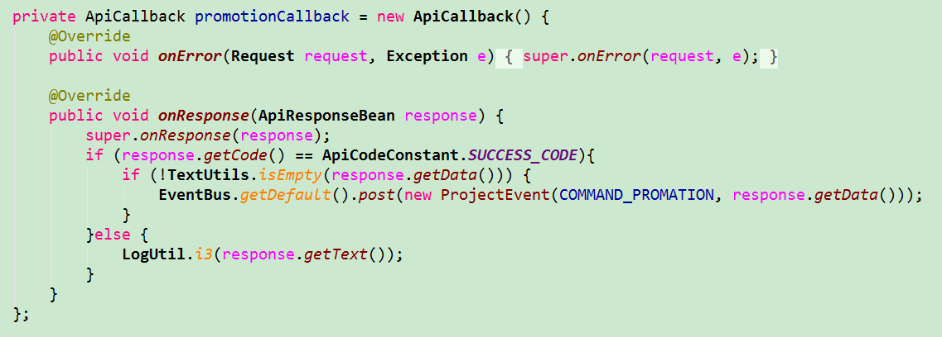
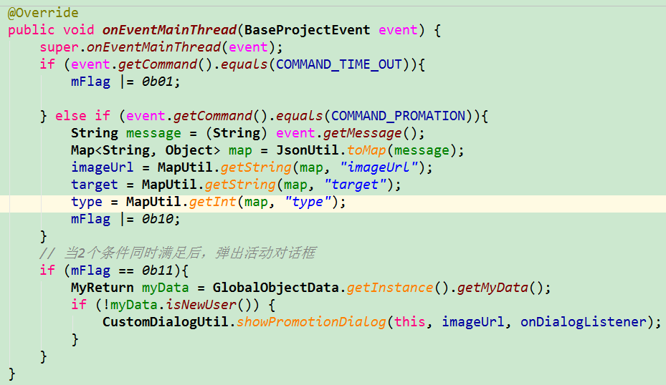
应用实例before
场景：投资成功后延时0.5s弹窗

Slide 38
应用实例after
场景：投资成功后延时0.5s弹窗
Observable.zip( RetrofitHelper.getInstance() .create(IndexApis.class, true) .getAdPositionInfo(ProjectConstant.AD_INVEST_SUCCESS) // 请求接口数据 , Observable.timer(500, TimeUnit.MILLISECONDS) // 延时0.5s , new Func2<ApiResult<AdPositionInfoBean>, Long, ApiResult<AdPositionInfoBean>>() { @Override public ApiResult<AdPositionInfoBean> call(ApiResult<AdPositionInfoBean> adPositionApiResult, Long aLong) { return adPositionApiResult; } // 返回延时后的结果 }) .compose(RxUtil.<AdPositionInfoBean>compose(this)) .subscribe(new APISubscriber<AdPositionInfoBean>() { @Override public void onNext(AdPositionInfoBean adPosition) { // 获取信息并弹出活动框 if (!myData.isNewUser()) { CustomDialogUtil.showPromotionDialog(mContext, adPosition.getImageUrl(), onDialogListener); } });

Slide 39
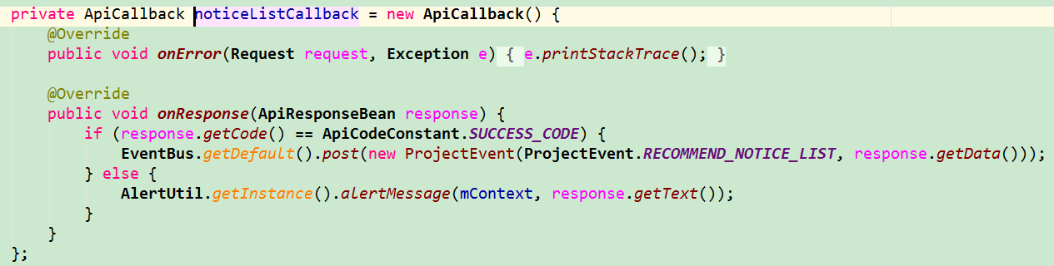
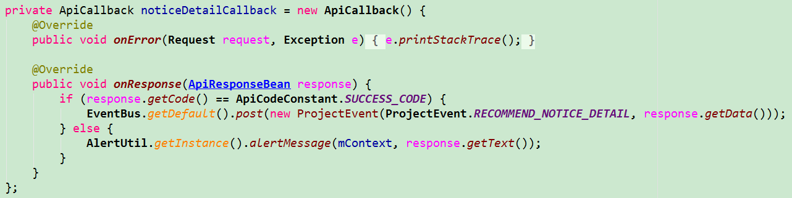
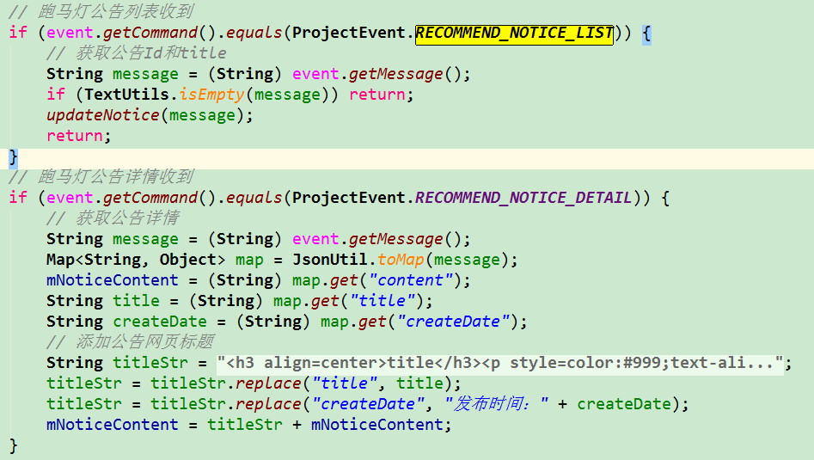
应用实例before
场景：首页公告内容

Slide 40
应用实例after
场景：首页公告内容
RetrofitHelper.getInstance() .create(IndexApis.class, true) .getNoticePageList(0) // 请求第一个接口数据 .compose(RxUtil.<NoticePageListBean>convertResult()) .observeOn(AndroidSchedulers.mainThread()) .doOnNext(new Action1<NoticePageListBean>() { @Override public void call(NoticePageListBean noticePageListBean) { String title = noticePageListBean.getResultList().get(0).getTitle(); // 设置跑马灯标题 mViewHelper.setText(R.id.txt_remind_msg, title); } }).observeOn(Schedulers.io()) .flatMap(new Func1<NoticePageListBean, Observable<ApiResult<NoticeDetailsBean>>>() { @Override public Observable<ApiResult<NoticeDetailsBean>> call(NoticePageListBean noticePageListBean) { String noticeId = noticePageListBean.getResultList().get(0).getNoticeId(); return RetrofitHelper.getInstance().create(IndexApis.class, true) // 请求第二个接口数据
.getNoticeDetails(noticeId); } }).compose(RxUtil.<NoticeDetailsBean>compose(mContext)) .subscribe(new APISubscriber<NoticeDetailsBean>() { @Override public void onNext(NoticeDetailsBean noticeDetailsBean) { // 添加公告网页内容 setNoticeContent(noticeDetailsBean); } });

Slide 41
RxJava工具集
Operators Categories - 按目录分类的主要操作符列表
Creating 创建操作 - Create/Defer/From/Just/Start/Repeat/Range
Transforming 变换操作 - Buffer/Window/Map/FlatMap/GroupBy/Scan
Filtering 过滤操作 - Debounce/Distinct/Filter/Sample/Skip/Take
Combining 结合操作 - And/StartWith/Join/Merge/Switch/Zip
Error Handling 错误处理 - Catch/Retry
Utility 辅助操作 - Delay/Do/ObserveOn/SubscribeOn/Subscribe
Conditional 条件和布尔操作 - All/Amb/Contains/SkipUntil/TakeUntil
Mathematical 算术和聚合操作 - Average/Concat/Count/Max/Min/Sum/Reduce
Async 异步操作 - Start/ToAsync/StartFuture/FromAction/FromCallable/RunAsync
Connect 连接操作 - Connect/Publish/RefCount/Replay
Convert 转换操作 - ToFuture/ToList/ToIterable/ToMap/toMultiMap
Blocking 阻塞操作 - ForEach/First/Last/MostRecent/Next/Single/Latest
String 字符串操作 - ByLine/Decode/Encode/From/Join/Split/StringConcat
ReactiveX/RxJava文档中文版
https://github.com/mcxiaoke/RxDocs

Slide 42
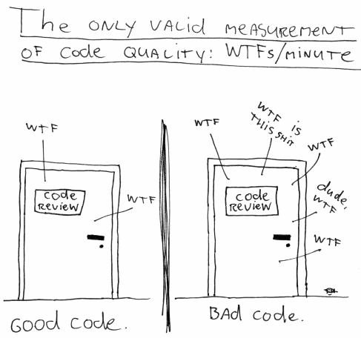
回调问题

Slide 43
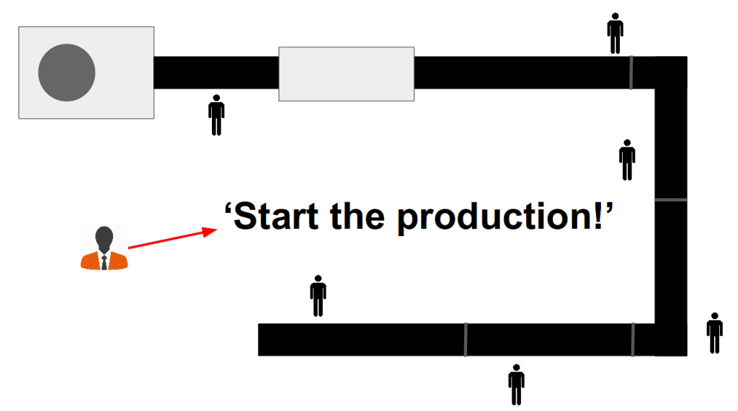
另一种视角
三份关于猫的信息
每份都是唯一的
每份都应该少于 300 字符
每份都配张猫的图片

Slide 44
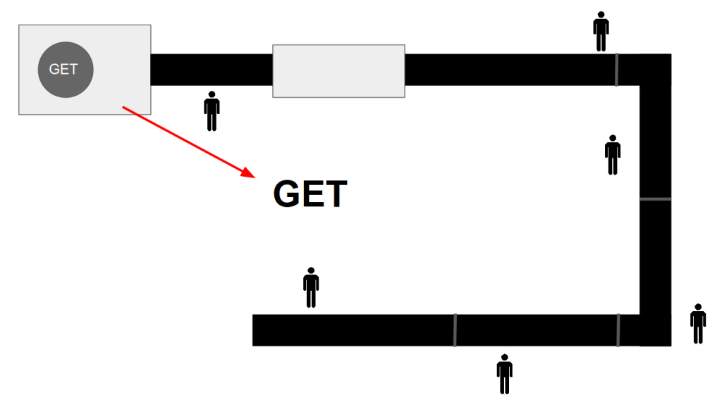
工厂流水线2

Slide 45
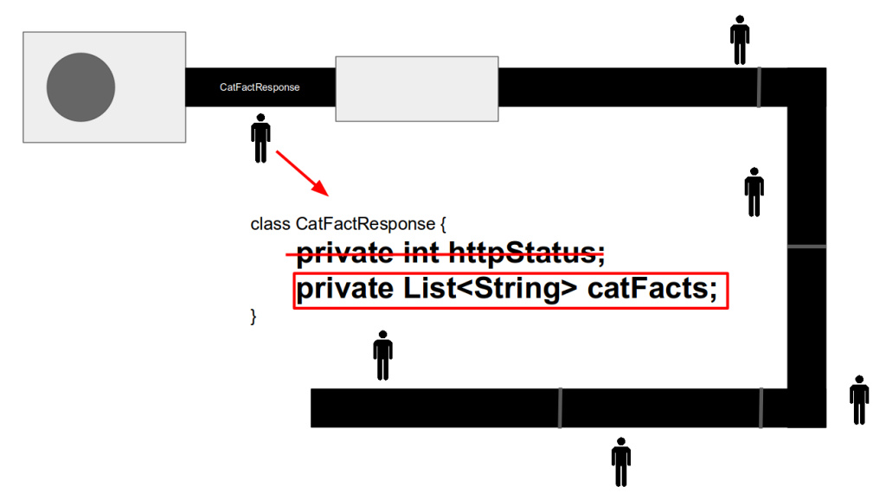
工厂流水线3

Slide 46
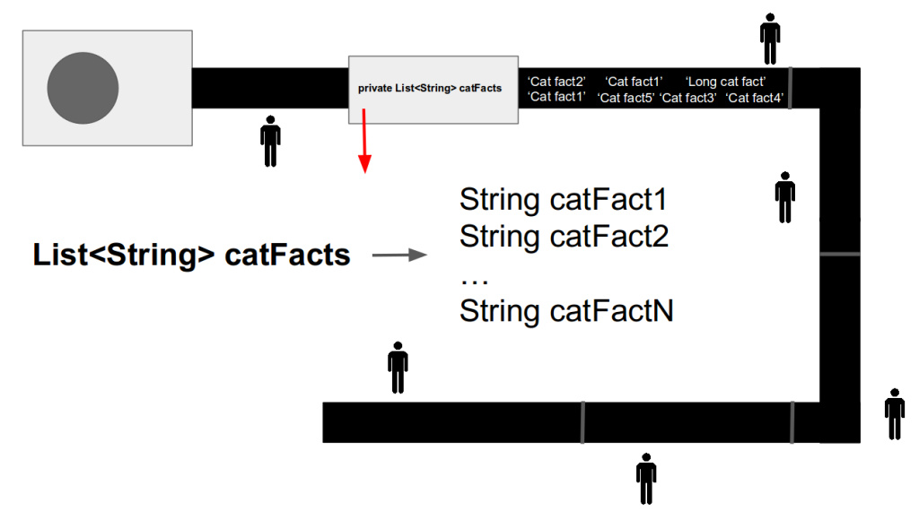
工厂流水线4

Slide 47
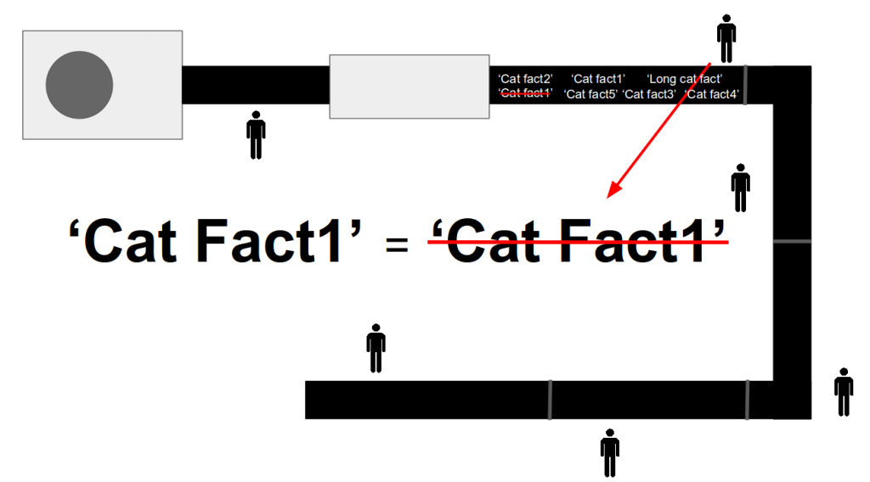
工厂流水线5

Slide 48
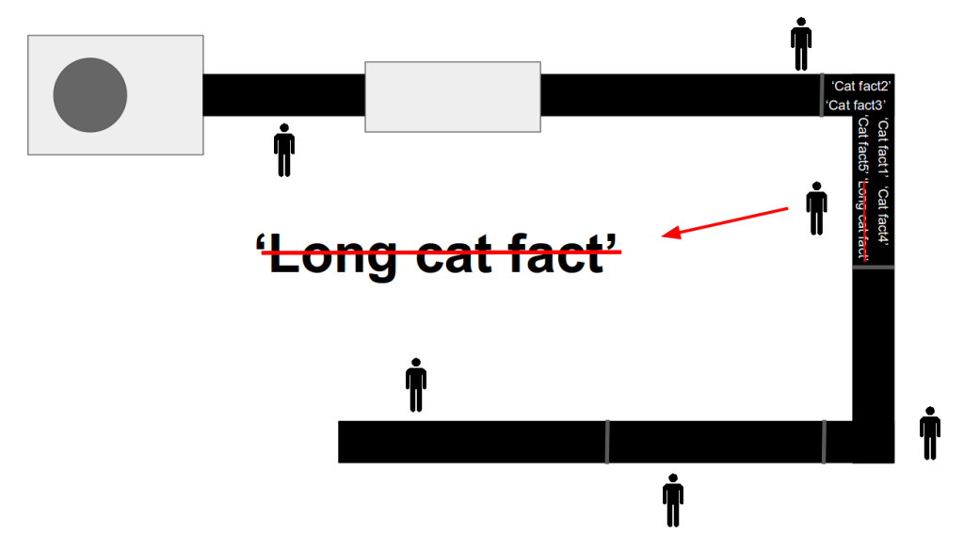
工厂流水线6

Slide 49
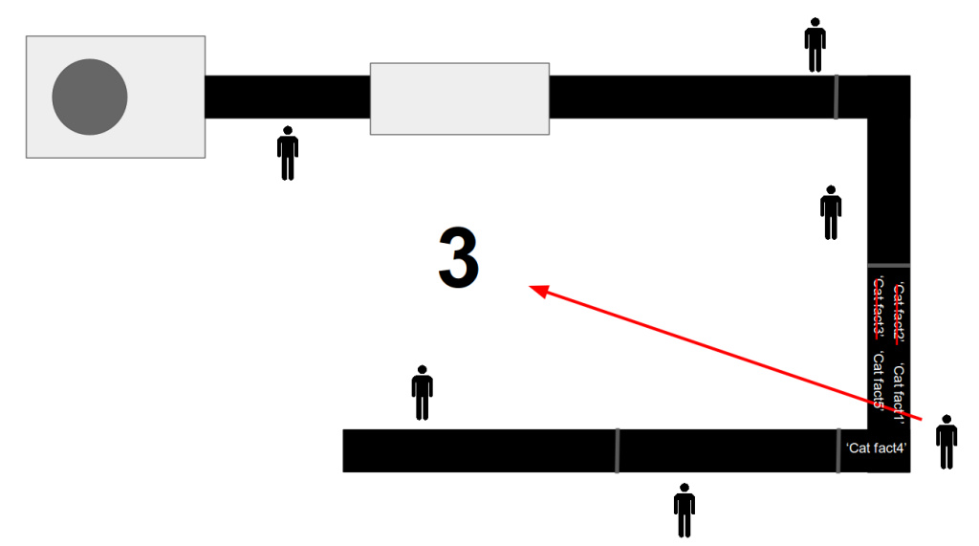
工厂流水线7

Slide 50
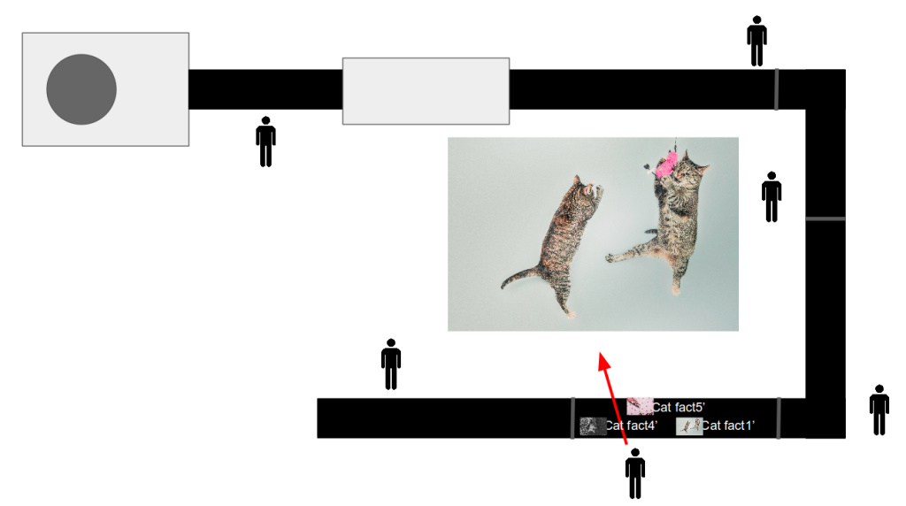
工厂流水线8

Slide 51
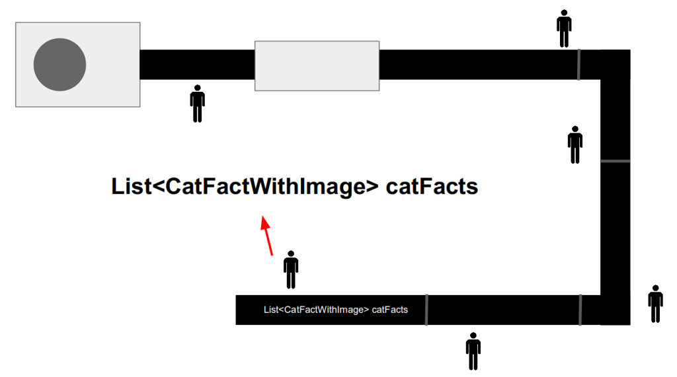
工厂流水线9

Slide 52
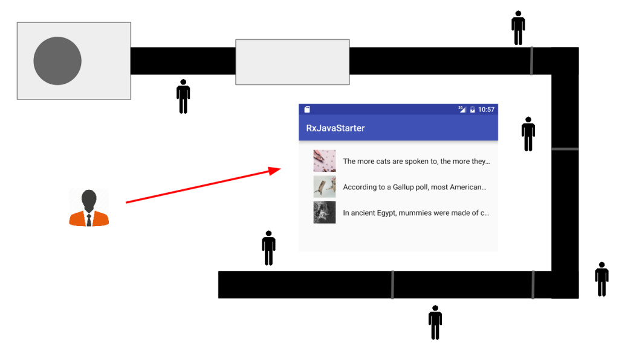
工厂流水线10

Slide 53

谢谢大家，可以鼓掌了

