Slide 1
SPortsMAte Find your Sports Partners
Jianrui Hu
Sep 23 2019

Slide 2
Motivation – I like Sports
Exercise bring a better lifestyle
Sports bring new friends
People more rely on social medial
Hard to find people with same hobby nearby
Hard to find people with same skill level
Hard to find people fit schedule
SportsMate CAN HELP

Slide 3
Description – Pose your Ticket
Create user name with password
Create personal profile with sports type and skill level
Pose your ticket with your schedule
Show all the ticket with your interest
Pick the ticket and make a match
Go and have fun

Slide 4
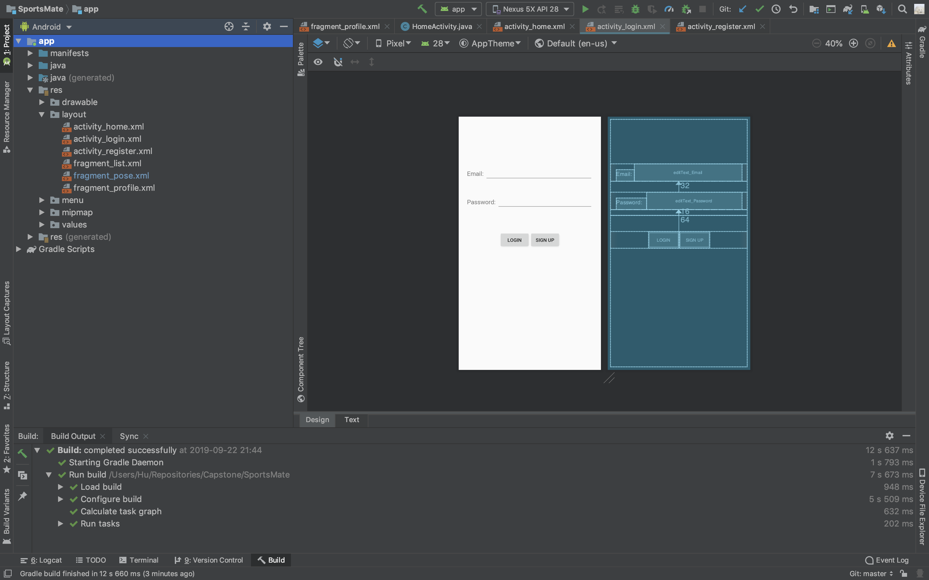
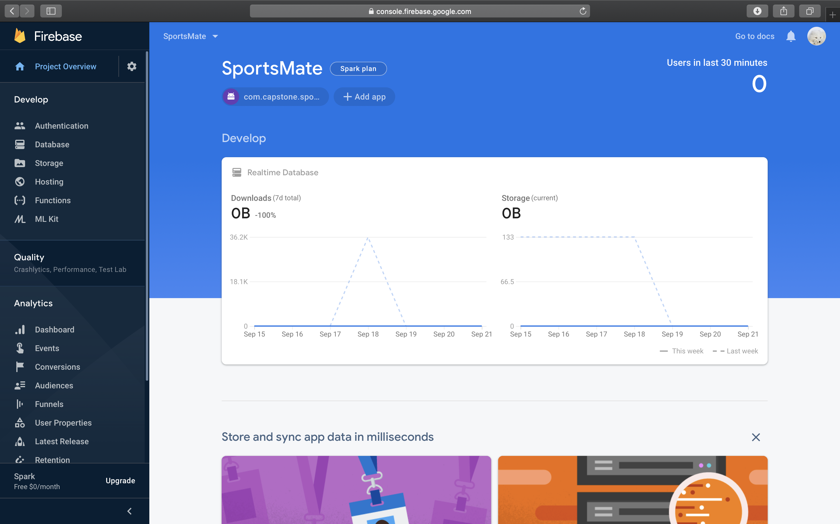
Tools
Frontend: Android Studio
Backend: Firebase

Slide 5
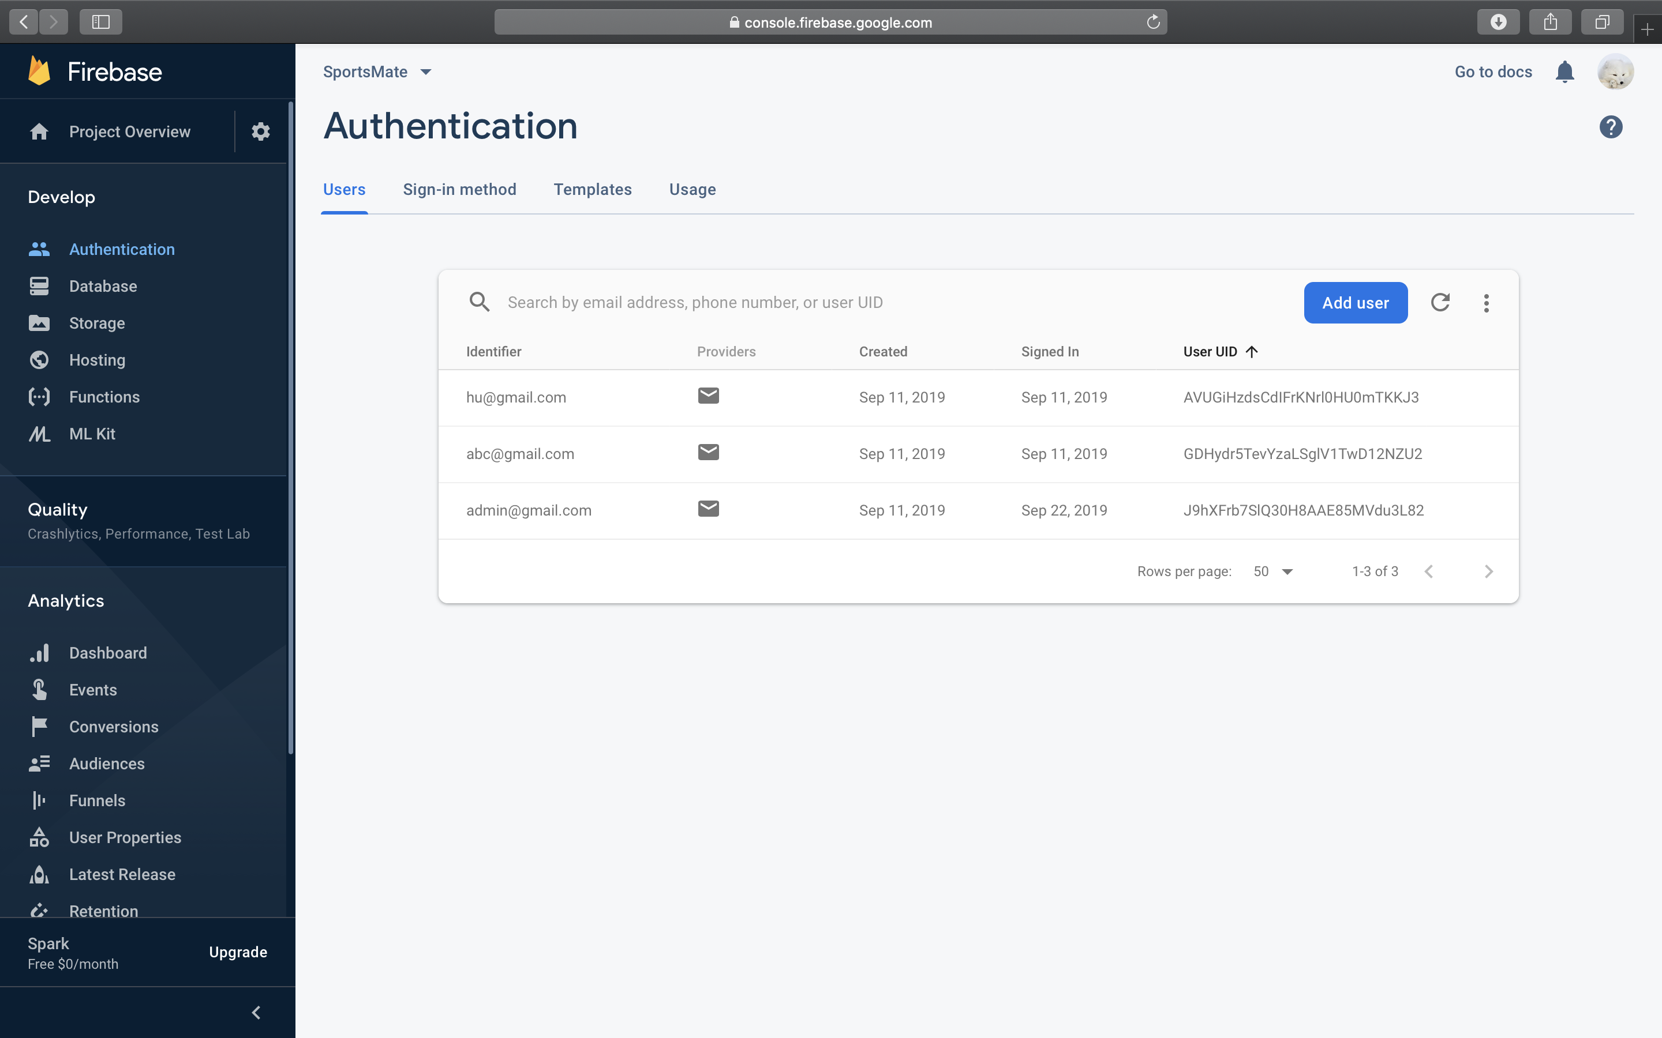
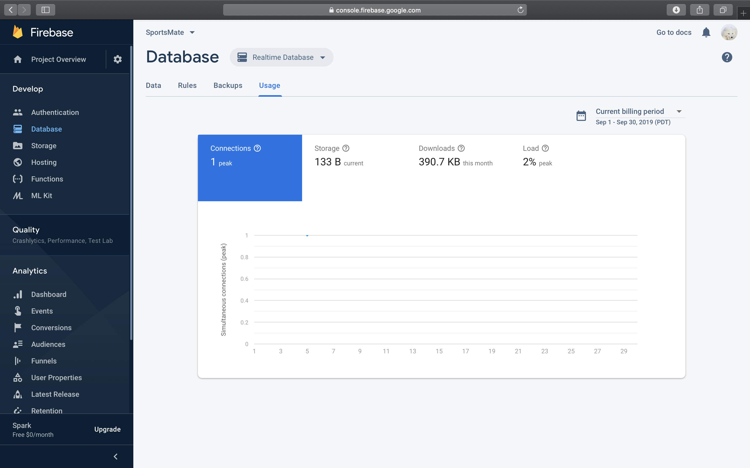
Firebase

Slide 6
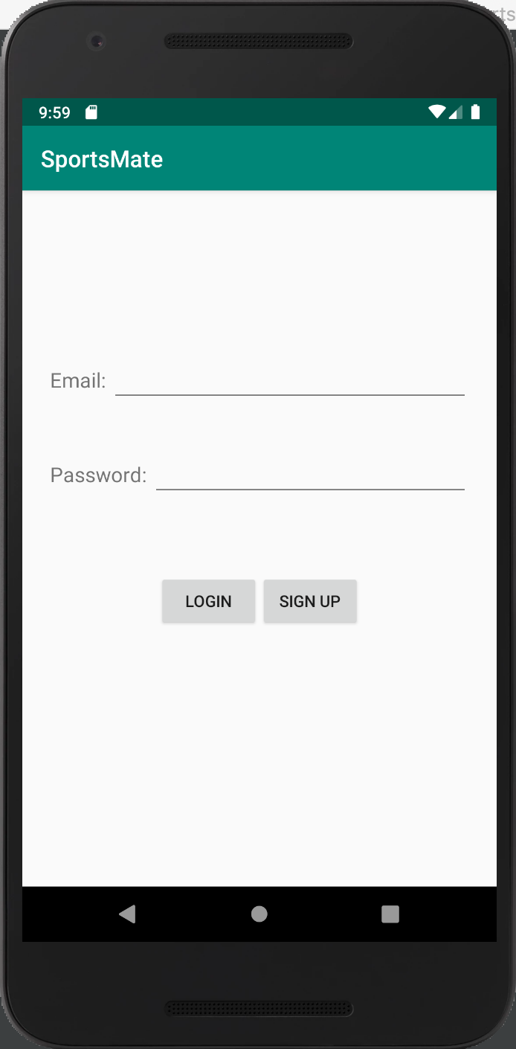
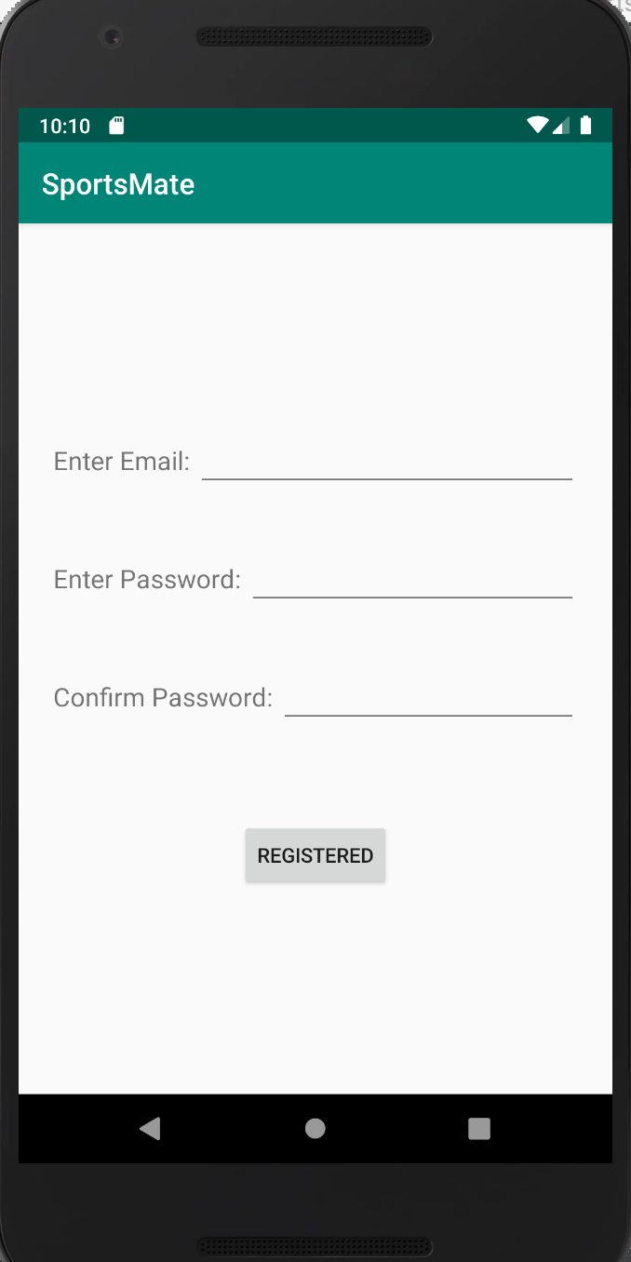
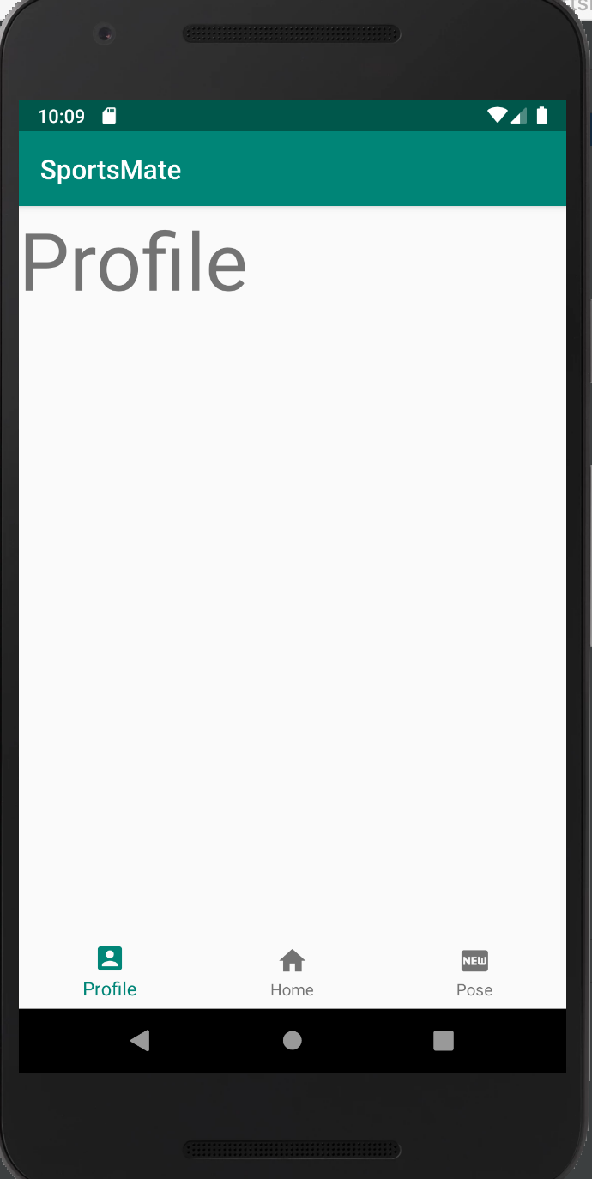
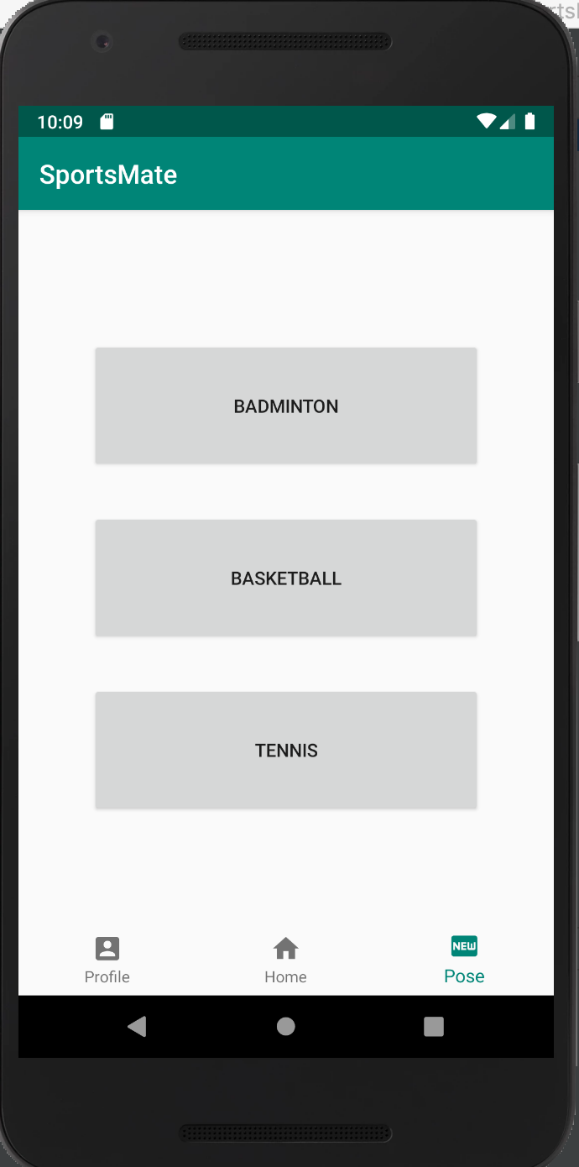
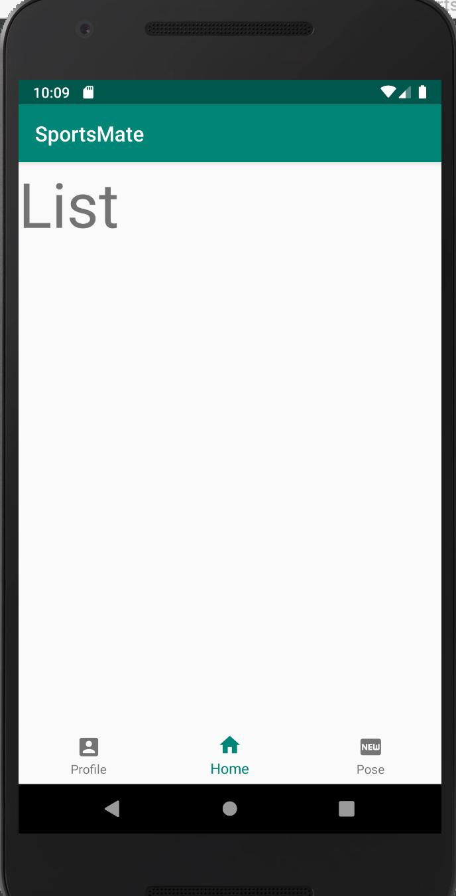
Demo
Log In
Register
Home
Profile
Pose

Slide 7
Plans
Week 1 – profile view & edit page
Week 2 – Pose view & edit page
Week 3 – Home view & ticket select page
Week 4 – Database connection
Week 5 – GUI
Week 6 - Testing

Slide 8
Questions
Thank You

