Slide 1
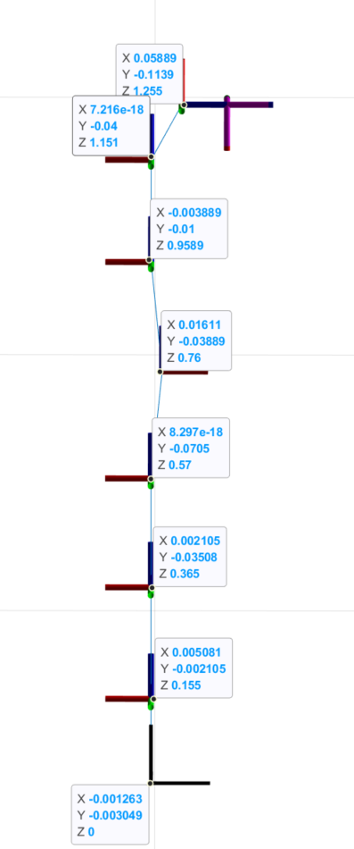
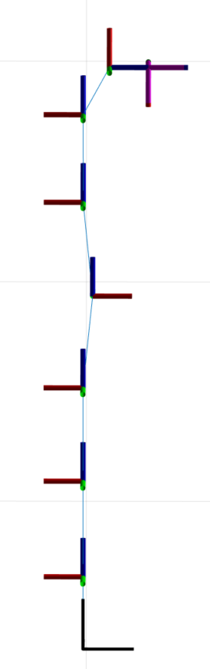
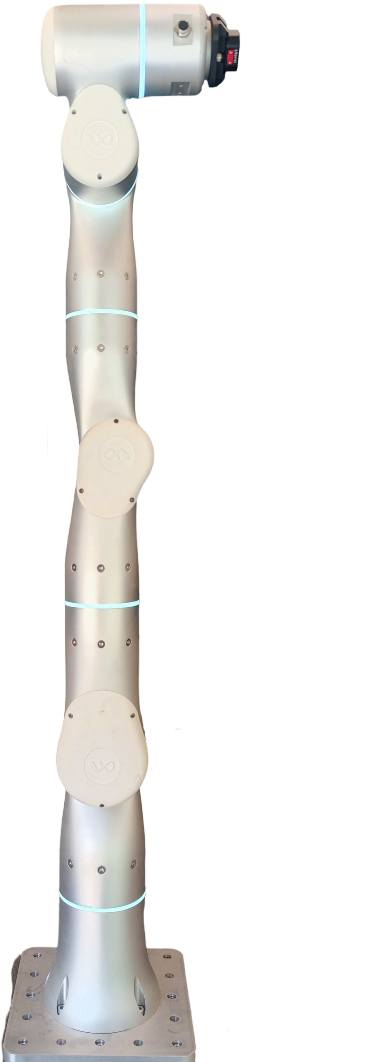













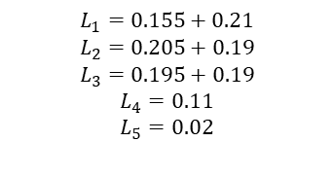






DH表格
0.07
$$x_{7}$$
$$z_{7}$$
$$L_{4}$$
$$z_{5}(x_{6})$$
0.11
$$z_{6}$$
$$x_{5}$$
Link | $$α$$ | $$a$$ | $$θ$$ | $$d$$
1 | $$0$$ | $$0$$ | $$q_{1}$$ | $$L_{1}$$
2 | $$90$$ | $$0$$ | $$q_{2}$$ | $$0$$
3 | $$−90$$ | $$0$$ | $$q_{3}$$ | $$L_{2}$$
4 | $$−90$$ | $$L_{5}$$ | $$q_{4}$$ | $$0$$
5 | $$90$$ | $$−L_{5}$$ | $$q_{5}$$ | $$L_{3}$$
6 | $$90$$ | $$0$$ | $$q_{6}+90$$ | $$0$$
7 | $$90$$ | $$L_{4}$$ | $$q_{7}$$ | $$0$$
0.19
$$L_{5}$$
$$L_{3}$$
$$z_{3}$$
0.195
0.02
$$z_{4}$$
$$x_{3}(x_{4})$$
0.19
$$L_{2}$$
$$z_{1}$$
0.205
$$z_{2}$$
$$x_{1}(x_{2})$$
0.21
$$L_{1}$$
$$L_{1}=0.155+0.21$$
$$L_{2}=0.205+0.19$$
$$L_{3}=0.195+0.19$$
$$L_{4}=0.11$$
$$L_{5}=0.02$$
$$z_{0}$$
0.155
$$x_{0}$$

Slide 2




重组参数
$$x_{7}$$
$$z_{7}$$
$$L_{1}=0.155+0.21$$
$$L_{2}=0.205+0.19$$
$$L_{3}=0.195+0.19$$
$$L_{4}=0.11$$
$$L_{5}=0.02$$
$$L_{4}$$
$$z_{5}(x_{6})$$
$$z_{6}$$
$$x_{5}$$
ZZ1R=I1zz + I2yy + Ia1;
XX2R=I2xx - I2yy + I3yy + L5^2*(m4 + m5 + m6 + m7) + L2^2*(m3 + m4 + m5 + m6 + m7) + 2*L2*mz3;
ZZ2R=I2zz + I3yy + Ia2 + L5^2*(m4 + m5 + m6 + m7) + L2^2*(m3 + m4 + m5 + m6 + m7) + 2*L2*mz3;
MY2R=L2*(m3 + m4 + m5 + m6 + m7) + my2 + mz3;
XX3R=I3xx - I3yy + I4yy + L5^2*(m5 + m6 + m7) - L5^2*(m4 + m5 + m6 + m7);
XY3R=I3xy - L5*mz4;
ZZ3R=I3zz + I4yy + L5^2*(m5 + m6 + m7) + L5^2*(m4 + m5 + m6 + m7);
MX3R=L5*(m4 + m5 + m6 + m7) + mx3;
MY3R=my3 + mz4;
XX4R=I4xx - I4yy + I5yy + L3^2*(m5 + m6 + m7) - L5^2*(m5 + m6 + m7) + 2*L3*mz5;
XY4R=I4xy - L3*L5*(m5 + m6 + m7) - L5*mz5;
ZZ4R=I4zz + I5yy + (L3^2 + L5^2)*(m5 + m6 + m7) + 2*L3*mz5;
MX4R=-(L5*(m5 + m6 + m7)) + mx4;
MY4R=-(L3*(m5 + m6 + m7)) + my4 - mz5;
XX5R=I5xx - I5yy + I6yy + L4^2*m7;
ZZ5R=I5zz + I6yy + L4^2*m7;
MY5R=my5 - mz6;
XX6R=I6xx - I6yy + I7yy - L4^2*m7;
XY6R=I6xy + L4*mz7;
ZZ6R=I6zz + I7yy + L4^2*m7;
MX6R=L4*m7 + mx6;
MY6R=my6 - mz7;
XX7R=I7xx - I7yy;
$$L_{3}$$
$$L_{5}$$
$$z_{3}$$
$$z_{4}$$
$$x_{3}(x_{4})$$
$$L_{2}$$
$$z_{1}$$
$$z_{2}$$
$$x_{1}(x_{2})$$
$$L_{1}$$
$$z_{0}$$
$$x_{0}$$

Slide 3
最小参数集
%% beta_M非对角：匀加减B段辨识
beta1 = XXR2;
beta2 = XXR3;
beta3 = XXR4;
beta4 = XXR5;
beta5 = XXR6;
beta6 = XXR7;
beta7 = I2xy;
beta8 = XYR3;
beta9 = XYR4;
beta10 = I5xy;
beta11 = XYR6;
beta12 = I7xy;
beta13 = I2xz;
beta14 = I3xz;
beta15 = I4xz;
beta16 = I5xz;
beta17 = I6xz;
beta18 = I7xz;
beta19 = I2yz;
beta20 = I3yz;
beta21 = I4yz;
beta22 = I5yz;
beta23 = I6yz;
beta24 = I7yz;
%% beta_M对角：匀加减A段辨识
beta25 = ZZR1;
beta26 = ZZR2;
beta27 = ZZR3;
beta28 = ZZR4;
beta29 = ZZR5;
beta30 = ZZR6;
beta31 = I7zz;
%% beta_G：匀速段往复运动辨识
beta32 = mx2;
beta33 = MXR3;
beta34 = MXR4;
beta35 = mx5;
beta36 = MXR6;
beta37 = mx7;
beta38 = MYR2;
beta39 = MYR3;
beta40 = MYR4;
beta41 = MYR5;
beta42 = MYR6;
beta43 = my7;
%% 电机惯量，舍去
beta44 = Ia3;
beta45 = Ia4;
beta46 = Ia5;
beta47 = Ia6;
beta48 = Ia7;

Slide 4
重力参数简化过程
% 注意：此时初始位置q4=-pi/2
old = [q1 q3 q4 q5 q6 q7];
new = [sym(0),sym(0),sym(-pi/2),sym(0),sym(0),sym(0)];
G(2)= subs(G(2),old,new);
% 注意：此时初始位置q2 = pi/2, q4=-pi/2
old = [q1 q2 q4 q5 q6 q7];
new = [sym(0),sym(pi/2),sym(-pi/2),sym(0),sym(0),sym(0)];
G(3)= subs(G(3),old,new);
old = [q1 q2 q3 q5 q6 q7];
new = [sym(0),sym(0),sym(0),sym(0),sym(0),sym(0)];
G(4)= subs(G(4),old,new);
% 注意：此时初始位置q4=-pi/2
old = [q1 q2 q3 q4 q6 q7];
new = [sym(0),sym(0),sym(0),sym(-pi/2),sym(0),sym(0)];
G(5)= subs(G(5),old,new);
old = [q1 q2 q3 q4 q5 q7];
new = [sym(0),sym(0),sym(0),sym(0),sym(0),sym(0)];
G(6)= subs(G(6),old,new);

Slide 5
重力参数简化结果
G_g =
0
% beta36*cos(q2) - beta33*cos(q2) - beta32*cos(q2) - beta40*cos(q2) + beta34*sin(q2) + beta35*sin(q2) +
beta38*sin(q2) - beta42*sin(q2)
% beta39*cos(q3) + beta41*cos(q3) + beta33*sin(q3) - beta36*sin(q3) + beta40*sin(q3)
% beta34*cos(q4) + beta35*cos(q4) - beta42*cos(q4) + beta36*sin(q4) - beta40*sin(q4)
% beta41*cos(q5) + beta35*sin(q5) - beta42*sin(q5)
% beta42*cos(q6) + beta36*sin(q6)
0

Slide 6
对角惯性参数简化过程
%% 对角惯性辨识A1
% 通过单轴加减速辨识 beta25-beta31(ZZR1,ZZR2,...,I7zz)。不需要区分Ia和ZZ，因为关节力传感器直接测连杆端的力矩。
% 123456轴零位，7轴匀加速正反转
Y_M7 = Y_M(7,:);
old = {q1 q2 q3 q4 q5 q6 dq1 dq2 dq3 dq4 dq5 dq6 ddq1 ddq2 ddq3 ddq4 ddq5 ddq6};
new = { sym(0) sym(0) sym(0) sym(0) sym(0) sym(0) sym(0) sym(0) sym(0) sym(0) sym(0) sym(0) sym(0) sym(0) sym(0) sym(0) sym(0) sym(0)};
Y_M7_simp_A1 = simplify(subs(Y_M7,old,new))
% 123457轴零位，6轴匀加速正反转
Y_M6 = Y_M(6,:);
old = {q1 q2 q3 q4 q5 q7 dq1 dq2 dq3 dq4 dq5 dq7 ddq1 ddq2 ddq3 ddq4 ddq5 ddq7};
new = { sym(0) sym(0) sym(0) sym(0) sym(0) sym(0) sym(0) sym(0) sym(0) sym(0) sym(0) sym(0) sym(0) sym(0) sym(0) sym(0) sym(0) sym(0)};
Y_M6_simp_A1 = simplify(subs(Y_M6,old,new))
% 12347轴零位，6轴90度，5轴匀加速正反转
Y_M5 = Y_M(5,:);
old = {q1 q2 q3 q4 q6 q7 dq1 dq2 dq3 dq4 dq6 dq7 ddq1 ddq2 ddq3 ddq4 ddq6 ddq7};
new = { sym(0) sym(0) sym(0) sym(0) sym(pi/2) sym(0) sym(0) sym(0) sym(0) sym(0) sym(0) sym(0) sym(0) sym(0) sym(0) sym(0) sym(0) sym(0)};
Y_M5_simp_A1 = simplify(subs(Y_M5,old,new))
% 12357轴零位，6轴90度，4轴匀加速正反转
Y_M4 = Y_M(4,:);
old = {q1 q2 q3 q5 q6 q7 dq1 dq2 dq3 dq5 dq6 dq7 ddq1 ddq2 ddq3 ddq5 ddq6 ddq7};
new = { sym(0) sym(0) sym(0) sym(0) sym(pi/2) sym(0) sym(0) sym(0) sym(0) sym(0) sym(0) sym(0) sym(0) sym(0) sym(0) sym(0) sym(0) sym(0)};
Y_M4_simp_A1 = simplify(subs(Y_M4,old,new))
% 12457轴零位，6轴90度，3轴匀加速正反转
Y_M3 = Y_M(3,:);
old = {q1 q2 q4 q5 q6 q7 dq1 dq2 dq4 dq5 dq6 dq7 ddq1 ddq2 ddq4 ddq5 ddq6 ddq7};
new = { sym(0) sym(0) sym(0) sym(0) sym(pi/2) sym(0) sym(0) sym(0) sym(0) sym(0) sym(0) sym(0) sym(0) sym(0) sym(0) sym(0) sym(0) sym(0)};
Y_M3_simp_A1 = simplify(subs(Y_M3,old,new))
% 1357轴零位，4轴-90度,6轴90度，2轴匀加速正反转
Y_M2 = Y_M(2,:);
old = {q1 q3 q4 q5 q6 q7 dq1 dq3 dq4 dq5 dq6 dq7 ddq1 ddq3 ddq4 ddq5 ddq6 ddq7};
new = { sym(0) sym(0) sym(-pi/2) sym(0) sym(-pi/2) sym(0) sym(0) sym(0) sym(0) sym(0) sym(0) sym(0) sym(0) sym(0) sym(0) sym(0) sym(0) sym(0)};
Y_M2_simp_A1 = simplify(subs(Y_M2,old,new))
% 23457轴零位，6轴90度，1轴匀加速正反转
Y_M1 = Y_M(1,:);
old = {q2 q3 q4 q5 q6 q7 dq2 dq3 dq4 dq5 dq6 dq7 ddq2 ddq3 ddq4 ddq5 ddq6 ddq7};
new = { sym(0) sym(0) sym(0) sym(0) sym(-pi/2) sym(0) sym(0) sym(0) sym(0) sym(0) sym(0) sym(0) sym(0) sym(0) sym(0) sym(0) sym(0) sym(0)};
Y_M1_simp_A1 = simplify(subs(Y_M1,old,new))

Slide 7
Y_M4_simp_A1 =
[ 0, 0, 0, 0, 0, 0, 0, 0, 0, 0, 0, 0, 0, 0, 0, 0, 0, 0, 0, 0, 0, 0, 0, ddq4, 0, ddq4, 0]
Y_G4_simp_A1 =
[ 0, 0, 0, -2*L5*ddq4, 2*L5*ddq4, 0, 0, 0, 0, -2*L3*ddq4]
Y_M3_simp_A1 =
[ 0, 0, 0, 0, 0, 0, 0, 0, 0, 0, 0, 0, 0, 0, 0, 0, 0, 0, 0, 0, 0, 0, ddq3, 0, ddq3, 0, ddq3]
Y_G3_simp_A1 =
[ 0, 0, 2*L5*ddq3, 0, 0, 0, 0, 0, 0, 0]
Y_M2_simp_A1 =
[ 0, 0, 0, 0, 0, 0, 0, 0, 0, 0, 0, 0, 0, 0, 0, 0, 0, 0, 0, 0, 0, ddq2, 0, ddq2, 0, ddq2, 0]
Y_G2_simp_A1 =
[ 0, 0, 2*L2*ddq2, ddq2*(2*L2 - 2*L5), ddq2*(2*L2 - 2*L5), 0, 0, 2*L5*ddq2, 0, ddq2*(2*L3 - 2*L5)]
Y_M1_simp_A1 =
[ 0, 0, 0, 0, 0, 0, 0, 0, 0, 0, 0, 0, 0, 0, 0, 0, 0, 0, 0, 0, ddq1, 0, ddq1, 0, ddq1, 0, ddq1]
Y_G1_simp_A1 =
[ 0, 0, 2*L5*ddq1, 0, 0, 0, 0, 0, 0, 0]
Y_M7_simp_A1 =
[ 0, 0, 0, 0, 0, 0, 0, 0, 0, 0, 0, 0, 0, 0, 0, 0, 0, 0, 0, 0, 0, 0, 0, 0, 0, 0, ddq7]
Y_G7_simp_A1 =
[ 0, 0, 0, 0, 0, 0, 0, 0, 0, 0]
Y_M6_simp_A1 =
[ 0, 0, 0, 0, 0, 0, 0, 0, 0, 0, 0, 0, 0, 0, 0, 0, 0, 0, 0, 0, 0, 0, 0, 0, 0, ddq6, 0]
Y_G6_simp_A1 =
[ 0, 0, 0, 0, 0, 0, 0, 0, 0, 0]
Y_M5_simp_A1 =
[ 0, 0, 0, 0, 0, 0, 0, 0, 0, 0, 0, 0, 0, 0, 0, 0, 0, 0, 0, 0, 0, 0, 0, 0, ddq5, 0, ddq5]
Y_G5_simp_A1 =
[ 0, 0, 0, 0, 0, 0, 0, 0, 0, 0]

Slide 8
对角惯性参数简化结果
Y_M7_simp_A1 =
[ 0, 0, 0, 0, 0, 0, 0, 0, 0, 0, 0, 0, 0, 0, 0, 0, 0, 0, 0, 0, 0, 0, 0, 0, 0, 0, ddq7]
Y_M6_simp_A1 =
[ 0, 0, 0, 0, 0, 0, 0, 0, 0, 0, 0, 0, 0, 0, 0, 0, 0, 0, 0, 0, 0, 0, 0, 0, 0, ddq6, 0]
Y_M5_simp_A1 =
[ 0, 0, 0, 0, ddq5, 0, 0, 0, 0, 0, 0, 0, 0, 0, 0, 0, 0, 0, 0, 0, 0, 0, 0, 0, ddq5, 0, 0]
Y_M4_simp_A1 =
[ 0, 0, 0, 0, 0, 0, 0, 0, 0, 0, 0, 0, 0, 0, 0, 0, 0, 0, 0, 0, 0, 0, 0, ddq4, 0, ddq4, 0]
Y_M3_simp_A1 =
[ 0, 0, 0, 0, ddq3, 0, 0, 0, 0, 0, 0, 0, 0, 0, 0, 0, 0, 0, 0, 0, 0, 0, ddq3, 0, ddq3, 0, 0]
Y_M2_simp_A1 =
[ 0, 0, 0, 0, 0, 0, 0, 0, 0, 0, 0, 0, 0, 0, 0, 0, 0, 0, 0, 0, 0, ddq2, 0, ddq2, 0, ddq2, 0]
Y_M1_simp_A1 =
[ 0, 0, 0, 0, ddq1, 0, 0, 0, 0, 0, 0, 0, 0, 0, 0, 0, 0, 0, 0, 0, ddq1, 0, ddq1, 0, ddq1, 0, 0]

Slide 9
非对角惯性参数简化结果
betaM=[beta1,beta2,beta3,beta4,beta5,beta7,beta8,beta9,beta10,beta11,beta13,beta14,beta15,beta16,beta17,beta19,beta20,beta21,beta22,beta23,,beta25,beta26,beta27,beta28,beta29,beta30,beta31];
Y_M6_simp_B =
[ 0, 0, 0, 0, -(dq1^2*sin(2*q6))/2, 0, 0, 0, 0, -dq1^2*cos(2*q6), 0, 0, 0, 0, -ddq1*sin(q6), 0, 0, 0, 0, -ddq1*cos(q6), 0, 0, 0, 0, 0, 0, (dq1^2*sin(2*q6))/2]
Y_M5_simp_B =
[ 0, 0, 0, (dq1^2*sin(2*q5))/2, 0, 0, 0, 0, dq1^2*cos(2*q5), -ddq1*cos(q5), 0, 0, 0, ddq1*cos(q5), ddq1*sin(q5), 0, 0, 0, -ddq1*sin(q5), dq1^2*cos(2*q5), 0, 0, 0, 0, 0, -(dq1^2*sin(2*q5))/2, (dq1^2*sin(2*q5))/2]
Y_M4_simp_B =
[ 0, 0, -(dq1^2*sin(2*q4))/2, -(dq1^2*sin(2*q4))/2, (dq1^2*sin(2*q4))/2, 0, 0, -dq1^2*cos(2*q4), -ddq1*sin(q4), -dq1^2*cos(2*q4), 0, 0, -ddq1*sin(q4), dq1^2*cos(2*q4), -ddq1*cos(q4), 0, 0, -ddq1*cos(q4), ddq1*cos(q4), -ddq1*sin(q4), 0, 0, 0, 0, (dq1^2*sin(2*q4))/2, 0, -(dq1^2*sin(2*q4))/2]
Y_M3_simp_B =
[ 0, (dq1^2*sin(2*q3))/2, (dq1^2*sin(2*q3))/2, (dq1^2*sin(2*q3))/2, 0, 0, dq1^2*cos(2*q3), -ddq1*cos(q3), dq1^2*cos(2*q3), -ddq1*cos(q3), 0, ddq1*cos(q3), dq1^2*cos(2*q3), ddq1*cos(q3), ddq1*sin(q3), 0, -ddq1*sin(q3), ddq1*sin(q3), -ddq1*sin(q3), dq1^2*cos(2*q3), 0, 0, 0, -(dq1^2*sin(2*q3))/2, 0, -(dq1^2*sin(2*q3))/2, (dq1^2*sin(2*q3))/2]
Y_M2_simp_B =
[ -(dq1^2*sin(2*q2))/2, -(dq1^2*sin(2*q2))/2, (dq1^2*sin(2*q2))/2, (dq1^2*sin(2*q2))/2, -(dq1^2*sin(2*q2))/2, -dq1^2*cos(2*q2), -ddq1*sin(q2), -dq1^2*cos(2*q2), -ddq1*cos(q2), -dq1^2*cos(2*q2), ddq1*sin(q2), -dq1^2*cos(2*q2), -ddq1*cos(q2), dq1^2*cos(2*q2), -ddq1*sin(q2), ddq1*cos(q2), -ddq1*cos(q2), -ddq1*sin(q2), ddq1*sin(q2), -ddq1*cos(q2), 0, 0, (dq1^2*sin(2*q2))/2, 0, -(dq1^2*sin(2*q2))/2, 0, (dq1^2*sin(2*q2))/2]

Slide 10
非对角惯性参数简化结果
Y_G6_simp_B =
[ 0, 0, 0, 0, dq1^2*sin(q6)*(L3 - L5), 0, 0, 0, 0, dq1^2*cos(q6)*(L3 - L5)]
Y_G5_simp_B =
[ 0, 0, 0, -ddq1*cos(q5)*(L3 - L5), 0, 0, 0, 0, ddq1*sin(q5)*(L3 - L5), ddq1*cos(q5)*(L3 - L5)]
Y_G4_simp_B =
[ 0, 0, L5*dq1^2*sin(q4), -dq1^2*(L3*(2*cos(q4)^2 - 1) - L5*sin(q4) + 2*L5*cos(q4)*sin(q4)), -dq1^2*(L5*cos(q4) - L5*(2*cos(q4)^2 - 1) + 2*L3*cos(q4)*sin(q4)), 0, 0, L5*dq1^2*cos(q4), -ddq1*(L3*cos(q4) + L5*sin(q4)), dq1^2*(L3*(2*cos(q4)^2 - 1) - L5*sin(q4) + 2*L5*cos(q4)*sin(q4))]
Y_G3_simp_B =
[ 0, -L2*ddq1*cos(q3), - L5*sin(2*q3)*dq1^2 - L2*ddq1*cos(q3), -ddq1*cos(q3)*(L2 + L3), 0, 0, L2*ddq1*sin(q3), L5*ddq1*cos(q3), ddq1*sin(q3)*(L2 + L3), ddq1*cos(q3)*(L2 + L3)]
Y_G2_simp_B =
[ 0, L2*dq1^2*cos(2*q2), dq1^2*(L5*cos(2*q2) - L2*sin(2*q2)), -dq1^2*(L3*cos(2*q2) - L5*cos(2*q2) + L2*sin(2*q2) - L5*sin(2*q2)), -dq1^2*(L2*cos(2*q2) - L5*cos(2*q2) - L3*sin(2*q2) + L5*sin(2*q2)), 0, L2*ddq1*cos(q2), dq1^2*(L2*cos(2*q2) + L5*sin(2*q2)), ddq1*(cos(q2)*(L2 - L5) - sin(q2)*(L3 - L5)), dq1^2*(L3*cos(2*q2) - L5*cos(2*q2) + L2*sin(2*q2) - L5*sin(2*q2))]

Slide 11
非对角惯性参数简化结果
G_g =
0
sin(q2)*(beta34 + beta35 + beta38 - beta42) - cos(q2)*(beta32 + beta33 - beta36 + beta40)
cos(q3)*(beta39 + beta41) + sin(q3)*(beta33 + beta34 + beta35 - beta42)
cos(q4)*(beta34 + beta35 - beta42) + sin(q4)*(beta36 - beta40)
beta41*cos(q5) + sin(q5)*(beta35 - beta42)
beta36*cos(q6) - beta42*sin(q6)
0

Slide 12
clear;close all;clc;
filename = 'flexiv_data_read_grav_rip_fric_ident_J7.txt';
data= load(filename);
qd=data(1:7,:)';
qd_dot=data(8:14,:)';
qd_ddot=data(15:21,:)';
t=data(22,:)';
figure(1); %q
for i = 1:7
subplot(2,4,i)
plot(t,qd(:,i));
end
figure(2); %q_dot
for i = 1:7
subplot(2,4,i)
plot(t,qd_dot(:,i));
end
figure(3); %q_ddot
for i = 1:7
subplot(2,4,i)
plot(t,qd_ddot(:,i));
end

