Slide 1
Using a Hidden Markov Model, Extended with WordNet, for Textual Based Emotion Detection in a System Initiative Dialog
By Hunter Johnson

Slide 2
Pervious approaches
Opinion Mining and Sentiment Analysis
Lexicon-Based Methods for Sentiment Analysis
Corpus Fusion for Emotion Classification
Affect in text and speech

Slide 3
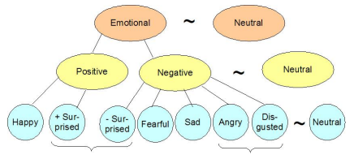
Approach: The data set
Three corpuses: Beatrix Potter, H. C. Andersen, and the Brothers Grimm
Annotated with:

Slide 4
My Hidden Markov Model
To the board!

Slide 5

My System Initiative Dialog
To the board again!

Slide 6
Results

Slide 7
Achievements, limitations, and Possible Future Work
Using an HMM was not ideal.
Applying this to more than just system initiative Dialogues.

