Slide 1
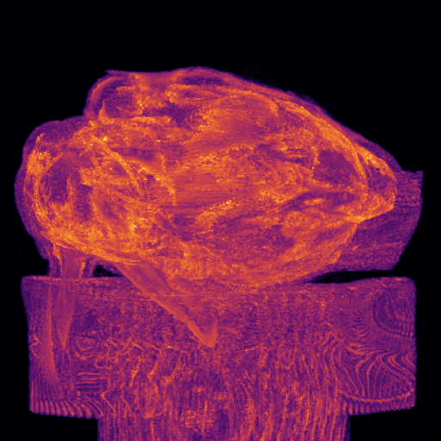
LARGE-SCALE COMPUTING · PRACTICAL ASSIGNMENT 3
BunnyMIP
Volumetric Maximum Intensity
Projection with CUDA
A GPU port of a three-stage volumetric rendering pipeline —
thresholding · 3×3×3 Gaussian blur · rotated MIP —
validated against a CPU gold standard and benchmarked.
Group cle08 · Hugo Castro (113889) · Ângela Ribeiro (109061) · Luís Diogo (108668)
Maximum Intensity Projection of the Stanford Bunny CT volume

Slide 2
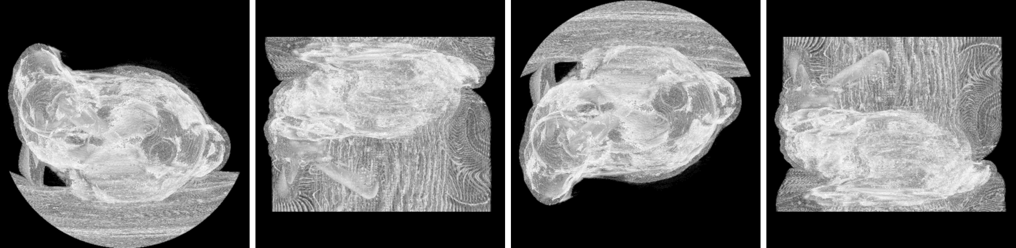
MOTIVATION
The problem: turning a CT volume into an image
02
Input: Stanford Bunny CT scan
512 × 512 × 361 voxels uint16 density field, ≈ 180 MiB
The bunny, projected at four rotation angles
≈ 9.5 × 10⁷ voxels processed every render
Output: a single 512 × 512 projected image
THE CHALLENGE
Maximum Intensity Projection reveals internal density
The sequential CPU pipeline takes ~6.8 seconds per
frame. Goal: port the three stages to the GPU with
CUDA and quantify the speedup.
BunnyMIP — Volumetric MIP with CUDA
CLE · Practical Assignment 3 · Group cle08

Slide 3
APPROACH
A three-stage pipeline, ported stage by stage
03
1
THRESHOLD
2
GAUSSIAN BLUR
3
MIP
Point operation
3×3×3 stencil
Ray reduction
v < T ⇒ 0
remove air noise
weighted average of
27 neighbours
max intensity along
each rotated ray
DATA LAYOUT contiguous 1-D uint16 array · idx = z·N² + y·N + x (N = 512, x is the fastest-varying axis)
Same threshold, σ and rotation matrix R feed both the CPU and GPU pipelines — which is what makes the validation meaningful.
BunnyMIP — Volumetric MIP with CUDA
CLE · Practical Assignment 3 · Group cle08

Slide 4
ARCHITECTURE
Device memory model
04
GLOBAL MEMORY — three device buffers
WHY THESE CHOICES
d_volume
thresholded in place
Constant cache broadcasts every thread reads the same R / weights in one transaction
512×512×361 uint16
d_blurred
Weights computed on the host the costly exp / normalisation runs once, not per thread
blur output — out-of-place
512×512×361 uint16
d_raster
Out-of-place blur separate output buffer avoids read-after-write hazards
final MIP image
512×512 uint16
__ldg read-only cache volume reads in the MIP go through the texture path
CONSTANT MEMORY read-only · broadcast
c_weights — 27 Gaussian weights
c_R — flattened 3×3 rotation matrix
VRAM freed each run no large allocations left resident — server etiquette
BunnyMIP — Volumetric MIP with CUDA
CLE · Practical Assignment 3 · Group cle08

Slide 5
KERNEL 1 OF 3
Thresholding — the point operation
05
device-bunnyMIP.cu
POINT OP
__global__ void threshold_kernel(
Embarrassingly parallel one thread handles many voxels
uint16_t* v, int N, uint16_t T){
for (i = tid; i < N; i += stride)
if (v[i] < T) v[i] = 0;
Grid-stride loop decouples launch size from data size
}
Fully coalesced consecutive threads → consecutive addresses
In place on d_volume. Mirrors the host exactly — same comparison, same result.
256 threads / block over 9.5×10⁷ voxels
BunnyMIP — Volumetric MIP with CUDA
CLE · Practical Assignment 3 · Group cle08

Slide 6
KERNEL 2 OF 3
Gaussian blur — the 3×3×3 stencil
06
STENCIL
device-bunnyMIP.cu
One thread per voxel organised as 8×8×8 blocks on a 3-D grid
__global__ void blur_kernel(
const uint16_t* __restrict__ in,
27-tap convolution weighted by c_weights from constant memory
uint16_t* __restrict__ out){
float acc = 0;
for (27 neighbours k)
Clamped boundaries mirrors the host's max/min edge handling
acc += c_weights[k]*in[clamp(idx)];
out[i] = (uint16_t)acc;
Out-of-place + __restrict__ no write hazards; enables aliasing opts
}
Truncating (uint16_t) cast reproduces the host's arithmetic bit-for-bit.
BunnyMIP — Volumetric MIP with CUDA
CLE · Practical Assignment 3 · Group cle08

Slide 7
KERNEL 3 OF 3
Maximum Intensity Projection — the reduction
07
device-bunnyMIP.cu
RAY-CAST
__global__ void mip_kernel(...){
uint16_t best = 0;
One thread per output pixel organised as 16×16 blocks
for (t = -range; t < range; ++t){
p = c_R * ray(x,y,t) + offset;
Backward mapping screen → volume via c_R, nearest-neighbour
if (in_bounds(p))
best = max(best, __ldg(&vol[p]));
ray_range = 405 half-diagonal → 810 steps span the full diagonal
}
raster[y*N+x] = best;
}
No atomics, no sync each ray's maximum is fully private
Volume read through __ldg (read-only data cache) — the kernel never writes the volume.
CLE · Practical Assignment 3 · Group cle08
BunnyMIP — Volumetric MIP with CUDA
CLE · Practical Assignment 3 · Group cle08

Slide 8
DESIGN
Concurrency strategy at a glance
08
STAGE
MAPPING
KEY TECHNIQUE
Threshold
1 thread ↔ many voxels
grid-stride loop
Blur
1 thread ↔ 1 voxel
independent reads, single input
MIP
1 thread ↔ 1 output pixel
private ray reduction
BY CONSTRUCTION
No locks · no atomics · no race conditions. Read-only inputs live in constant memory; the volume is read through the read-only cache.
BunnyMIP — Volumetric MIP with CUDA
CLE · Practical Assignment 3 · Group cle08

Slide 9
CORRECTNESS
Validated against the CPU gold standard
09
0.00 %
0
PASS
differing pixels
max absolute difference
tolerance ≤ 1.0 %
across every benchmarked configuration
16-bit intensity units
non-zero exit code on fail — scriptable
WHY THE OUTPUT IS BIT-STABLE
The kernels reproduce the host's arithmetic exactly — same weight math, same boundary clamping,
the same (uint16_t) truncation, the same nearest-neighbour ray sampling and the same ray range.
Metric: percentage of pixels whose absolute difference exceeds PIXEL_TOL = 2.
BunnyMIP — Volumetric MIP with CUDA
CLE · Practical Assignment 3 · Group cle08

Slide 10
PERFORMANCE
Speedup over the sequential CPU
10
HEADLINE
93–165× end-to-end
143–287× kernels
CPU baseline ≈ 6.8 s GPU end-to-end ≈ 42 ms
Blur is σ-independent same 27-tap work for any σ
~18 ms fixed overhead 180 MiB H→D upload + alloc
BunnyMIP — Volumetric MIP with CUDA
CLE · Practical Assignment 3 · Group cle08

Slide 11
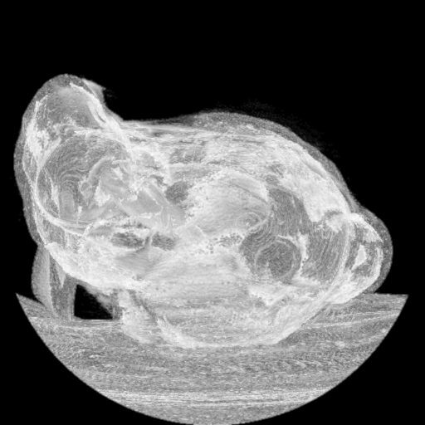
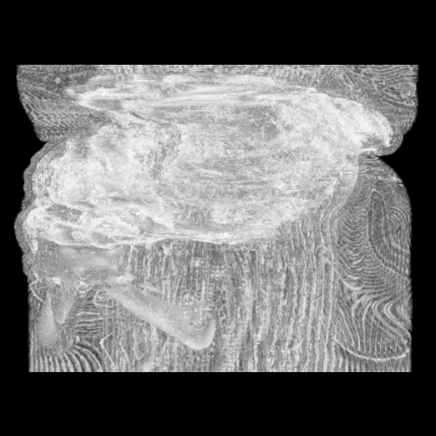
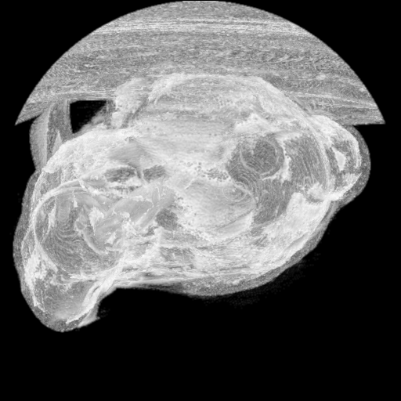
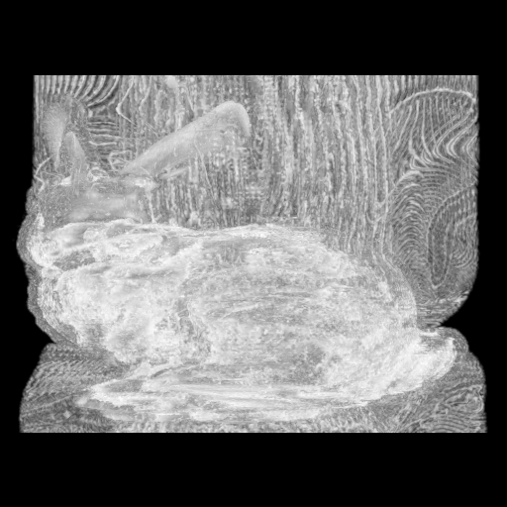
INNOVATION
N MIP frames in a single kernel call
11
Threshold + blur run once the blurred volume is reused for every frame
3-D GRID — frame axis as extra layers
3-D grid (x, y, frame) grid z-dimension — one layer per frame
Thread (x, y, f)
casts pixel (x, y)
of frame f through
the shared volume.
No atomics,
no sync.
frame 3
One launch renders all N MIPs each frame uses its own c_Rmulti[f]
frame 2
frame 1
N matrices in constant memory MAX_FRAMES = 512 ≈ 18 KB
frame 0
Encoded into a rotating video FFmpeg, contrast-normalised to 8-bit
output/frame_000.pgm … frame_119.pgm → bunny-spin.mp4
BunnyMIP — Volumetric MIP with CUDA
CLE · Practical Assignment 3 · Group cle08

Slide 12
SUMMARY
Three kernels, one validated GPU pipeline
Faithful port
Large speedup
Bit-stable with the CPU gold standard — 0.00 % difference
93–165× end-to-end, up to 287× kernels-only
Sound CUDA design
Innovation
Constant memory · grid-stride · __ldg · no atomics
N MIP frames in a single kernel call → rotating video
BunnyMIP · CLE Practical Assignment 3 · Group cle08 · NVIDIA GTX 1660 Ti · CUDA 10.2 · banana.ua.pt

