Slide 1
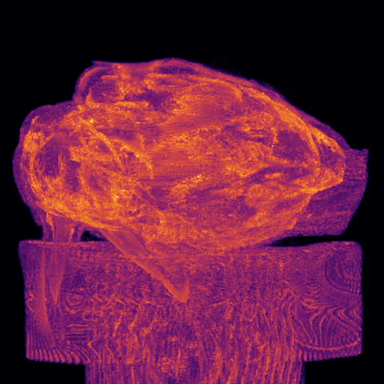
LARGE-SCALE COMPUTING · PRACTICAL ASSIGNMENT 3
BunnyMIP
Volumetric Maximum Intensity
Projection with CUDA
A GPU port of a three-stage volumetric rendering pipeline —
thresholding · 3×3×3 Gaussian blur · rotated MIP —
validated against a CPU gold standard and benchmarked.
Group cle08 · Hugo Castro (113889) · Ângela Ribeiro (109061) · Luís Diogo (108668)
Maximum Intensity Projection of the Stanford Bunny CT volume

Slide 2
PROBLEM & APPROACH
Three stages over a CT volume
02
Stanford Bunny CT 512 × 512 × 361 uint16 · ≈ 180 MiB · 9.5×10⁷ voxels CPU baseline ≈ 6.8 s → port to the GPU
1
THRESHOLD
2
GAUSSIAN BLUR
3
MIP
Point operation
3×3×3 stencil
Ray reduction
v < T ⇒ 0
remove air noise
weighted average of
27 neighbours
max intensity along
each rotated ray
DATA LAYOUT contiguous 1-D uint16 array · idx = z·N² + y·N + x (N = 512, x fastest-varying)
The same threshold, σ and rotation matrix R feed both the CPU and GPU pipelines — making the validation meaningful.
BunnyMIP — Volumetric MIP with CUDA
CLE · Practical Assignment 3 · Group cle08

Slide 3
IMPLEMENTATION · 1 OF 2
The CUDA kernels — point & stencil
03
THRESHOLD
POINT OP
GAUSSIAN BLUR
STENCIL
256 thr/block · grid-stride
8×8×8 blocks · out-of-place
Embarrassingly parallel 1 thread ↔ many voxels
27-tap convolution weights in constant memory
In place v < T ⇒ 0, on d_volume
Clamped boundaries mirrors the host exactly
Fully coalesced consecutive threads → addresses
__restrict__ + cast (uint16_t) truncation
if (v[i] < T) v[i] = 0;
out = Σ c_weights[k] · in[clamp(n)]
BunnyMIP — Volumetric MIP with CUDA
CLE · Practical Assignment 3 · Group cle08

Slide 4
IMPLEMENTATION · 2 OF 2
The CUDA kernels — the MIP reduction
04
MAXIMUM INTENSITY PROJECTION
RAY-CAST
One ray per pixel → max intensity
16×16 blocks · one thread per output pixel
Backward mapping screen → volume via c_R, nearest-neighbour
810-step ray ray_range = 405 (half-diagonal) → full diagonal
__ldg read-only cache the volume is never written by this kernel
Private maximum no atomics, no synchronisation
the projected raster (d_raster)
BY CONSTRUCTION
No locks · no atomics · no race conditions. Read-only inputs in constant memory; the volume is read through the read-only cache.
BunnyMIP — Volumetric MIP with CUDA
CLE · Practical Assignment 3 · Group cle08

Slide 5
RESULTS
Bit-stable — and 90–290× faster
05
SPEEDUP
93–165× end-to-end
143–287× kernels
VALIDATION
0.00 % differing
max abs diff = 0 bit-stable vs CPU gold standard
PASS tolerance ≤ 1.0 %
BunnyMIP — Volumetric MIP with CUDA
CLE · Practical Assignment 3 · Group cle08

Slide 6
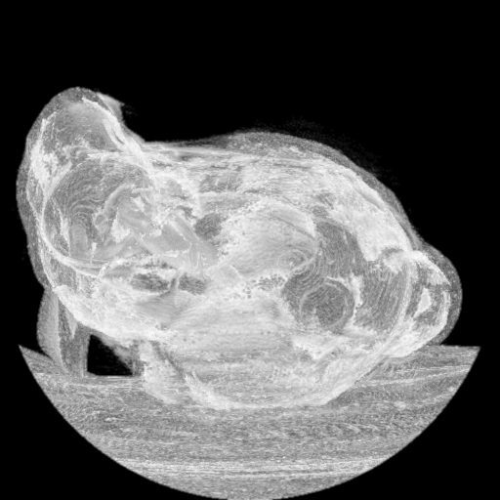
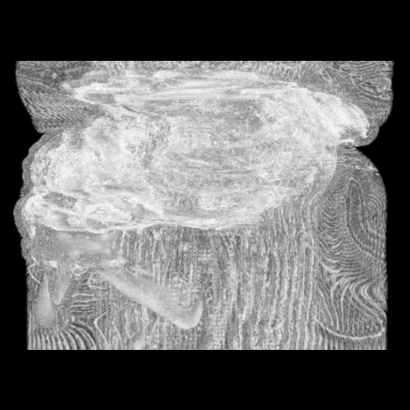
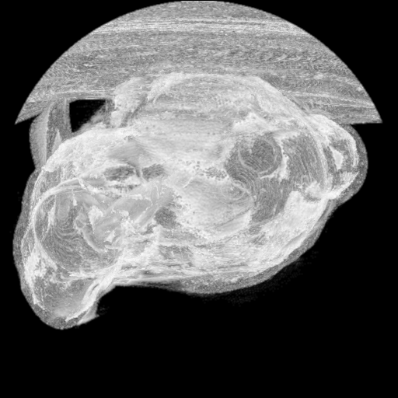
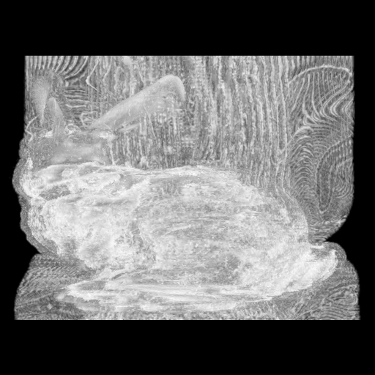
INNOVATION (GRADED)
N MIP frames in a single kernel call
06
Threshold + blur run once the blurred volume is reused for every frame
3-D GRID — frame axis as extra layers
3-D grid (x, y, frame) grid z-dimension — one layer per frame
Thread (x, y, f)
casts pixel (x, y)
of frame f through
the shared volume.
No atomics,
no sync.
frame 3
frame 2
One launch renders all N MIPs each frame uses its own c_Rmulti[f]
frame 1
frame 0
Encoded into a rotating video MAX_FRAMES = 512 · FFmpeg, normalised to 8-bit
frame_000.pgm … frame_119.pgm → bunny-spin.mp4
BunnyMIP — Volumetric MIP with CUDA
CLE · Practical Assignment 3 · Group cle08

Slide 7
SUMMARY
Three kernels, one validated GPU pipeline
Faithful port
Large speedup
Bit-stable with the CPU gold standard — 0.00 % difference
93–165× end-to-end, up to 287× kernels-only
Sound CUDA design
Innovation
Constant memory · grid-stride · __ldg · no atomics
N MIP frames in a single kernel call → rotating video
BunnyMIP · CLE Practical Assignment 3 · Group cle08 · NVIDIA GTX 1660 Ti · CUDA 10.2 · banana.ua.pt

