Slide 1
Practical tips on Apptainer/Singularity Kai Hu 01/17/2023

Slide 2
Agenda
Introduction to Singularity
core concepts, why use it, core commands, definition file
practical issues when building with Singularity
How to solve the practical issues
a strategy that worked for me
demo
other tips
References

Slide 3
Introduction to Singularity
Core concepts
Apptainer/Singularity: an open-source container framework for HPC
Allows running Docker containers natively
A replacement for Docker on HPC systems
shared file system with the host
does not require root privilege
Recipe (.recipe/.def) vs image (.sif) vs container:
Recipe is the definition (blueprint) file to build an image
Running an image creates a container (analogy: class vs instance)
Why bother to learn Singularity?
Reproducible analysis on HPC/SCI
Use with SCI OpenOnDemand (OOD): JupyterNotebook, Rstudio
OOD has a default Rstudio image, but it is not usable at all
Good thing is that OOD offers a recipe template for you to build your own
Notes:
https://nickjanetakis.com/blog/differences-between-a-dockerfile-docker-image-and-docker-container

Slide 4
Introduction to Singularity: core commands
singularity/apptainer build
to build an image with a definition file
to convert an image between container formats
to download images from external resource
singularity/apptainer exec
to run a command within a container
singularity/apptainer shell
to run a shell within a container
singularity/apptainer pull/push
to pull or upload an image from a URI
Notes:
https://nickjanetakis.com/blog/differences-between-a-dockerfile-docker-image-and-docker-container

Slide 5
Introduction to Singularity: definition file
Header (required)
Bootstrap:
describes the core operating system to build with
there are many bootstrap agents to choose from:
docker (preferred, use images hosted on Docker Hub)
yum (yum based systems )
library (image hosted on Library API Registries, by Sylab)
Sections (all are optional)
The order of sections in the def won’t affect their execution order
%setup, %files, %app, %post, %test, %environment, %startscript, %runscript, %labels, %help
Notes:
the Bootstrap keyword must be the on top.
%setup: executed on the host system outside the container after the base OS has been installed
%files: a safer alternative to copying files from host to container during build
%post: where you can download files, install new software and libraries, write configuration files, create new directories
%test: runs at the very end of the build process to validate the container using a a method of your choice
%environment: define environment variables that will be set at runtime, the info is written to the container metadata file which will be sourced at run time. %post variables take precedence over %environment variables.
%runscript: the content will be written to a file within the container that is executed when the container image is run
%labels: add metadata (key-value pairs) within your container, which can be viewed with “singularity inspect”
%help: will be displayed when the run-help command was invoked.
%app: for encapsulating multiple apps into a container, each app will have its own entry point, env, and metadate. so that you don’t need to collect different containers.

Slide 6
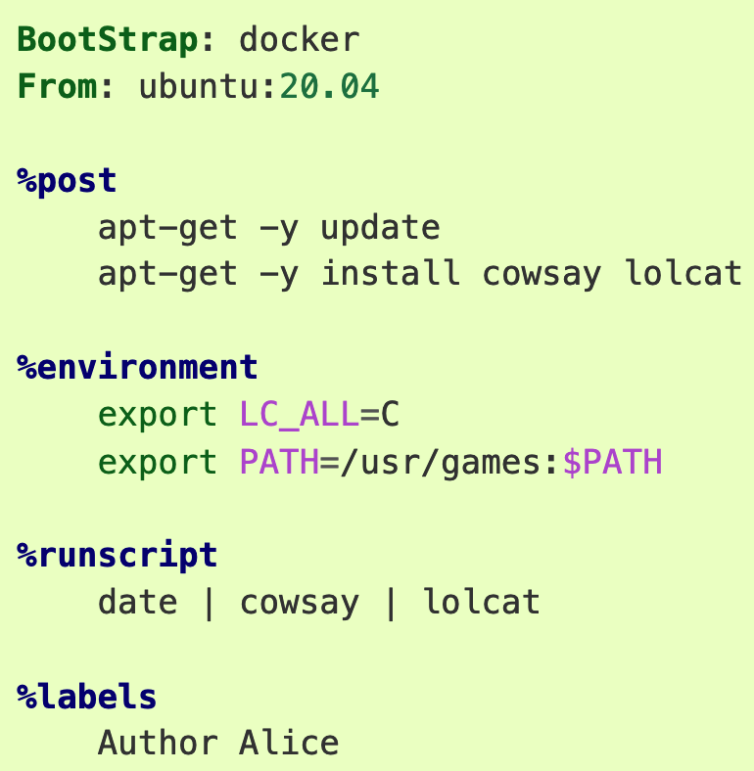
Definition file: example
This is the header: defines the base container to begin with: from Docker Hub or official repositories: Ubuntu, CentOS, Debian, Arch
Execute after the base OS has been installed:
a place to perform installations of new applications
Define environmental variables that will be available to the container at runtime, not available at build time
User defined scripts that would execute when running the container: singularity run xxx.sif or ./xxx.sif
Add custom metadata to the container
Notes:
The header defines which base image to start with.
The body defines sections that:
software installation
environment setup
copying files from host to container
%post is named to indicate that those commands execute after the base OS has been installed
If you want the environmental variable to be available at build time, use %post

Slide 7
Practical issues when building with Singularity
If you have a Linux machine with root access:
things are easy, simply use the following commands to interactively build and test your image:
singularity build --sandbox xxx.sif xxx.def (building sandbox is much slower)
singularity shell --writable xxx.sif
On Windows:
you will need a VM and some other tools
On macOS:
option 1: use VM, but VM can drag your Mac very slow, tested on MacBook Pro 2019
option 2: use Singularity Desktop for macOS (https://docs.sylabs.io/guides/3.2/user-guide/installation.html)
singularity push and singularity pull are supported
singularity shell and singularity build are not supported
On SCI: we do not have root privilege
singularity shell, singularity pull, and singularity push are supported
singularity build is partially supported
can only build from pre-built Docker images
can not build from recipe file (require root privilege)
In short, we can not perform interactive testing with Singularity when building your image.
Notes:
You may use SCI singularity build --sandbox to convert a pre-built docker image into a sandbox, however, some new packages still can not be installed due to privilege issues.

Slide 8
A working strategy: Sylab remote builder
How to build?
Use the Remote Builder created by Sylabs: works on macOS with Singularity Desktop and SCI
Register at: (https://sylabs.io/guides/3.3/user-guide/cloud_library.html#make-an-account
Generate a token: https://sylabs.io/guides/3.3/user-guide/cloud_library.html#creating-a-access-token
singularity remote login
singularity build --remote your_image_name.sif your_definition_name.def
singularity push library://user/collection/container[:tag]
singularity shell
Quotas: 11GB storage and 500 minutes build minutes per month

Slide 9
A working strategy: interactive testing
Need interactive testing?
On macOS or Windows, install Docker desktop:
(https://www.docker.com/products/docker-desktop/)
Interactively test with a Docker image created with the same base system (so that the package managers are the same):
keep track of the working commands
then, copy them to the Singularity definition file
use remote builder to build

Slide 10
Other tips
Singularity can pull and convert Docker images directly:
So, most of the time, you don’t even need to be bothered by singularity build at all
singularity pull docker://user_name/image_name:version
Regarding the base OS:
Choose Ubuntu, since most hard-to-install packages are developed on Ubuntu, thus, easier to deploy on Ubuntu
Ubuntu is derived from Debian:
they use the same package manager
Demo:
cd /pi/mccb-umw/shared/singularity/demo
demo.md
https://www.chpc.utah.edu/documentation/software/containers-localbuild.php
Notes:
Debian is the more stable and conservative version of Ubuntu, only fully tested functions on Ubuntu will be transferred to Debian.

Slide 11
References
Docker and Singularity containers: which one is better?
https://blogs.oregonstate.edu/learningbydoing/2022/01/04/docker-and-singularity-containers-which-one-is-better/
Singularity paper:
https://journals.plos.org/plosone/article?id=10.1371/journal.pone.0177459
Recipe vs image vs container:
https://nickjanetakis.com/blog/differences-between-a-dockerfile-docker-image-and-docker-container

