Slide 1
A practical guide to using nf-core base template
Kai Hu
2024/10

Slide 2
Prerequisites
Basic knowledge of Nextflow:
Process/module, channel, channel factory, configuration file, Docker/container
nf-core commands:
nf-core create, nf-core install, etc.
Familiar with nf-core base template (termed TEMPLATE hereafter) architecture (optional)
Working knowledge of conda commands
conda create, conda activate, conda install, etc.

Slide 3
Agenda
Revisit the core nf-core commands
The TEMPLATE architecture
Build a toy pipeline by leveraging the nf-core facilities
Environment setup
Toy pipeline outline: from FastQ files -> FastQC, cutadat, MultiQC
if written manually
if written by using the TEMPLATE
Practical tips of using the TEMPLATE and the “nf-core install” command

Slide 4
Core nf-core commands
nf-core list: show all available nf-core pipelines
nf-core modules list: show all available nf-core modules
nf-core download: download pipeline code from nf-core
nf-core modules install: install modules from nf-core/modules in your pipeline at “.modules/nf-core/modules”
nf-core create: create a new pipeline using the nf-core base template
nf-core modules create: create a new module using the nf-core module template

Slide 5
The nf-core TEMPLATE file structure
main.nf: main file which will get executed when the pipeline runs
nextflow.config: main configuration file
nextflow_schema.json: for parameter specification
bin/: directory for scripts that must be directly accessible within a pipeline process
conf/: directory for configuration files
base.config: basic pipeline configurations, like CPU, memory, etc.
modules.config: module-specific configurations
workflows/: contains main pipeline workflows to be executed in main.nf
subworkflows/: contains sub-workflows invoked in main workflows
modules/: contains module files used in main- and sub-workflows.
For full list of files/directories:
https://nf-co.re/docs/contributing/pipelines/pipeline_file_structure

Slide 6
Agenda
Revisit the core nf-core commands
The TEMPLATE architecture
Build a toy pipeline by leveraging the nf-core facilities
Environment setup
Toy pipeline outline: from FastQ files -> FastQC, cutadat, MultiQC
if written manually
if written by using the TEMPLATE
Practical tips of using the TEMPLATE and the “nf-core install” command

Slide 7
Environment setup
Required software: Nextflow, nf-core, conda, Docker/Singularity
Method1 (recommended): use conda to manage environments
Install miniconda: https://docs.conda.io/projects/conda/en/latest/user-guide/install/macos.html
Install Nextflow and nf-core
conda create -n nextflow python=3.12
conda activate nextflow
conda install bioconda::nextflow # installs v24.04
conda install bioconda::nf-core # installs v2.14.1
Install Docker: https://www.docker.com/products/docker-desktop/
Method2 (install Nextflow manually, not recommended)
Follow https://www.nextflow.io/docs/latest/install.html

Slide 8
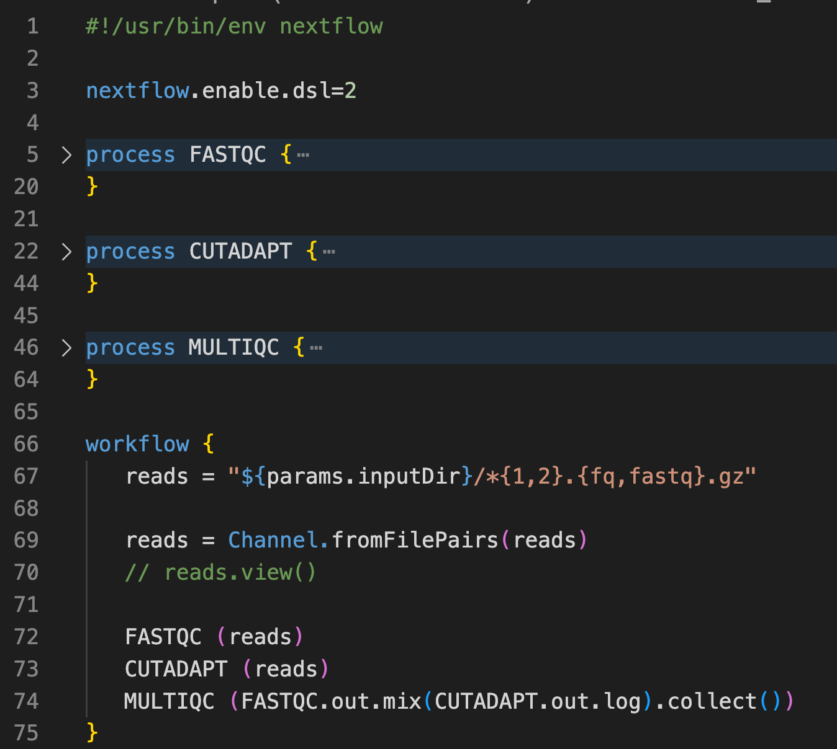
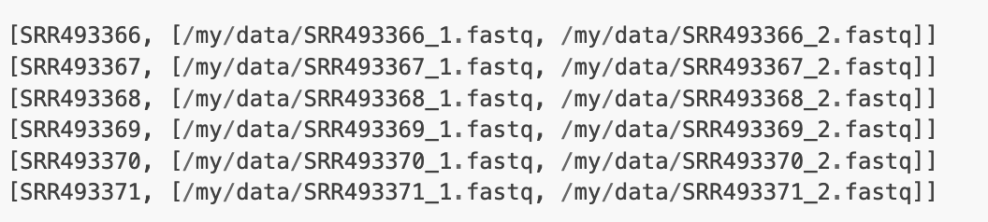
Toy pipeline: if written manually
A minimal of two files are needed:
main_sole_demo.nf
main_sole_demo.config
Command to run:
nextflow run main_sole_demo.nf -profile docker -c main_sole_demo.config
Input is specified with: Channel.fromFilePairs(), which creates a tuple consisting of grouping key and a list of the files, e.g.:
Use reads.view() to check if the input format is as expected

Slide 9
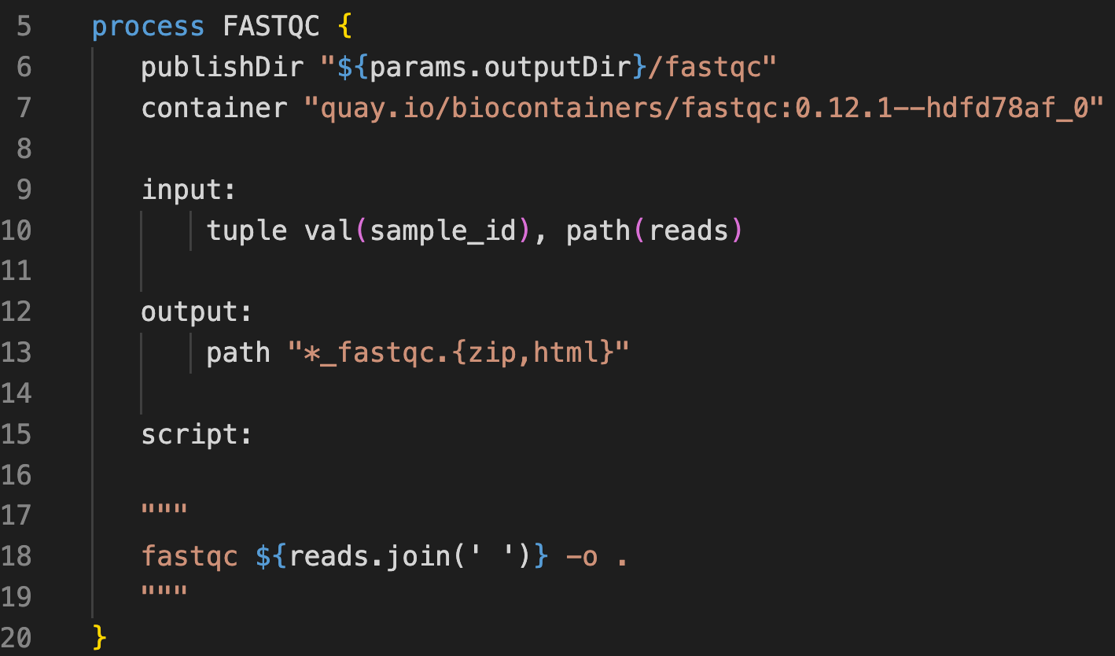
Toy pipeline: FASTQC module zoom in
Can be organized to module config file

Slide 10
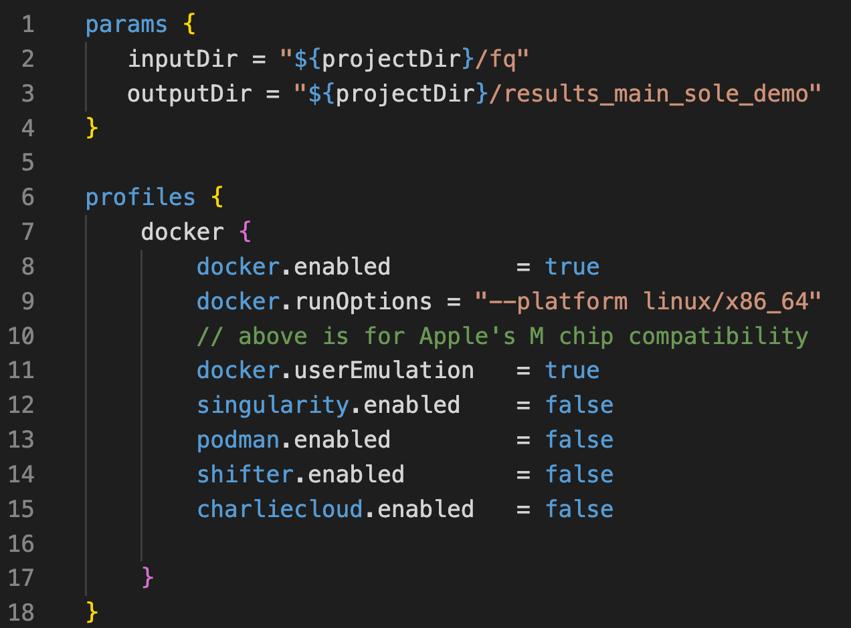
Toy pipeline: main config file zoom in
Directory that contains input fastq files
Directory that contains output files
Use “-profile docker” to enable docker related settings
Better turn on this option on M-chip devices

Slide 11
Toy pipeline: use the TEMPLATE
Step1: download the TEMPLATE
nf-core create
Step2: get familiar with the main.nf
Step3: comment out non-essential parts in the main.nf
Step4: test run by tweaking the input file
Step5: install needed modules
nf-core modules install fastqc (pre-installed)
nf-core modules install cutadapt
nf-core modules install multiqc (pre-installed)
Step6: put back selected non-essential parts

Slide 12
Step1: download the TEMPLATE
nf-core create
Workflow name: preprocess
Description: Perform FastQC, Cutadapt, etc. and MultiQC on fastq files.
Author: your_name
Do you want to customize which parts of the template are used? Yes
Pipeline prefix: test
Select GitHub hosting: it is HIGHLY recommended to host your repo on GitHub
Edit .gitignore if needed

Slide 13
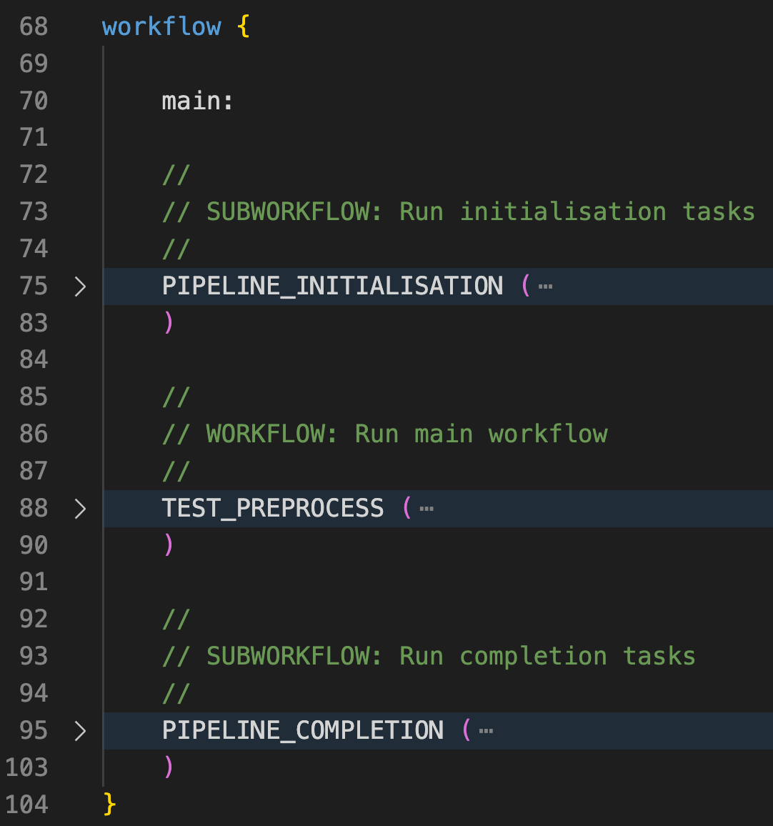
Step2: get familiar with the main.nf
Tasks before running the main pipeline:
Basic checks: version, check conda, etc.
Parameter validation: against “nextflow_schema.json”
Parameter validation: CLI positional argument format
Parameter validation: custom
Create input channel given input sample sheet
1. Our main pipeline
Tasks after running the main pipeline:
Construct and sent out completion email and more

Slide 14
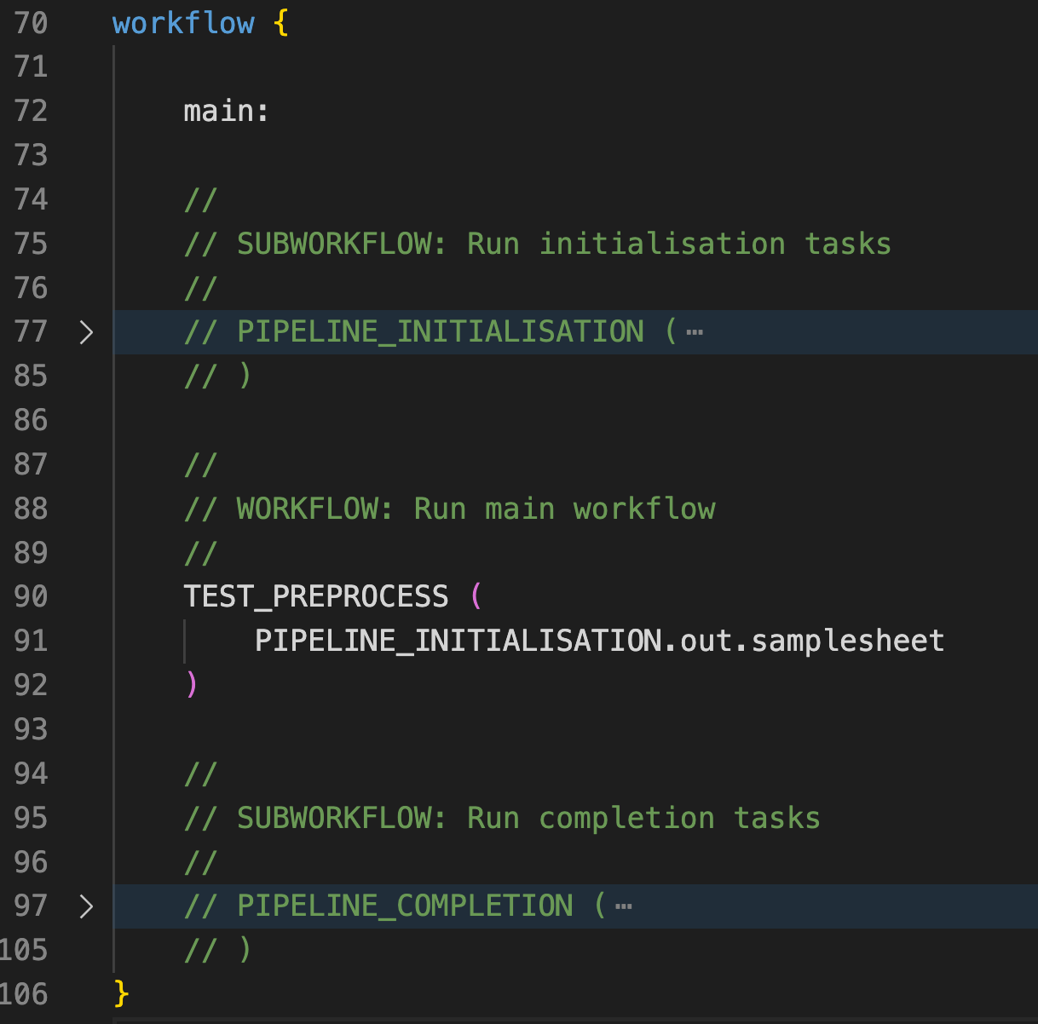
Step3: comment out non-essential parts !
PIPELINE_INITIALISATION
TEST_PREPROCESS
PIPELINE_COMPLETION
A practical tip is to comment out non-essential parts in main.nf and focus solely on the main workflow logic (TEST_PREPROCESS).
This approach minimizes distractions and enables quicker turnaround.
TEST_PREOPROCESS wraps the PREPROCESS workflow. We could replace it with PREPROCESS, but let’s stick with the TEMPLATE for now.

Slide 15
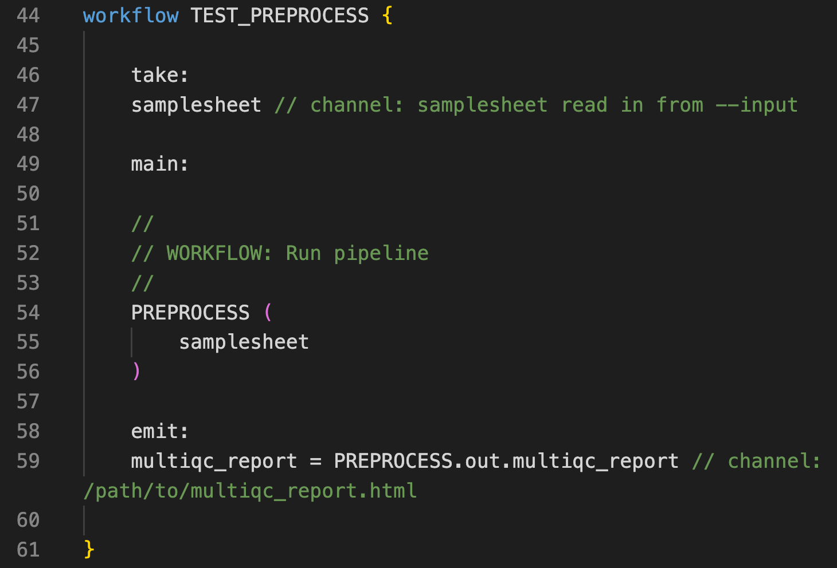
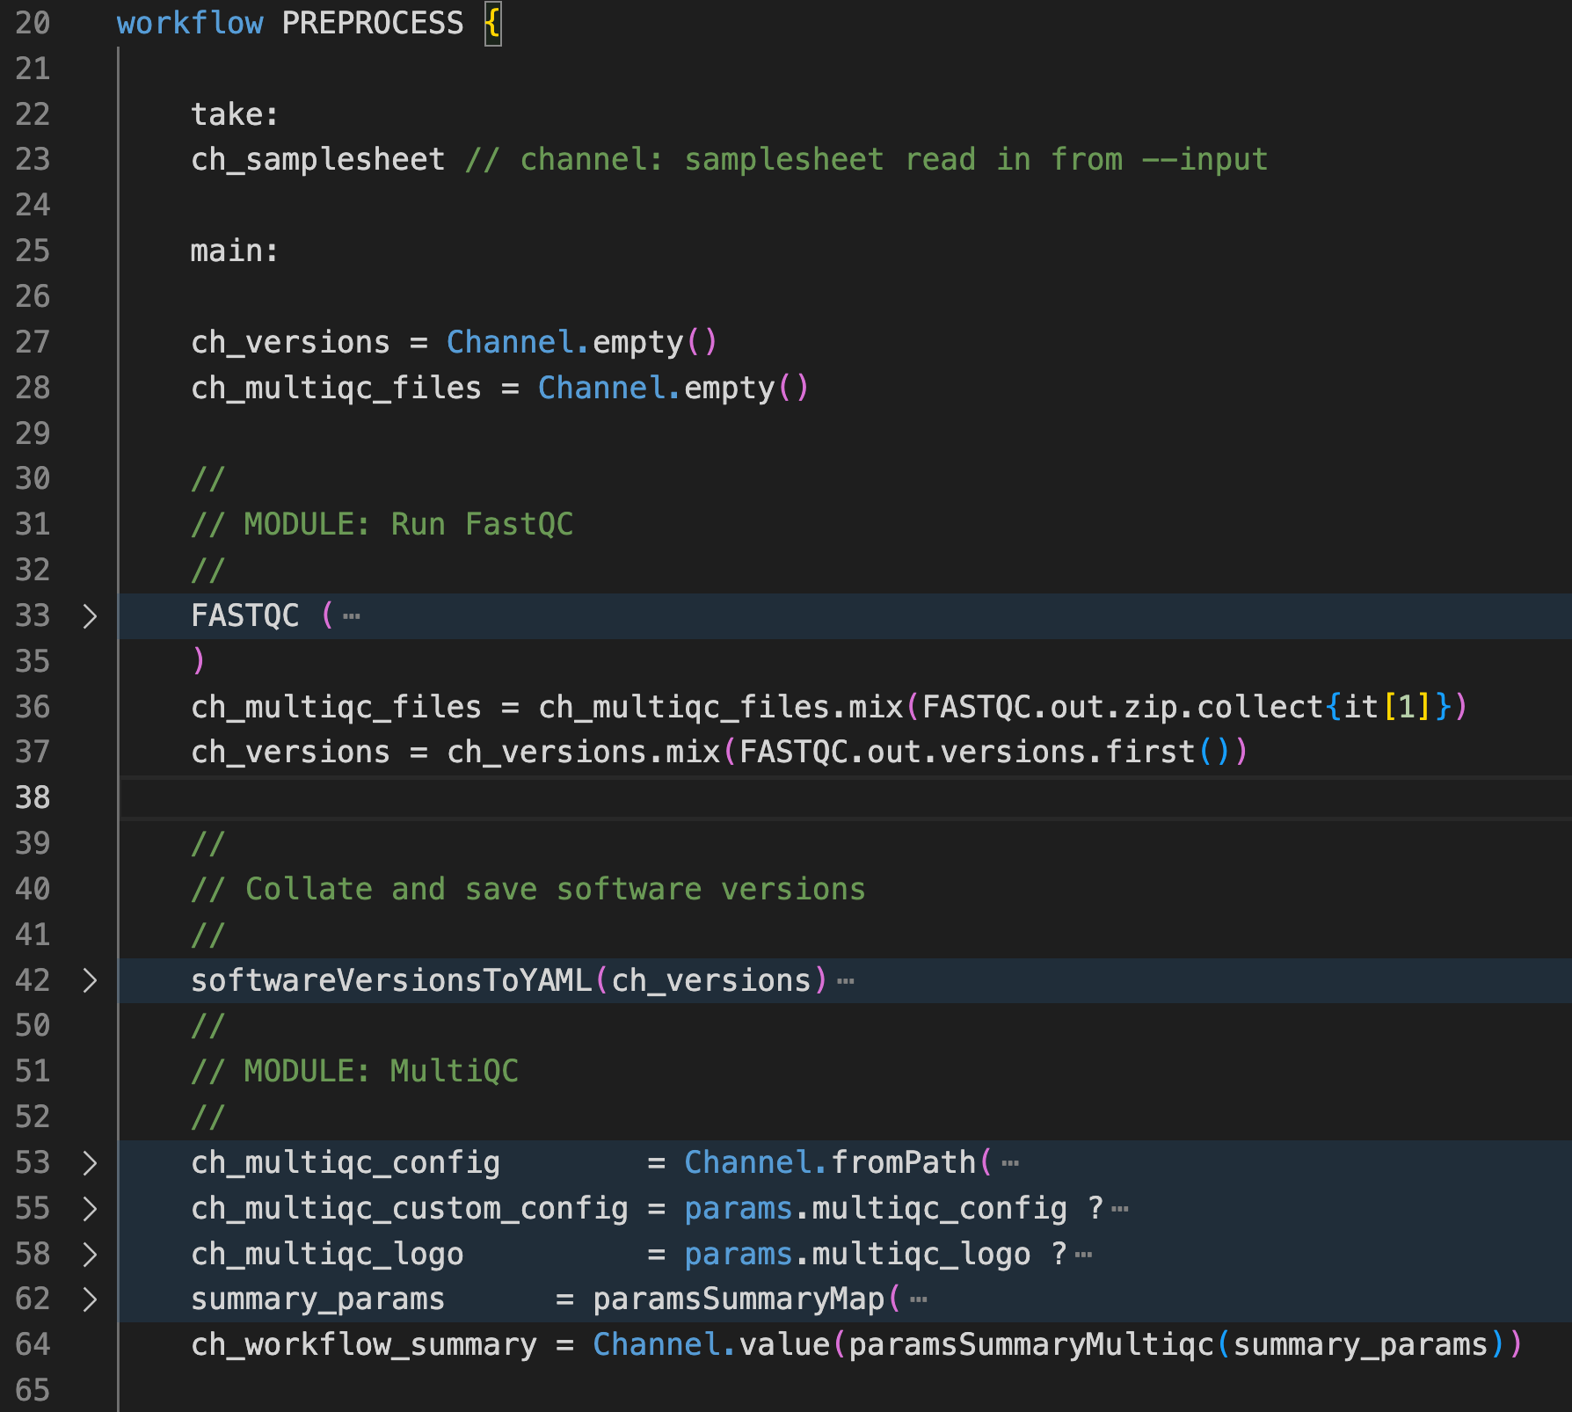
TEST_PREPROCESS: zoom in
TEST_PREPROCESS wraps PREPROCESS.
PREPROCESS consists of the following default modules from nf-core:
FASTQC
MULTIQC
Line 27-28, 42, 53-52 are related to MULTIQC module: MULTIQC needs to be properly configured: worth its own topic.

Slide 16
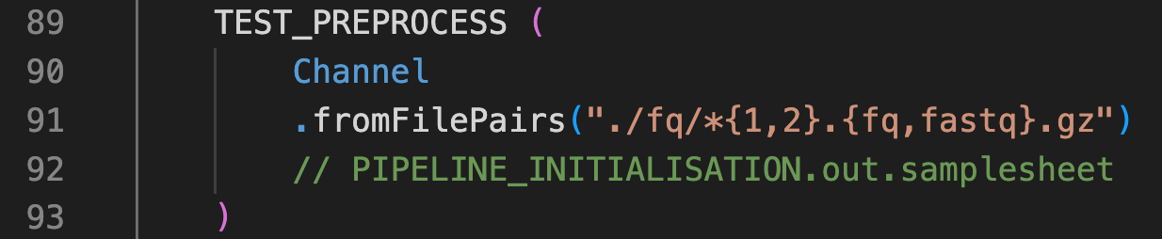
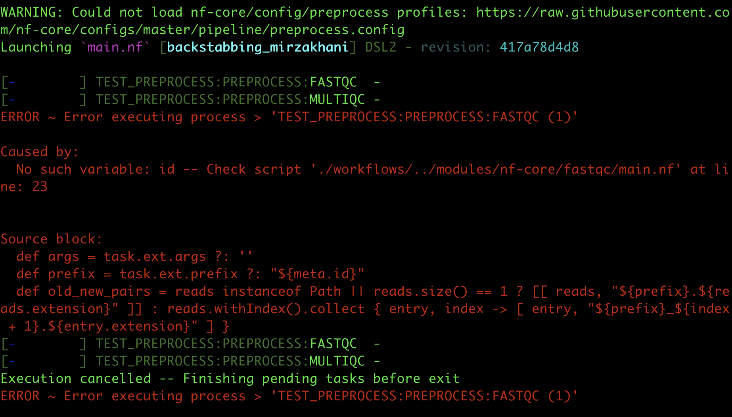
Step4: test run by tweaking the input file
First download a minimal test fq folder:
https://github.com/hukai916/nextflow_learn/tree/main/fq
Test by replacing the default input with Channel.fromFilePairs()
Also, update nextflow.config:
outdir
max_cpu, max_memory
nextflow run main.nf -profile docker,arm
FASTQC module complains about missing “id”. To debug: read FASTQC input requirements in the module definition file and/or the parameter yaml file:
modules/nf-core/fastqc/main.nf
modules/nf-core/fastqc/meta.yml

Slide 17
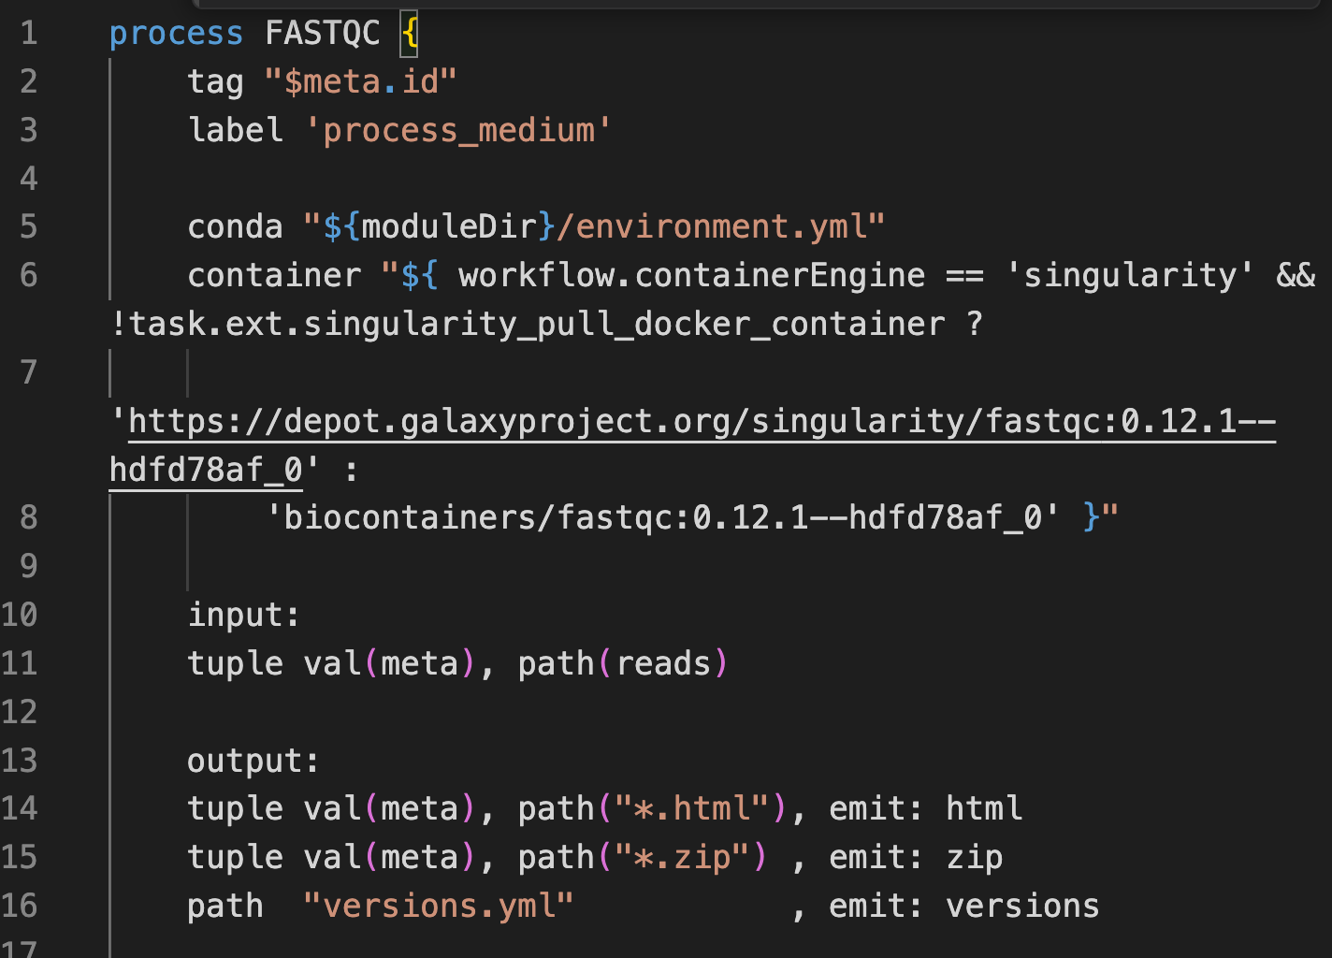
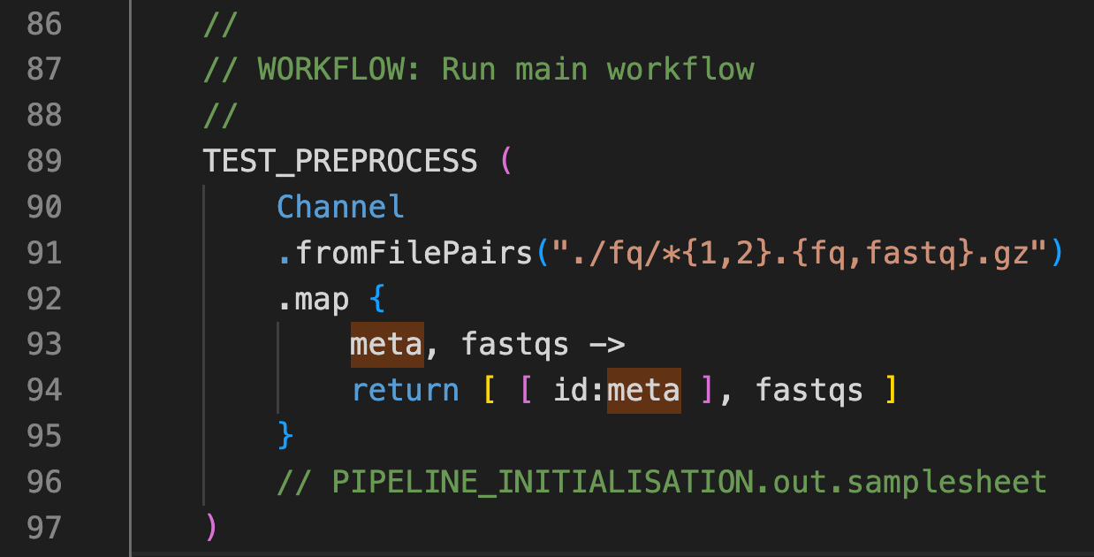
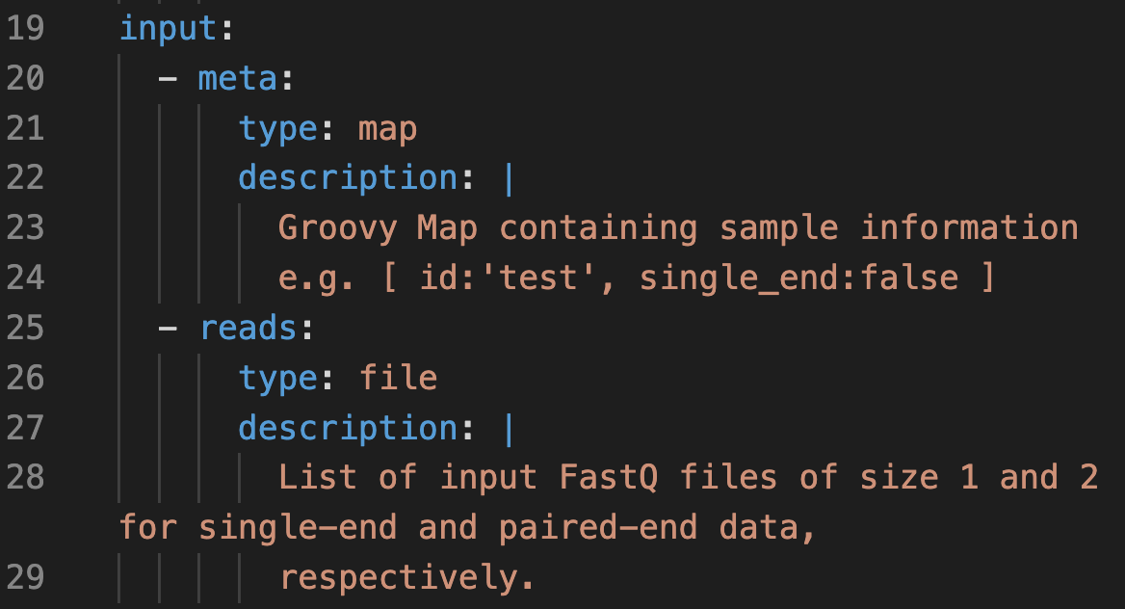
FASTQC module input requirements
fastqc/main.nf:
FASTQC takes input as a tuple consisting of two elements:
[[id:sample1], [reads1, reads2]]
The first element is a groovy map object that should at least contain the “id” key. Whereas Channel.fromFilePairs() return a tuple with a single value as its first element:
[sample1, [reads1, reads2]]
More on the meta map object: https://nf-co.re/docs/contributing/components/meta_map
fastqc/meta.yml:
Quick fix

Slide 18
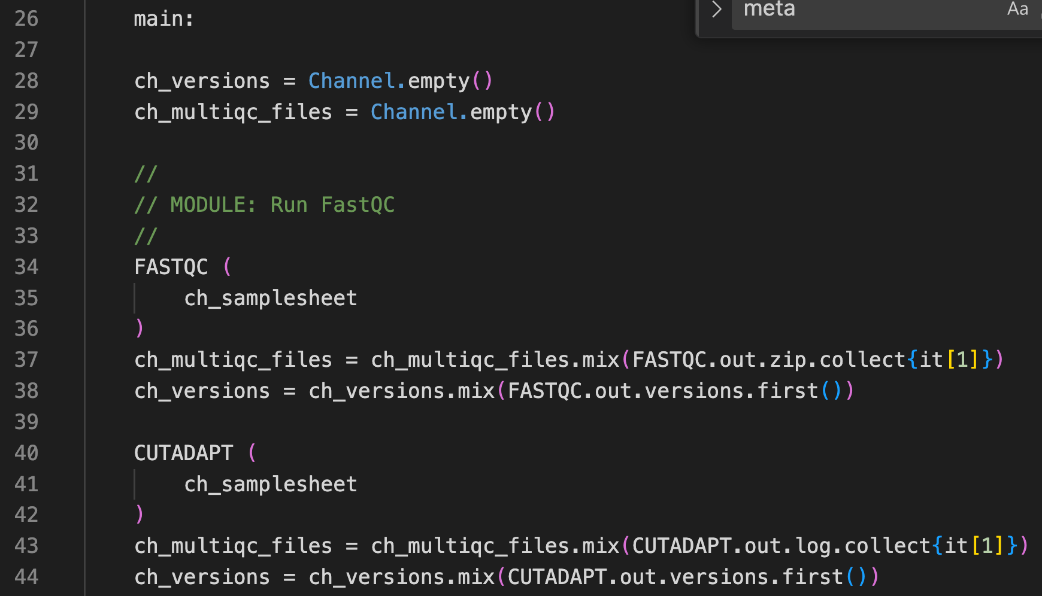
Step5: install needed modules (CUTADAPT)
Command:
nf-core modules install cutadapt
CUTADAPT will be installed at modules/nf-core/cutadapt/
CUTADAPT has the same input requirements as FASTQC, allowing us to seamlessly integrate it into the PREPROCESS pipeline

Slide 19
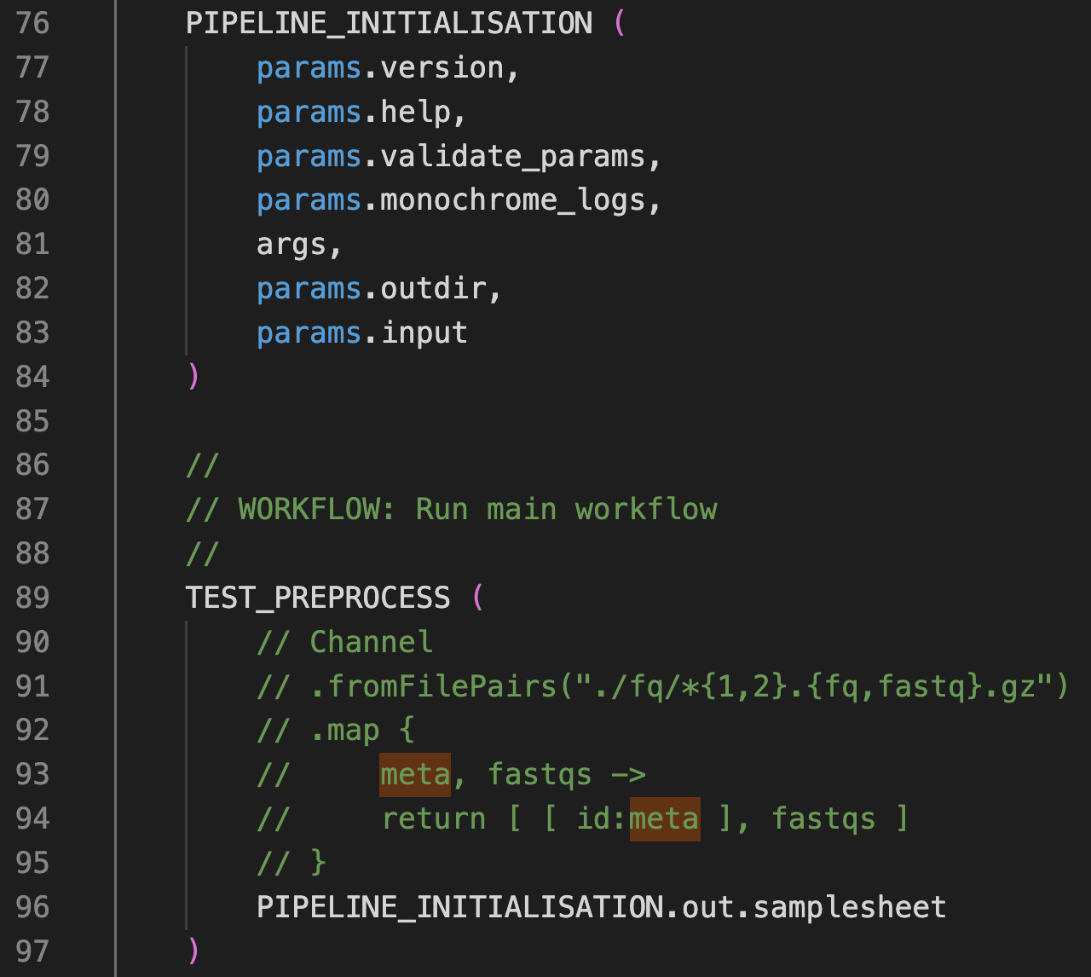
Step6: put back selected non-essential parts
PIPELINE_INITIALISATION
TEST_PREPROCESS
PIPELINE_COMPLETION
Including PIPELINE_INITIALISATION is highly recommended, as it takes a sample sheet (params.input) as input and performs parameter validation, largely enhancing the pipeline's robustness.
Command:
nextflow run main.nf -profile docker,arm --input assets/samplesheet.csv
Download example: samplesheet.csv

Slide 20
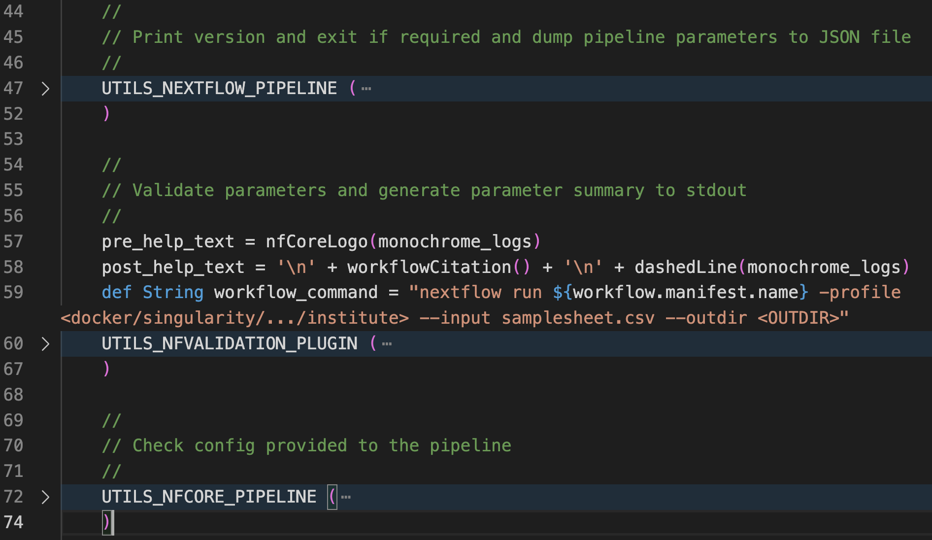
PIPELINE_INITIALISATION functions
Basic checks: version, conda env, etc.
Parameter validation: against “nextflow_schema.json”
input type, format, etc.
nextflow_schema.json can be created using “nf-core pipelines schema build” that scans the nextflow.config file
3. Parameter validation: CLI positional argument format

Slide 21
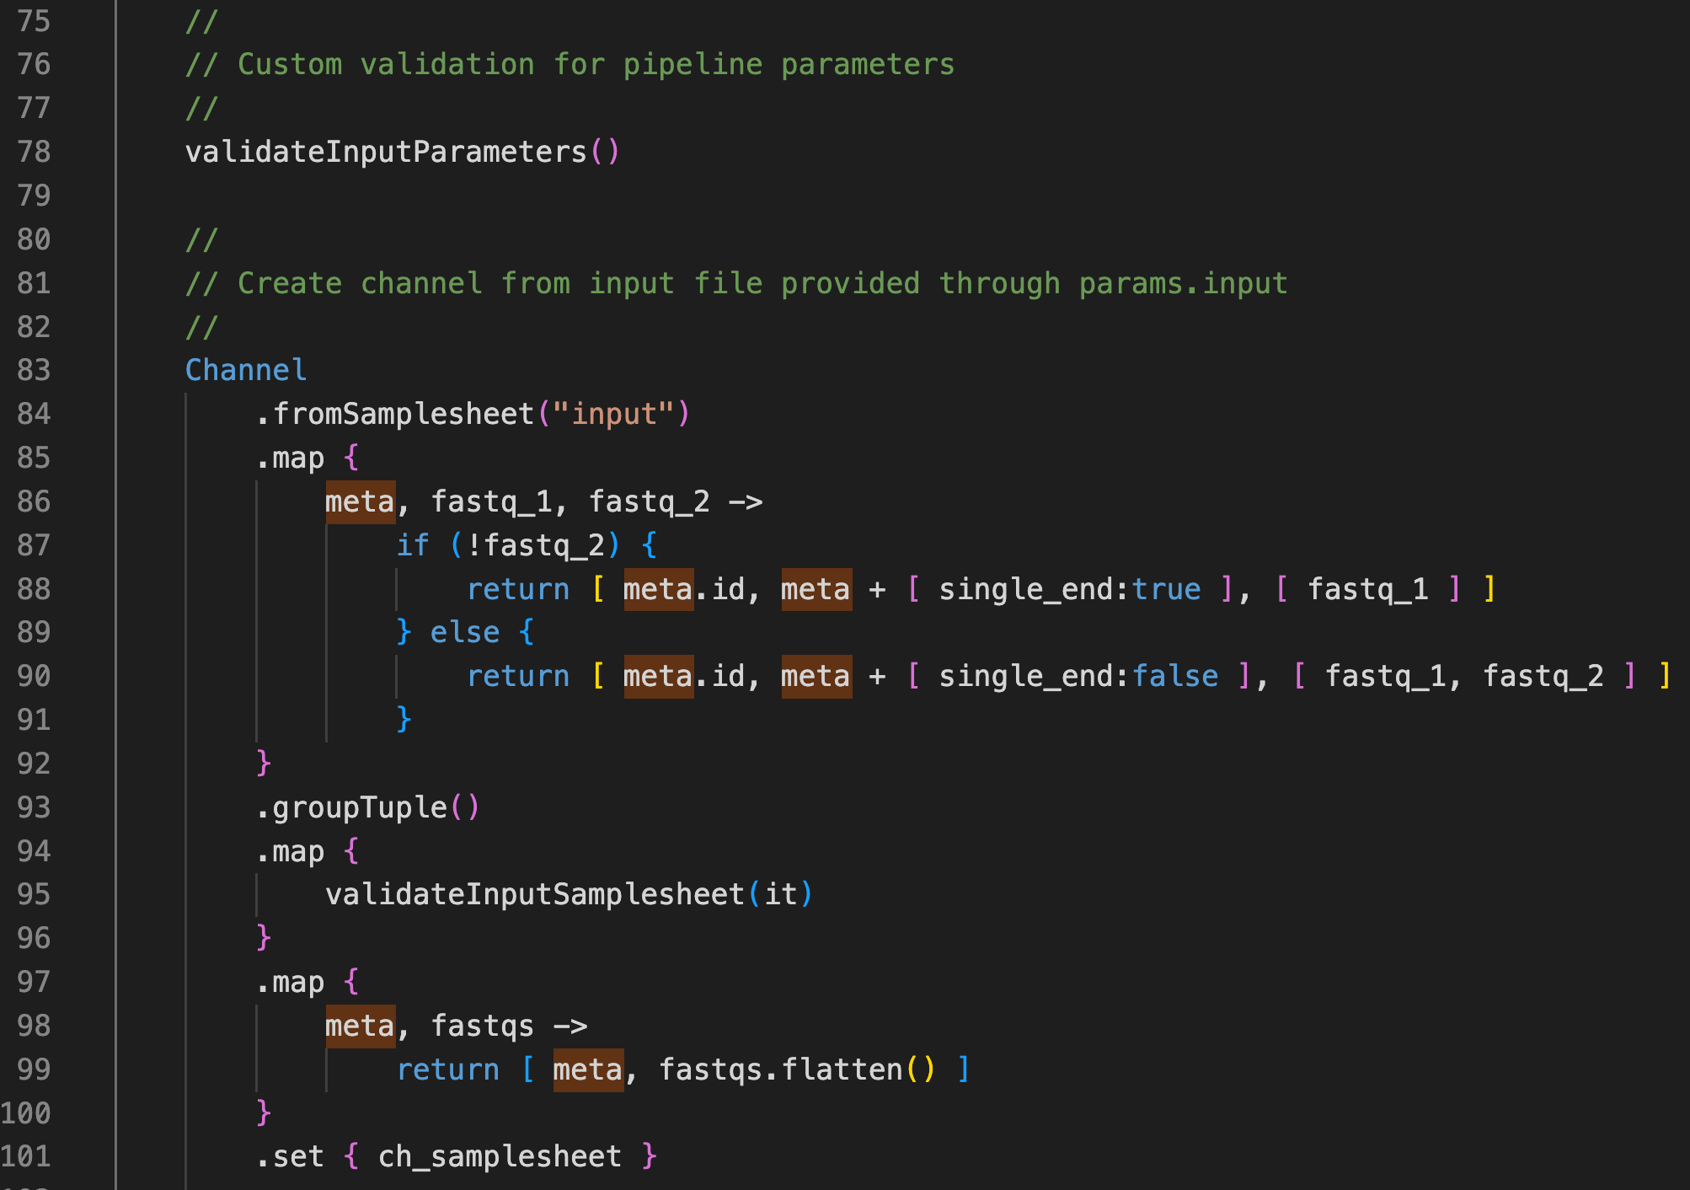
PIPELINE_INITIALISATION functions, Cont’d
Parameter validation: custom
Beyond those that are defined in the nextflow_schema.json file
More on Channel.fromSamplesheet() function (validation plugin):
https://nf-co.re/events/2023/bytesize_nf_validation
5. Create input channel given input sample sheet
Additional sanity checks have been implemented for the sample sheet validation. The older TEMPLATE used a subworkflow with Python scripts for this purpose, while the current version utilizes a Groovy function.

Slide 22
Summary
A minimal Nextflow pipeline should contain at least two files:
main.nf
nextflow.config
It is recommended to leverage the nf-core base TEMPLATE
The TEMPLATE is getting bulky over time, comment out non-essential parts as you develop the core logic of your pipeline
Put back the PIPELINE_INITIALISATION will make the pipeline more robust
Always use the latest TEMPLATE from the community!

