Slide 1
A brief introduction to the SIKI-project
Kai Hu
10/2023

Slide 2
A collaboration with Lawson Lab
SIKI: Short Insert Knock-In experiment using CRISPR-Cas system
Overall goal:
to determine optimal conditions for targeted knock-in of a short insert sequence
Tested variables:
Cas9 vs Cas12
Various target genes: ep300a, ep300b, etv2, h3f3d, hey2
Various donor DNA templates (?): ISce1, unigRNA, mod
Sequencing platform: PacBio

Slide 3
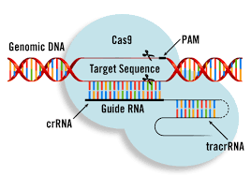
Gene editing with CRISPR system
https://www.google.com/url?sa=i&url=https%3A%2F%2Fwww.mirusbio.com%2Fapplications%2Fgenome-editing-using-crispr-cas&psig=AOvVaw2yIzXdBr-ZFJvje8_uqBFb&ust=1698180204420000&source=images&cd=vfe&opi=89978449&ved=0CBAQjRxqFwoTCLiYkraEjYIDFQAAAAAdAAAAABBN
Notes:
Cas9 originally needs two RNAs: crRNA(crisprRNA) for targeting DNA site, and a structural component called tracrRNA (trans-activating crispr RNA), or a single combined sgRNA.

Slide 4
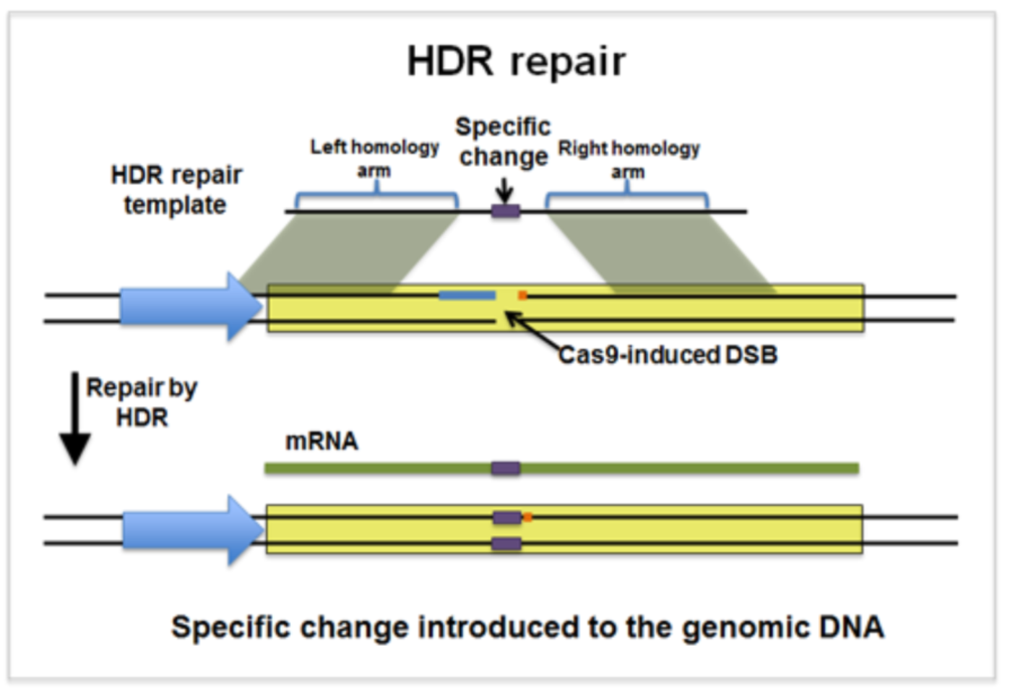
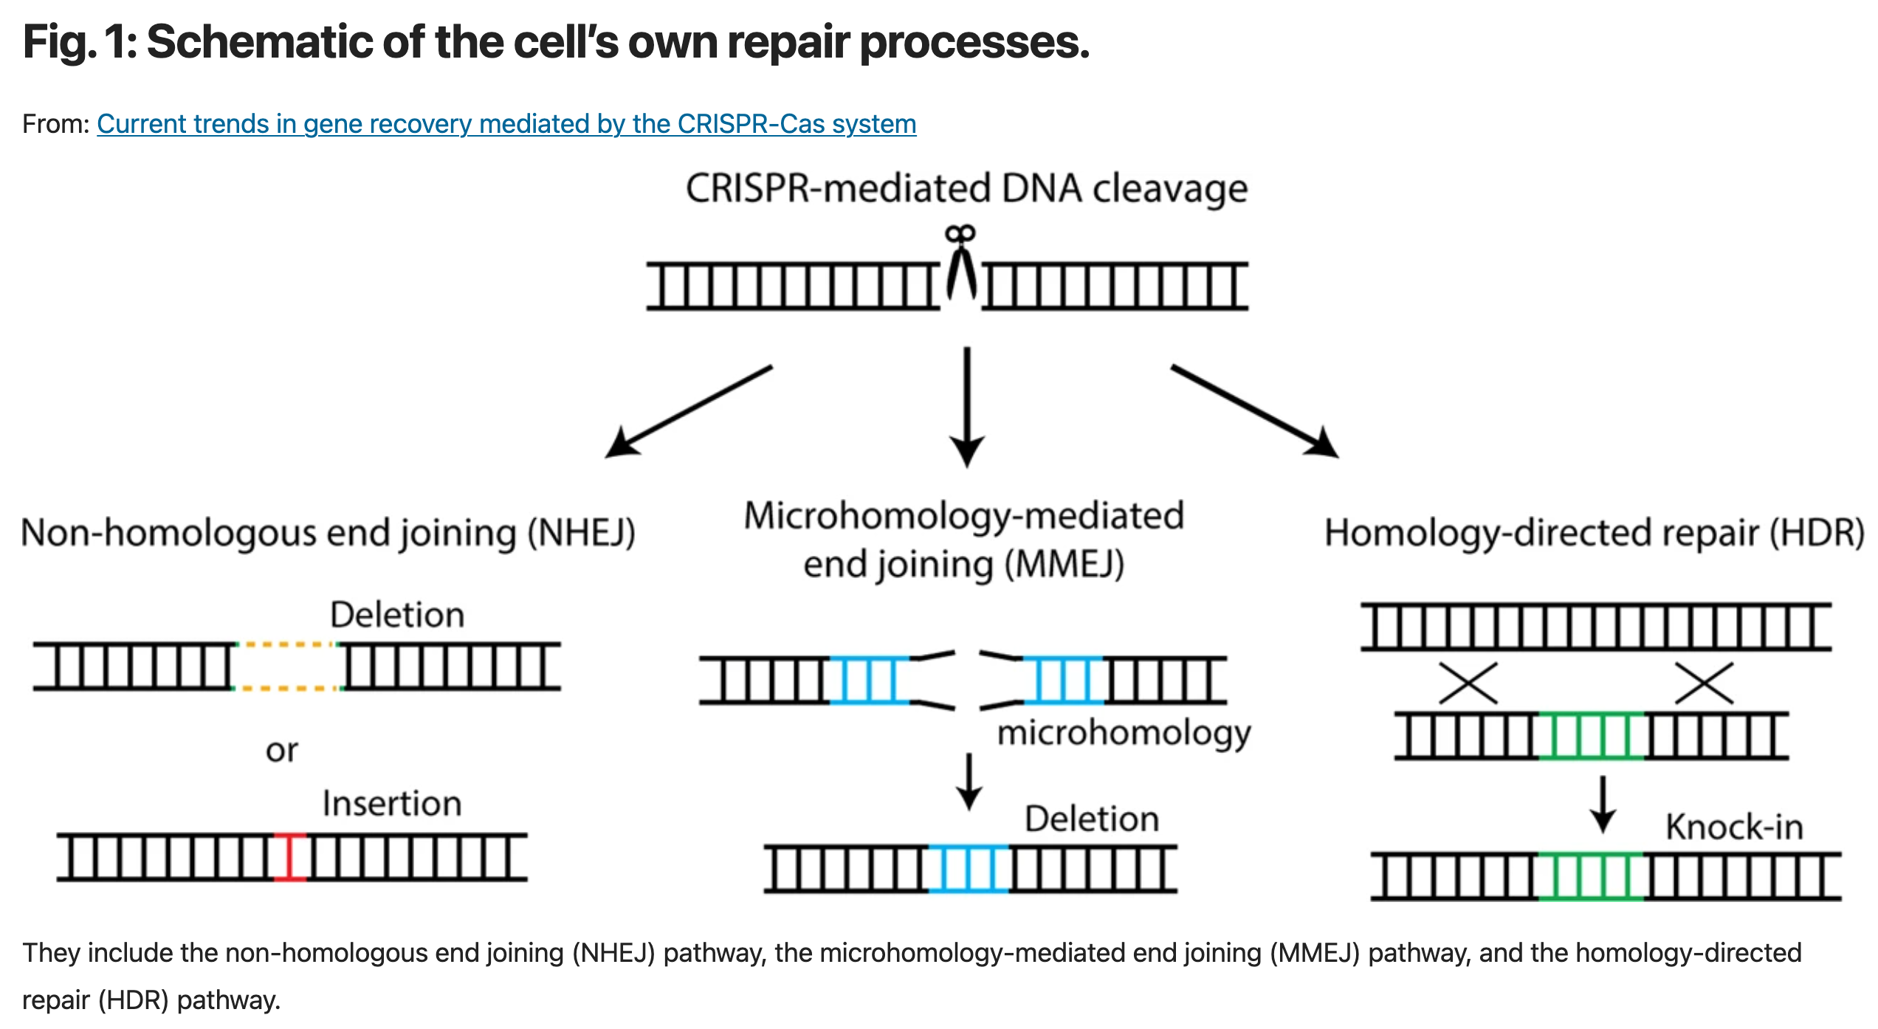
Knock-in with Homology-Directed Repair (HDR)
https://www.nature.com/articles/s12276-020-0466-1
https://blog.addgene.org/crispr-101-homology-directed-repair
Notes:
When no donor DNA templates, INDEL will be introduced whereas in presence of donor DNA, a specific change can be introduced.

Slide 5
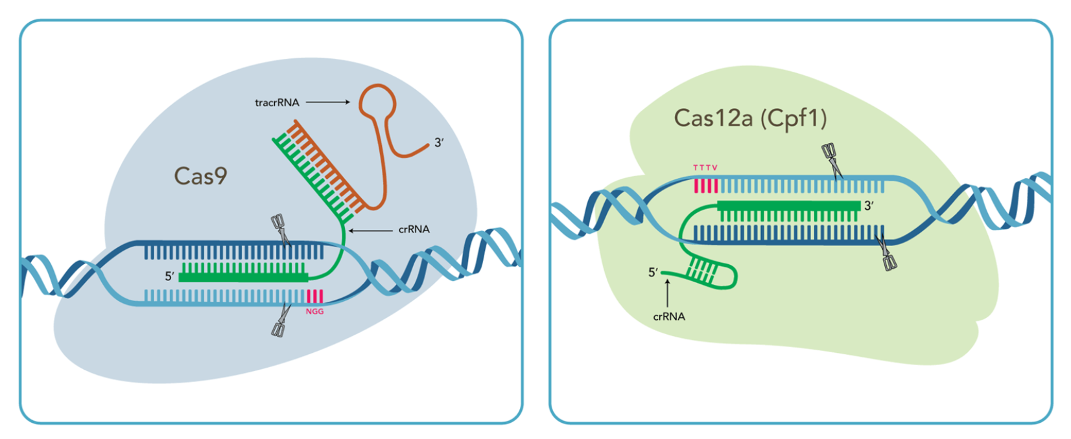
Cas9 vs Cas12
https://www.idtdna.com/pages/products/crispr-genome-editing
Notes:
Key differences:
PAM sequences: NGG vs TTN
Cutting site: 3 bp upstream of PAM vs 18-23bp downstream of PAM
Cutting efficiency: Cas9 is slightly higher

Slide 6
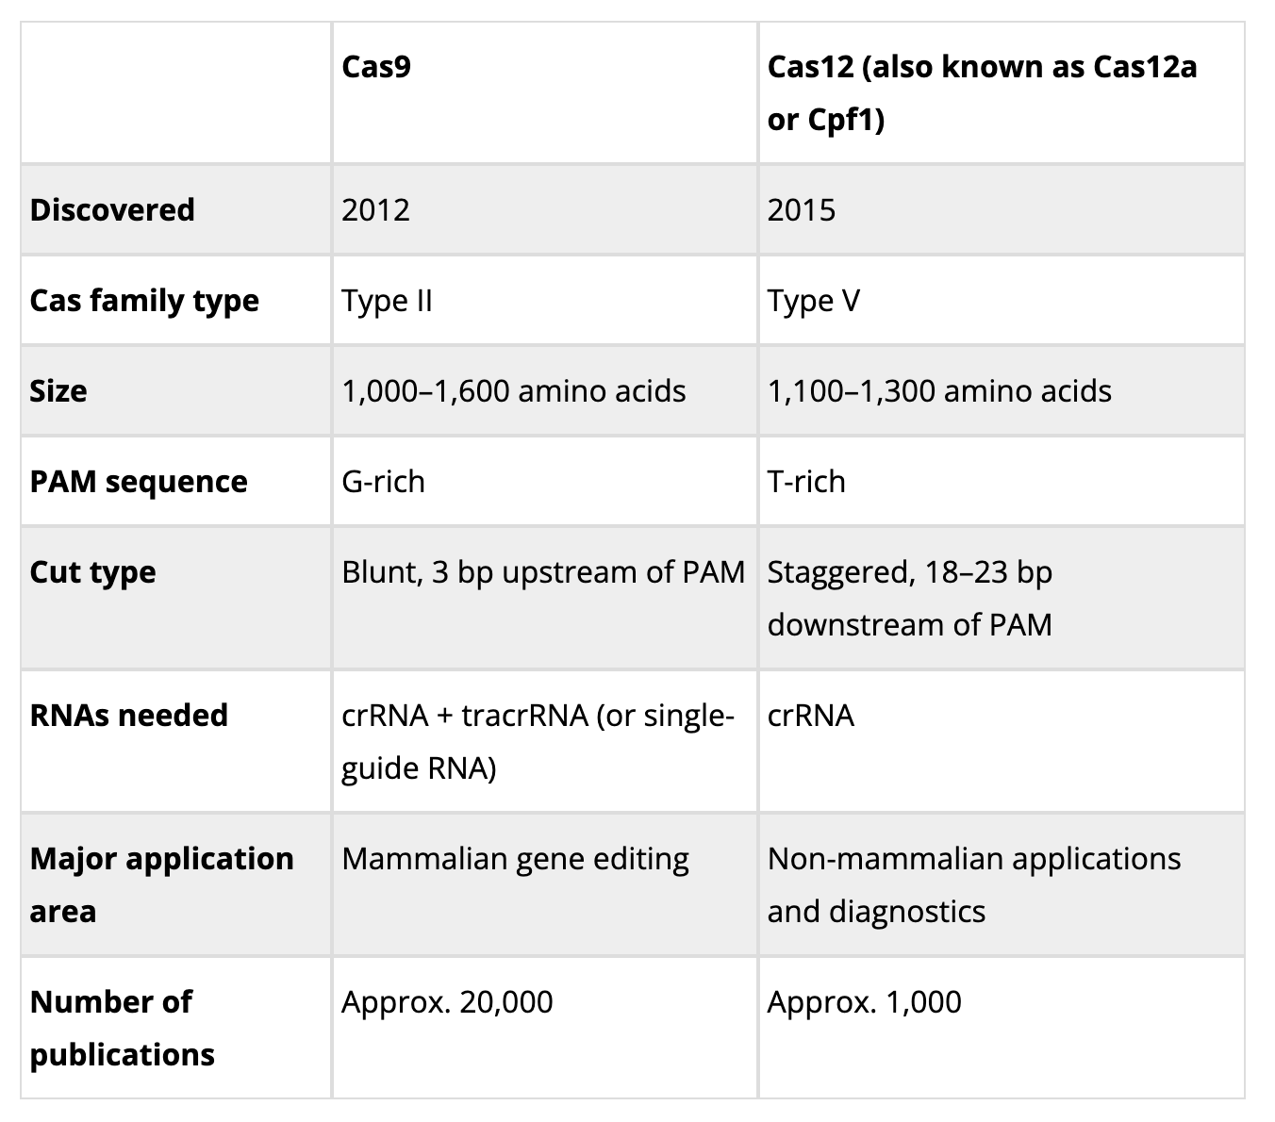
Cas9 vs Cas12, Cont’d
https://www.technologynetworks.com/genomics/articles/cas9-or-cas12-picking-the-right-crispr-system-for-your-research-359883

Slide 7
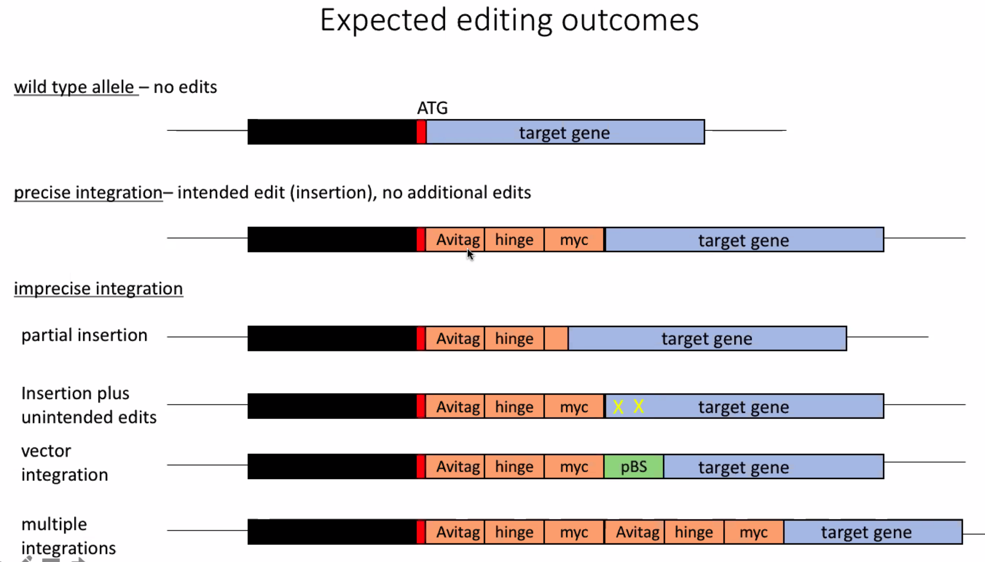
Experimental setup
9 conditions, 3 replicates each condition
uninjected
LbCas12a_no_donor
LbCas12a_ISce1_donor
LbCas12a_unigRNA_donor
LbCas12a_mod_donor
Cas9_no_donor
Cas9_ISce1_donor
Cas9_unigRNA_donor
Cas9_mod_donor
Condition and replicate barcodes have been demultiplexed by sequencing core
Plot by Sarah
Notes:
The goal is to compare the performance of each condition for each target gene the category of insertions and their proportion. And optimally visualize it.

Slide 8
Sequencing library
5p universal primer
UMI
Gene-specific primer
Insert
3p universal primer
~ 2k bp
primer | UNIVERSAL | UMI | GENESPECIFIC_FPRIMER
5p_ep300a | GCAGTCGAACATGTAGCTGACTCAGGTCAC | NNWNNDDB | AATAACTGGAACGTAAAATCCCTTC
5p_ep300b | GCAGTCGAACATGTAGCTGACTCAGGTCAC | NNWNNDBB | TAAACCATTGAACTTGTCACTTTGA
5p_etv2 | GCAGTCGAACATGTAGCTGACTCAGGTCAC | NNWNNHVB | AACAAAACGTTTAGAGTTTGTCCTG
5p_h3f3d | GCAGTCGAACATGTAGCTGACTCAGGTCAC | NNWNNBDV | AATCACGTCTAATGTTTCTTTCAGC
5p_hey2 | GCAGTCGAACATGTAGCTGACTCAGGTCAC | NNWNNVHD | CCTCTCCTCTGTTTCTTTTTCATTT
3p_Univ | TGGATCACTTGTGCAAGCATCACATCGTAG
52 files in total
SIKI1, SIKI2, SIKI3
3 replicates to access precise targeting efficiency across 5 different target genes: ep300a, ep300b, etv2, h3f3d, hey2
each fastq.gz should have sequences for all 5 target genes
SIKI5, SIKI6, SIKI7
3 replicates to access targeting efficiency at single target: ep300b

Slide 9
Proposed computational workflow
preprocess:
filter abnormal reads
reverse complement if needed
parse insert stat
map to ref:
bwa
blat
csv
fastq.gz
fastq.gz
fastq.gz
bam
demultiplex: by target gene
process UMI:
UMI extraction
collapse reads by UMI
plot
categorize and visualize (?):
crispRVariants
knock-knock
sikipipe
Notes:
abnormal reads: 1. out of size: 1000 – 5000 bp; 2. first 30 nt > 10 nt distance away from expected universal nt; 3. reverse compliment if needed by comparing to 3p-univ and 5p-univ.

Slide 10
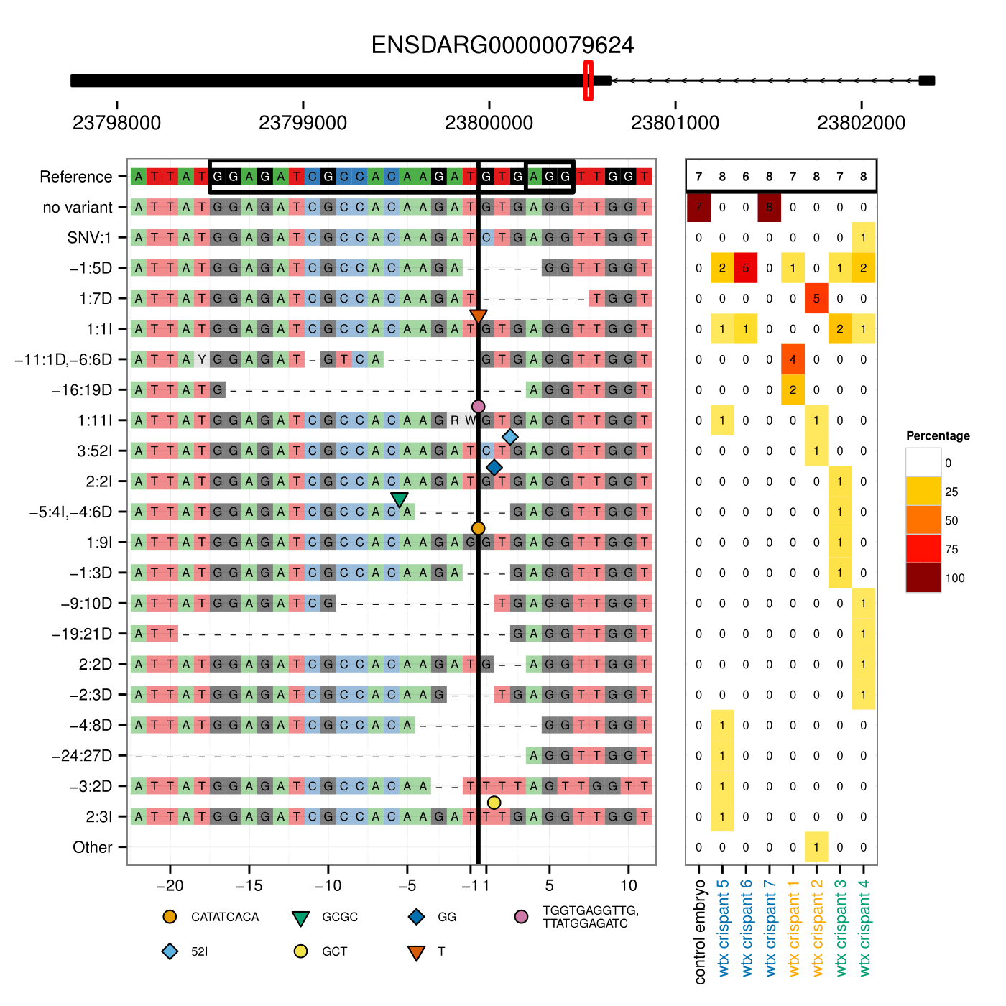
CrispRVariants
R library: https://github.com/markrobinsonuzh/CrispRVariants/tree/master
Take bam files as input
Count and visualize INDEL variants

Slide 11
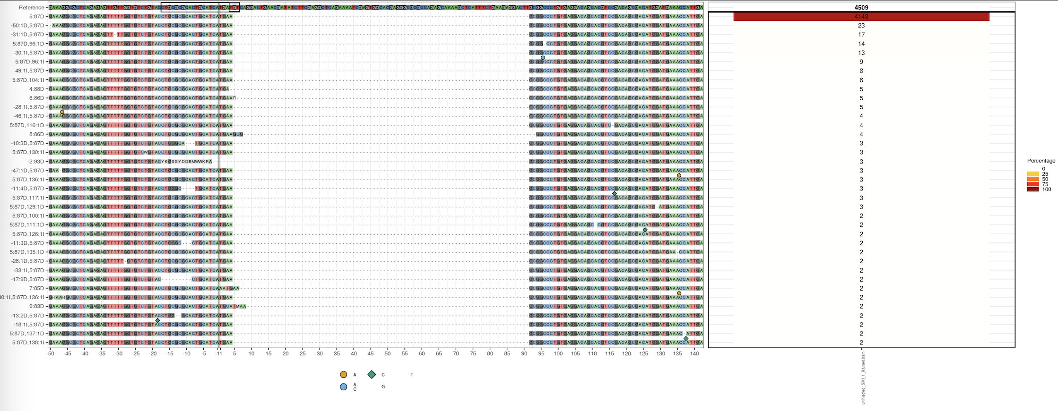
Example plot: hey2, uninjected control

Slide 12
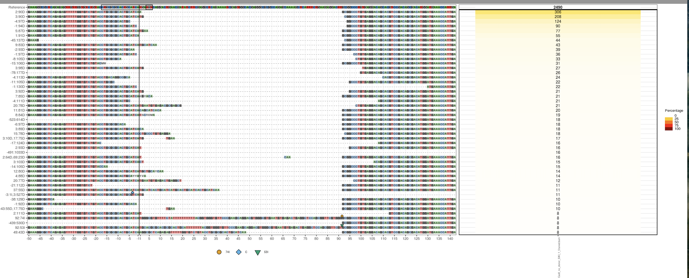
Example plot: hey2, Cas9 no donor control

Slide 13
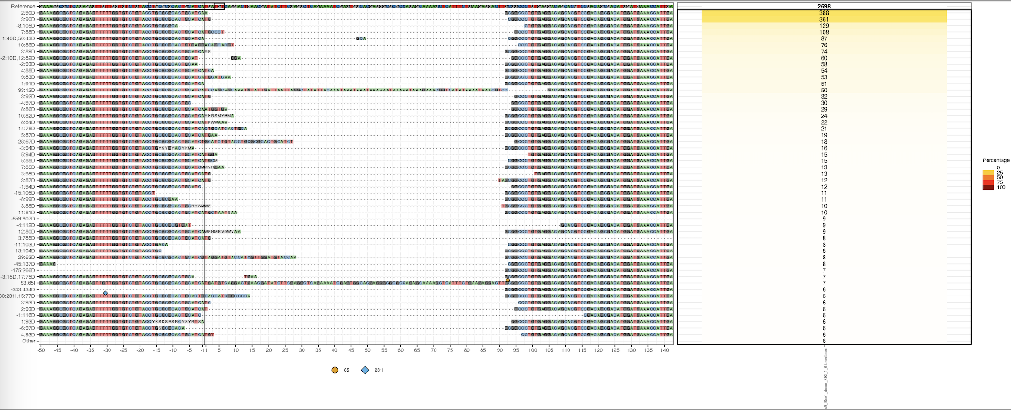
Example plot: hey2, Cas9 ISce1 donor

Slide 14
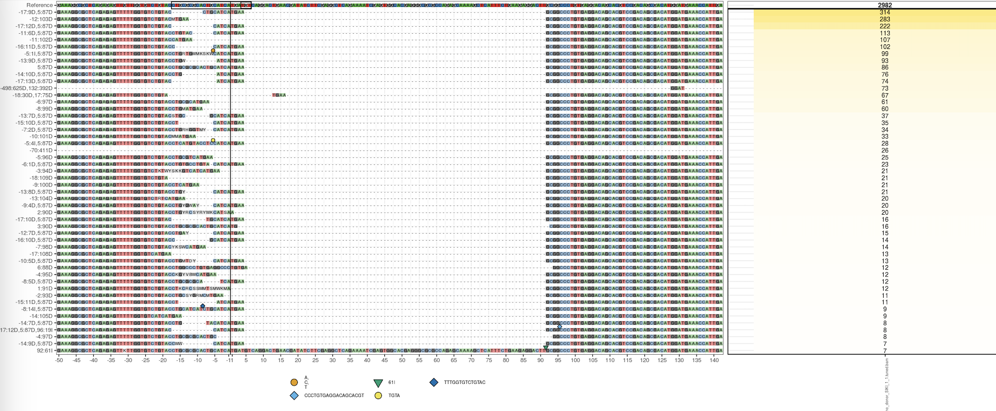
Example plot: hey2, Cas12 no donor

Slide 15
knock-knock
Python library: https://github.com/jeffhussmann/knock-knock
Take fastq files as input
Count and visualize INDEL variants by generating interactive table

Slide 16
Questions
Mapping tools failed to capture large INDELs
softclipped or hardclipped: bwa can disable softclipping
BLAT seems to work better, but not compatible with crispRVariants
Sequencing qualities drop at repeat-rich regions:
causes artificial INDELs
What are ISce1, unigRNA, and mod donors?

