Slide 1
Quantifying CRISPR Knock-in Outcome Spectrum
Kai Hu
10/2024

Slide 2
A collaboration with Lawson Lab
Goal:
Quantify the Short Insert Knock-In experiment outcome
Sequencing platform: PacBio
Available tools:
knock-knock
CrispRVariants
In-house scripts

Slide 3
Quantifying editing outcome: practical concerns
How to capture mutations in each sequence?
single mutation, INDEL, inversion, etc.
How to define “editing outcome categories”?
need input from lab scientists
How to deal with natural mutations?
the mutations that also occur in control samples

Slide 4
How does knock-knock work
Take fastq file, ref genome, primer seq, donor seq, etc. as input
First, for each read, produce a set of local alignments between portions of the read and all relevant sequences present in the edited cell.
Then, identify a parsimonious subset of local alignments that cover the whole read.
Last, categorize by analyzing the architecture of the covering alignments.
https://github.com/jeffhussmann/knock-knock/blob/master/docs/visualization.md
knock-knock also supports interactive exploring of the categorization results.

Slide 5
Issues when running knock-knock
Unpublished Python tool, documentation is not very clear
Buggy in many places, NOT being actively maintained
https://github.com/jeffhussmann/knock-knock/issues/14
Many parameters hard-coded in the scripts:
minimap2, STAR, blastn
not sure how those parameters would affect the final categorization
small INDELs (< 5 bps) will not be reflected in the plot
Editing outcome categories seemingly arbitrarily defined and lack of definition
simple indel, blunt misintegration, etc?
We finally made knock-knock run with our sequencing data, however, upon inspection, Nathan found many mis-categorizations

Slide 6
How does CrisprVRriants work
First, obtain a BAM file by mapping fastq to ref: can be done outside of R
Then, locate and prepare a target region in reference
gRNA + flanking bases
Next, prepare a crispr_set object that contains alignment info, target region, and variant info
Finally, summarize variant counts and visualize:
https://bioconductor.org/packages/release/bioc/vignettes/CrispRVariants/inst/doc/user_guide.html

Slide 7
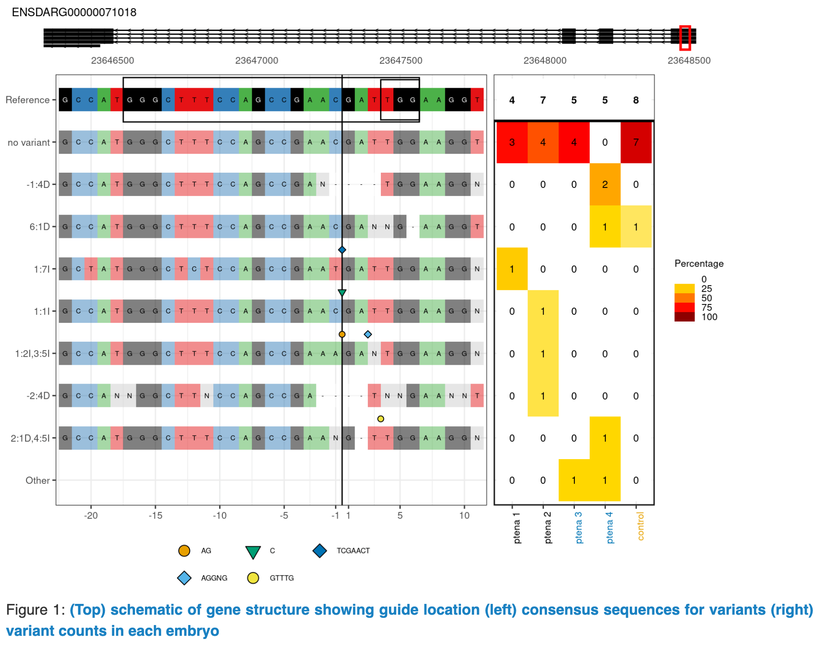
How does CrisprVRriants work, Cont’d
The crispr_set object basically consists of the plotting information by parsing the BAM file.
https://bioconductor.org/packages/release/bioc/vignettes/CrispRVariants/inst/doc/user_guide.html

Slide 8
Issues when running CrispRVariants
The variants (species and location) are determined by the mapping (BAM file) results
Some variants may not be captured by BAM (e.g., soft-clipped large INDELs, inversions, etc.)
With CrispRVariants, it is best to focus on a small target region
If target region is too large, the plot will be too large to read
Therefore, distant variants will not be captured
Can NOT mask natural SNP variants:
Therefore, many variant reads will be “detected” even in control samples
In this project, we are particularly interested in INDELs instead of natural SNPs
CrispRVariants plots are still very informative, especially when you know what you are looking for

Slide 9
The need of in-house scripts
Determine tag(insert)-containing read ratio
count of reads with single tag
count of reads with multiple tags
For tag-containing reads:
determine the percentage of precise-insert-containing read ratio
determine if INDELs are present and their locations
for precise-insert reads:
further divide them into sub-groups according to a SNP site
For non-tag-containing reads:
determine if INDELs are present and their locations
(optional) filter out natural INDELs that appear in control samples

Slide 10
Workflow overview
SIKIpipe: https://github.com/hukai916/sikipipe
Step1: demultiplex (target gene)
Step2: preprocess (filter, rc, etc.)
Step3:
UMI collapse
fastq
fastq
Step4:
classify precise-tag reads (SNP)
Step2:
classify tag reads (minimap2)
SIKIclass: https://github.com/hukai916/sikiclass
Step1:
classify by tag (BWA)
Count table
Step3:
classify no-tag reads (minimap2)

Slide 11
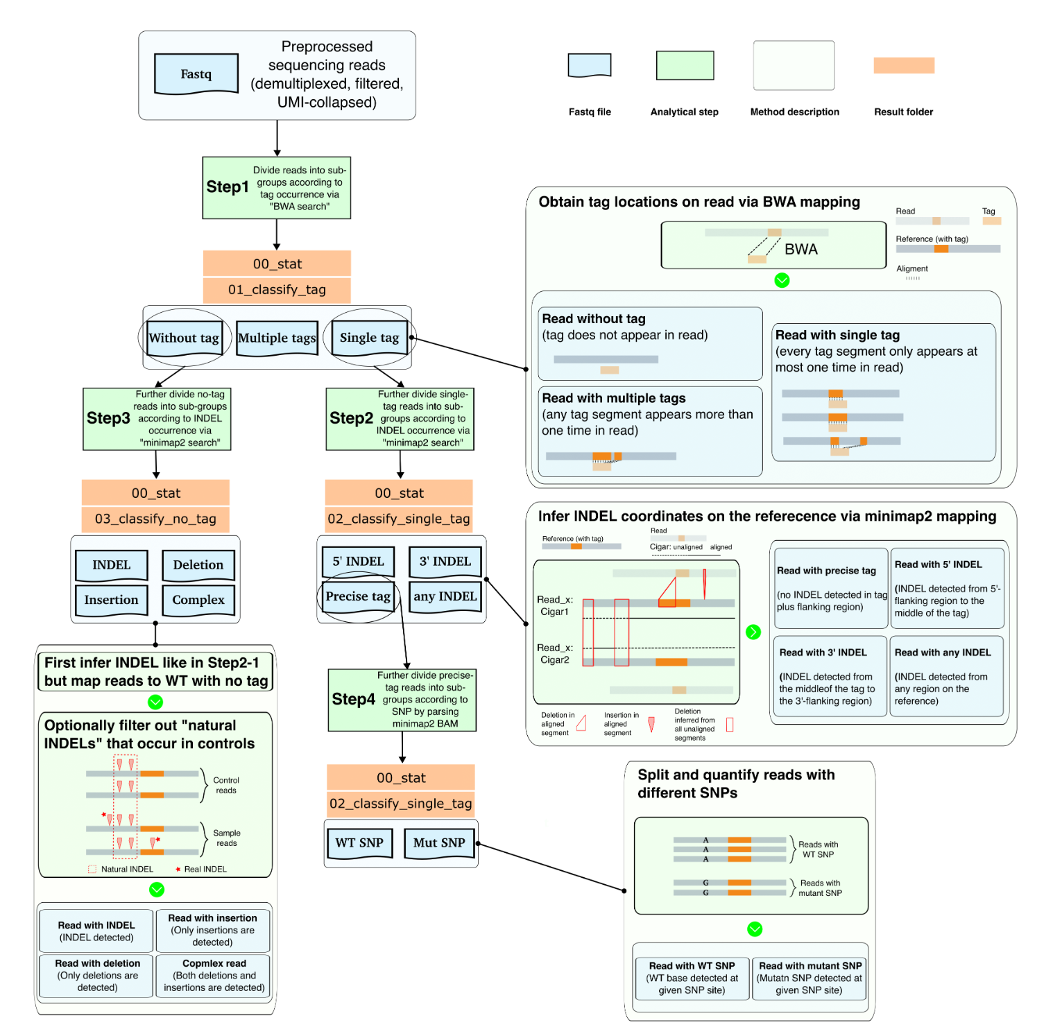
SIKIclass pipeline
Powered by Nextflow
Take input from SIKIpipe output
Output:
Categories
Summary tables
Fastq files for each category
https://github.com/hukai916/sikiclass?tab=readme-ov-file

Slide 12
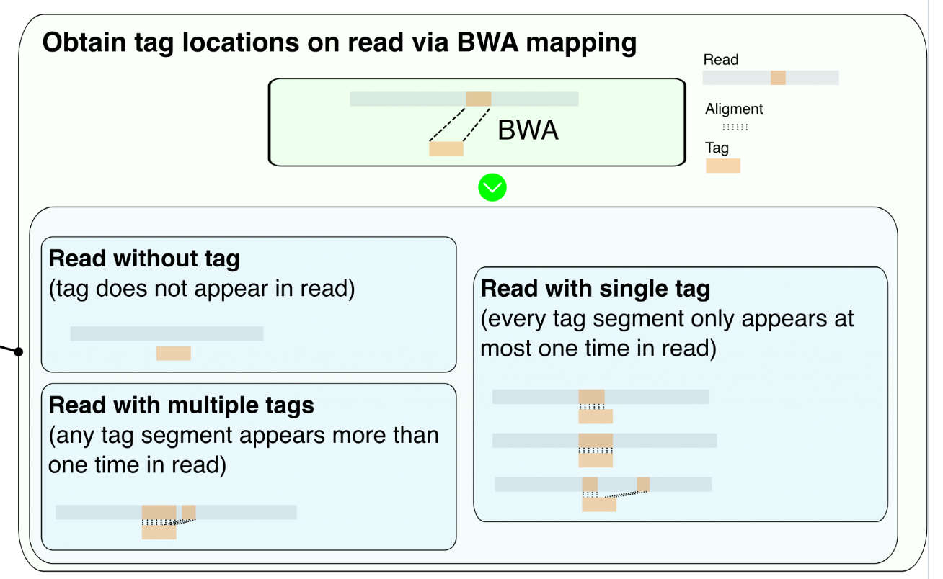
Step1: classify reads by tag occurrence (BWA)
BWA search:
Reference: each read
Query: tag sequence

Slide 13
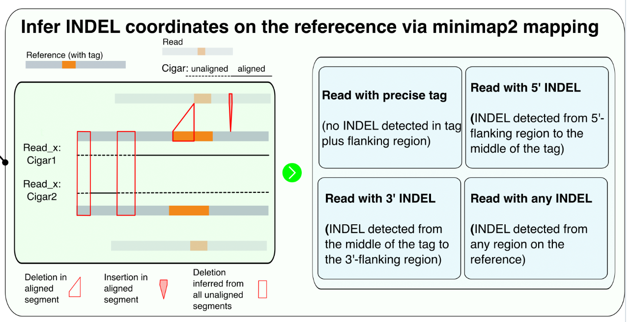
Step2: find INDEL locations for tag reads
Minimap2 search:
Reference: expected editing outcome (tag + flanking sequences)
Query: reads
INDEL locations can be determined by parsing the CIGAR strings:
directly from aligned region
infer from un-aligned region (clipped)

Slide 14
Step3: find INDEL locations for no-tag reads
Minimap2 search:
Like Step2
Since we obtain the size and location of INDELs, we can also optionally filter out ”natural INDELs” that occur in control saamples

Slide 15
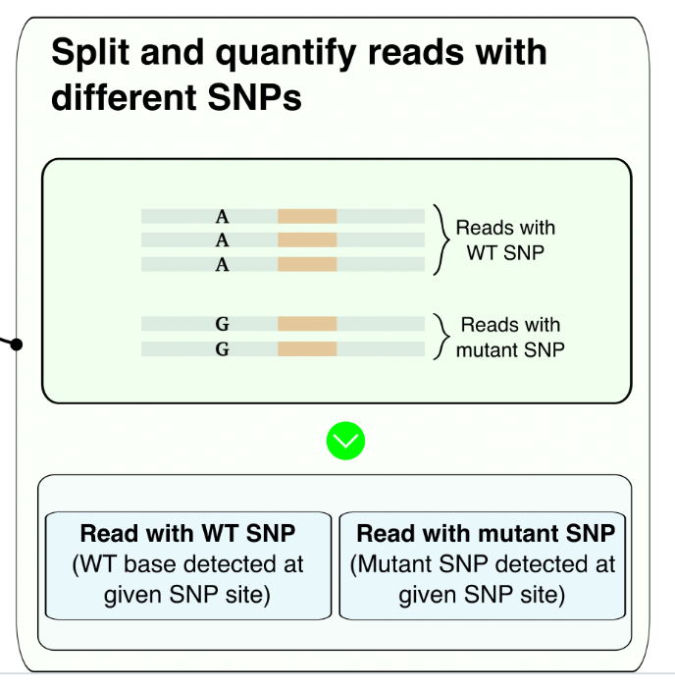
Step4: further split precise-tag reads by SNP
Given SNP position, by parsing the BAM file, we can determine the SNP species for each read

Slide 16
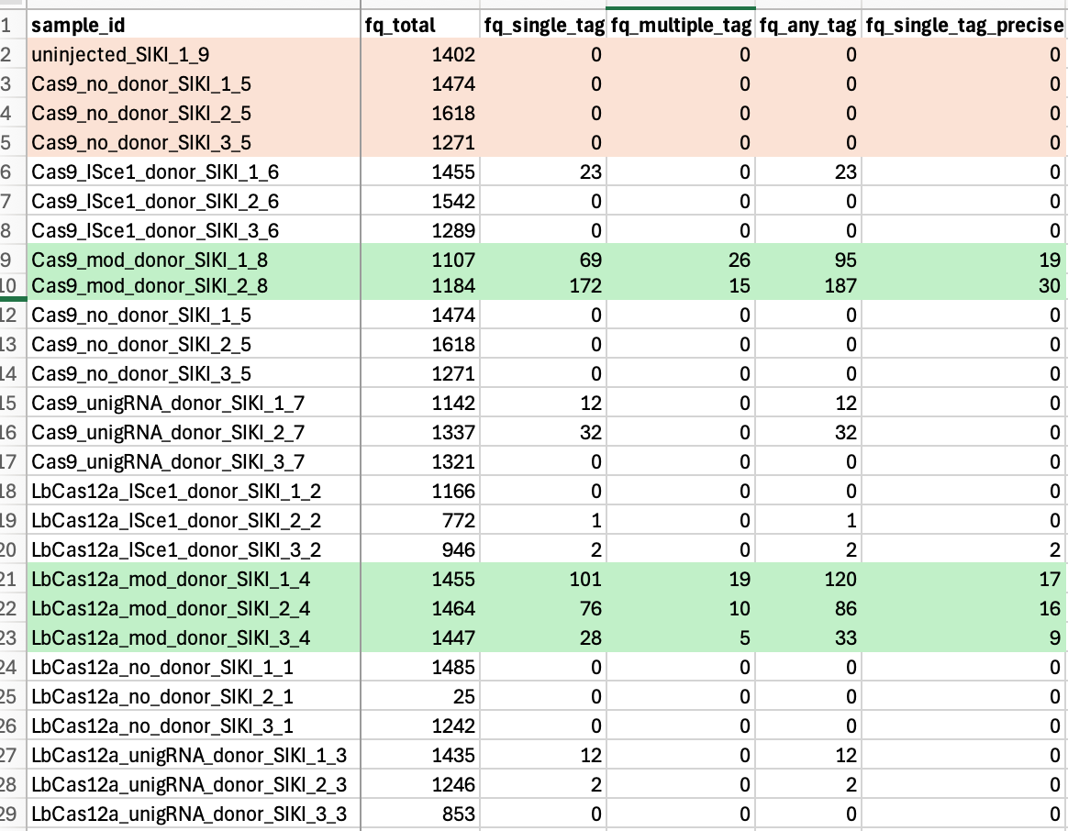
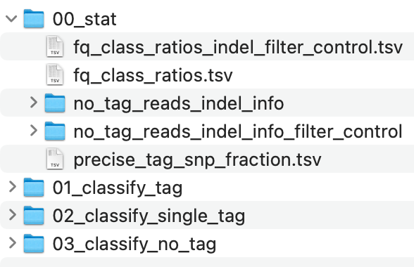
Example output files

