Slide 1
MATHCOUNTS
COUNTDOWN ROUND
2018 Austin Math Circle
Practice Competition

Slide 3
Answer: -1

Slide 4


Slide 5
Answer: 68

Slide 7
Answer: 50 (degrees)

Slide 8


Slide 9
Answer : 189/2

Slide 11
Answer : 100

Slide 12


Slide 13
Answer : 1459

Slide 14


Slide 15
Answer : 9/20

Slide 16


Slide 17
Answer : 2 (triangles)

Slide 19
Answer : 4

Slide 20


Slide 21
Answer : 70 (dollars)

Slide 22


Slide 23
Answer : 310 (pages)

Slide 24


Slide 25
Answer : (n-1)/n

Slide 26


Slide 27
Answer : sqrt(2018) - 1

Slide 28


Slide 29
Answer : 1010/1009

Slide 30


Slide 31
Answer : 7 (numbers)

Slide 33
Answer : 2

Slide 35
Answer : 9pi

Slide 36


Slide 37
Answer : 100%

Slide 38


Slide 39
Answer : 32sqrt(2)/3

Slide 40


Slide 41
Answer : 77 (games)

Slide 42


Slide 43
Answer : 1093 (problems)

Slide 44


Slide 45
Answer : August 12th, 2018 (8/12/18)

Slide 47
Answer : 2016

Slide 48


Slide 49
Answer : 24

Slide 50


Slide 51
Answer : 20 (students)

Slide 53
Answer : 2019/2

Slide 55
Answer : 3sqrt(3)

Slide 57
Answer : 38 (values)

Slide 59
Answer : 3

Slide 60


Slide 61
Answer : sqrt(6)

Slide 62


Slide 63
Answer : 1/2

Slide 64


Slide 65
Answer : -9.5

Slide 66


Slide 67
Answer : 11

Slide 69
Answer : -1

Slide 70


Slide 71
Answer : 40 (powers)

Slide 72


Slide 73
Answer : 352 (integers)

Slide 74


Slide 75
Answer : 1/10

Slide 76
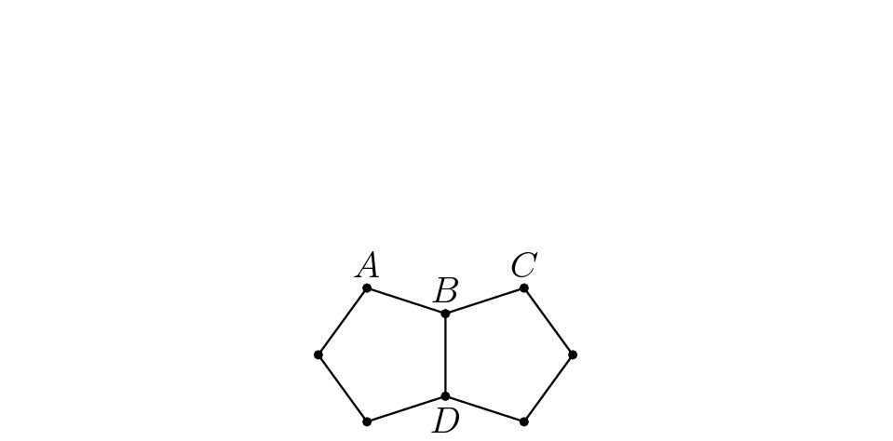

Slide 77
Answer : 10 (sides)

Slide 78


Slide 79
Answer : 36 (ways)

Slide 81
Answer : 256

Slide 83
Answer : 9

Slide 85
Answer : 14

Slide 87
Answer : 42

Slide 88


Slide 89
Answer : 1104

Slide 90


Slide 91
Answer : 7/8

Slide 93
Answer : 21

Slide 95
Answer : 41/333

Slide 96


Slide 97
Answer : 4

Slide 99
Answer : 0

Slide 100


Slide 101
Answer : 2sqrt(10)

Slide 102


Slide 103
Answer : 203,500,000 (plates)

Slide 104


Slide 105
Answer : 205

Slide 107
Answer : 16

Slide 108


Slide 109
Answer : 3744

Slide 110


Slide 111
Answer : 27

