Slide 1
應用深度學習於畫時鐘測試
presenter：虎冠廷

Slide 2
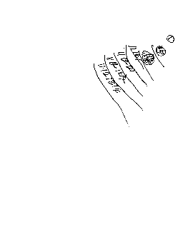
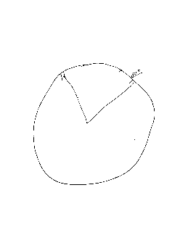
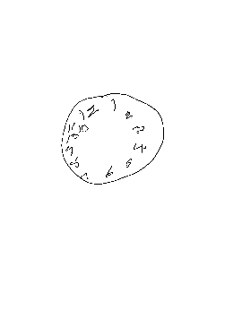
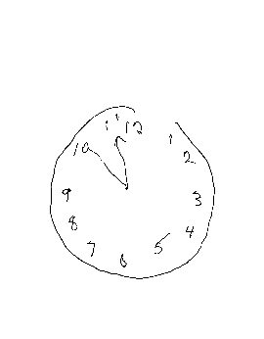
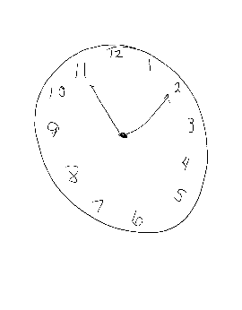
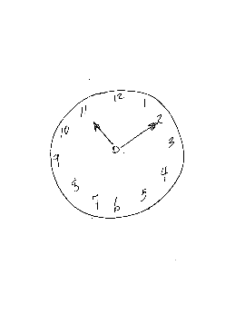

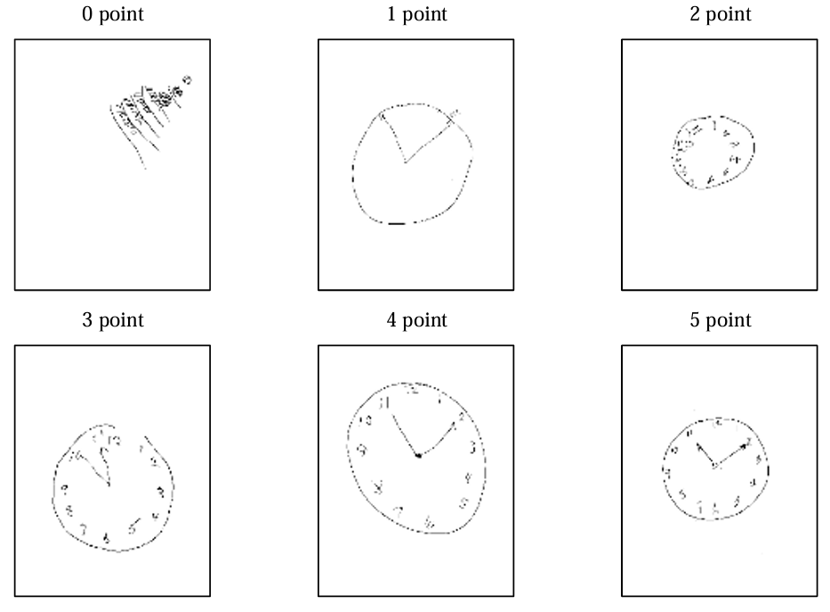
DATASET
An association sponsored by National Institutes of Health (United States)

Slide 3
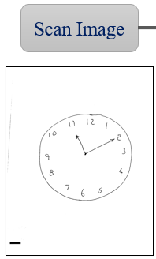
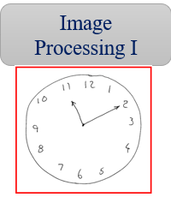
Objective
3000 samples for each class
Deal with data imbalance
up-sample
data augmentation
Generative AI
down-sample
Python (opencv)

Slide 4
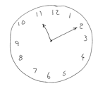

Small Dataset
VS
Big Dataset
Pretrain weight

Slide 5
Dataset
Dataset
5-fold
Train
Valid
Test
Unsupervised Learning
CNN
Pretrain weight
Result

Slide 6
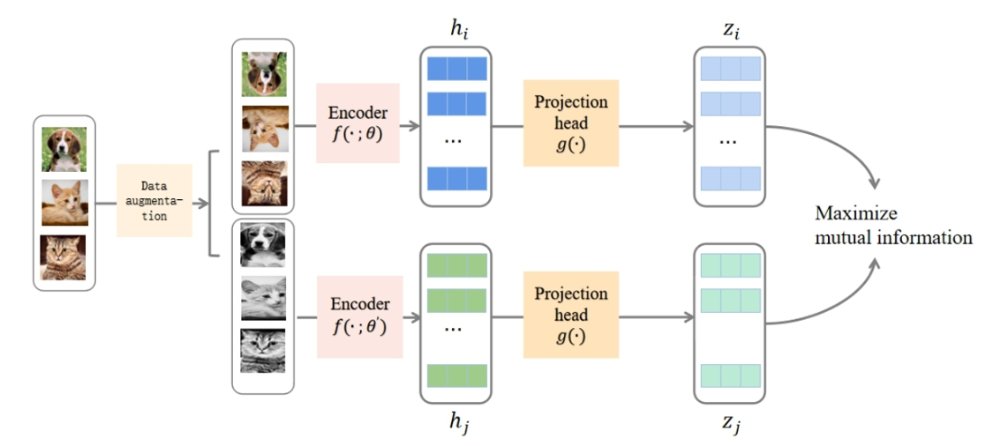
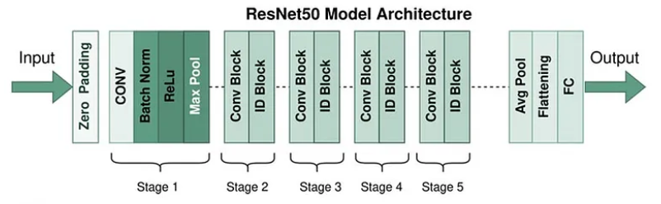
Model
Part I : Simclr
Part II : Resnet50

Slide 7
Experiment Process

Slide 8
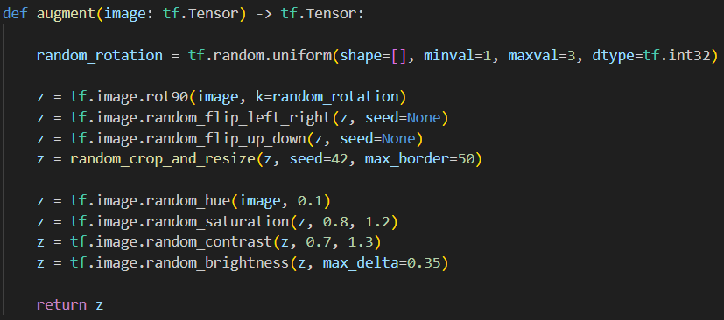
Create data through data augmentation to balance the dataset

Slide 9
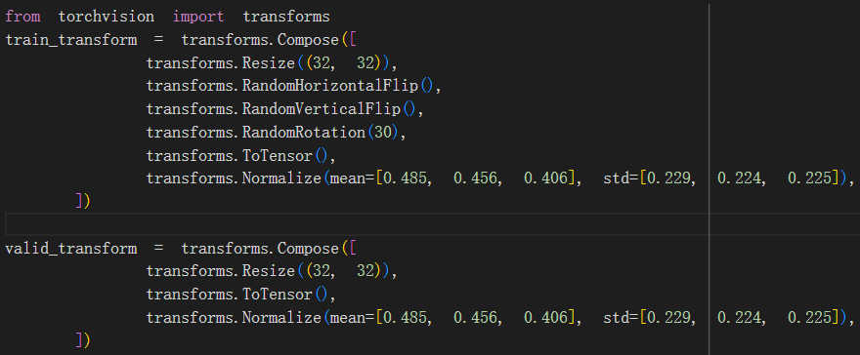
2. transform

Slide 10
3. hyperparameter
batch size = 128
loss function = nn.CrossEntropyLoss()
learning rate = 5e-4
optimizer = optim.Adam(model.parameters(), lr=learning rate)
scheduler = lr scheduler.ExponentialLR(optimizer, gamma=0.9)
epochs = 50

Slide 11
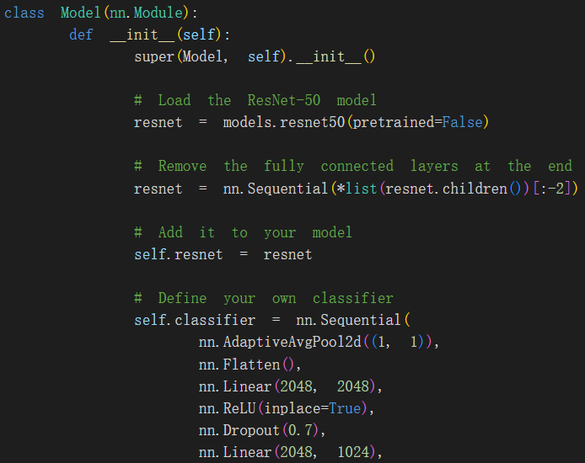
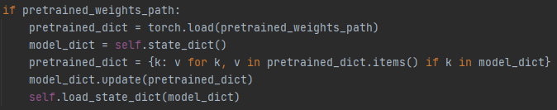
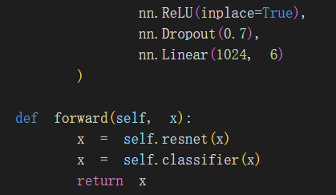
4. Model Structure
ResNet50
with / without pretrained weight

Slide 12
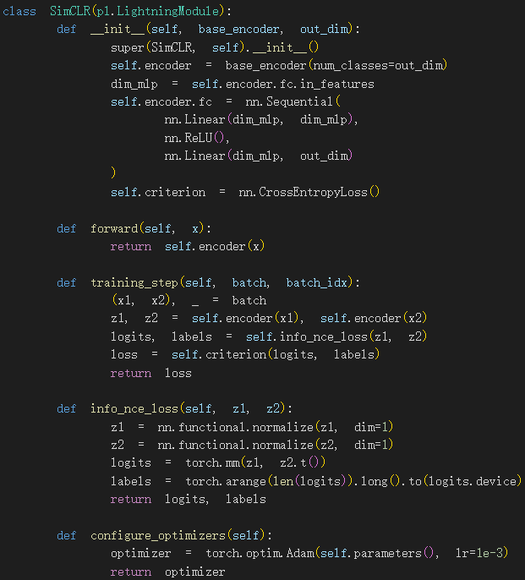
SimCLR model
base_encoder=resnet50
out_dim=128

Slide 13
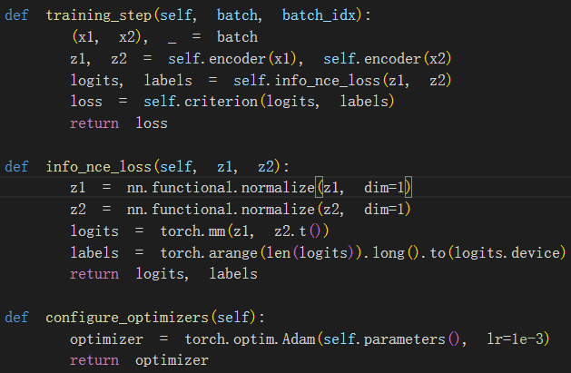
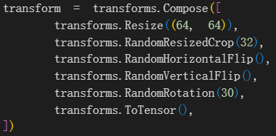
SimCLR hyperparameter
batch_size=256
epochs = 200

Slide 14
Result

Slide 15
without pretrained weight
Resnet50
Dataset :
train, valid, test (each class)= 2320, 580, 100
with pretrained weight
Resnet50
Dataset :
train, valid, test (each class)= 1520, 380, 100
SimCLR
Dataset :
train = 11400

Slide 16

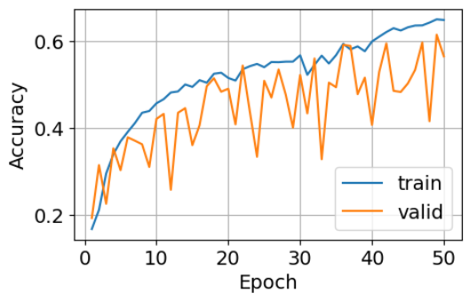
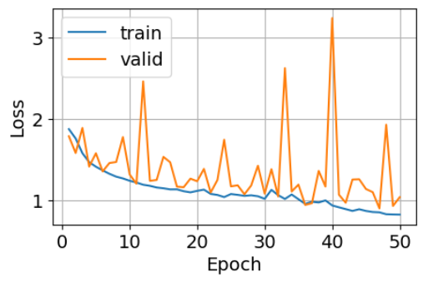
without pretrained weight

Slide 17

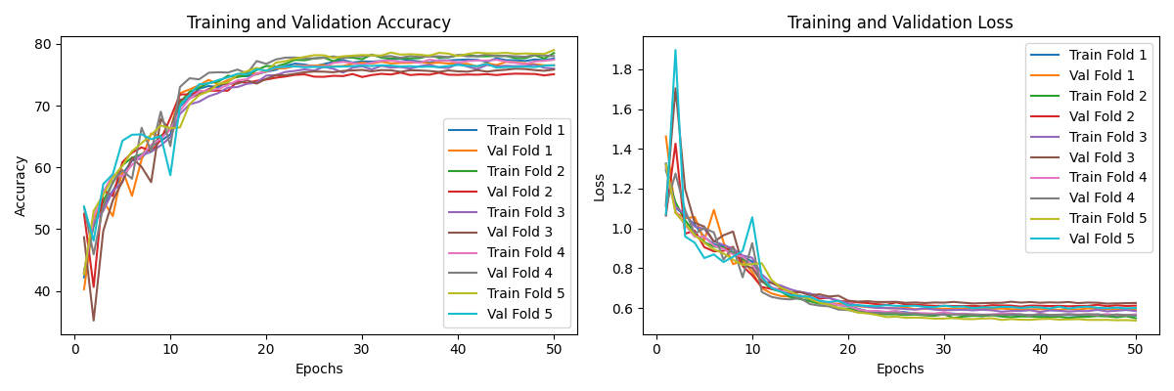
with pretrained weight

Slide 18
















Additional try :
DCGAN:

