Slide 1
HW3
F94096071 虎冠廷

Slide 2
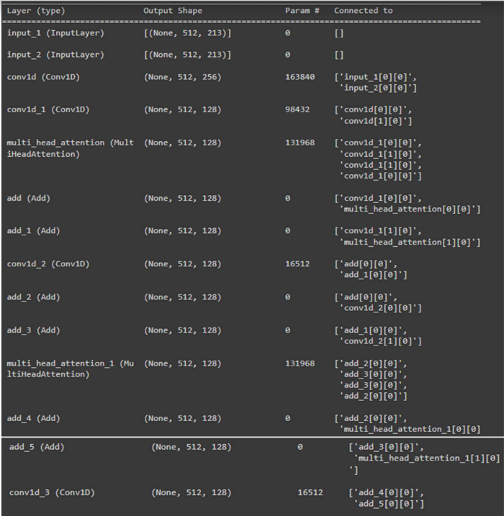
1. Model Structure

Slide 3
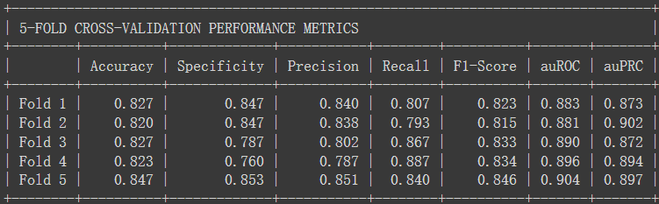

2. 5-fold Average Validation Performance

Slide 4
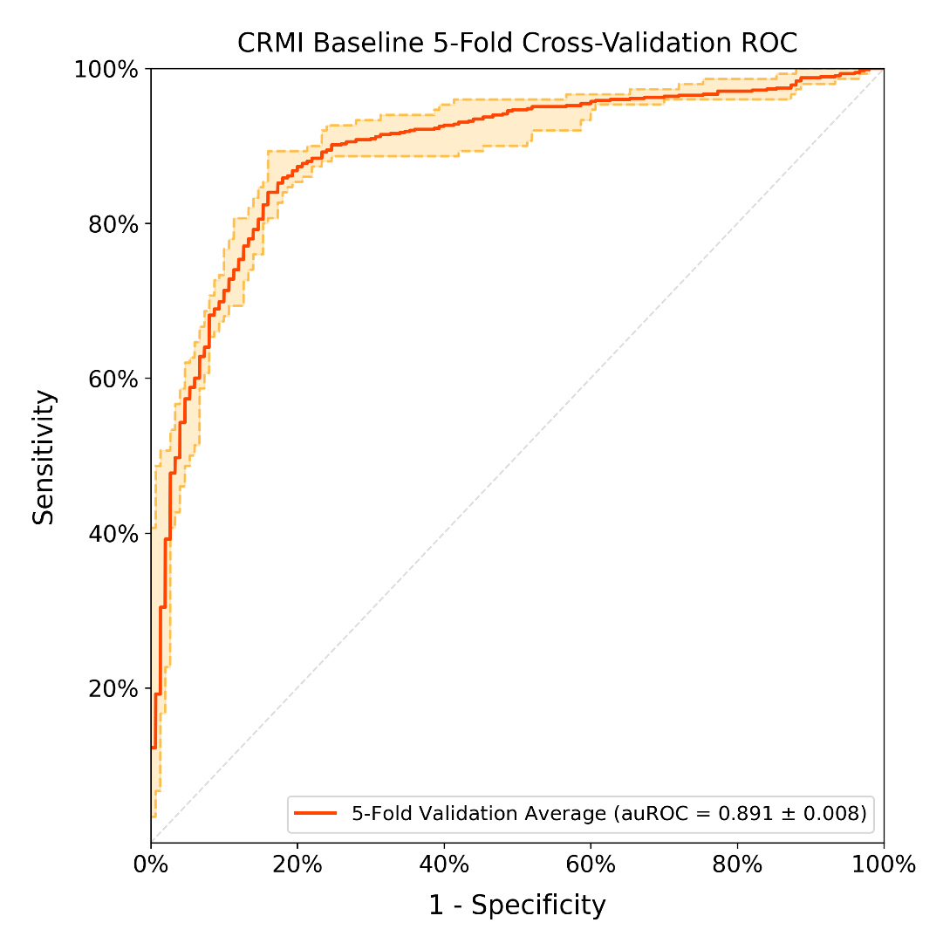
3. ROC curve

Slide 5
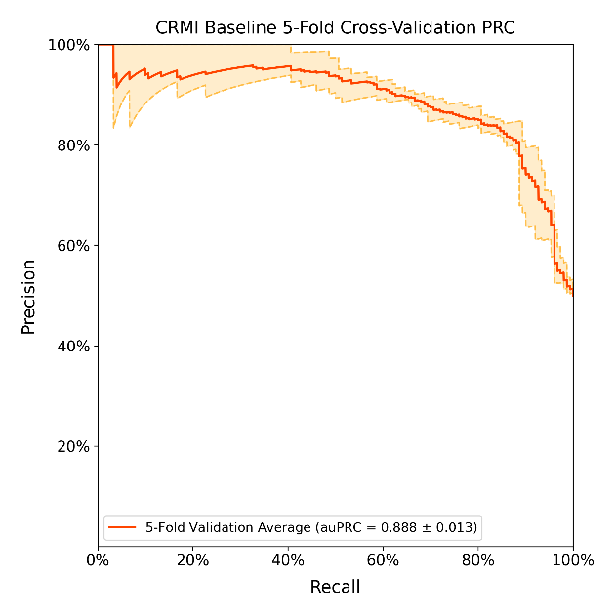
4. PRC curve

Slide 6
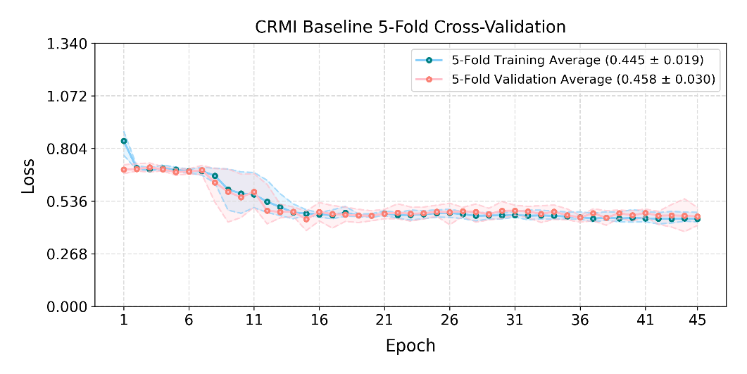
5. Loss curve

Slide 7
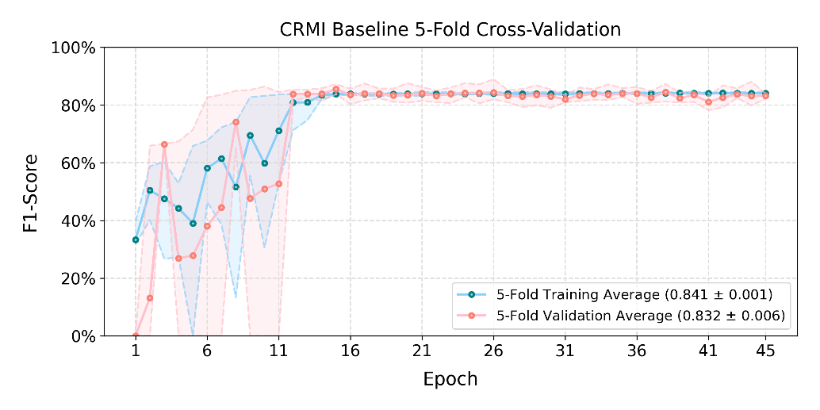
6. F1 curve

