Slide 1
Generative Pre-trained Transformer
(GPT)
Presenter: F94096071 虎冠廷
F94091128 林姿齊
Date: 04.18.2024
BME, NCKU

Slide 2
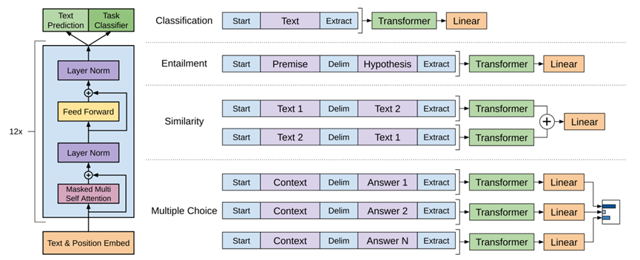
Fine-tuning
Pre-training

Slide 3
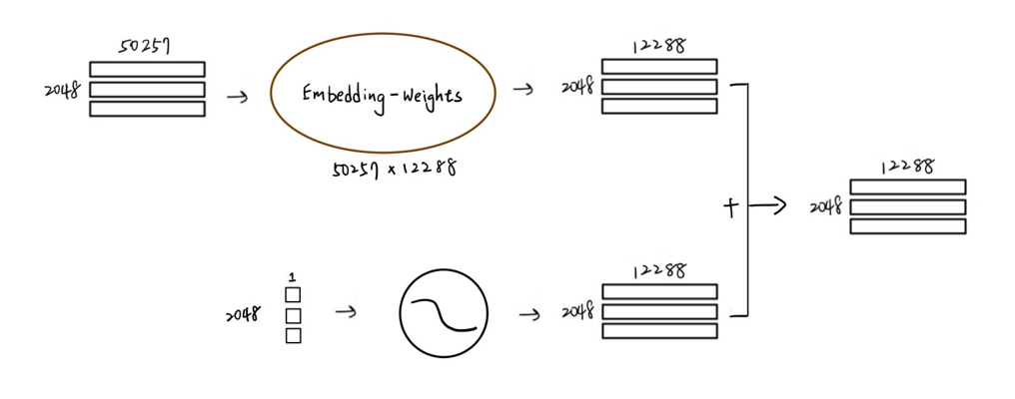
Input
Token
Embedding
Positional Encoding
Embedding
Positional Encoding

Slide 4
Decoder
Decoder 1
Decoder 2
. . .
Decoder 3
Decoder 96
Self-attention layer
Layer Norm
Feed Forward
Layer Norm

Slide 5
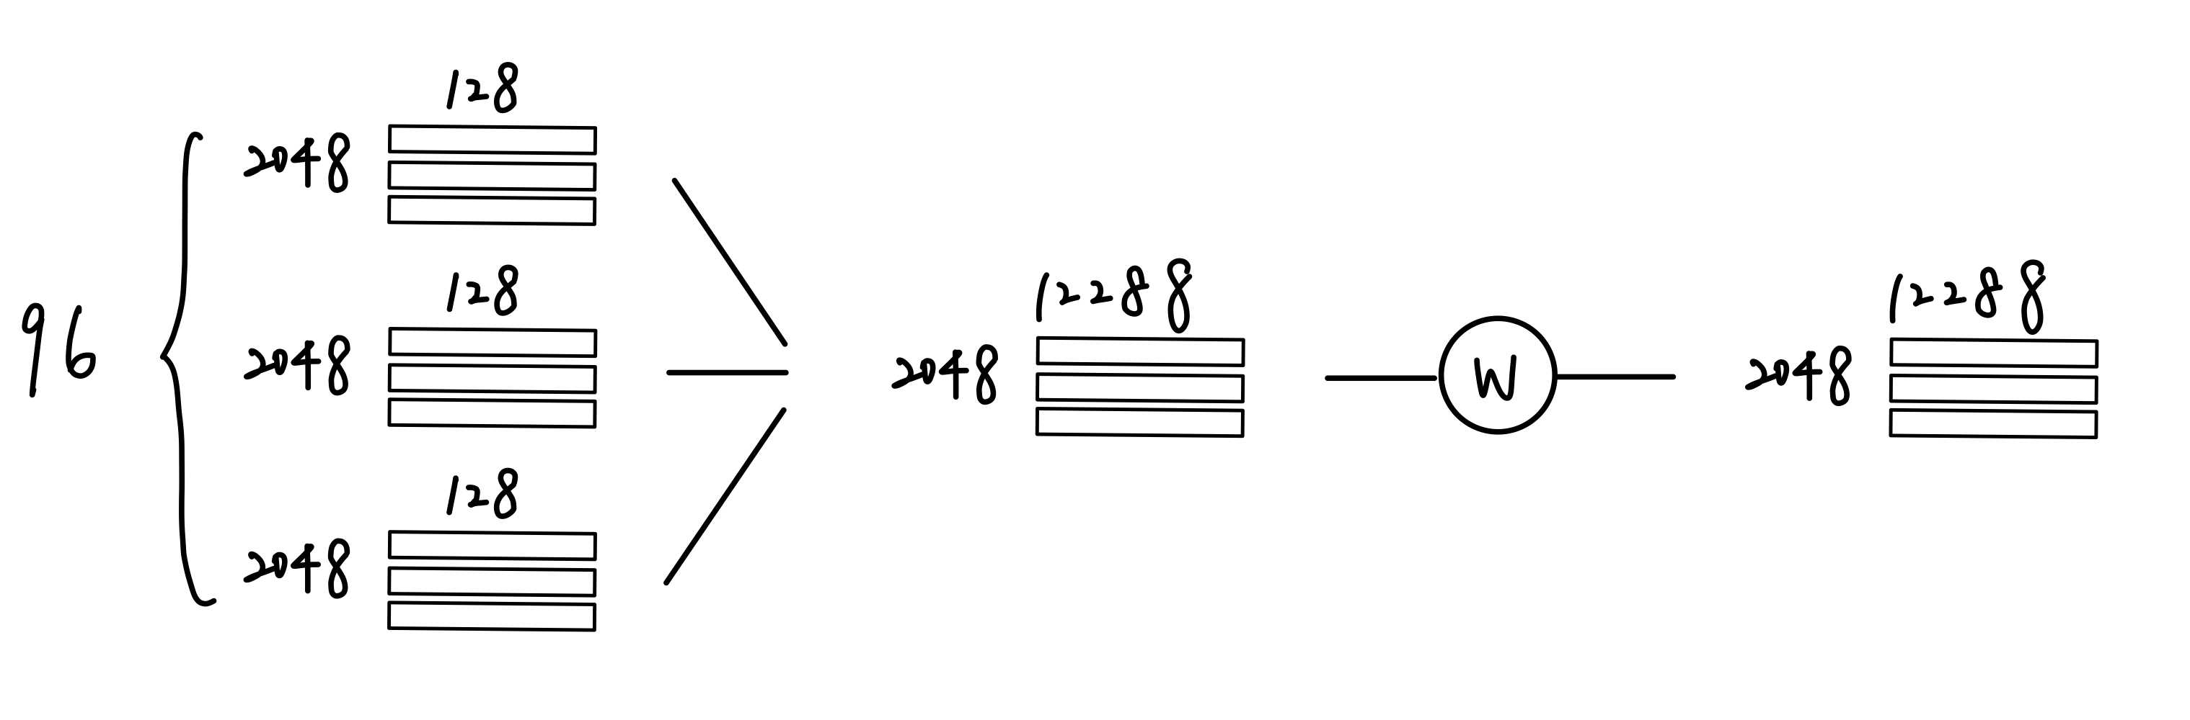
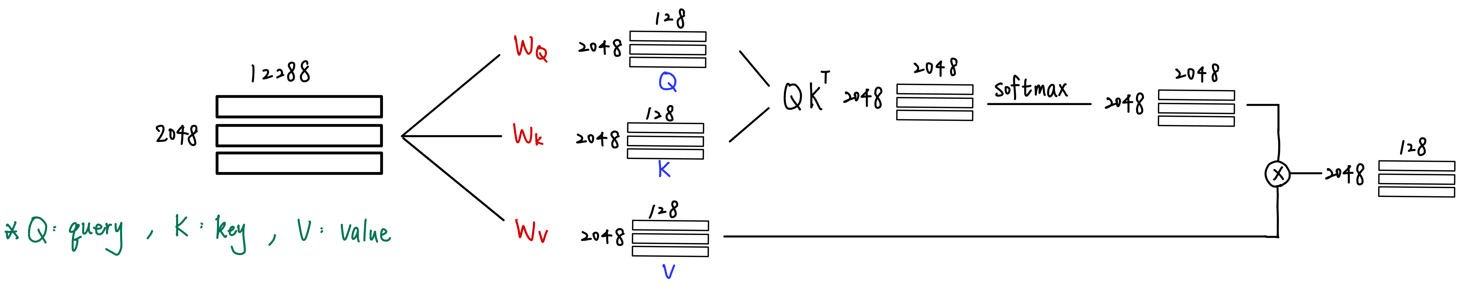
Self-attention layer
self attention 1
multi-head vector concatenation
fully connected linear layer
activation function
residual connection
normalization layer
self attention 2
...
self attention 96

Slide 6
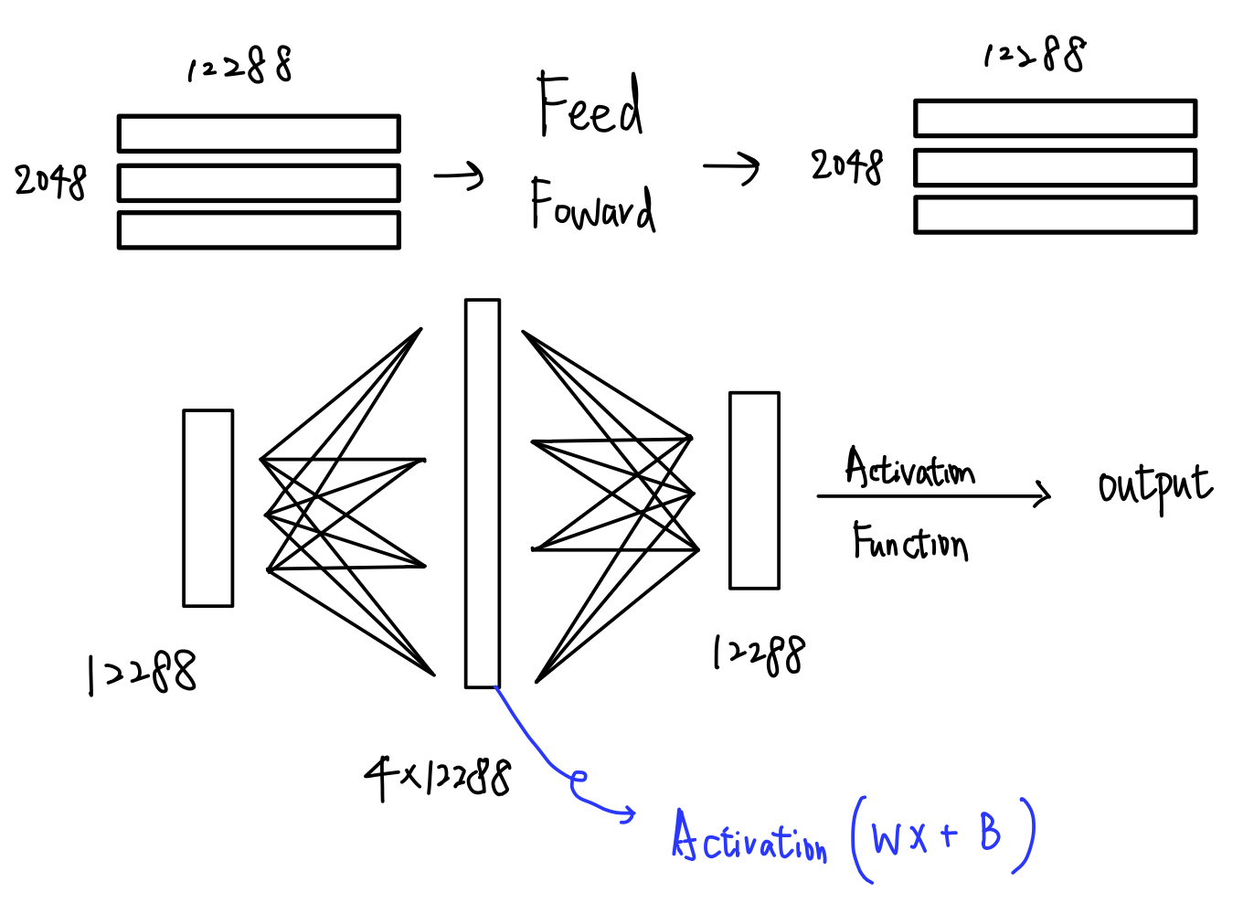
Feed Forward
fully connected extended linear layer
activation function
fully connected contracting linear layer
residual connection
normalization layer

Slide 7
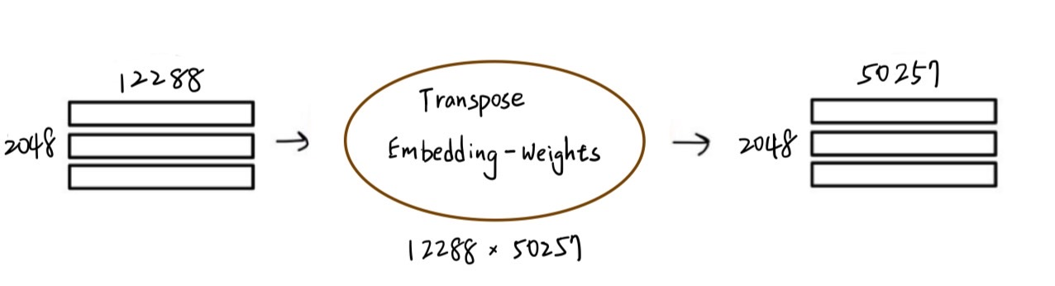
Output
Layer
Sofmax

Slide 8
Reference
[1] Radford, A., Narasimhan, K., Salimans, T. and Sutskever, I., 2018. Improving language understanding by generative pre-training.
[2] Radford, A., Wu, J., Child, R., Luan, D., Amodei, D. and Sutskever, I., 2019. Language models are unsupervised multitask learners. OpenAI blog, 1(8), p.9.
[3] Brown, T., Mann, B., Ryder, N., Subbiah, M., Kaplan, J.D., Dhariwal, P., Neelakantan, A., Shyam, P., Sastry, G., Askell, A. and Agarwal, S., 2020. Language models are few-shot learners. Advances in neural information processing systems, 33, pp.1877-1901
[4] The GPT-3 Architecture, on a Napkin (dugas.ch)

