Slide 1

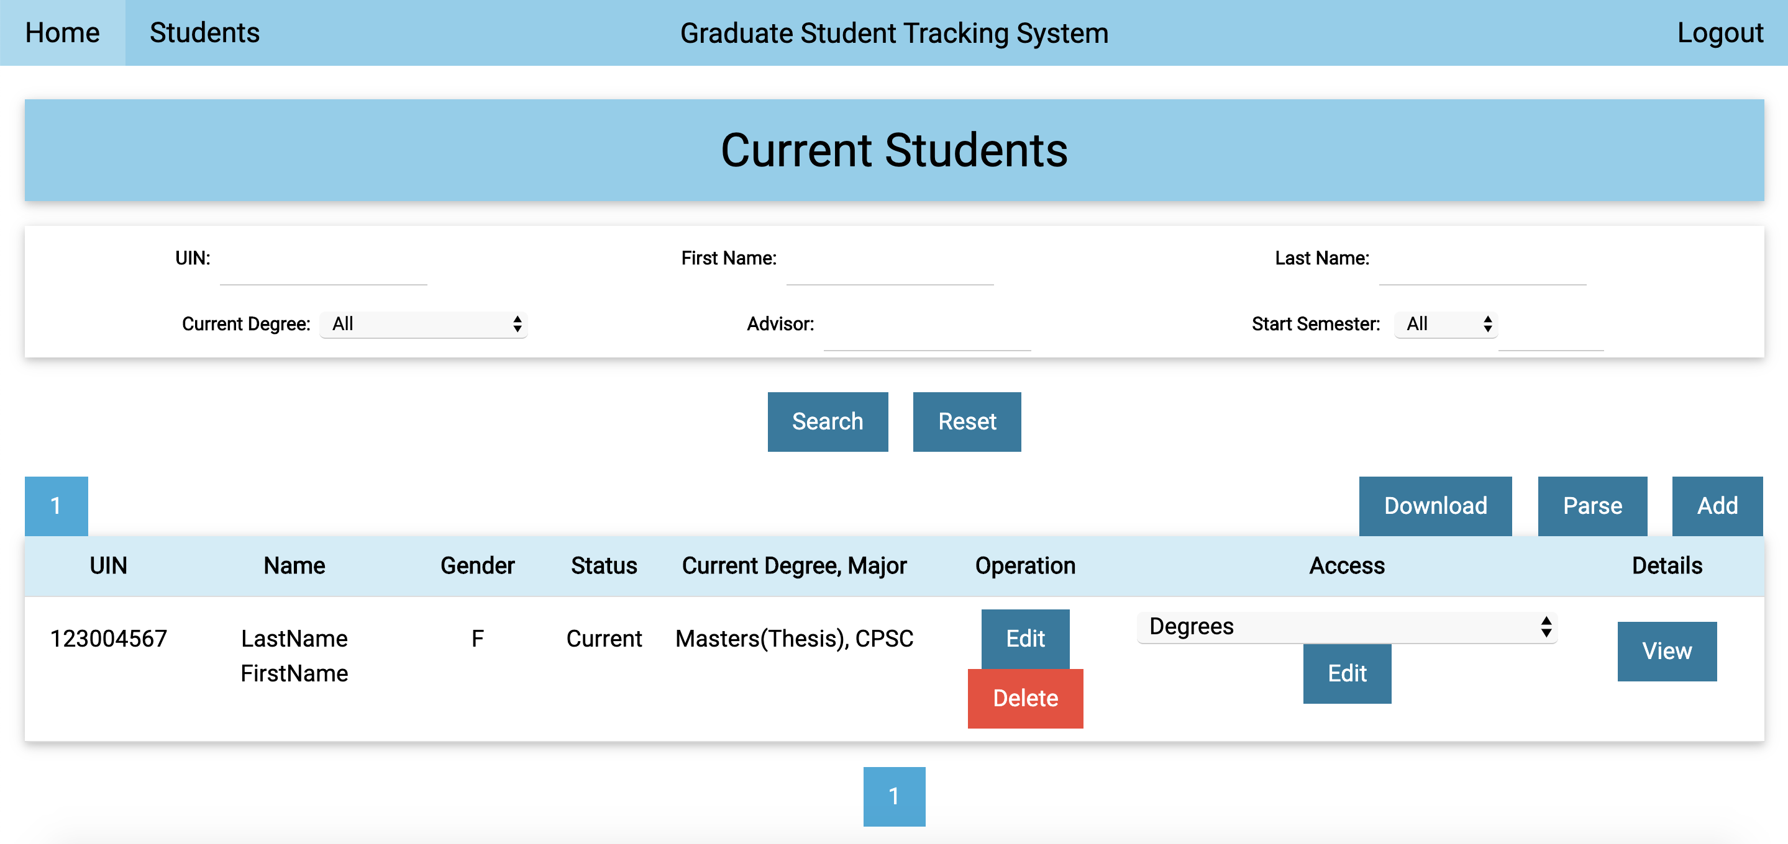
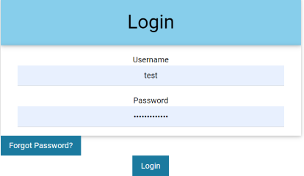
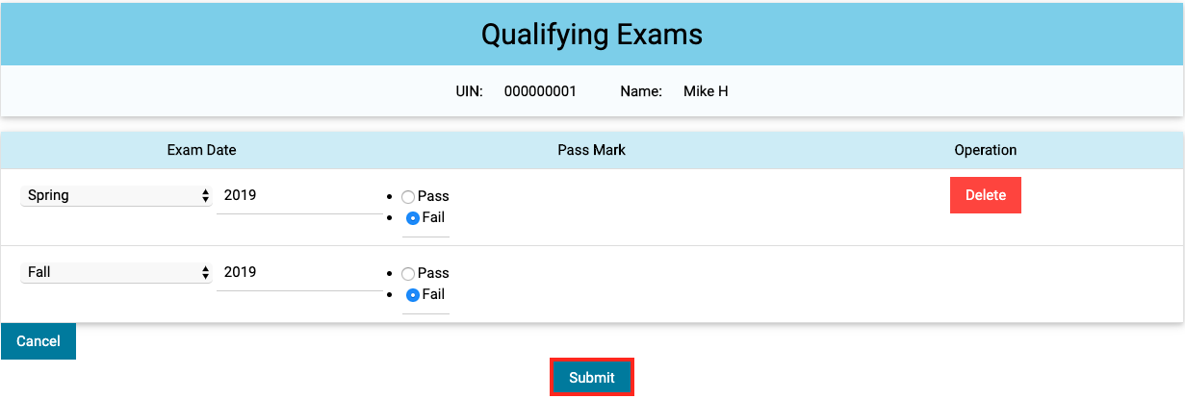
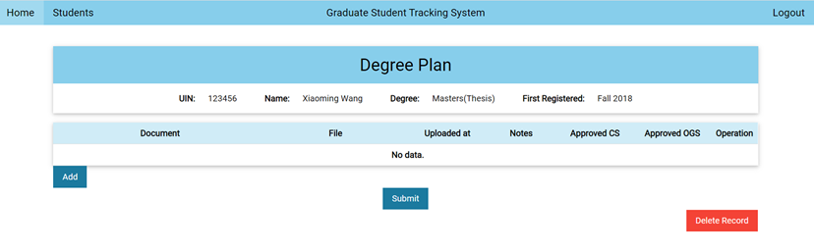
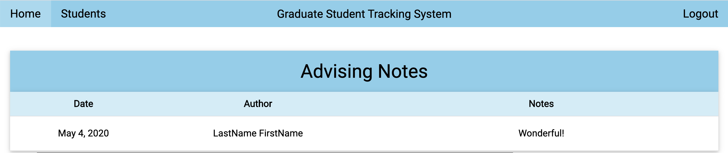
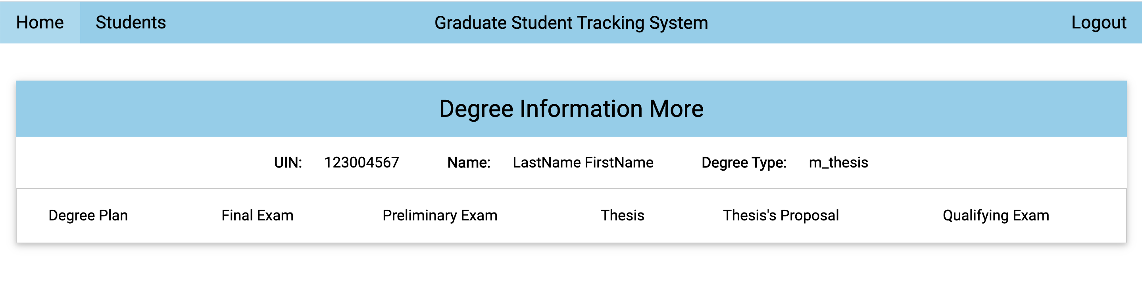
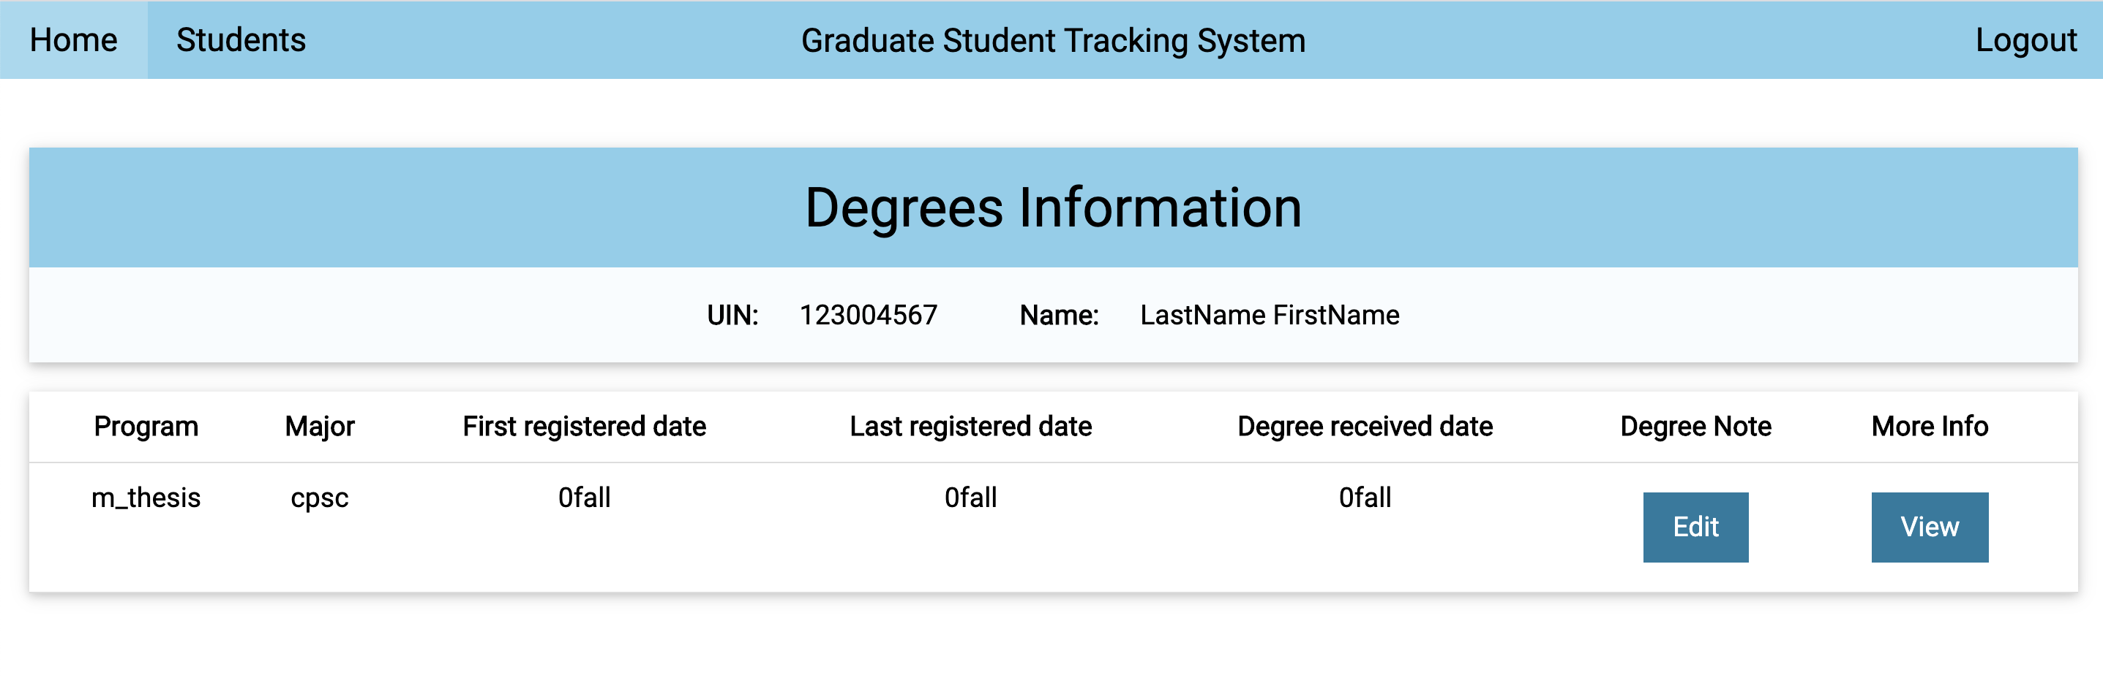
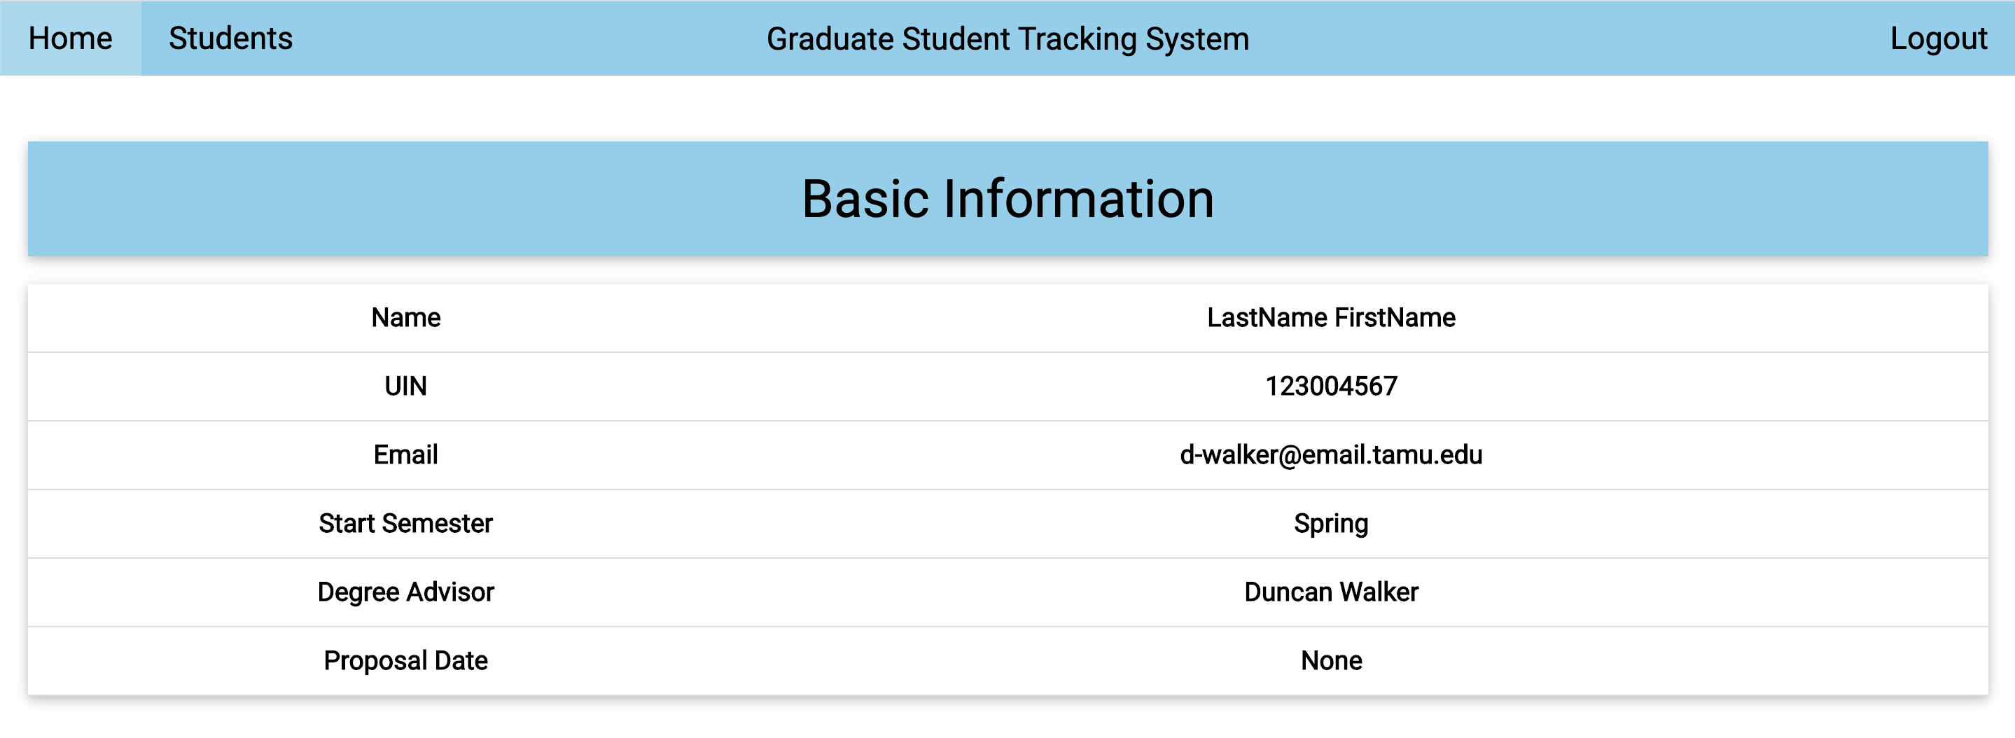
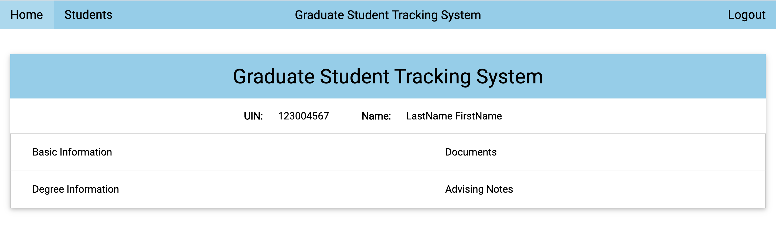
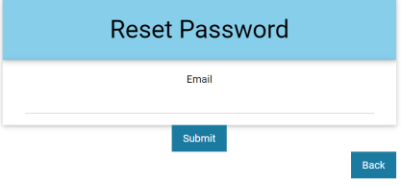
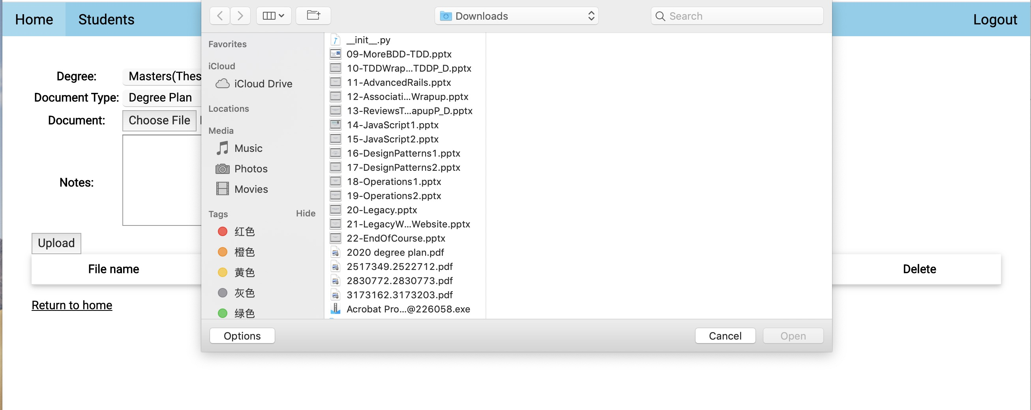
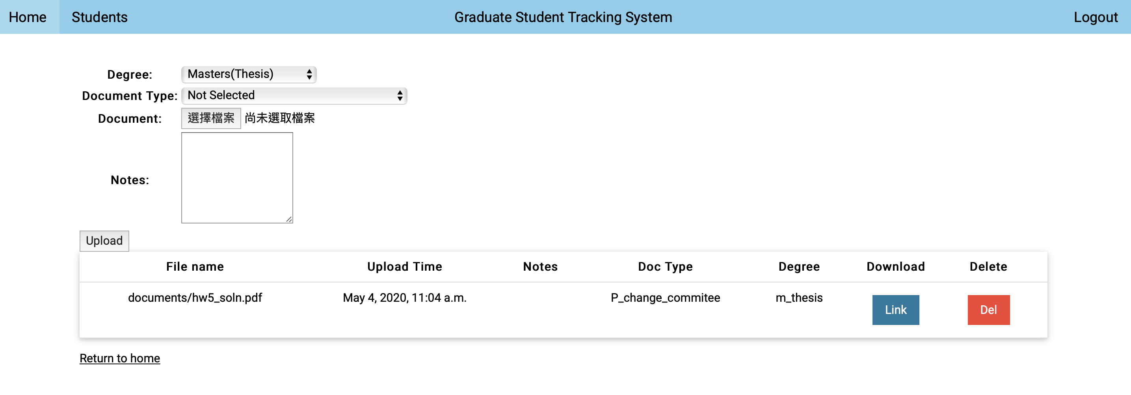
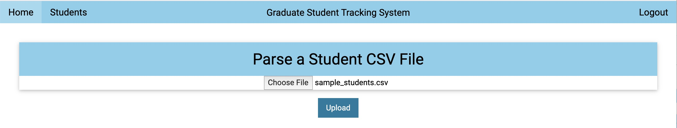
Graduate Student Tracking System
Muxi Leng, Jingwen Han, Bo Wang, Zhiqin Cai, Yuhang Xie, Yiwen Tang, Libing Zeng
Dept. of Computer Science and Engineering, Texas A&M University
Introduction
User Story: Search Students
This project is required by our customer, Mrs. Karrie, to build a system for department advisors to keep track of graduate student related documents.
The development is done on Google App Engine/Cloud9.
The system builds on Python Django.
14 interfaces, back-end documents stored in Tamu Google Drive accounts by calling API.
Search a current student in Graduate Student Tracking System, get details related to basic information, degree plan, qualifying exam, advising notes.
User interface:
User Story: Log In
After sign up, users can login and change password.
User interface:
User Story: Document Transmission
User Story: Security
Upload each student’s degree plan file to the system, the data are submitted to the backend, download link we can download files from the google drive.
User interface:
No worry about the security and legal issues of getting data, successfully storing the uploading files in Tamu Google Drive Account by API.
Create a configuration file named client_secrets.json in the main directory.
Save the Tamu google account verification information for automating verification.
Challenges and Future Implementation
Challenges:
How to migrate system platform through Heroku to Google App Engine with many existing incompatible libraries and configuration problems.
How to build an 14 interfaces based on customer’s requirements and improve code reusability and flexibility.
How to parsing csv files in the system, which helps user to upload multiple students information to database easier.
How to call Google Drive API within our system, and verify the Tamu Google Drive account.
How to upload and download files between our system and Google Drive.
What should be implemented in future:
Deploy our system in Tamu CAS platform to make the system more secure, and can be logged in with Tamu UIN.
Develop more features for customer use.
Download to google drive
User Story: Parsing CSV
Migration of graduate student’s information from local csv files to database.
User interface:

