Slide 1
VSLAM
James Yang

Slide 2
Overview
Point triangulation and camera pose estimation
Velocity estimation
EKF/UKF

Slide 3
Point Triangulation/Pose Estimation
Fundamental matrix estimation
Camera pose estimation and chirality resolution
Feature Triangulation

Slide 4
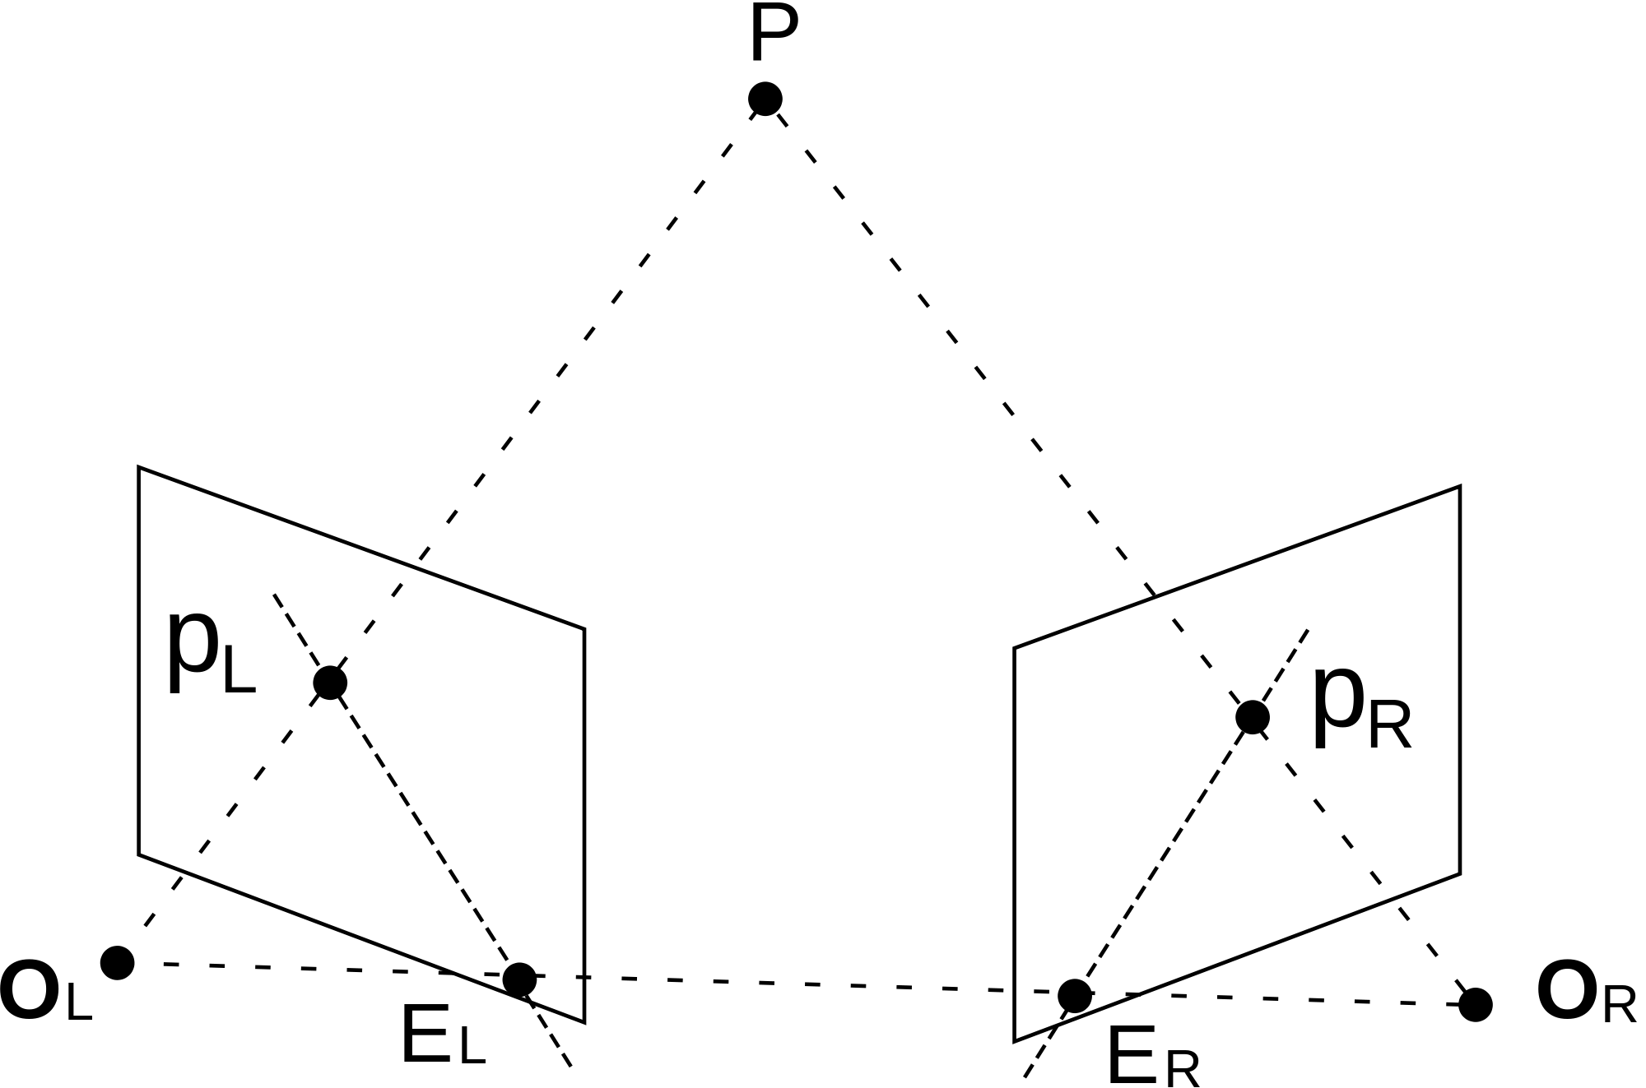

Point Triangulation
Fundamental matrix estimation

Slide 5

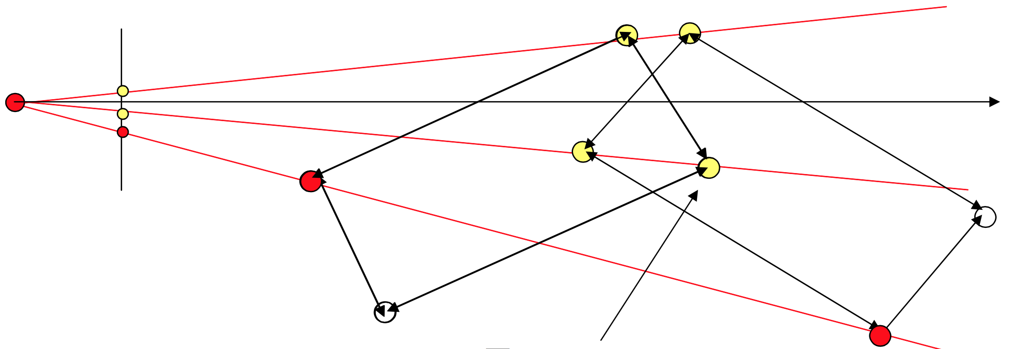


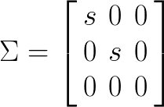
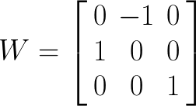

Point Triangulation
Camera pose estimation and chirality resolution

Slide 6
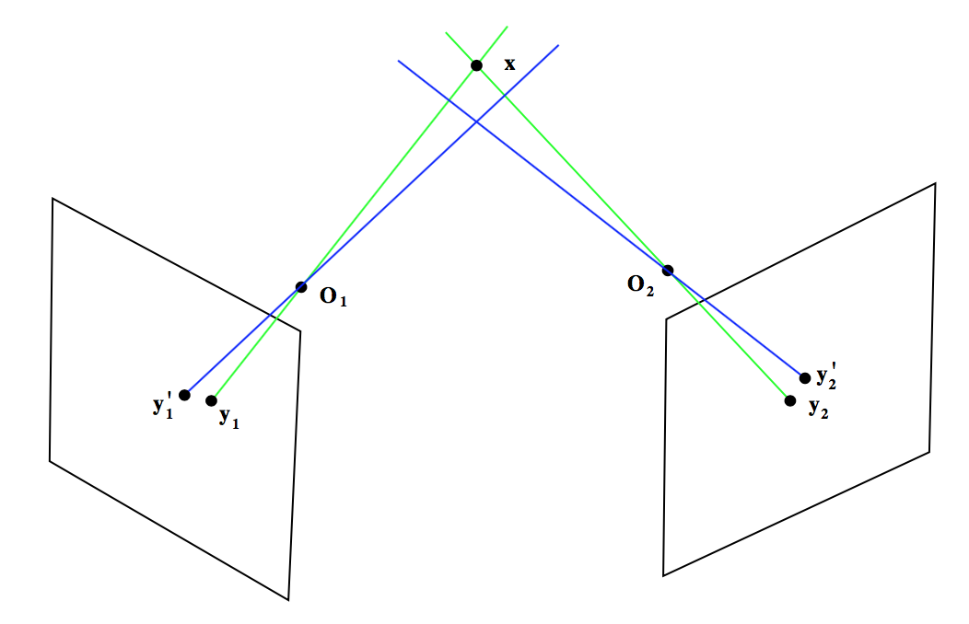
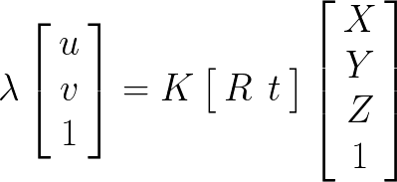
Point Triangulation
Feature Triangulation

Slide 7
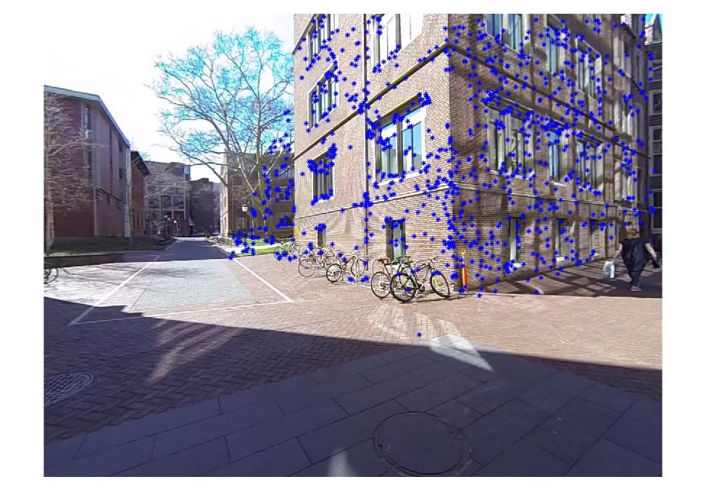
Example

Slide 8
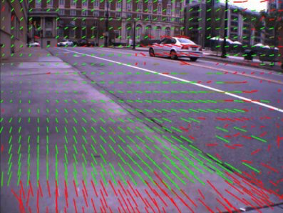
Velocity Estimation
Optical flow
Road detection (Z=0)

Slide 9
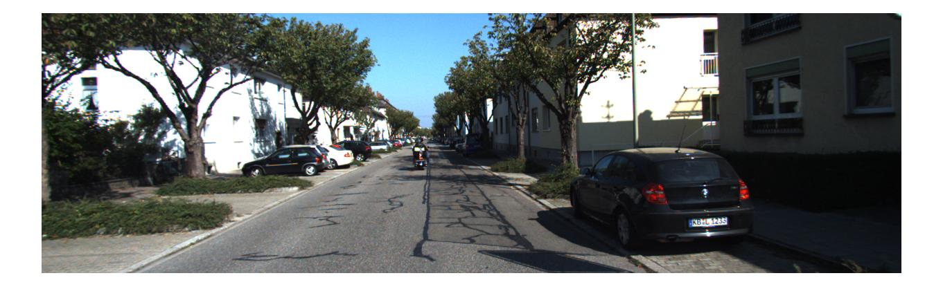
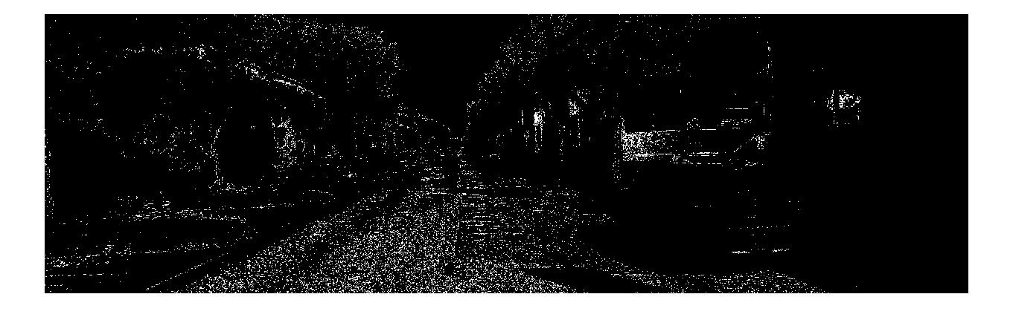
Road Detection
GMM pixel classification

Slide 10
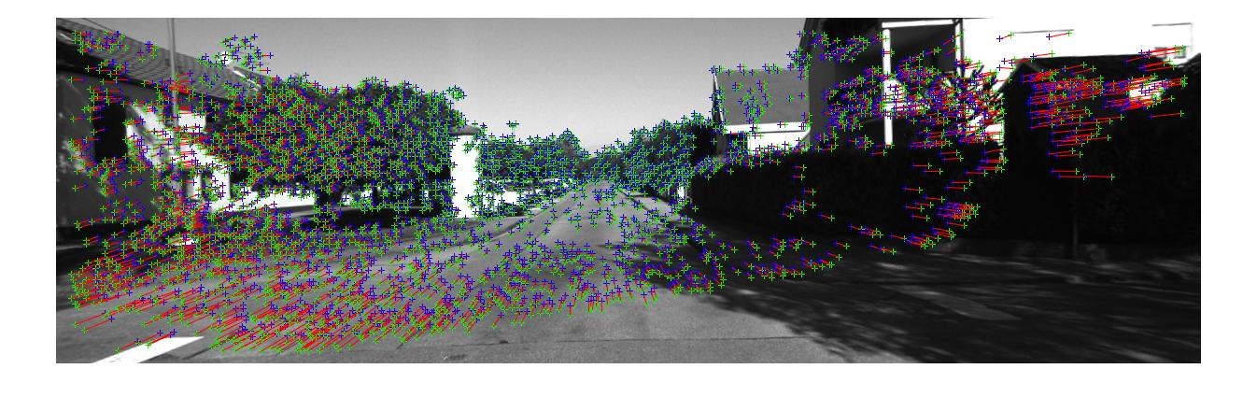
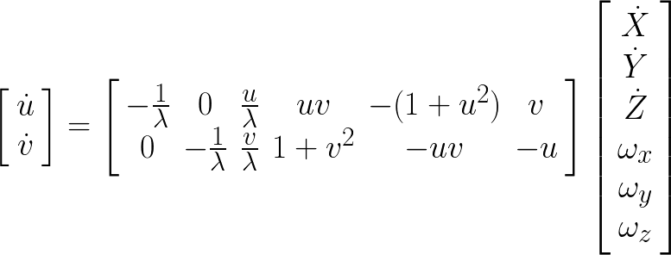
Optical Flow

Slide 11
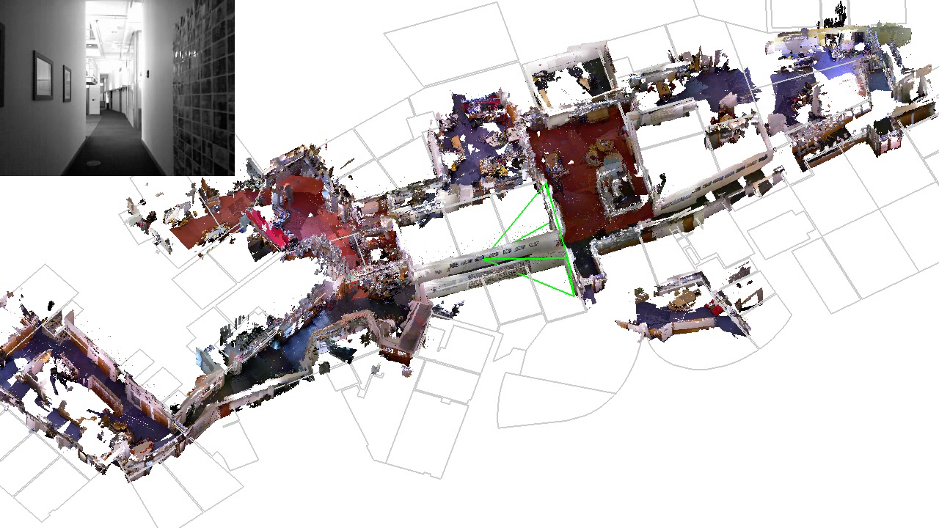
Where I Hope to Get

