Slide 1


QEMU设备模拟 --以RISC-V为例

Slide 2
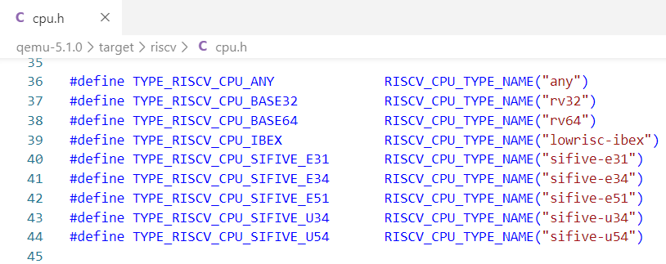
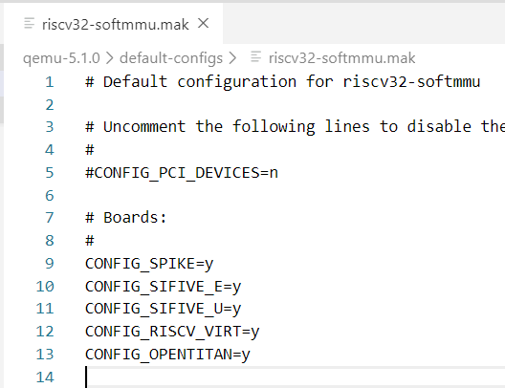
QEMU 支持的RISCV板子
$ ./qemu-system-riscv32 -machine help
Supported machines are:
opentitan RISC-V Board compatible with OpenTitan
sifive_e RISC-V Board compatible with SiFive E SDK
sifive_u RISC-V Board compatible with SiFive U SDK
spike RISC-V Spike Board (default)
virt RISC-V VirtIO board

Slide 3
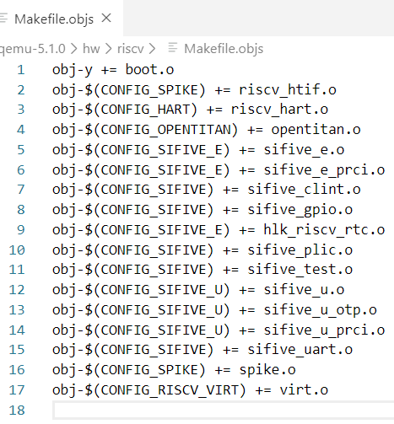
What’s in Sifive QEMU
Sifive_e vs Sifive_u
PRCI (Power, Reset, Clock, Interrupt)
CLINT (Core-Local Interrupter)
PLIC (Platform-Level Interrupt Controller)
OTP(One-Time Programmable Memory)

Slide 4
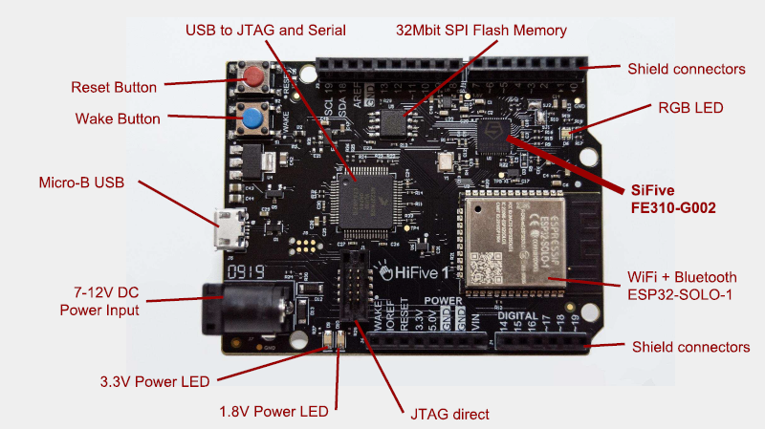

Slide 5
Architecture – How it fits together 以sifive gpio为例

Slide 6
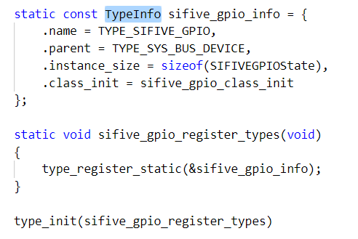
一、设备注册, 就是注册设备的TypeInfo
每类设备都会定义一个TypeInfo结构体来描述
type_init(fn) 将TypeInfo插入到一条保存设备信息的链表ModuleTypeList
QEMU启动时调用fn注册函数，完成module初始化

Slide 7
设备注册 – 图解
type_table
(hw/riscv/gpio.c)
gpio typeinfo
(hw/riscv/uart.c)
uart typeinfo
(hw/riscv/soc.c)
soc typeinfo
main()

Slide 8
进入QEMU monitor查看拓扑
./qemu-system-riscv32 –machine sifive_e –monitor stdio
https://qemu.readthedocs.io/en/latest/system/monitor.html
Command | infomation
(qemu) info qtree | Show device tree
(qemu) info qom-tree | Show QOM composition tree
(qemu) info mtree | Show memory tree
(qemu) info roms | Show roms (where to boot up)

Slide 9
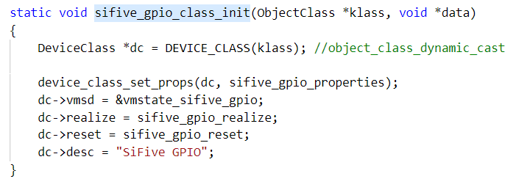
二、设备class初始化

Slide 10
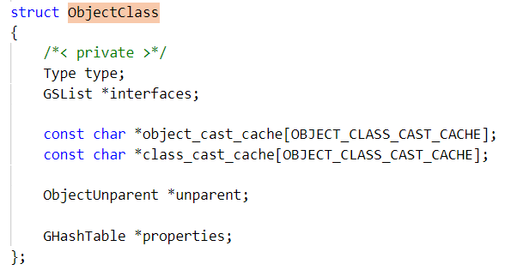
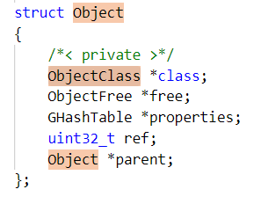
补充：QEMU的面对对象(Object Oriented)
两个BASE
ObjectClass： Base for all classes
Object： Base for all objects

Slide 11
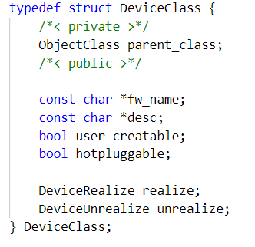
设备类(class)继承关系，以及dynamic cast
从parent到child: 利用C语言内存布局的特性，强制转换
从child到parent: 往上追溯parent关系是否成立
OBJECT_CHECK(type, obj, name)
object dynamic cast
OBJECT_CLASS_CHECK(class_type, class, name)
object class dynamic cast
OBJECT_GET_CLASS(class, obj, name)
class for the given object

Slide 12
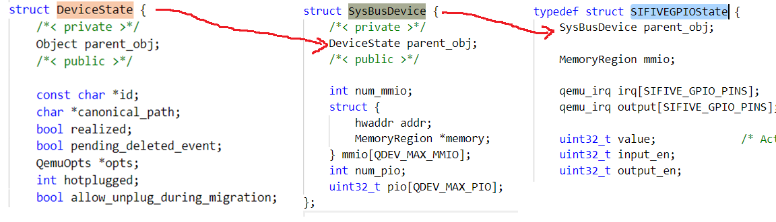
设备实体(instance)继承关系
Object ->DeviceState -> SysBusDevice -> GPIO state.
如info qom-tree所见的树状结构

Slide 13
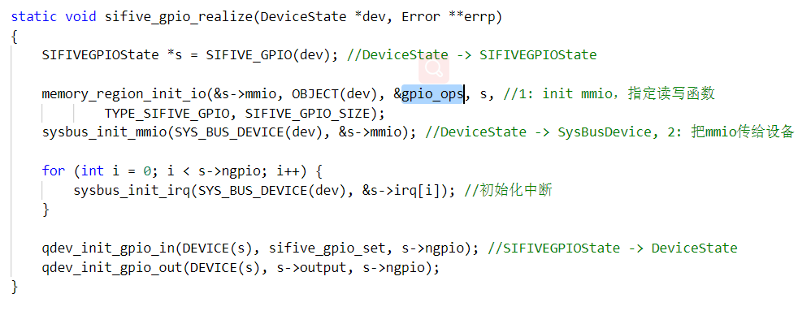
三、设备实现
1.定义内存大小，读写操作
2.初始化中断
3.初始化输入输出

Slide 14
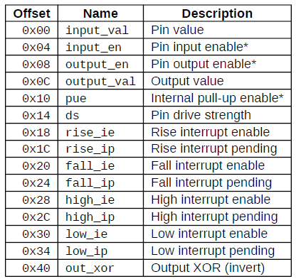
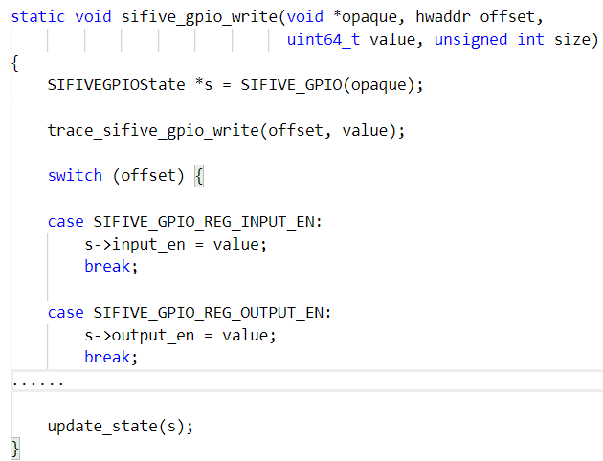
设备操作，例如写

Slide 15
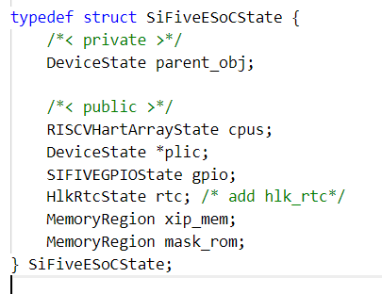
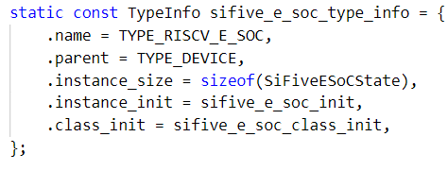
四、(1)定义SOC (sifive_e.c)
SOC的object
SOC的TypeInfo

Slide 16
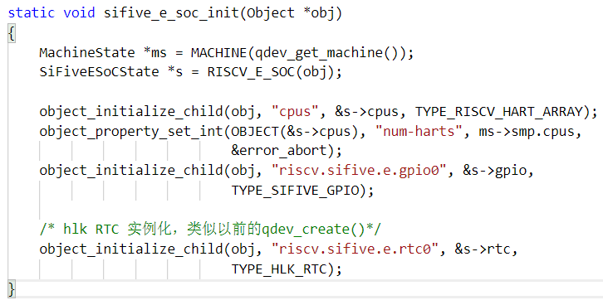
四、(2)SOC的初始化，连接
添加child成员
CPU
GPIO
HLK_RTC
整个QOM用object_property_add_child建立属性的关联。用qemu console中使用Info qom-tree命令可看到树状结构

Slide 17
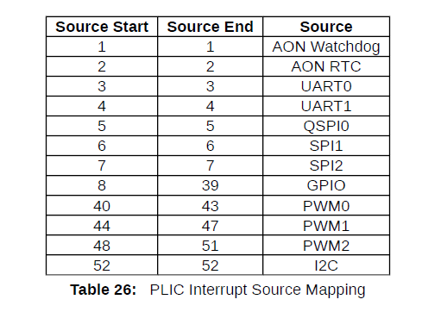
PLIC:platform-level interrupt controller

Slide 18
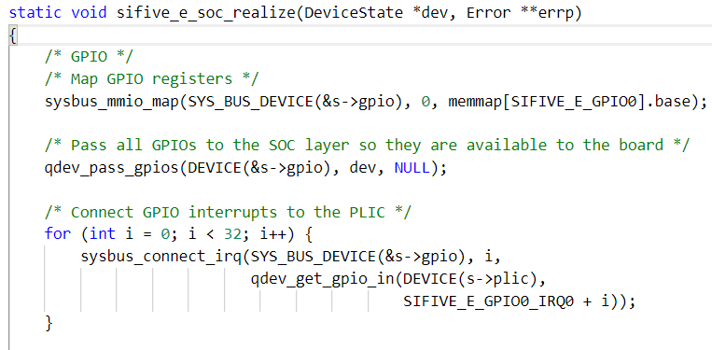
四、(3)SOC的实现
GPIO的内存map
GPIO的中断连接到PLIC

Slide 19
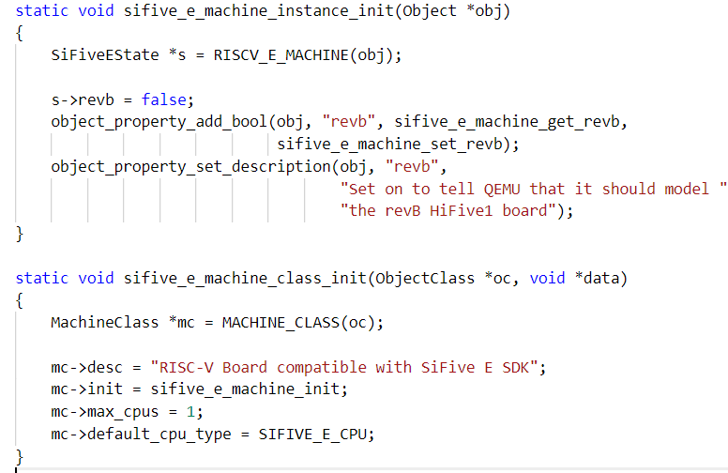
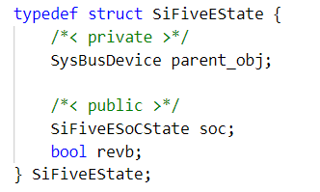
五、sifive revb machine

Slide 20
QEMU vs Simics
QEMU | Simics
hw/.c, include/hw/.include | Simics src/device/*.dml
Device object structure | Simics Component
Device Frontend/backend | DML template
realize | Simics implement
Makefile.objs | Simics moduleinfo
-monitor stdio | Simics Command line
./qemu-system-riscv32 -d --help | Simics log-level

Slide 21
RTC Demo for RISC-V QEMU sifive_e Model
Freedom Studio: Eclipse IDE + Freedom E SDK
Step1:Freedom设置外部的QEMU路径
Your Project->properties->Freedom Studio ->QEMU Path
Step2:启动qemu
qemu-system-riscv32 -kernel path/to/xxx.elf -S -s -machine sifive_e
step3:Build and Debug

Slide 22
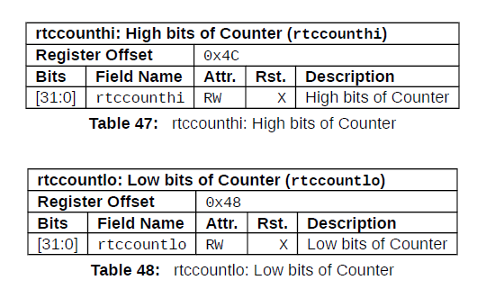
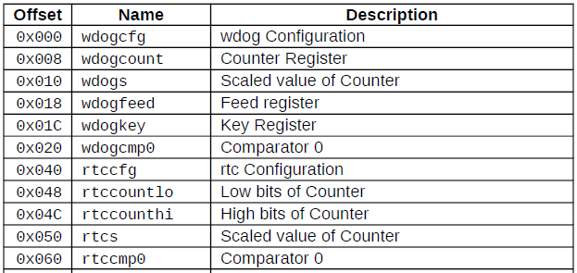
Sifive RTC register
Table 36: AON Domain Memory Map

