Slide 1
Alzheimer Diagnoser
HU, Li Tao MAO, Zhi Yuan
LIU, Yu Chen CUI, Zhi Wei

Slide 2
Part 0 MOTIVATION AND BACKGROUND
Part 1 SYSTEM OVERVIEW
Part 2 USE CASE
Content
Part 3 FRONT-END DESIGN
Part 4 BACK-END DESIGN
Part 5 DATABASE
Part 6 DEMO

Slide 3
0
MOTIVATION AND BACKGROUND

Slide 4
1
SYSTEM OVERVIEW

Slide 5
Part One SYSTEM BLOCK DIAGRAM
1
Collect User Information
2
Test questions
Basic information:
Gender;
Name;
Age
Four Parts:
Picture recognition;
Commonsense question;
Memory test;
Basic math calculation.
Based on the user’s answers and performance
Answer the users’ question about there evaluation result
3
Test Result Evaluation
4
Q&A For Users

Slide 6
Part One SYSTEM OVERVIEW
Common
Sense
Questions
Basic
Information
Picture
Recognition
Q&A
Basic
Math
Calculation
Memory
Test
Evaluation
After finishing all the questions, the robot will give the test results of each parts and risk of illness.
Users can also ask questions to the robot at the end of evaluation.

Slide 7
2
USE CASE

Slide 8
Part Two USE CASE
That will be counted to wrong answer, the test will go on. If you give a wrong answer, nothing will happen, if you don’t know the answer or refuse, the system will say ”That ok let’s go on to next question.”
Refuse to answer or
give the wrong answer
The system will repeat the question, that will not be counted to correct or wrong answer as long as you do not give an answer or refuse
Give correct answer will
Continue to the next question
Say pardon or let the robot repeat again

Slide 9
3
FRONT-END DESIGN

Slide 10
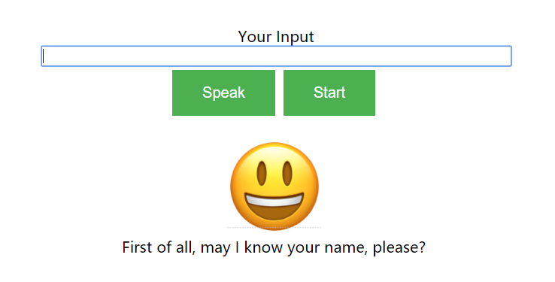
Part Three FRONT-END DESIGN
Test Site
Speak Button
Your speech will be recorded automatically, if your speech is too long the input will be cut down, then you have to press the speak button and continue the speech.
Start Button
Press once to start test.
If you press the button during the test, the test will start again, all the record will be reset.
Notes:
So there comes to our front end design,

Slide 11
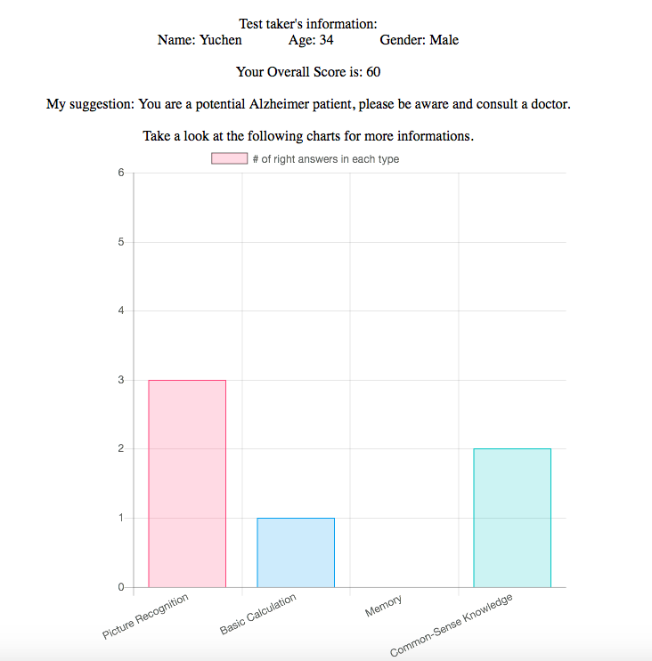
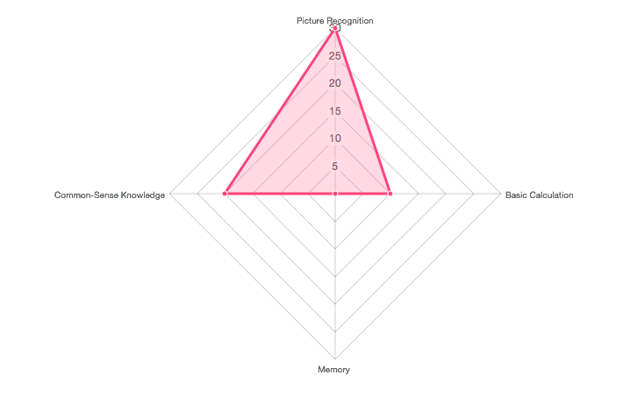
Part Three FRONT-END DESIGN
Result Site
Result Page
Your speech will be recorded automatically, if your speech is too long the input will be cut down, then you have to press the speak button and continue the speech.

Slide 12
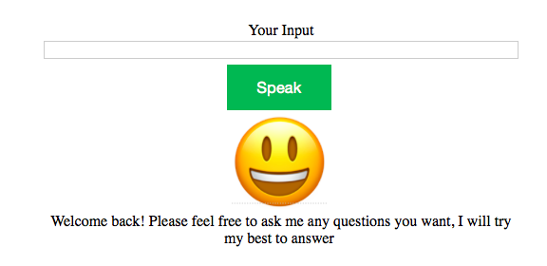
More on Alzheimer’s
Speak Button
Your speech will be recorded automatically, if your speech is too long the input will be cut down, then you have to press the speak button and continue the speech.

Slide 13
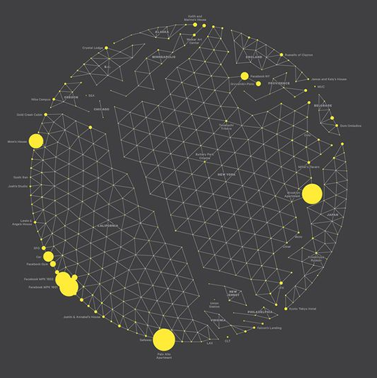
Part Three FRONT-END DESIGN
Interact by speech
The robot will talk to user directly and can also recognize the user’s speech.
Interact by text
While speaking, the system will also output the text on the dialog box under the buttons. Also, for shy users or users who have accent, they can input what they want to say in text and the system will recognize them.

Slide 14
4
BACK-END DESIGN

Slide 15
Part Four BACK-END DESIGN
Webkit
The Webkit is used to do text-speech and speech-text translation.
API.AI
API.AI will do further interpretation and processing to give the result
Analyzer
The analyzer will record the
performance of the user in the test. The final interpretation will be made
based on the raw scores, type based scores and the age of the user.

Slide 16
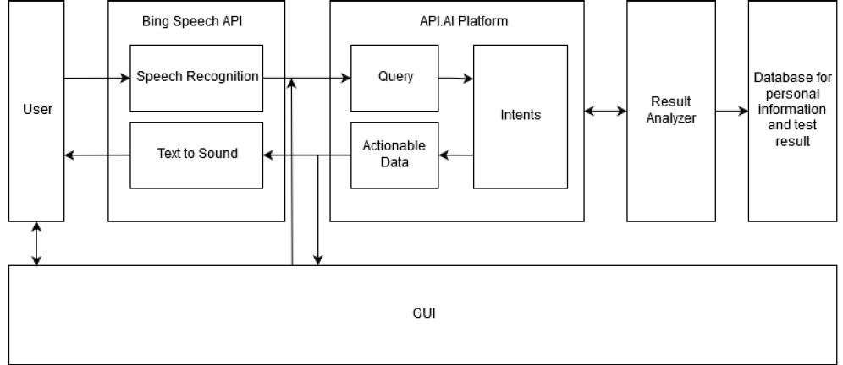
Part Four BACK-END DESIGN

Slide 17
5
DATABASE

Slide 18
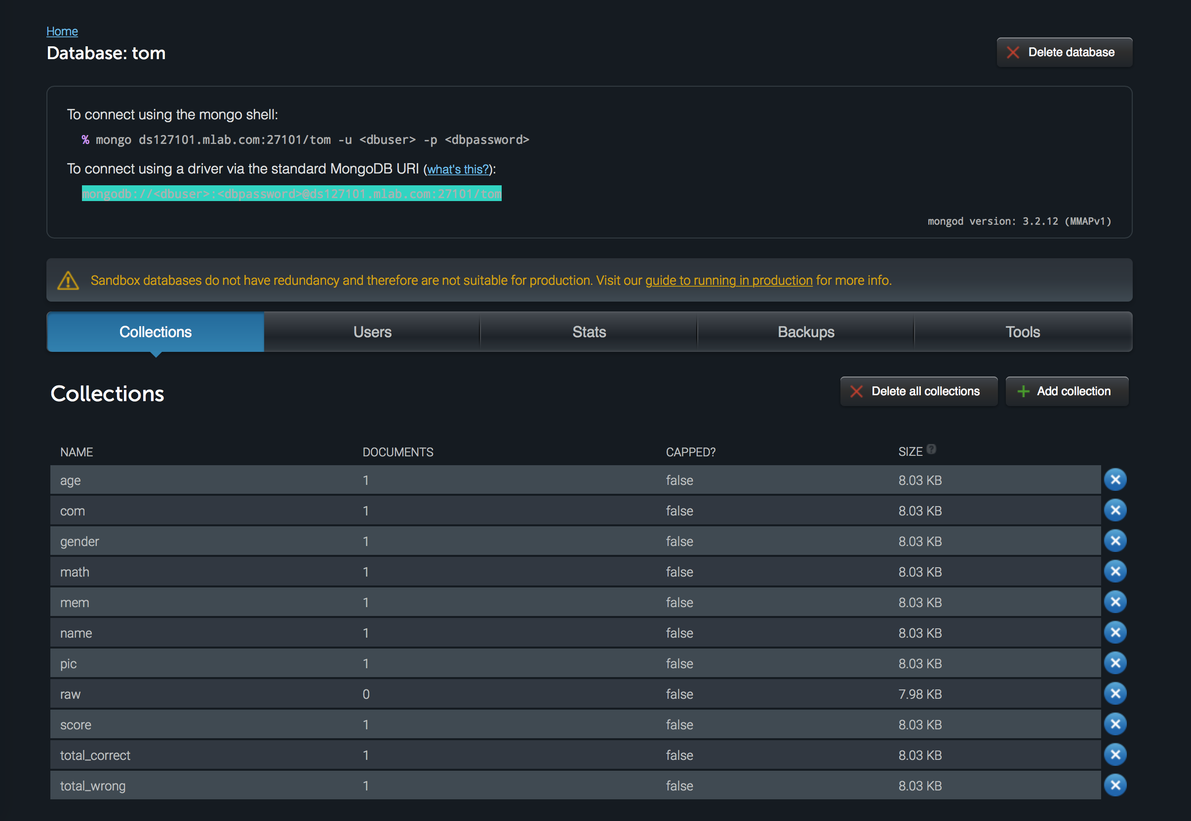

Part Five DATABASE
Our database will store all the basic information， test results as well as whatever said by the users, for further diagnose use.

Slide 19
6
DEMO TIME

Slide 20
THANK YOU FOR LISTENING
HU,Li Tao MAO,Zhi Yuan
LIU,Yu Chen CUI,Zhi Wei

