Slide 1



Engie Data Challenge
HOME SERVICES CHALLENGE – Model description
DAB Team
00/00/2015
PRESENTATION TITLE ( FOOTER CAN BE PERSONALIZED AS FOLLOW: INSERT / HEADER AND FOOTER")
1

Slide 2

Preprocessing
- Make use of parquet file format (http://parquet.apache.org/)
- Necessitate to type all columns
- From (~80s, almost 200Mo) to (~10s, 100Mo) to (~4s, 80Mo)
processed parquet
csv
raw parquet
csv
csv
1
Notes:
1

Slide 3
Feature creation / processing
- Remove primary keys of relational DB
- Encode labels replacing NaNs by -1 (there are open issues on sklearn to allow keeping NaNs)
- Datetime features :
- Absolute datetime features (number of day in year, number of month in year), by the way, this should be put into continuous feature using sinus or cosinus.
- Relative datetime features (timedelta in days with CRE_DATE_GZL, which is the Intervention record creation date)
- Some ratio of timedeltas (ex : duration contract / install days)
- Str features :
- Use len of Commentaire_bi
- No tricks found to dissociate features with huge number of categories.
1
Notes:
1

Slide 4
Models
- Best score obtained with LightGBM :
"scale_pos_weight": 0.33, # as umbalanced target classes
"boosting_type": "dart",
"learning_rate": 0.04,
"num_leaves": 100, # we should let it be smaller than 2^(max_dep
"min_data_in_leaf": 20, # Minimum number of data need in a child
"max_depth": -1, # -1 means no limit
"bagging_fraction": 0.84, # Subsample ratio of the training inst
"feature_fraction": 0.75, # Subsample ratio of columns when cons
"bagging_freq": 9, # frequence of subsample, <=0 means no enable
- Hyperparameters tuning using hyperopt (https://github.com/hyperopt/hyperopt)
- No stacking done (not enough time)
- Tested also xgboost (similar results) & catboost (overfitting a lot)
1
Notes:
1

Slide 5
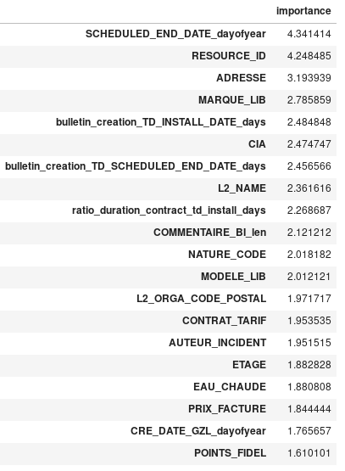
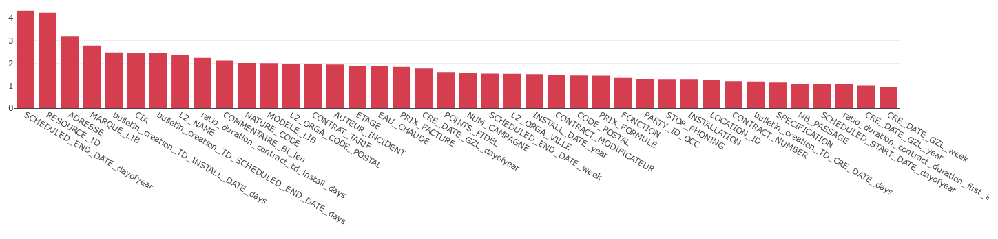
Feature importances
1
Notes:
<number>

Slide 6
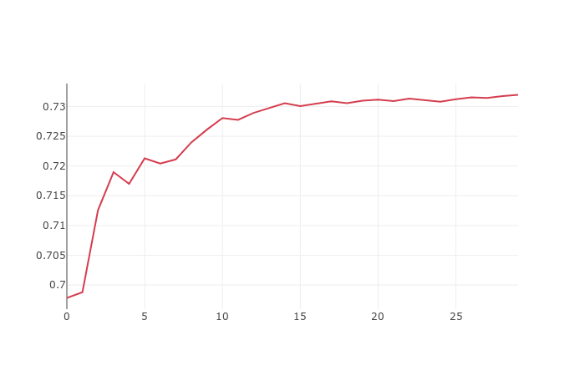
Final blend
1
Notes:
<number>

Slide 7
Tools & framework
Python 3.6
Scikit-learn (http://scikit-learn.org/stable/)
LightGBM (https://lightgbm.readthedocs.io/en/latest/)
HyperOpt (https://github.com/hyperopt/hyperopt)
Python-Fire (https://github.com/google/python-fire)
Categorical-encoding (https://github.com/scikit-learn-contrib/categorical-encoding)
SHAP (https://github.com/slundberg/shap)
Geopy (https://github.com/geopy/geopy)
1
Notes:
<number>

